Slide 1
Zoonoses and Public Health
Julia Murphy, DVM, MS, DACVPM
State Public Health Veterinarian
Division of Environmental Epidemiology
Office of Epidemiology

Slide 2
Zoonosis
An infection or infestation shared in nature by humans and other animals
Stedman’s Medical Dictionary,
27th Edition
Notes:
Zoonontic diseases are those that are shared in nature by humans and other animals.

Slide 3
Zoonotic Skew
~60% of the 1709 known human pathogens are zoonotic
~75% of 156 emerging human pathogens zoonotic
Emerging pathogens 3 times more likely to be zoonotic.
Taylor & Woodhouse, ICEID 2000
Notes:
Approximately 60 percent of all known human pathogens are considered zoonotic and ¾ of emerging pathogens are considered zoonotic.

Slide 4
Zoonotic Agents of Concern
CDC has categorized biological agents of concern
All but one Category A agent is zoonotic:
Viral Hemorrhagic Fevers
Plague Tularemia Anthrax
Smallpox Botulism
Notes:
The Centers for Disease Control and Prevention (CDC) has identified certain pathogens that are of particular concern as bioterrorst weapons. All but one (smallpox) is a zoonotic pathogen. For more information about bioterrorism diseases and agents, visit
http://emergency.cdc.gov/agent/agentlist.asp

Slide 5
Zoonotic transmission
Possible routes:
Fecal-Oral
Inhalation
Direct Contact
Vector-borne
Notes:
People may be exposed to zoonotic disease by one of a number of routes: fecal-oral, inhalation, direct contact or vector-borne.

Slide 6
Fecal-oral transmission
Salmonella Ancylostoma
Campylobacter Toxoplasma
E. coli O157:H7 Listeria
Giardia Trichinella
Cryptosporidia Toxocara
Food safety threats = Category B Agents
Notes:
Zoonotic diseases that people may be exposed to via the fecal oral route are seen here. Most food safety threats are characterized by the CDC as Category B bioterrorism agents.

Slide 7
Salmonella
Frequently reported in Virginia (>1000 cases/year)
~42,000 human cases reported to CDC/yr
Over 1 million human cases suspected in US/yr
~2000 serotypes cause disease
Certain Salmonella bacteria are normal fecal flora in animals
Notes:
Salmonellosis is an infection with bacteria called Salmonella. For over 100 years, it has been know that Salmonella can cause illness. Every year, approximately 42,000 confirmed cases of salmonellosis are reported in the United States. Because many milder cases are not diagnosed or reported, the actual number of infections may be many times greater. There are many different kinds or serotypes of Salmonella bacteria some of which are normal fecal flora in some animals. Salmonella serotype Typhimurium and Salmonella serotype Enteritidis are the most common serotypes in the United States.

Slide 8
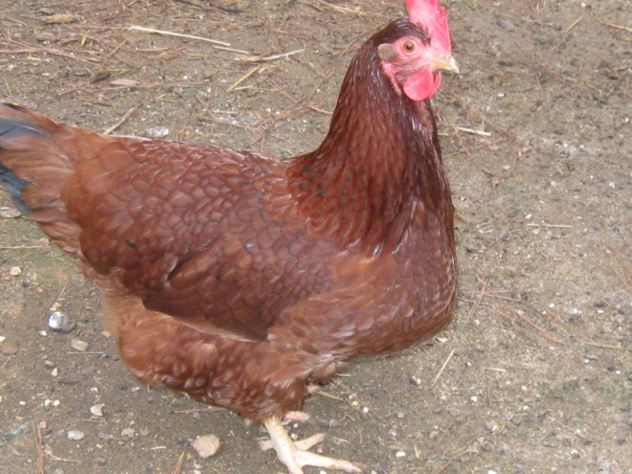
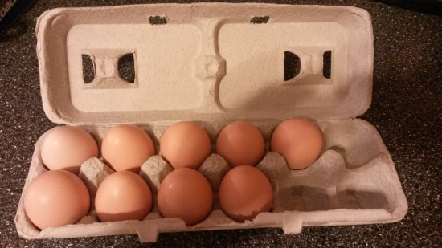
Salmonella
Most commonly transmitted to people via contaminated food
Common foods include meat, poultry, and dairy
Wide reservoir in animals and environment
Notes:
Salmonella is found in many places in the environment as well as in animals especially poultry and swine. The foods that are commonly associated with Salmonella infection are raw meats, poultry and dairy products, but many different foods have been associated with human illness. Poultry is considered a principle reservoir of Salmonella.
Salmonella live in the intestinal tracts of humans and other animals, including birds. Salmonella are usually transmitted to humans by eating foods contaminated with animal feces. Contaminated foods usually look and smell normal and are often of animal origin, such as beef, poultry, milk, or eggs, but all foods, including vegetables may become contaminated. Many raw foods of animal origin are frequently contaminated, but fortunately, thorough cooking kills Salmonella. Food may also become contaminated by the unwashed hands of an infected food handler, who is not being particularly diligent about hand hygiene.
Even though chicken and eggs are most frequently thought of when it comes to foods associated with Salmonella it’s important to remember that any food can become contaminated. One of the largest outbreaks of Salmonella occurred in 1985 and was associated with milk when raw milk containing S. typhimurium contaminated already pasteurized milk. Thousands of people in six states were affected including over 1500 culture confirmed cases.

Slide 9
Salmonella: Human
Incubation 12-72 hours
Vomiting, stomach cramps, diarrhea
15-20 bacteria to infect
Mostly self limiting
Very young, elderly and immunocompromised people most likely to be more severely affected
Notes:
A person becomes infected if he consumes food contaminated with fecal material containing Salmonella or the bacteria is introduced into his mouth in some other way. This bacteria is mainly spread through what is called the “fecal-oral” route. Its infective dose is rather low and it only takes 15-20 bacteria to cause illness. Most persons infected with Salmonella develop diarrhea, fever, and abdominal cramps 12 to 72 hours after infection. The illness usually lasts 4 to 7 days, and most persons recover without treatment. However, in some persons, the diarrhea may be so severe that the patient needs to be hospitalized. In these patients, the Salmonella infection may spread from the intestines to the blood stream, and then to other body sites and can cause death unless the person is treated promptly with antibiotics. The elderly, infants, and those with impaired immune systems are more likely to have a severe illness, but most Salmonella infections are self limiting, so most people recover on their own without any professional, medical intervention. As with many illnesses, the very young, elderly and immunocompromised are more likely to be severely affected by infection.

Slide 10
Salmonella Outbreaks: Human
2003-13 in Virginia
Range 4-13/year
Some multistate
Common serotypes: enteritidis, typhimurium, newport
Various foods associated with illness
Notes:
In Virginia, it is not unusual for the health department to report several Salmonella outbreaks per year and also participate in CDC led multistate outbreaks of Salmonella. Foods associated with illness in outbreaks Virginia has investigated have included eggs, poultry, cheese and spinach. More information about Salmonella outbreaks in Virginia can be found at http://www.vdh.virginia.gov/Epidemiology/Surveillance/index.htm

Slide 11
Salmonella Outbreaks: Human
CDC often investigates multiple multistate outbreaks per year
Foods involved have included: eggs, tomatoes, beef, chicken, peppers, cantaloupe, peanut butter
Animals as risk factors for illness have included chicks, ducklings and small turtles
Notes:
The CDC often investigates multiple multistate Salmonella outbreaks in people every year. Through the years, illness from Salmonella has been linked to a number of different foods including eggs, chicken, beef, cantaloupe, peanut butter and tomatoes. Contact with certain live animals has also been linked to illness and these include chicks, ducklings and small pet turtles. Information about recent Salmonella outbreaks the CDC has investigated can be found at http://www.cdc.gov/salmonella/

Slide 12
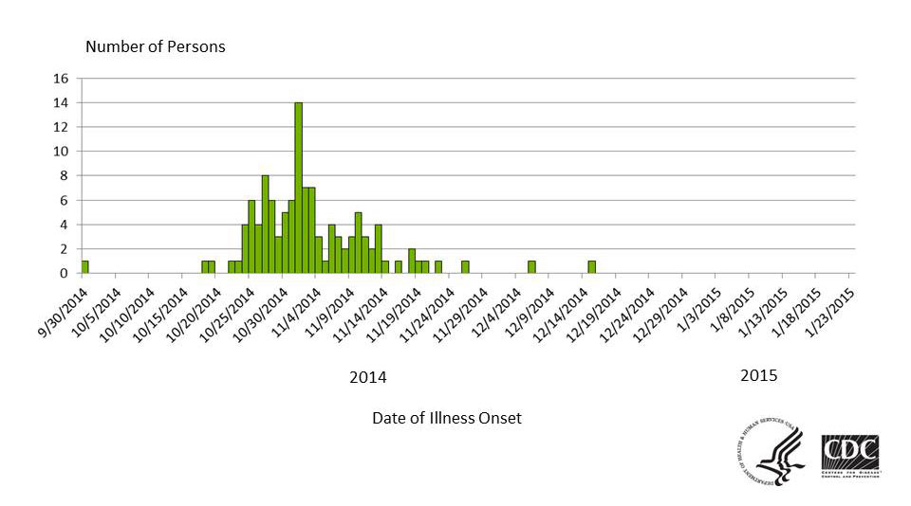
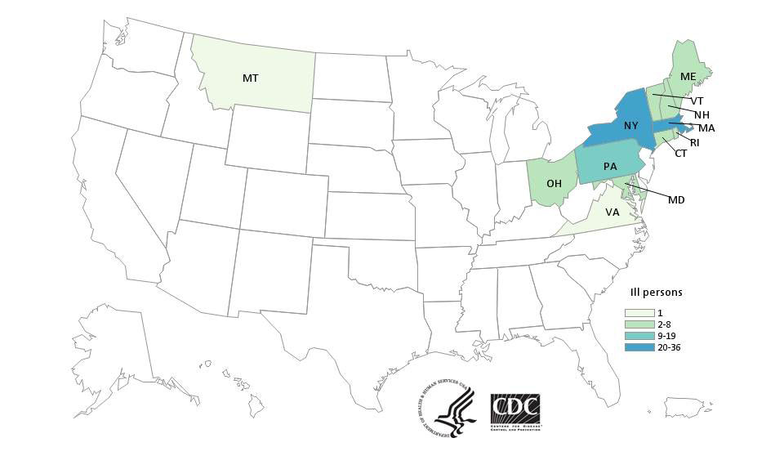
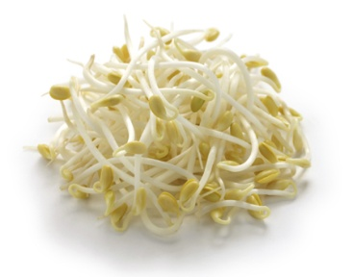
Human Salmonella outbreaks, US
Multistate Outbreak of Salmonella Enteritidis Infections Linked to Bean Sprouts, 2014
Images courtesy of CDC
Notes:
An example of a multistate investigation of a Salmonella outbreak associated with food, specifically bean sprouts, is featured here. More information about this outbreak and selected outbreak highlights can be found in the text and the link below.
http://www.cdc.gov/salmonella/enteritidis-11-14/index.html, posted January 2015
Outbreak highlights: A total of 115 persons in 12 states were reported with the outbreak strain of Salmonella Enteriditis. Twenty five percent of those reported were hospitalized. No deaths were reported. Collaborative investigation efforts of state, local, and federal public health and regulatory agencies indicated that bean sprouts produced by Wonton Foods, Inc. were the likely source of this outbreak.

Slide 13
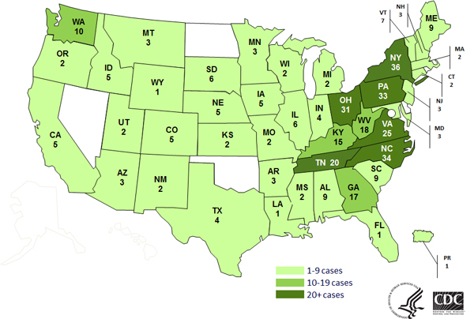
Human Salmonella outbreaks, US
Multistate Outbreak of Human Salmonella Infantis Newport or Hadar Infections Linked to Live Poultry in Backyard Flocks, 2014
Images courtesy of CDC
Notes:
An example of a multistate investigation of a Salmonella outbreak associated with live animals is featured here. More information about this outbreak and selected outbreak highlights can be found in the text and the link below.
Posted at http://www.cdc.gov/salmonella/live-poultry-05-14/index.html
Outbreak highlights:
As of October, 2014, a total of 363 persons infected with the outbreak strains of Salmonella Infantis, Salmonella Newport, or Salmonella Hadar were reported from 43 states and Puerto Rico.
33% of ill persons have been hospitalized, and no deaths have been reported.
Epidemiologic, laboratory, and traceback findings linked this outbreak of human Salmonella infections to contact with chicks, ducklings, and other live poultry from Mt. Healthy Hatcheries in Ohio.
73% of ill people reported contact with live poultry in the week before their illness began.
Findings of multiple traceback investigations of live baby poultry from homes of ill persons have identified Mt. Healthy Hatcheries in Ohio as the source of chicks and ducklings. This is the same mail-order hatchery that has been associated with multiple outbreaks of Salmonella infections linked to live poultry in past years, including in 2012 and 2013.
Mail-order hatcheries, agricultural feed stores, and others that sell or display chicks, ducklings, and other live poultry should provide health-related information to owners and potential purchasers of these birds prior to the point of purchase. This should include information about the risk of acquiring a Salmonella infection from contact with live poultry.
Read the advice to mail-order hatcheries and feed stores and others that sell or display live poultry.
Always wash your hands thoroughly with soap and water right after touching live poultry or anything in the area where they live and roam.
Do not let live poultry inside the house.
Additional recommendations are available.
These recommendations are important and apply to all live poultry, regardless of the age of the birds or where they were purchased.

Slide 14
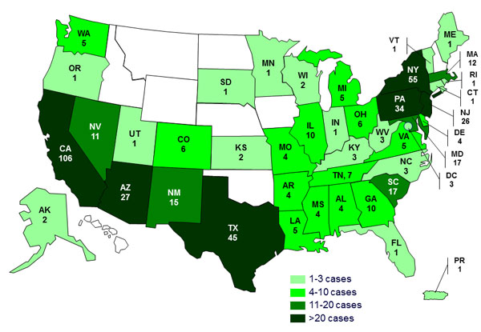
Human Salmonella Outbreaks, US
Human Salmonella Infections Linked to Small Turtles, 2013
Image courtesy of CDC
Courtesy of FDA
Notes:
CDC posting at http://www.cdc.gov/salmonella/small-turtles-03-12/index.html as of October 2013.
A total of 473 persons infected with outbreak strains of Salmonella that eventually identified eight different multistate outbreaks. Epidemiologic, environmental, and traceback investigations indicated exposure to turtles or their environments (e.g., water from a turtle habitat) was the cause of these eight outbreaks. 70% of ill persons were children 10 years of age or younger, and 31% of ill persons were children 1 year of age or younger. 69% of ill persons with available information reported exposure to turtles before their illness. 88% of ill persons with turtle exposure specifically reported exposure to small turtles (shell length less than 4 inches). Small turtles are a well-known source of human Salmonella infections, especially among young children. Because of this risk, the Food and Drug Administration has banned the sale and distribution of these turtles as pets since 1975. Turtles with a shell length of less than 4 inches in size should not be purchased as pets or given as gifts.

Slide 15
Salmonella: Animals
Has been described as normal flora and clinical disease
Cattle, sheep, pigs and horses may have mild or severe disease including diarrhea, fever, abdominal pain, abortion
Disease in dogs and cats is often subclinical, but diarrhea, fever, septicemia can occur
Pet reptiles and amphibians should be considered carriers
Chicks and ducklings should be considered carriers
Notes:
In animals, Salmonella has been described both as normal gut flora, but has also been described as causing clinical illness. Cattle, sheep, pigs and horses may have mild or severe disease and clinical signs including diarrhea, fever, abdominal pain and abortion. Disease in dogs and cats is often subclinical, but can manifest itself in diarrhea, fever and septicemia. Pet reptiles, chicks and ducklings are not often ill with Salmonella and should be considered carriers of Salmonella. The environments in which these animals are kept should be considered possible sources of Salmonella infections.

Slide 16
Salmonella-Prevention: Foods
Avoid temperature abuse and cross contamination
Avoid consumption of raw meats and raw dairy
Wash produce thoroughly
Hand washing
Notes:
Ways a person can avoid becoming ill with Salmonella are by using good practices associated with handling and cooking food. Best practices include:
washing your hands, cutting boards, utensils, and countertops routinely through cooking. The importance of good handwashing practices to help avoid this and other illness cannot be overemphasized.
Separating raw meat, poultry, and seafood separate from ready-to-eat foods.
Using a food thermometer to ensure that foods are cooked to a safe internal temperature: 145°F for whole meats (allowing the meat to rest for 3 minutes before carving or consuming), 160°F for ground meats, and 165°F for all poultry.
Keeping your refrigerator below 40°F and refrigerate food that will spoil.
Avoiding preparing food for others if you have diarrhea or vomiting.
Avoiding consumption of raw meats and raw dairy products
And being especially careful when preparing food for children, pregnant woman, those in poor health, and older adults.

Slide 17
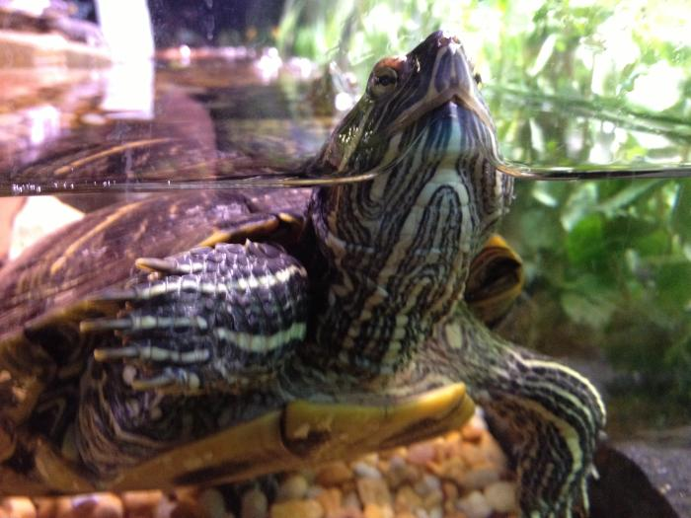
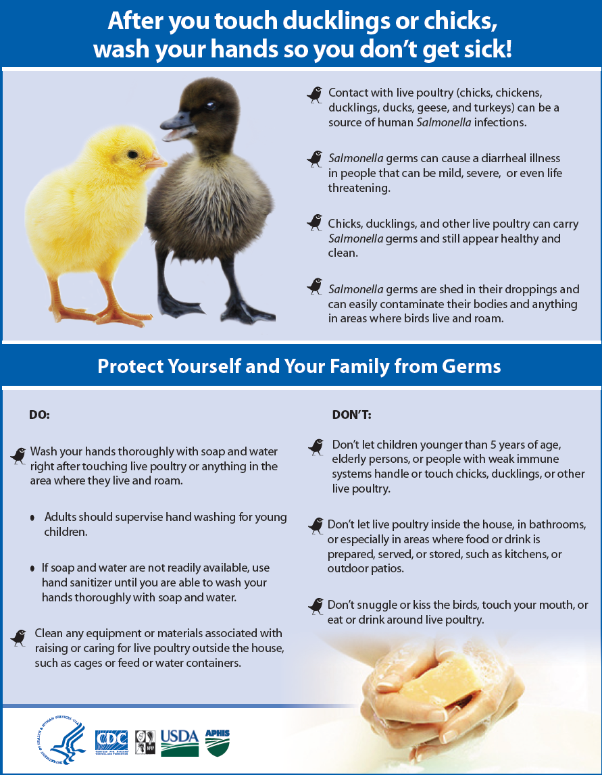
Salmonella Prevention: Animal contact
Pet reptiles and amphibians and their environments
Chicks and ducklings and their environments
Pets fed a raw meat diet
Animals clinically ill with Salmonella
Images courtesy of CDC
Notes:
Other ways people can avoid becoming ill with Salmonella is using good practices when handling and working around animals. For instance, good barrier precautions and hygiene are important whenever handling pet reptiles, amphibians, chicks and ducklings and working in or cleaning the environments where these animals are housed. In addition, animals fed a raw meat diet are more likely to shed Salmonella and, of course, animals clinically ill with Salmonella are likely to be shedding the organism. In addition, it is important to keep in mind that stressful situations, like animals being kept in shelters or in unfamiliar surroundings may be more likely to become clinically ill with Salmonella and so animal health responders may be more likely to be exposed. In each case, good barrier and hygiene precautions (again, particularly hand washing) are very important to decrease the likelihood of human illness.

Slide 18
Salmonella Prevention
People at increased risk of infection should avoid contact with reptiles and amphibians and associated items
Reptiles and amphibians should not be allowed in households with children <5 years old or immunocompromised people
Do not let children <5 years old, elderly persons or immunocompromised people touch chicks, ducklings or other live poultry
Good hand and equipment hygiene
Good hygiene around animals with diarrhea
Notes:
Additional infection control measures recommended to decrease the likelihood of human infection with Salmonella include:
People at increased risk of infection should avoid contact with reptiles and amphibians and associated items.
Reptiles and amphibians should not be allowed in households with children <5 years old or immunocompromised people.
Do not let children <5 years old, elderly persons or immunocompromised people touch chicks, ducklings or other live poultry.
Maintain good hand and equipment hygiene and good hygiene around animals with diarrhea.

Slide 19
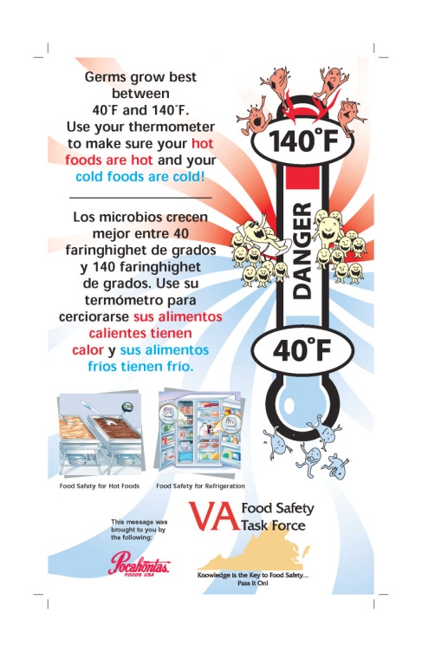
Salmonella resources
www.cdc.gov/salmonella/
Image courtesy of the Virginia Food Safety Task Force
www.fda.gov/Food/FoodborneIllnessContaminants/default.htm
Links to FDA’s “Bad Bug Book”
www.fsis.usda.gov/wps/portal/fsis/topics/food-safety-education
Notes:
For more information about Salmonella visit these websites.

Slide 20
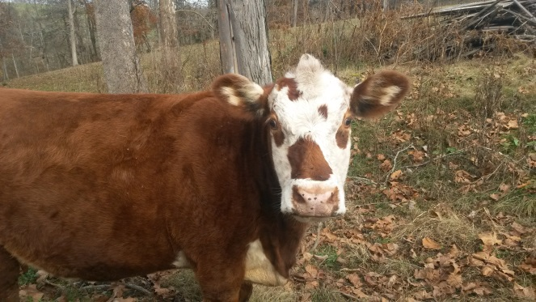
Shiga toxin producing E. coli (STEC)
E. coli bacteria area found in intestines of all animals and humans
E. coli O157:H7 is an STEC that is more likely than others to cause severe illness
Cattle recognized as the most important source of O157:H7 and it has been isolated from deer
Notes:
Escherichia coli (E. coli) bacteria normally live in the intestines of people and animals. Most E. coli are harmless and actually are an important part of a healthy human intestinal tract. However, some E. coli are pathogenic, meaning they can cause illness, either diarrhea or illness outside of the intestinal tract. The types of E. coli that can cause diarrhea can be transmitted through contaminated water or food, or through contact with animals or persons.
E. coli consists of a diverse group of bacteria. Pathogenic E. coli strains are categorized into pathotypes. Six pathotypes are associated with diarrhea and collectively are referred to as diarrheagenic E. coli.
Shiga toxin-producing E. coli (STEC)—STEC may also be referred to as Verocytotoxin-producing E. coli (VTEC) or enterohemorrhagic E. coli (EHEC). This pathotype is the one most commonly heard about in the news in association with foodborne outbreaks. Other types of E. coli can also produce illness in people.
STEC live in the guts of ruminant animals, including cattle, goats, sheep, deer, and elk. The major source for human illnesses is cattle. Transmission is mainly through the ingestion of food contaminated with ruminant feces and direct contact with animals and their environments although person to person transmission can also occur particularly in families, childcare centers and custodial institutions

Slide 21
STEC: Human
Reportable in VA since 1999
~150 cases reported/year in VA
CDC estimates 265,000 cases/year
Image courtesy of CDC
Notes:
STEC has been reportable in Virginia since 1999. About 150 cases per year are reported in VA and the CDC estimates that about 265, 000 human cases occur each year nationwide.

Slide 22
STEC: Human
Incubation 3-4 days
Diarrhea
Severe stomach cramps
Potential kidney failure
Hemolytic uremic syndrome
Notes:
The route of infection is fecal-oral and the incubation period ranges from 3-4 days. Once a person becomes sick, the illness typically takes about a week to resolve. Stomach cramps and bloody diarrhea are common features of this infection. While most of these infections will resolve on their own, some of them, can result in more serious complications such as kidney failure. Can be self limiting if immunocompromised.
Around 5–10% of those who are diagnosed with STEC infection develop a potentially life-threatening complication known as hemolytic uremic syndrome (HUS). HUS is believed to develop when STEC enters into circulation through the inflamed bowel wall, releasing a specific chemical system known as shiga-like toxin (SLT). SLT, and probably other chemical mediators, attach to receptors on the inside surface of blood vessel cells (endothelial cells). Some organs appear more susceptible than others to the damage caused by these toxins, possibly due to the presence of increased numbers of toxin-receptors. These organs include the kidney, pancreas, and brain. Thrombocytopenia and formation of renal thrombi are characteristic of HUS, suggesting that platelet activation is involved in its pathogenesis. Thrombocytopenia caused by platelet consumption in thrombi is a major manifestation of hemolytic uremic syndrome (HUS) associated with Shiga toxin (Stx) producing Escherichia coli.
HUS was first described in 1955, and is now recognized as the most common cause of kidney failure in childhood. E. coli O157: H7 is responsible for the majority of the cases of HUS that develop in North America.

Slide 23
STEC Outbreaks in Virginia: Human
Occasional outbreaks
Improperly cooked ground beef often associated with illness, although other foods have been associated with illness
Notes:
Virginia has investigated occasional outbreaks (usually no more than one per year) of E. coli. It is not unusual that outbreaks are associated with improperly cooked ground beef.

Slide 24
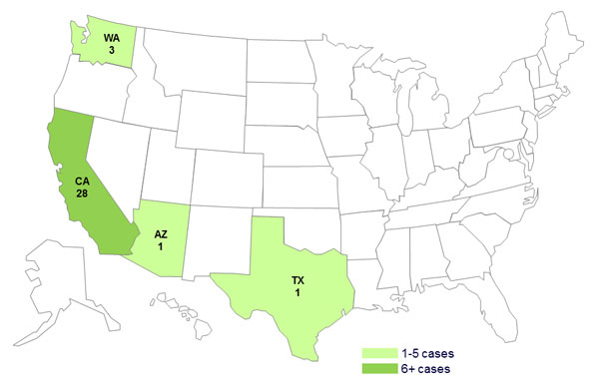
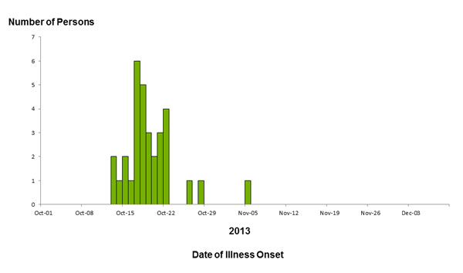
E. Coli O157:H7 outbreaks US
Multistate Outbreak of Shiga toxin-producing Escherichia coli
O157:H7 Infections Linked to Ready-to-Eat Salads, 2013
Images courtesy of CDC
Notes:
An example of a multistate investigation of a E. coli outbreak associated with food, specifically bagged salads, is featured here http://www.cdc.gov/ecoli/2013/O157H7-11-13/index.html
A total of 33 persons infected with the outbreak strain of STEC O157:H7 were reported from four states. 32% of ill persons were hospitalized. Two ill persons developed hemolytic uremic syndrome (HUS), and no deaths were reported.
Epidemiologic and traceback investigations conducted by local, state, and federal officials indicated that consumption of two ready-to-eat salads, Field Fresh Chopped Salad with Grilled Chicken and Mexicali Salad with Chili Lime Chicken, produced by Glass Onion Catering and sold at Trader Joe’s grocery store locations, was the likely source of this outbreak of STEC O157:H7 infections.
On November 10, 2013, Glass Onion Catering voluntarily recalled numerous ready-to-eat salads and sandwich wrap products that may be contaminated with STEC O157:H7.

Slide 25
Human STEC outbreaks, US
Lebanon Bologna, 2011
Hazelnuts, 2011
Romaine Lettuce, 2011
Cheese, 2010
Raw Cookie Dough, 2009
Notes:
Other foods can also be associated with STEC. Additional information about all of these outbreaks can be found at http://www.cdc.gov/ecoli/outbreaks.html

Slide 26
STEC: Animals
Cattle are probably the most important source of E. coli O157:H7
Often commensal in adult cattle
Young calves can become clinically ill
Illness in other animals has also been reported
Notes:
E coli O157: H7 can be found as normal flora in adult cattle. When it does cause illness in this species, it usually affects calves and causes diarrhea, which can be bloody, and dehydration. Infection with this organism has also been reported in pigs, dogs and horses.

Slide 27
E. Coli-Prevention
Avoid cross contamination
Thoroughly cooking all foods
Avoid consumption of raw meats and raw dairy
Wash produce thoroughly
Hand washing
Notes:
Never eat rare or undercooked ground beef. Cook to 160 degrees F or until the meat color is brown or gray.
Do not drink unpasteurized milk or cider.
Always wash any raw fruits or vegetables before eating.
Always carefully wash hands before and after preparing foods.
Always refrigerate meat products. Never leave raw meats at room temperature.
Make sure children wash their hands carefully, especially after using the toilet or handling animals.
Always wash hands with soap and warm water after using the toilet or changing diapers.
Persons with diarrhea should not use public swimming facilities.
Clean and disinfect diapering areas, toilets/potty chairs, toys, etc. at least daily and when soiled

Slide 28
E. Coli resources
www.cdc.gov/Features/EcoliInfection/
www.foodsafety.gov/
www.vdh.virginia.gov/Epidemiology/Surveillance
Notes:
For more information about E. coli, visit these websites.

Slide 29
Inhalation Transmission
Psittacosis
Histoplasmosis
Hantavirus
Coxiella burnetii (Q Fever)
Tuberculosis
Notes:
Examples of zoonotic pathogens that may cause illness in people via inhalation are listed here.

Slide 30
Psittacosis: Human
Caused by Chlamydia psittaci
Exposure to pet birds
Rarely reported in VA
<50 cases reported/year in US
Notes:
Psittacosis, also known as parrot fever and ornithosis, is a bacterial infection of humans. It is caused by Chlamydia psittaci and was formerly known as Chlamydophila psittaci. In general, human cases occur after exposure to infected pet birds, usually cockatiels, parakeets, parrots, and macaws. Infected birds shed the bacteria through feces and nasal discharges, and humans become infected from exposure to these materials.
Very few human cases occur in Virginia every year. From 2002 through 2012, one case of psittacosis was reported in Virginia and, since 1996, fewer than 50 confirmed cases have been reported in the United States each year to the Centers for Disease Control and Prevention (CDC). In general, these cases occur after exposure to infected pet birds, usually cockatiels, parakeets, parrots, and macaws.

Slide 31
Psittacosis: Human
Inhaled from desiccated droppings/secretions, dust from feathers
Incubation 1-2 weeks
Fever, headache, rash, chills
Person to person spread rare
Notes:
The disease resulting from C. psittaci infection in humans is called psittacosis. Most infections have been reported as being in association with exposure to psittacine birds, although transmission has also been documented from poultry and free-ranging birds including doves, pigeons, birds of prey and shore birds. Human infection with C. psittaci usually occurs when a person inhales organisms that have been aerosolized from dried feces or respiratory tract secretions of infected birds. Other means of exposure include mouth-to-beak contact and handling of infected birds’ plumage and tissues.
The onset of illness typically follows an incubation period of 5 to 14 days, but longer periods have been reported. The severity of the disease ranges from a mild, non-specific illness to a systemic illness with severe pneumonia. Before antimicrobial agents were available, 15% to 20% of humans with C. psittaci infection died; however, mortality has been extremely rare since the advent of antibiotics. Humans with symptomatic infections typically have an abrupt onset of fever, chills, headache, malaise, and myalgia. A nonproductive cough is usually present and can be accompanied by breathing difficulty and/or chest tightness. Person-to-person transmission is rarely reported.

Slide 32
Psittacosis Investigation
Infection in people is uncommon
Infection in birds is much more common
Often report in a bird prompts public health follow up with bird owners or aviaries
Notes:
Infection in birds is more common than in people and so it is typically a report of infection in a bird that triggers public health follow up.

Slide 33
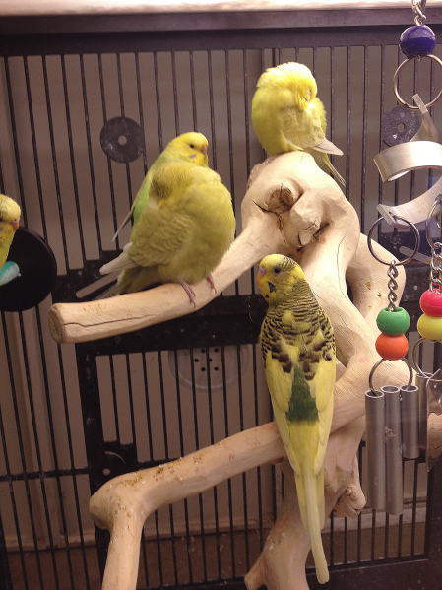
Psittacosis: Animals
Birds shed intermittently in feces and respiratory secretions
Birds often appear healthy
Stress initiates shedding/illness
Image courtesy of CDC
Notes:
C. psittaci is excreted in the feces and nasal discharges of infected birds. The organism is environmentally labile but can remain infectious for over a month if protected by organic debris (e.g., litter and feces). Some infected birds can appear healthy and shed the organism intermittently. Shedding can be exacerbated by stress factors, including reproductive activities, rearing of young, relocation, shipping, crowding, and chilling.
In birds, C. psittaci illness is referred to as avian chlamydiosis . The usual incubation period of C. psittaci ranges from 3 days to several weeks. However, active disease can appear with no identifiable exposure or risk factor. Signs of avian chlamydiosis are non-specific and include lethargy, anorexia and ruffled feathers. Other signs include serous or mucopurulent ocular or nasal discharge, conjunctivitis, diarrhea and excretion of green to yellow-green urates. Severely affected birds may become anorectic and produce sparse, dark green droppings, followed by emaciation, dehydration, and death. Whether the bird has acute or chronic signs of illness or dies, depends on the species of bird, virulence of the strain, infectious dose, stress factors, age, and extent of treatment or prophylaxis.

Slide 34
Psittacosis-Prevention
Diagnose and treat sick birds
Clean bird cages regularly
Use of protective clothing and equipment when working with birds with avian chlamydiosis
Notes:
Controlling the disease in the bird population helps reduce the risk for people. However, birds that seem healthy can shed the bacteria and new birds may reintroduce the bacteria, so prevention depends on properly designed and managed facilities that raise and sell birds and the use of protective clothing, including masks, and gloves by those working with birds with avian chlamydiosis. Sick birds should be diagnosed and treated. If they are sold while they are being treated, the new owner should be informed and be sure that treatment is completed. Bird cages should be cleaned regularly with disinfectants (alcohol, Lysol, or bleach solution) and the contents of the cage should be disposed of properly.

Slide 35
Psittacosis resources
Compendium of Measures To Control Chlamydophila psittaci Infection Among Humans (Psittacosis) and Pet Birds (Avian Chlamydiosis)
available at www.nasphv.org
http://www.cdc.gov/pneumonia/atypical/psittacosis.html
Notes:
Additional information about psittacosis can be found via the resources on this slide.

Slide 36
Q Fever
Caused by Coxiella burnetii
Primary reservoirs are cattle, sheep and goats
Very hardy in the environment
Animal reservoirs typically remain well and shed the bacteria in birthing fluids, placenta, milk, urine and feces
Notes:
Q fever is a worldwide disease with acute and chronic stages caused by the bacteria Coxiella burnetii. Infected animals such as sheep, goats, and cattle are the main source of infection for human beings although a variety of species may be infected. Humans are exposed to the bacterium via contact with the fluids of infected animals such as birth products, urine, milk, and feces; with the highest bacterial load being shed in the birth products (placenta, fetus, amniotic fluid) making them the highest risk material. During birthing the organisms are shed in high numbers within the amniotic fluids and the placenta. The organism is extremely hardy and resistant to heat, drying, and many common disinfectants which enable the bacteria to survive for long periods in the environment. Infection of humans usually occurs by inhalation of these organisms from air that contains airborne barnyard dust contaminated by dried placental material, birth fluids, and excreta of infected animals. Other modes of transmission to humans, including tick bites, ingestion of unpasteurized milk or dairy products, and human to human transmission, are rare. Humans are often very susceptible to the disease, and very few organisms may be required to cause infection.

Slide 37
Q Fever: Human
~2 cases are reported/year in Virginia
Cases are more commonly reported from western states and the CDC reports between 150-200 human cases/year
Annual reported incidence (per million population) for Q Fever in the United States for 2010, CDC
Notes:
Very few cases of Q Fever in people are reported in Virginia each year. The CDC reports between 150 and 200 people with Q Fever annually. Cases of Q fever are most frequently reported from western and plains states where ranching and rearing of cattle are common. In other states, areas where sheep, goat, and cattle ranching are locally practiced may demonstrate increased incidence. Seven states (California, Colorado, Illinois, Kentucky, Missouri, Tennessee, and Texas) have accounted for more than half (52%) of all cases since human Q fever became notifiable. Cases of Q fever are reported less frequently in the eastern United States. Sporadic reports of cases may result from patients involved in animal research work and from patient travel to other states.

Slide 38
Q Fever: Transmission to People
Inhalation of infectious aerosols is the most common mode
directly from birth fluids of infected animals or via inhalation of dust contaminated with dried birth fluids or excreta
birth assistance, exposure to birth materials
Other transmission methods (e.g., tick bites, consumption of raw dairy products, person to person) are rarely reported
Notes:
The most common mode of transmission in humans is inhalation of infectious aerosols directly from birth fluids of infected animals or via inhalation of dust contaminated with dried birth fluids or excreta. C. burnetii is extremely resistant to physical stresses, including heat and desiccation and can survive in the environment for months to years. The bacteria can become airborne, traveling on wind currents for miles. As mentioned previously, the highest numbers of organisms are shed in birth products, although viable organisms also might be shed in the urine, milk, and feces of infected animals. Other modes of transmission such as tick-borne, food borne and person to person have been reported, but are considered rare.
In the United States, Q fever outbreaks have resulted mainly from occupational exposure involving veterinarians, meat processing plant workers, sheep and dairy workers, livestock farmers, and researchers at facilities housing sheep. Individuals who reside or spend time near ranches and livestock rearing facilities are at increased risk for infection. While typically thought of as an infection people with livestock contact will acquire, cases with no known exposure or close proximity to livestock have been reported.
Although most persons with acute Q fever infection recover, others may experience serious illness with complications that may include pneumonia, granulomatous hepatitis, myocarditis and central nervous system complications.
The frequency of reported cases of Q fever increases with age and is highest among males, which may reflect occupational risks for exposure among livestock handlers. A past history of heart valve defects, endocarditis, or valvular implants may increase the risk of chronic infection and severe disease outcome. Infection is also more common in patients with compromised immune systems (such as may occur through cancer treatments, advanced human immunodeficiency virus (HIV) infection, prior organ transplants, or some medications). Individuals who reside or spend time near ranches and livestock rearing facilities are at increased risk for infection.

Slide 39
Q Fever: Human Illness
Some exposed remain asymptomatic
Incubation 2-3 weeks for acute illness
Acute and chronic forms
Acute illness:
Flu-like symptoms (e.g., high fever, severe headache, muscle aches, cough) most common
Pneumonia of varying severity
More severe symptoms like meningitis and heart problems are uncommon
Notes:
The acute symptoms caused by infection with Coxiella burnetii usually develop within 2-3 weeks of exposure, although as many as half of humans infected with C. burnetii do not show symptoms. Acute illness is more common than the chronic form of Q Fever and is typically associated with flu like symptoms such as high fever, severe headache, myalgia, and non productive cough. 30-50% of people who have acute Q Fever may have changes in their lungs consistent with pneumonia. A small percentage of people with acute illness have more severe symptoms like meningitis and heart problems like myocarditis and pericarditis. Asymptomatic infections followed by seroconversion have been reported in up to 60% of cases identified during outbreak investigations.

Slide 40
Q Fever: Human Illness
Post-Q Fever fatigue syndrome
Majority of acute Q Fever patients recover completely
Fatigue syndrome has been reported in 20-42% of acute cases
Previously healthy people with no pre-existing conditions who develop a complex of symptoms dominated by debilitating fatigue
Notes:
The majority of patients with post-Q fever fatigue syndrome are previously healthy persons with no underlying medical or psychological problems who develop a complex of symptoms dominated by a debilitating fatigue after symptomatic acute Q fever infection. Other symptoms might also occur along with the fatigue such as nausea, headache, night sweats, difficulty sleeping, depression and impaired short-term memory. There is no apparent organ involvement. It is characterized by fatigue and other expected Q fever symptoms that last beyond a year and for many patients last for several years or for life. No consensus has been reached on the pathogenesis of post-Q fever fatigue syndrome, although genetic predisposition and the severity of acute illness have been suggested to play a role in its development.

Slide 41
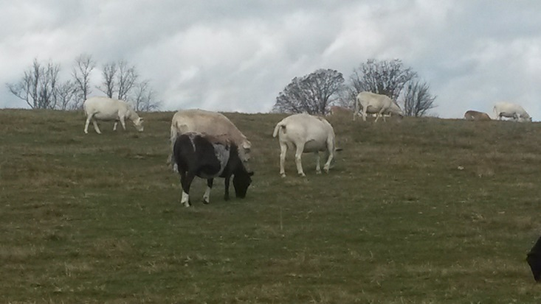
Q Fever: Human Illness
Chronic illness
Occurs in <5% of infected patients
Can occur months or years after initial infection
Can manifest as endocarditis, hepatitis, chronic vascular, bone or lung infections
Those at highest risk include people with pre-existing heart conditions like heart valve disease
Notes:
Chronic Q Fever occurs in <5% of infected patients and can occur after acute illness or asymptomatic infection. The patients at highest risk for chronic Q fever are those with valvular heart disease, a vascular graft, or an arterial aneurysm. Endocarditis or an inflammation of the inner lining of the heart, is the most common manifestation of chronic Q fever, although chronic infection can also manifest in liver disease and chronic vascular, bone or lung infection. The initial clinical signs and symptoms in patients with chronic Q fever often are nonspecific and highly variable. Features might include fatigue, fever, abdominal or chest pain, weight loss, night sweats, or hepatosplenomegaly. Arterial embolism, pulmonary embolism, or deep venous thrombosis also might occur.

Slide 42
Q Fever: Human Illness
Special populations
Children
Pregnant women
Immune compromised
Notes:
Certain populations of individuals may manifest disease differently in regard to severity and complications. For instance, children are less likely to have symptoms than adults and might have a milder illness and have a tendency to develop a rash along with flu like symptoms. Pregnant women might also be less likely to develop symptoms of acute Q Fever, but may be at risk for an adverse outcome to their pregnancy (such as a miscarriage) or at higher risk for developing chronic Q Fever particularly if an acute infection occurs in the first trimester of pregnancy. Immune compromised individuals are also at greater risk for developing chronic Q Fever infections.

Slide 43
Q Fever: Animal Illness
Primary reservoirs (cattle, sheep and goats) are typically asymptomatic
When clinical illness is seen:
Goats and sheep: abortion, stillbirth, weak kids/lambs
Cattle: abortion, low birth weight calves, subclinical mastitis, metritis
Studies in cats would indicate adverse reproductive events in this species as well
Notes:
While infection has been confirmed in multiple vertebrate species, including wildlife, marine mammals, domestic mammals, birds, and reptiles, cattle, sheep, and goats are the primary reservoirs for C. burnetii. Coxiella burnetii infection in livestock species is generally asymptomatic, but when clinical illness is seen in animals, it is typically goats, sheep and cattle that will manifest illness. Goats and sheep are the species in which abortions, stillbirths, and early neonatal mortality have been most frequently documented. Abortion in cattle due to C. burnetii infection has been reported, and more research is needed to determine the organism’s role in infertility, metritis and endometritis. Coxiella burnetii can cause adverse pregnancy outcomes in cats, and contact with infected cats has been associated with human infection.

Slide 44
Q Fever: Animal Transmission
Inhalation of infectious aerosols and/or direct contact with infected and contaminated environments
Birth products, excreta and milk are the most likely sources of infection
Ticks may also serve as a route of infection

Slide 45
Q Fever Outbreaks: Human
Q Fever outbreak in the Netherlands
Ongoing since 2007
Over 4000 human cases
Mass vaccination of goats and sheep
Culling of goat herds
The large numbers of human cases thought to be due to proximity to aborting small ruminants
Notes:
The 2007–2009 human Q fever epidemic in The Netherlands attracted attention due to its magnitude and duration. The current epidemic and the historical background of Q fever in The Netherlands are reviewed according to national and international publications. Seroprevalence studies suggest that Q fever was endemic in The Netherlands several decades before the disease was diagnosed in dairy goats and dairy sheep. This was in 2005 and the increase in humans started in 2007. Q fever abortions were registered on 30 dairy goat and dairy sheep farms between 2005 and 2009. Over 4000 human cases were notified between 2007 and 2010. Proximity to aborting small ruminants and high numbers of susceptible humans are probably the main causes of the human Q fever outbreak in The Netherlands.

Slide 46
Q Fever Outbreaks: Human
The Q Fever in The Netherlands: an update on the epidemiology and control measures. Van der Hoek, et al, Euro Surveill. 2010;15(12):pii=19520. Available online: http://www.eurosurveillance.org/
Notes:
Epi Curve of the Q fever outbreaks in the Netherlands that spanned 2007–2010 with a peak in 2009. Among other measures, it resulted in mass vaccination of dairy goats and sheep and culling of dairy sheep flocks and goat herds. Seroprevalence studies suggest that Q fever was endemic in The Netherlands several decades before the disease was diagnosed in dairy goats and dairy sheep. This was in 2005 and the increase in humans started in 2007. Q fever abortions were registered on 30 dairy goat and dairy sheep farms between 2005 and 2009. Over 4000 human cases were notified between 2007 and 2010.

Slide 47
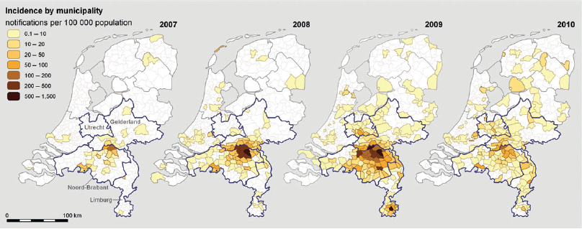
Q Fever Outbreaks: Human
Proximity to aborting small ruminants probably main cause
Q Fever abortions registered in 30 dairy goat and dairy sheep farms between 2005-2009
Dijkstra, et al, Immunology and Medical Microbiology, (64) 2012, 3-12
Notes:
Proximity to aborting small ruminants and high numbers of susceptible humans are probably the main causes of the human Q fever outbreak in The Netherlands.

Slide 48
Q Fever Outbreaks: Human
Outbreak Associated with Goat Farms --- Washington and Montana, 2011
First reported multistate Q Fever outbreak in US
Q Fever detected in a placenta from a goat on a Washington farm in April
Abortions in goats had been ongoing since January
Ill people identified in May
15 ill people, 4 hospitalized
Notes:
On April 22, 2011, the Q fever bacterium Coxiella burnetii was detected in a goat placenta collected from a farm in Washington, where 14 of 50 (28%) pregnant does had aborted since January. A county health alert advised health-care providers to ask patients with symptoms compatible with Q fever (e.g., fever, headache, chills, and myalgia) about exposure to goats, and the owners of the farm informed purchasers of their goats that C. burnetii had been detected in their herd. On May 25, the county health department reported a symptomatic patient with antibodies to C. burnetii who had purchased goats from the farm in February. Eventually a total of 15 symptomatic individuals (both MT and WA residents) were identified and 4 of those folks were hospitalized.

Slide 49
Q Fever: Prevention
Prevention methods include barrier precautions during birth assistance to avoid contamination broken skin or mucous membranes
Proper cleaning of stalls, removal of bedding, removal of birthing materials
Proper handling of laboratory samples
Notes:
Prevention and control efforts should be directed primarily toward the groups who work in environments where infection is more likely including: veterinarians, meat processing plant workers, sheep and dairy workers, livestock farmers, and researchers at facilities housing sheep.
The following measures represent some of the measures that should be used to prevent and control of Q fever:
Educate the public on sources of infection.
Appropriately dispose of placenta, birth products, fetal membranes, and aborted fetuses at facilities housing sheep and goats.
Restrict access to barns and laboratories used in housing potentially infected animals.
Use only pasteurized milk and milk products.
Use appropriate procedures for bagging, autoclaving, and washing of laboratory clothing.
Counsel persons at highest risk for developing chronic Q fever, especially persons with pre-existing cardiac valvular disease or individuals with vascular grafts.

Slide 50
Q Fever resources
www.cdc.gov/qfever/
Diagnosis and Management of Q Fever: US, 2013
www.cdc.gov/mmwr/preview/mmwrhtml/rr6203a1.htm
Roest, et al. The Q fever epidemic in The Netherlands : history, onset, response and reflection. Epidemiol. Infect. (2011), 139, 1-12.
Prevention and Control of Coxiella burnetii Infection among Humans and Animals: Guidance for a Coordinated Public Health and Animal Health Response, 2013
Available at www.nasphv.org
Notes:
More information about Q Fever as well as a history of Q Fever in the Netherlands via these resources.

Slide 51
Direct Contact Transmission
Leptospirosis
Tularemia
Brucellosis
Monkeypox
Orf

Slide 52
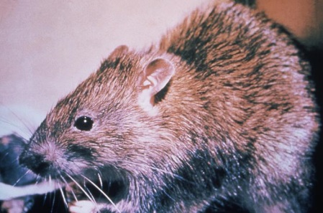
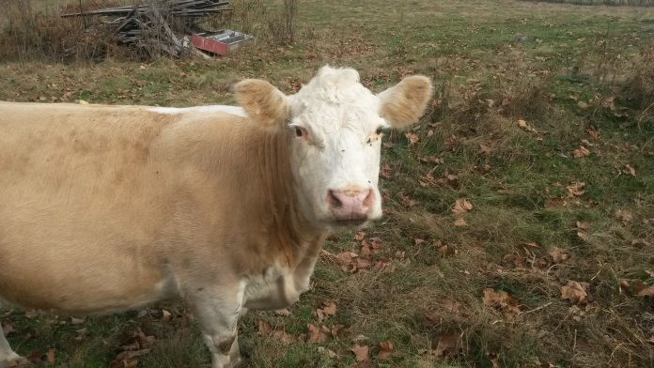
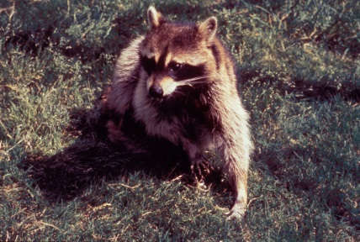
Leptospirosis
Caused by spiral shaped bacteria (leptospires)
Over 200 serovars have been described
Wild and domestic animals are reservoirs; serovars vary with species of animal
Images courtesy of CDC
Notes:
Leptospirosis is a bacterial disease that affects humans and animals. It is caused by bacteria of the genus Leptospira. There a number of different serovars or serotypes of this bacteria and a number of animals can act as both reservoirs of those serovars and also become ill with those serovars. Leptospires are most commonly spread through the urine of infected animals, which can get into water or soil and can survive there for weeks to months. These organisms can be very hardy in the environment and they survive particularly well in stagnant slow moving water and in places where ambient temperatures range from 32-77 degrees Fahrenheit. So it’s not unusual for leptospires to be present in stock ponds or slow moving streams particularly in warmer environments and many animals including a number of wild animal species such as raccoons, opossums skunks and rodents contribute to the environmental level of this bacteria.

Slide 53
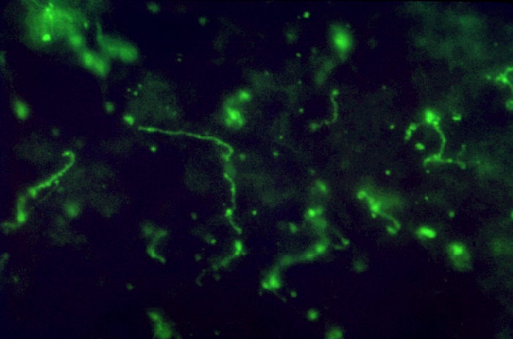
Leptospirosis: Human
Nationally notifiable
100-200 cases identified each year in the US
Considered to be the most widespread zoonotic disease in the world
Image courtesy of CDC
Notes:
Leptospirosis is nationally notifiable, but not currently part of the Virginia Department of Health’s reportable disease list. Leptospirosis was last included on the VDH list of reportable disease and conditions from 1989-1999, with no more than 2 cases per year reported during that time. Approximately 100-200 cases are identified annually in the United States. About 50% of cases occur in Hawaii.
Although incidence in the United States is relatively low, leptospirosis is considered to be the most widespread zoonotic disease in the world.

Slide 54
Leptospirosis
Direct and indirect
Contact with urine, infected tissues, bite wounds
Contact with contaminated water sources, food, bedding
Contact with mucous membranes and/or abraded/scratched/water-softened skin
Notes:
The bacteria that causes leptospirosis are typically spread through the urine of infected animals, which can get into water or soil and can survive there for weeks to months. Humans and animals can become infected through contact with this contaminated urine (or other body fluids, except saliva), water, or soil. The bacteria can enter the body through skin or mucous membranes (eyes, nose, or mouth), especially if the skin is broken from a cut or scratch. Drinking contaminated water can also cause infection. Infected wild and domestic animals may continue to excrete the bacteria into the environment continuously or every once in a while for a few months up to several years.

Slide 55
Leptospirosis: Human
Severity of illness can vary
Initial symptoms often flu-like and usually begin 10 days after exposure (range 2-30)
Can cause renal disease and coagulopathy
Person to person transmission rare
Antibiotic prophylaxis typically not recommended
Notes:
In humans, leptospirosis can cause a wide range of symptoms, including: high fever, headache, chills, muscle aches, vomiting, jaundice (yellow skin and eyes), red eyes, abdominal pain, diarrhea and rash. Many of these symptoms can be mistaken for other diseases. In addition, some infected persons may have no symptoms at all. The time between a person's exposure to a contaminated source and becoming sick is 2 days to 4 weeks. Illness usually begins abruptly with fever and other symptoms. Leptospirosis may occur in two phases: after the first phase (with fever, chills, headache, muscle aches, vomiting, or diarrhea) the patient may recover for a time but become ill again.
If a second phase occurs, it is more severe; the person may have kidney or liver failure or meningitis. This phase is also called Weil's disease. The illness lasts from a few days to 3 weeks or longer. Without treatment, recovery may take several months.
Person to person transmission of leptospirosis is rare and antibiotic prophylaxis for people who have been exposed is typically not recommended

Slide 56
Leptospirosis outbreaks: Human
Largest outbreak in the US occurred in 1998
Outbreak among triathletes in IL and WS
775 people exposed and 90 people were either confirmed with or suspected of having illness
Outbreaks in the US have also been documented in association with infected dogs
Notes:
The largest recorded U.S. outbreak occurred in 1998, when 775 people were exposed to the disease. Of these, 90 people were either confirmed with or suspected of having Lepto. More information about this outbreak can be found at http://www.cdc.gov/mmwr/preview/mmwrhtml/00054395.htm. Outbreaks in the US have also been documented in association with infected dogs.

Slide 57
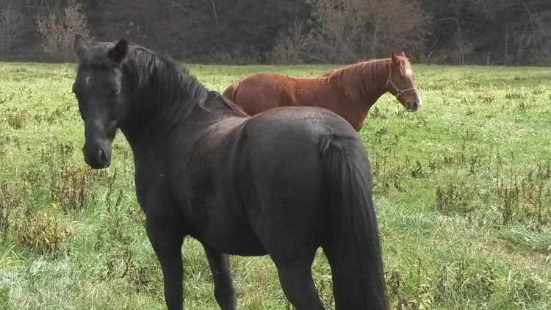
Leptospirosis: Animals
Wide variety of clinical signs or asymptomatic
Depends on species, immunity, age, stage of gestation, serovar
Renal disease
Liver disease
Coagulopathy
Abortion/infertility
Decreased milk production
Notes:
There can be a wide variety of clinical signs that accompany leptospirosis illness in animals and some animals may not become ill at all. For instance, clinical signs are usually mild or not apparent in cats, however dogs (depending on the serovar they are infected with) can experience vomiting, jaundice, rapid breathing, lethargy, diarrhea. Cattle can experience reproductive disorders like abortion and renal disease.

Slide 58
Leptospirosis: Human
Most human illness caused by occupational or recreational exposures
Infected wildlife
Infected domestic animals
Contaminated recreational water
Notes:
Leptospirosis occurs worldwide, but is most common in temperate or tropical climates. It is an occupational hazard for many people who work outdoors or with animals, such as veterinarians, animal caretakers and farmers. The disease has also been associated with swimming, wading, kayaking, and rafting in contaminated lakes and rivers. As such, it is a recreational hazard for campers or those who participate in outdoor sports. The risk is likely greater for those who participate in these activities in tropical or temperate climates.

Slide 59
Leptospirosis: Prevention
Avoid contact with urine, other fluids of sick animals
Good barrier precautions: gloves, face protection, hand washing
Isolate infected animals if possible
Vaccinate livestock and pets
Avoid water with potential contamination
Control rodents
Notes:
To prevent infection with leptospirosis, it is best to avoid direct contact with the urine or other body fluids of sick animals by using good barrier precautions like gloves and or face protection to avoid fluids like urine splashing into your eyes, nose or mouth. Isolate sick animals from well animals if possible and vaccinating livestock and pets are also good practices to decrease the likelihood that animals will be infected. In addition, good rodent control and avoiding potentially contaminated water are also helpful in preventing illness.

Slide 60
Leptospirosis resources
www.cdc.gov/leptospirosis/
Levett, P. Leptospirosis. Clin. Microbiol. Rev. 2001, 14(2):296.
Notes:
More information about leptospirosis can be found via these resources.

Slide 61
Contagious Ecthyma “Orf”
A viral disease of sheep, goats, wild ruminants and humans
Found world wide
The virus survives weeks to months in the environment in dry scabs and crusts in feed bunks and in barns
Introduced into previously uninfected herds or flocks through fomites or by infected additions
Notes:
The virus that causes contagious ecthyma, commonly known as orf, is in the pox virus family. This poxvirus is present worldwide and can survive for long periods of time in the environment in dry scabs that come off of infected animals that may be found in areas like feed bunks and barns. This virus more commonly affects small ruminants like sheep and goats, but this infection has been reported in some wild ruminants, like reindeer. People can also become infected. Herds or flocks may develop orf when infected new animals are introduced and commingled with existing animals. Younger animals in a herd or flock are typically more susceptible to infection.

Slide 62
Clinical Signs in Animals
Sheep and goats
Sores usually develop around mouth and head area
Lesions usually resolve in 14-21 days
Young animals more susceptible to infection
May persist in animals with weak immune systems
Notes:
When sheep and goats are infected, the sores that develop are typically around the mouth and head area, but can also occur on the feet and the udder. Younger animals are more susceptible to infection. Lesions typically resolve in 14 to 21 days but may persist in animals with weak immune systems. Producers and caretakers can help affected animals by offering supportive care, like applying topical medication to severe skin lesions and ensuring infected kids or lambs receive sufficient milk.

Slide 63
Clinical Signs in Humans
Incubation period: 3-7 days
Clinical signs:
One or more reddish, weeping lumps on the fingers, hand, forearm or face
May be painful
May last up to 2 months
Low-grade fever
Serious infection in people with weak immune systems
Notes:
A person who comes into contact with the orf virus from an infected animal or fomites can potentially get infected. The incubation period for people exposed to orf is typically 3-7 days. People often develop one or more reddish, weeping lumps on the fingers, hand, forearm or face. The sore may be painful and can last for 2 months. With orf, a low-grade fever may occur but is usually gone within 3-4 days. People do not infect other people. Sores usually heal without scarring. While orf is usually a self-limiting illness, it can progress to serious infection in people with weak immune systems. It’s important to remember that if you develop symptoms that could be due to a zoonotic disease, you tell your doctor about any animal contact you have had since this might be helpful in figuring out the cause of your illness.

Slide 64
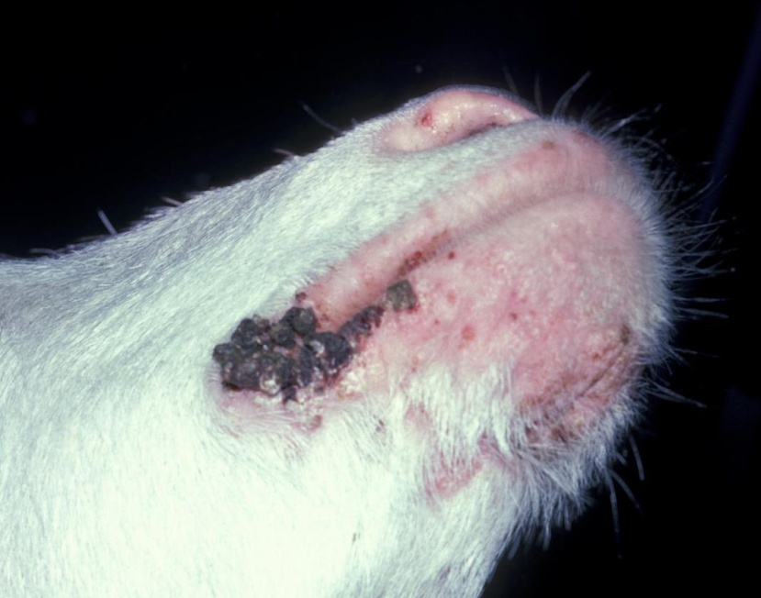
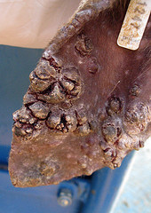
Photo courtesy of Iowa State University,
College of Veterinary Medicine
Photo courtesy of Susan Schoenian
Skin lesions caused by ORF
Photo courtesy of CDC
Notes:
The images seen on this slide demonstrate the lesions that can be seen with orf infections in sheep and goats. As mentioned previously, signs include pustules and sores on the lips and muzzle and less commonly in the mouth of young lambs and on the eyelids, feet, and teats of ewes. Orf in the mouths of lambs may prevent suckling. The lesions progress to thick crusts which may bleed.

Slide 65
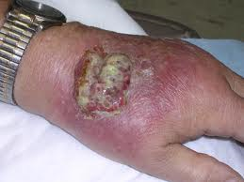
Orf lesion on the finger of a shepherd
Images courtesy of CDC
"Sore mouth" in a person with a weak immune system
Notes:
In people, orf usually appears as a small sore on the finger following contact with an infected animal or contaminated fomite. Sometimes these sores can be more severe in people with weak immune systems.

Slide 66
Transmission in Animals
Transmission of orf among animals is either by direct contact or indirectly from contaminated environment
Virus enters animal’s body through skin abrasions
Notes:
Transmission of orf among animals in a herd or flock occurs either by direct contact with infected animal or indirectly from contact with environments contaminated with this pox virus. The virus enters the animal’s body though skin abrasions and so illness rate can be high among animals that eat coarse feeds and pasture plants likely to cause damage to the mouth.

Slide 67
Transmission to Humans
Contact of the skin or mucus membranes of people with the lesions of infected sheep or goats
Contact with contaminated fomites or carcasses of infected animals
Skin with small cuts or sores is especially vulnerable
People do not infect other people
.
Notes:
Orf is transmitted by direct contact inoculation. Humans acquire the infection from contact with infected animals, carcasses, or a contaminated fomite. Orf is very common among shepherds, veterinarians and farmers who bottle-feed young lambs, as well as in butchers from handling infected carcasses.

Slide 68
Preventing exposure
PPE- Gloves
Wear latex/nitrile gloves when working with animals to prevent exposure and transmission to healthy animals
Wash hands after removing gloves,
coveralls and boots
Keep work clothes “on farm”
Notes:
To prevent exposure to orf, avoid having direct, bare skinned contact with animals that have skin lesions. Use of PPE is one way to create a barrier between people and disease agents spread by direct contact. Gloves should be worn when working with sick animals, animals with skin lesions or animals whose health status is unknown. This is especially important if your hands have cuts, abrasions or are severely chapped because areas of broken skin provide an entrance for disease agents. Wearing gloves does not replace good hand washing habits and it is important to wash hands in warm water and soap after removing gloves. Other disease transmission prevention practices that you can incorporate on your farm are to require or provide PPE such as clean coveralls for everyone entering animal areas and having clothing dedicated to on farm use only.

Slide 69
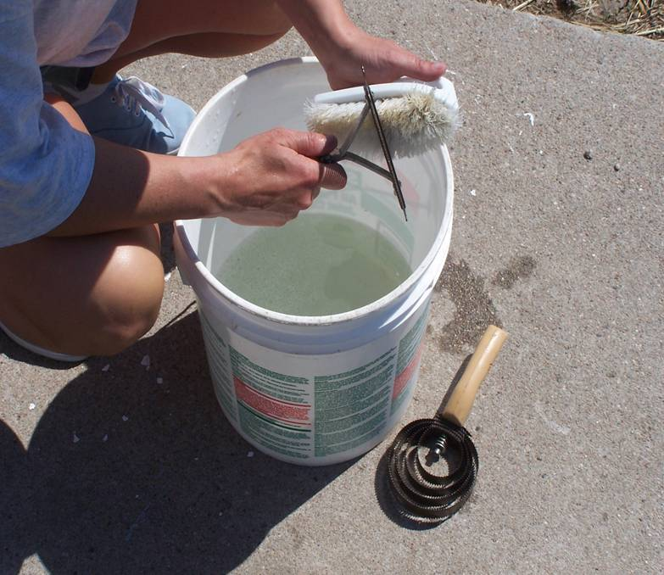
Stop Transmission
Keep equipment clean
Wash and disinfect grooming equipment especially if used on animals with skin lesions
Notes:
Various types of equipment can become contaminated and spread disease to humans or other animals. Things such as grooming tools can spread disease such as ORF, so it is important to wash and disinfect any equipment used on animals, particularly if those animals have skin lesions. The photo from the Center for Food Security and Public Health is demonstrating grooming tool disinfection and the photo from University of Arkansas Research and Extension is demonstrating the use of alcohol to disinfect ear tattoo equipment.

Slide 70
Keeping Orf out!
Quarantine new additions to your flock/herd
Don’t comingle animals at shows or fairs
Don’t share grooming tools
Vaccinate only if your animals have been exposed or infected previously as it is a “live” vaccine
Notes:
Measures a producer can take to prevent and control orf include quarantining new additions to a herd or flock for at least 2 weeks to see if any animals become ill, avoid comingling animals at shows and fairs and avoiding sharing grooming tools especially with someone whose animals’ disease status is unknown or without thoroughly disinfecting those tools in between animals. If illness with orf does occur in a herd or flock, separate out any infected stock to slow down cross-transmission to healthy animals. There is a vaccine available for orf, but it is typically only recommended in herds or flocks that have a problem with orf, since the vaccine contains live virus which can persist in the environment for as long as 2 years. Consult your veterinarian about the best treatment for orf and management practices that can help control orf.

Slide 71
Orf Summary
Orf can cause skin lesions in both animals and people
Humans can develop and Orf infection from contact with infected animals, carcasses, or a contaminated fomite
People can avoid becoming infected with Orf by taking precautions like wearing gloves and keeping equipment clean
Notes:
Orf can cause skin lesions in both animals and people. People can become infected with Orf if they have direct contact with infected animals, infected animal carcasses or infected equipment. Using simple precautions, like wearing gloves especially when working with animals that have skin lesions and keeping equipment clean, can help decrease the likelihood of people becoming infected. For more information about Orf, visit http://www.cdc.gov/poxvirus/orf-virus/

Slide 72
Vector-Borne Transmission
Arboviral encephalitis
Examples: West Nile virus (WNV), Eastern equine encephalitis (EEE), Zika virus
Rocky Mountain spotted fever
Lyme disease
Ehrlichiosis
Notes:
People can become infected with zoonotic disease via vectors such as mosquitoes and ticks. Included here are some examples of such vector-borne diseases.

Slide 73
West Nile Virus
Mosquito-borne (Culex spp.)
1999- First identified in US
2002- First identified in VA
Reported human cases in US have ranged from 712-9862/year since 2002
Reported human cases in VA have ranged from 1-30/year from 2003-13
Notes:
West Nile virus (WNV) has become firmly established in the Western Hemisphere since its discovery in the New York City area in 1999 . The virus has spread at an unprecedented rate throughout the continental United States and to neighboring countries, where it is maintained in an enzootic cycle that involves wild birds and ornithophilic mosquitoes. To date, 60 mosquito species have been found to be infected with WNV in North America; while many types of mosquitoes may carry West Nile Virus, certain Culex spp. appear to be primary vectors, depending on region.

Slide 74
Image courtesy of CDC
Notes:
West Nile virus is almost always spread to humans, birds and other animals through the bite of an infected mosquito. The virus is maintained in nature by bird reservoir hosts. A mosquito becomes infected by biting a bird that is carrying the virus. People and other animals are incidental hosts. West Nile virus is not spread from person to person. Although uncommon, WNV may be transmitted by blood products via transfusion or transplanted organs from infected donors or by cuts or punctures with contaminated scalpels or needles and, more rarely, through inhalation or ingestion of dust or particles from infected bird feces.

Slide 75
West Nile Virus “Iceberg”
<1% CNS
Disease
~20%
“West Nile Fever”
~80%
Asymptomatic
Notes:
An estimated 80% of people infected with the virus show no symptoms. About 1 in 5 people who are infected will develop a fever with other symptoms such as headache, body aches, joint pains, vomiting, diarrhea, or rash. Most people with this type of West Nile virus disease recover completely, but fatigue and weakness can last for weeks or months. Less than 1% of people who are infected will develop a serious neurologic illness such as encephalitis or meningitis (inflammation of the brain or surrounding tissues). The symptoms of neurologic illness can include headache, high fever, neck stiffness, disorientation, coma, tremors, seizures, or paralysis. People with certain medical conditions, such as cancer, diabetes, hypertension and kidney disease are also at greater risk for serious illness. Recovery from severe disease may take several weeks or months. Some of the neurologic effects may be permanent. About 10 percent of people who develop neurologic infection due to West Nile virus will die.

Slide 76
West Nile Virus: Animals
Most cases in incidental hosts have been documented in horses
Encephalitis is the most common manifestation
Arboviral infections in animals are reportable to the Virginia Department of Health
Virginia has reported a range of 0-15 horses/year since 2001
Treatment is supportive care
Vaccine for horses is available
Notes:
WNV infection has been documented in the U.S. primarily in wild birds, humans and horses, but a few cases have also occurred in other species such as sheep, bats, alligators, squirrels, chipmunks, raccoons, skunks, rabbits, cats, and dogs. Horses manifest illness mostly by developing encephalitis which leads to a loss of coordination, lack of interest in their surroundings and loss of appetite and can cause the horse to go down and be unable to get up without help. Even though the disease is called West Nile Fever, affected horses may not develop a noticeable fever although some will. Treatment consists of supportive therapy to prevent the animal from injuring themselves and nurse them through the 2-3 weeks of the disease. A WNV vaccine for horses is available.

Slide 77
WNV-Prevention
Long, loose, light clothing
Repellants – e.g., DEET, picaridin, IR3535
Screens on windows
Avoid environments/times of day when mosquitoes biting
Notes:
How to protect yourself from mosquitoes that bite:
Wear long, loose and light-colored clothing.
Use insect repellent products that contain active ingredients which have been registered with the U.S. Environmental Protection Agency (EPA) for use as repellents applied to skin and clothing such as DEET, picaridin and IR3535
Follow label instructions when using insect repellents.
Eliminate standing water and avoid environments and times of day when mosquitoes will likely be biting. Culex mosquitoes typically bite during twilight hours.

Slide 78
WNV-Prevention
Mosquito Control
Eliminate breeding sites
proper drainage
remove or turn over water containers
change bird baths weekly
Larvicide – treat water that is not dump-able
Adulticide – aerial spraying after hurricanes sometimes employed
Notes:
The best defense against WNV is to protect yourself from biting mosquitoes and to eliminate mosquito breeding areas.
How to eliminate mosquito breeding areas:
Turn over or remove containers in your yard where rainwater collects, such as potted plant trays, buckets, or toys.
Empty bird baths once a week.
Remove old tires from your yard.
Clean roof gutters and downspout screens.
Eliminate standing water on flat roofs, boats, and tarps.
Clear obstructions in ditches so they flow and drain. Fill in puddles with soil, or a mixture of sand and gravel, or dig drainage ditches to drain puddles.
If puddles or ditches cannot be drained or filled in, treat standing water with mosquito larvicide's (dunks or granules) that can be purchased at any hardware store.

Slide 79
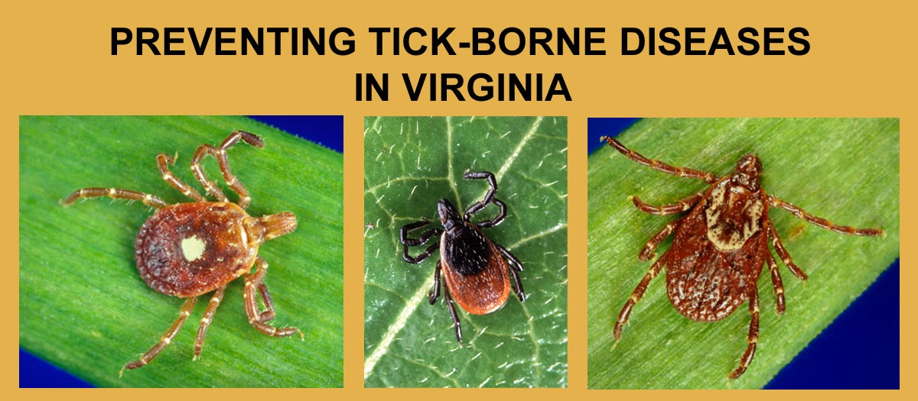
Lyme Disease
Tick-borne diseases (TBD) are the most commonly reported vector-borne disease in people in Virginia and Lyme disease is the most commonly reported TBD
Lone Star Tick
Blacklegged Tick
American Dog Tick
Image courtesy of CDC
Notes:
There are three different tick species that commonly bite people in Virginia.
By far, the most common tick to bite people in Virginia is the lone star tick. All three tick species can transmit various diseases, but only one species, the blacklegged tick (a.k.a. deer tick, latin name Ixodes scapularis) transmits Lyme disease. *It is the only human biting tick in Virginia that has black legs.*

Slide 80
Lyme Disease Transmission – Two Year Cycle
Image courtesy of CDC
Notes:
The blacklegged tick has a two year life cycle.
In the spring, adult blacklegged ticks lay eggs. By mid summer, larval ticks hatch from eggs and are infected with the Lyme disease agent by feeding on infected white-footed mice which are typically found in forest environments. Blood-fed larvae molt into nymphs and remain dormant in the forest leaf litter until the next spring.
In the 2nd spring & summer, the nymphs feed on rodents, dogs, cats & people. Infected nymphs transmit Lyme disease to people primarily during the spring and early summer, but transmission can occur from early spring to late summer. In the 2nd fall & winter, infected nymphs become infected adults. Adult ticks feed mostly on deer & use deer blood to nourish a batch of eggs. Infected adult ticks can sometimes bite people or pets and transmit Lyme disease.

Slide 81
Blacklegged Ticks
1/16
Inch (fractions)
Image courtesy of CDC
Notes:
Adult blacklegged ticks feed almost exclusively on deer and they seldom bite people. Therefore, it is the tiny nymph stage tick that causes the most Lyme disease transmission to people. The nymph stage blacklegged tick is typically about 1/16 of an inch in length which is about the size of a poppy seed and has dark legs and a dark spot on its back behind the head.
The blacklegged nymph must be ATTACHED (and feeding) for at least 36 hours to transmit the Lyme disease agent. Lyme disease infection rates measured in Virginia’s ticks have ranged from < 1% up to 40%. The Lyme disease agent resides in the tick's mid-gut, and during a blood meal on a warm host, the warmth of the host and the presence of ingested blood causes the bacteria to reactivate, multiply, pass through the gut wall into the tick's hemolymph, and infect the tick's salivary glands. Infection of the salivary glands allows the Lyme disease agent to be transmitted to the tick's host in saliva that is injected to facilitate blood flow and reduce host immune response to the tick bite. This process takes at least 36 hours.

Slide 82
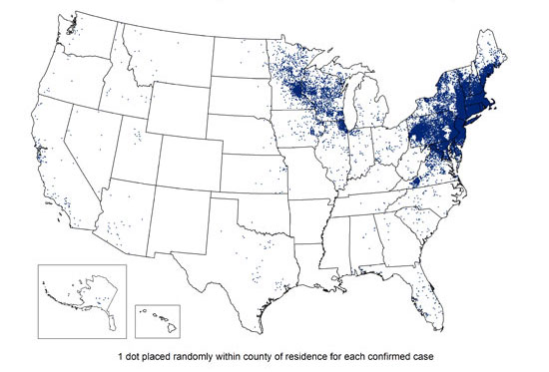
Reported Cases of Lyme Disease - United States, 2013
Image courtesy of CDC
Notes:
Depicted here is the geographic incidence of human Lyme disease in the United States in 2013. Zones of human Lyme disease activity have expanded from where they initially occurred in the Northeastern and North Central United States. Currently, approximately 30,000 cases of Lyme disease are reported in people each year in the US. Virginia is now on the front line of this expansion.

Slide 83
Lyme Disease Incidence in Virginia,
1990 - 2014
Notes:
Since 2000, Virginia has seen a steady increase in its annual number of newly identified Lyme disease cases. In 2007, Lyme disease increased dramatically and has remained high since that time. Virginia’s recent increase in Lyme disease incidence has coincided with a progressive geographic spread of activity southward and westward from northern regions of the state.
In 2010, 1,245 new Lyme disease cases were reported to Virginia Department of Health. This is an estimated 30% increase over what was counted in 2009. The increased case rate in 2010 can be attributed to multiple factors including the improved Lyme disease reporting practices by Virginia’s healthcare providers. Since then, Virginia has continued to report a statewide incidence rate of between 12 and 17 cases/100,000.

Slide 84
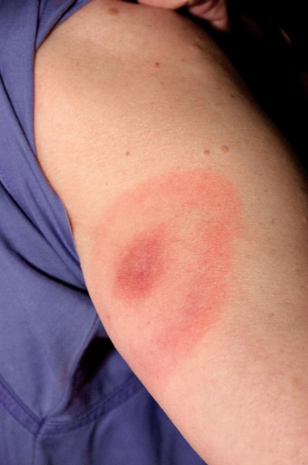
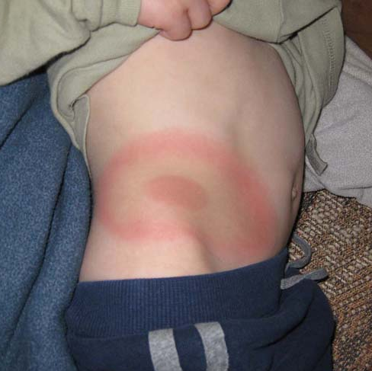
Lyme Disease: Human
Bull’s Eye rash
Fatigue
Fever
Joint or muscle aches
Headache
Swollen glands
Images courtesy of CDC
Image courtesy of Virginia Department of Health
Notes:
Learning the early signs of Lyme disease facilitates its recognition, treatment, and cure. The most recognizable early sign of Lyme disease is the erythema migrans rash, also known as the EM rash or bull’s-eye rash. Most people infected with Lyme disease will develop an EM rash. EM rashes cause little or no sensation or pain, so if the EM rash is on a person’s back side or scalp, it may go unnoticed. Recognizing these symptoms early is important so that early treatment can be initiated in order to prevent onset of later, the more severe manifestations of disease like radiculoneuropathy, Bell’s palsy or atrioventricular block.
As depicted in the image in the lower left hand corner, the EM rash presents as darker colored rings on African Americans or persons with darker skin color. Other early signs of Lyme disease may include: fatigue, fever, headache, joint or muscle aches, and swollen glands. Multiple EM rashes (as shown in the top left) may appear as the early localized infection begins to disseminate.

Slide 85
Lyme Disease: Animals
Dogs may develop illness that includes lameness, fever, anorexia, myalgia and lethargy
Cats may develop arthritis (rare)
Horses may develop illness, but disease in this species is poorly understood at this time
Notes:
Other than humans, dogs are the animal that is most likely to manifest clinical signs of Lyme disease. There have been rare reports in cats. Horses may develop illness, however, this disease in that species is poorly understood at this point.

Slide 86
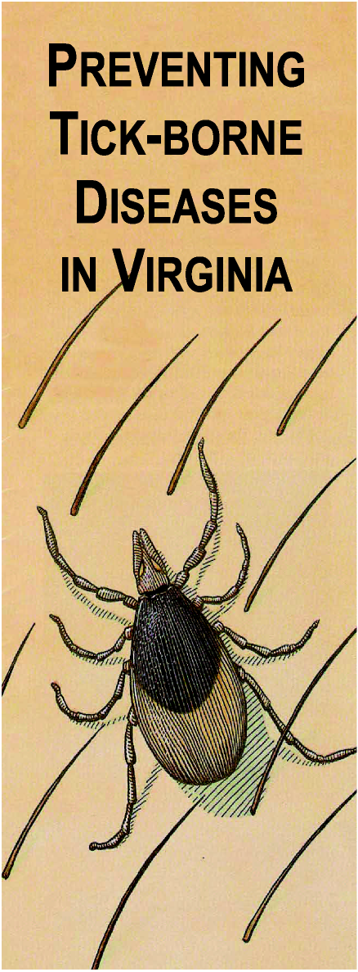
Lyme Disease: Prevention
1. Recognize tick habitats
2. Dress appropriately
3. Use repellents
4. Do tick checks
5. Remove ticks
Image courtesy of Virginia Department of Health
Notes:
Because it is not currently economically or technically possible to eliminate tick or deer populations in Virginia, VDH must work to prevent Lyme disease through educational outreach.
The best currently available method for preventing infection with B. burgdorferi and other tick transmitted pathogens is to avoid exposure to vector ticks. If exposure to ticks is unavoidable, measures recommended to reduce the risk of infection include: the use of both protective clothing and tick repellents, checking the entire body for ticks daily, prompt removal of attached ticks before transmission of disease agents can occur, and knowledge of the early signs of Lyme disease and other tick-borne diseases.

Slide 87
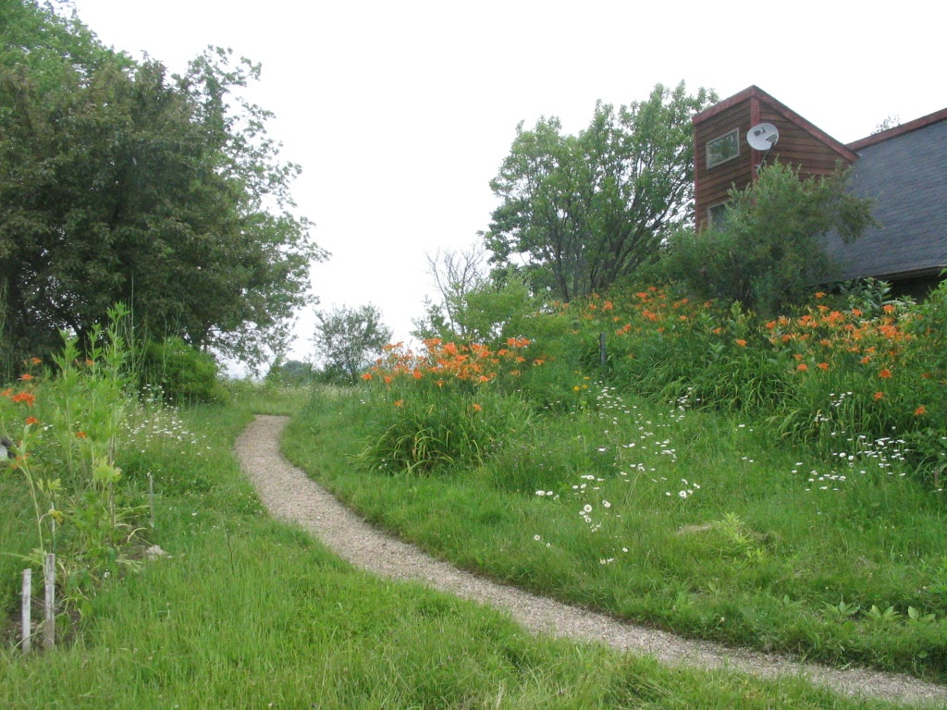
1. Recognize Tick Habitats
Images courtesy of Virginia Department of Health
Notes:
Blacklegged ticks are forest creatures. They are not normally found in open fields. Recognize tick habitats and task the appropriate precautions when entering into a tick habitat. Tick habitats include leaf litter areas in shady forest environments; tall weeds, grass, brush and leaf litter along forest trails and forest margins; and wood piles, rock piles, and stone walls that provide cover for rodents and ticks.

Slide 88
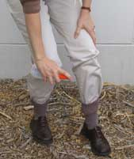
2. Dress Appropriately
Light colors
Tucked and buttoned
Prompt clothing removal
Launder with hot water and high heat
Image courtesy of Virginia Department of Health
Notes:
Appropriate dress includes wearing light colored clothing. Dark colored blacklegged ticks are easier to spot and remove from light colored clothing.
Tuck pants legs into socks and shirts into pants. Ticks typically get on a person’s feet first and crawl up the leg. If pants are tucked into socks, the ticks will be forced to crawl up the outside of the pants where they can be seen and removed. If a shirt is tucked into pants, the ticks will have limited access to skin on the belly, back, or chest. Button shirt and long sleeves to prevent easy access to the body and arms by ticks. If clothing is treated with a tick repellent containing permethrin, ticks that cross that clothing and eventually encounter some skin will not feel well enough to bite at that point.
It is important to remove clothing immediately upon return from a tick habitat to prevent carrying ticks around the house. Also, clothing worn outdoors should be laundered in hot water and dried on high heat. This step will kill any ticks that remain on clothing.

Slide 89
3. Use Insect Repellents
Image courtesy of Virginia Department of Health
Notes:
There are a variety of different repellent products for use on skin, and a variety of repellent active ingredients that are known as effective in repelling ticks. Those active ingredients include DEET, Picaridin, IR3535, 2-Undecanone, and oil of lemon eucalyptus. Different products may contain one or another active ingredient, so it is necessary to look on the active ingredients section of the repellent label to chose a repellent with your preferred active ingredient.
For treatment of clothing, socks and shoes, use Permethrin. Clothing repellents containing Permethrin may last up through 6-7 laundry cycles and do not stain clothes. Permethrin should not be used on skin. Ticks usually access the feet initially; therefore, treating shoes and socks will repel most ticks (although called a repellent permethrin does not repel the ticks, it just makes them feel too ill to feed after they have crossed treated clothing).
It is important to follow label instructions on any repellent package, and exercise particular care when applying repellents to children.

Slide 90
4. Do a Tick Check
Take a bath or shower
Use mirror if needed
Pay special attention to children
Image courtesy of Virginia Department of Health
Notes:
On returning from potential tick habitats it is important to promptly take a bath or shower and wash with soap and hot water. This will wash away any unattached ticks. Request assistance from a spouse or friend to check self for ticks, or use a full length mirror and/or a hand mirror.
It is important to thoroughly examine children after they have been in tick habitats. The sooner ticks are found and removed, the less likely they are to transmit disease. Blacklegged ticks require a minimum of 36 hours attachment before Lyme disease transmission may occur.

Slide 91
5. Remove Ticks Promptly
Images courtesy of Virginia Department of Health
Use pointed tweezers to grasp the tick by the head; do not squeeze its body!
Pull slowly and steadily until the tick releases; do not jerk or twist the tick.
Notes:
It is important to remove ticks promptly. Careful tick removal reduces the chance of disease transmission.
Use pointed tweezers to grasp the tick by the head. Do not squeeze or rupture the tick’s body. Removal must be done carefully to prevent tick from regurgitating into the wound. Pull slowly and steadily until the tick releases. Do not jerk or twist the tick out as this may cause tick mouthparts to break off and remain in the wound.
We recommend saving the tick in a jar of alcohol so it can be properly identified. VDH central office in Richmond can assist with identifying the tick if needed. A “Tick Identification Chart” can also be obtained on the VDH website to help identify the tick species.

Slide 92
Vector-borne disease resources
www.cdc.gov/ncezid/dvbd/
www.cdc.gov/lyme/
www.vdh.virginia.gov/epidemiology/DEE/Vectorborne/
Notes:
Resources for additional information about vectorborne diseases can be found at these websites.

Slide 93
Zoonotic Disease References
www.cdc.gov
http://www.cdc.gov/healthypets/index.html
http://www.cdc.gov/healthypets/specific-groups/index.html
www.vdh.virginia.gov
www.vdh.virginia.gov/Epidemiology/DEE/
Notes:
Additional information about zoonotic diseases can be found via these websites.

Slide 94
Zoonotic Disease References
Control of Communicable Diseases Manual
Available through the American Public Health Association (www.aphabookstore.org)
Zoonoses and Communicable Diseases Common to Man and Animals, 3rd edition
www.paho.org
Notes:
Additional information about zoonotic diseases can be found via these resources.

Slide 95
Zoonotic Disease References
www.nasphv.org
Animal Contact Compendia
Animal Rabies Compendium
Psittacosis Compendium
Veterinary Standard Precautions Compendium
Model Infection Control Plan for Veterinary Practices (MS Word)
Notes:
Additional information about zoonotic diseases can be found via these resources.

Slide 96
Zoonotic Disease References
www.cfsph.iastate.edu/
Iowa State Center for Food Safety and Public Health
www.avma.org
Public Health section
Notes:
Additional information about zoonotic diseases can be found via these websites.

Slide 97
Questions?

