Slide 1
Rabies: Overview of Epidemiology, Exposure Response and Law
Julia Murphy, DVM, MS, DACVPM
State Public Health Veterinarian
Office of Epidemiology
Virginia Department of Health

Slide 2
Rabies History

Slide 3
Rabies History
A recognized disease as early as 2300 BC
Aristotle wrote about rabies in 322 BC
Saliva of rabid dogs was recognized as “venomous” in the 1st century AD

Slide 4
Rabies History, US
First documented case in US
Virginia, 1753
Colonial times-1950s
Dogs highest vector risk
1960s-today
Wildlife greatest reservoir

Slide 5
Rabies History, Virginia
Raccoon rabies:
Noticed in FL in mid 50s
Spread to VA in 1970s
Seen everywhere but sw VA
Skunk rabies
Present in low levels in sw VA since 1960s
Notes:
Raccoons recognized as a reservoir for rabies in the southeastern US since the 1950s. An outbreak that began during the late 1970s in the mid-Atlantic states was attributed to people translocating infected raccoons from the Southeast US. Although identifiable as separate foci prior to 1994, the mid-Atlantic and southeastern foci have merged. Raccoon rabies is now enzootic in all of the eastern coastal states. Skunks are also one of the recognized reservoirs of rabies in Virginia and has been present in low levels in extreme southwest Virginia since the 1960s.

Slide 6
Why rabies?
~20,000 – 40,000 people undergo rabies prophylaxis each year in US
Infection is almost always fatal
Public health costs (detection, prevention, control) > $300,000,000 annually in U.S.
Rabies is endemic in Virginia
Notes:
As many as 40,000 people undergo rabies post-exposure prophylaxis in the US each year. Once people become clinically ill with rabies the infection is almost always fatal. The costs associated with rabies control, prevention and detection in the US are estimated at over 300 million dollars per year.

Slide 7
Rabies: Presentation outline

Slide 8
Rabies - Outline
Virus
Disease and diagnosis
Variants
Animal epidemiology – US and VA
Human epidemiology – US and VA
Rabies control and exposure response
Rabies laws in the Code of Virginia
Notes:
Outline of topics to be discussed in this presentation are outlined above.

Slide 9
Rabies: Virus characteristics

Slide 10
Rabies Virus
Only affects mammals
Inactivated by drying, high temperatures, sunlight, most disinfectants
Survives freezing
Found in wet saliva and central nervous system tissue of infected mammals
Image courtesy of CDC
Notes:
Rabies is a rhabodvirus that only infects mammals. Rabies is not a particularly hardy virus outside of a living host especially in the face of drying, high temperatures, UV light and most disinfectants. It does, however, survive freezing. The two body materials that are infectious in mammals infected with rabies are wet saliva and central nervous system tissue (ie brain and spinal cord).

Slide 11
Rabies: Disease and diagnosis

Slide 12
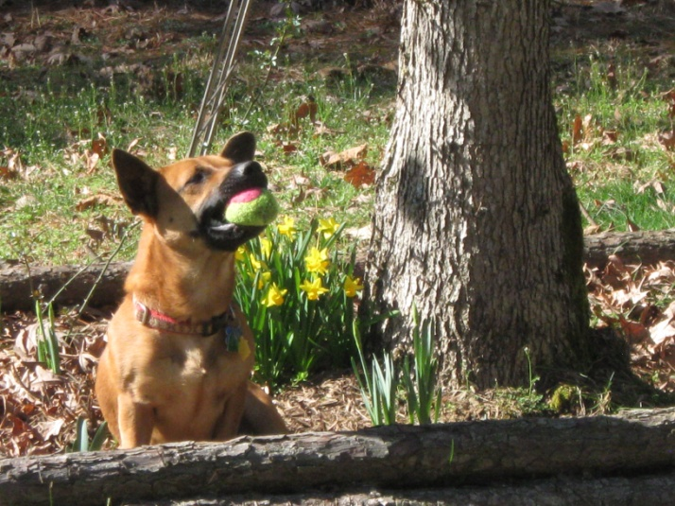
Rabies Virus - Transmission
Most commonly through the bite and virus-containing saliva of an infected animal
Virus can not enter intact skin
Other possible routes
Contamination of mucous membranes
Scratches - only if contaminated with wet saliva or CNS material
Aerosol
Transplantation
Notes:
Rabies is most commonly transmitted through a bite, however, other possible routes of exposure include contamination of mucus membranes (eyes, nose and mouth) with wet saliva or central nervous system tissue or getting wet saliva or central nervous system tissue in a fresh, open wound. Transplantation of organs from a person infected with rabies has also been documented as a route of infection and, rarely, aerosol transmission is a possible route of infection. The touching or handling of a potentially rabid animal or another animal or inanimate object that had contact with a rabid animal does not constitute an exposure unless wet saliva or CNS material from the potentially rabid animal entered a fresh, open wound or had contact with a mucous membrane. The virus cannot enter intact skin.

Slide 13
Rabies virus-Pathogenesis
Virus enters the body
Virus enters NM junctions
Travels via peripheral nerves to
spinal cord
Then to brain stem and forebrain
Notes:
When rabies virus enters the body it will travel via the peripheral nerves to the central nervous system. Typically this involves the rabies virus traveling up the spinal cord into the brain.

Slide 14
Rabies – signs and symptoms in animals
Clinical presentation is variable
Early – vague, nonspecific
Behavioral – more or less aggressive, vocalization
Physical – appetite loss, paralysis, seizures, coma, death
Behavior or physical signs or symptoms that are clearly abnormal
Notes:
Clinical presentation may vary within and among species. The early signs/symptoms of rabies may be vague, however, the illness will progress quickly. Typically, once most animals start exhibiting clinical signs of rabies, they die quickly.

Slide 15
Rabies-Symptoms in Humans
Initial clinical symptoms include anxiety, headache, mild fever, irritation at bite site
Progresses to muscle spasms, difficulty swallowing, hydrophobia
Clinical course is typically short
Notes:
Rabies progresses in a similar way in humans. People may have vague symptoms at first, but within a short time (i.e. typically within a week) they become obviously very ill and require hospitalization.

Slide 16
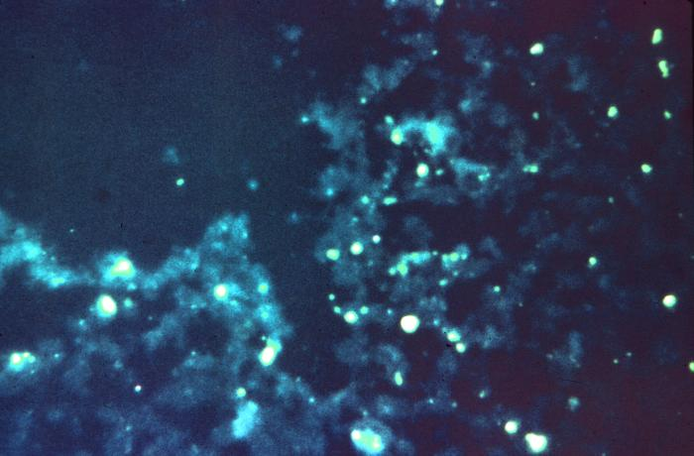
Rabies Diagnosis in Animals
Postmortem test
Samples should be refrigerated and submitted to the state laboratory
Results available in about 24 hours
Results reported to local health department
Image courtesy of CDC
Notes:
The diagnosis of rabies in animals is made postmortem. In Virginia, samples for rabies testing are submitted via the local health department and are then tested via the state laboratory or, for samples submitted to the Fairfax County Health Department, the Fairfax County public health laboratory. Results are then typically available in about 24 hours and are reported to the submitting health department.

Slide 17
How is testing performed?
No accurate test exists for examining live non-primate animals for rabies infection
Animal necropsy of optimal parts:
Brain stem or medulla oblongata,
Cerebellum,
Hippocampus or Ammon’s Horn
Notes:
Testing multiple parts of the brain is the most accurate way to determine whether the animal submitted for testing was infected with rabies and whether it may have infected anyone coming in contact with it. In the insert you see a bat whose brain (on the tongue depressor) has been removed and is about to be undergo the testing process.
1st step in testing is obtain the optimal portions of the specimen’s brain for testing. These three areas are where the rabies virus has been scientifically shown to most likely replicate in the later stages of infection. As the virus infects its host, it travels up the spinal cord and enters the brain at the medulla. At this point the infected host is beginning to exhibit nervous disease symptoms.
No accurate test exists for examining live non-primate animals for rabies infection
There are ante mortem tests available for people that can be used to support the differential of rabies although in the absence of a positive ante mortem test, the diagnosis may need to be confirmed via testing of brain tissue.

Slide 18
Direct Fluorescent Antibody Test for Rabies Virus
May be used on fresh or decomposed tissue
Produces sensitive and rapid results
Considered the most reliable of all available technologies
Daily quality control steps assure accuracy
Notes:
The principle behind the direct fluorescent antibody (or DFA) technique is really a very simple one and helps in the understanding of why this diagnostic technique has stood the test of time.
An Antibody is a natural protein produced by a animal in response to a specific foreign substance, such a bacteria or virus, invading its body. This specifically-produced antibody seeks to combine with the foreign substance [sometimes called an antigen] and help eliminate it from the body through a multi-step process. The DFA test takes advantage of this scientific fact that antibodies and antigens combine and uses the principle to detect specific antigen in a specimen’s tissue.
Antibodies against specific antigens are made and tagged with a compound able to adsorb light and give off its energy at a higher wavelength. Tested tissue containing these specific antigen-antibody combinations tagged in such manner appear apple-green in color under a special microscope.

Slide 19
Rabies virus variants

Slide 20
Rabies virus variants, US
Raccoon
Fox
3 variants
Skunk
3 variants
Bat
Multiple variants
Mongoose
Any variant can infect any species
Majority of animals diagnosed with the raccoon variant each year
Notes:
There are multiple variants of the rabies virus that are maintained in the environment in the US via raccoons, skunks, foxes and bats. There is also a rabies virus variant found in mongoose which is endemic to Puerto Rico. Variants are named after the species that maintain that variant in circulation in the wild. Any variant, however, can infect any species. The majority of animals laboratory confirmed with rabies in the US every year are diagnosed with the raccoon variant of the rabies virus.

Slide 21
Rabies Virus - Variants
Associated with certain animal species
Associated with certain geographic areas (except bats)
Spillover to other species
Vaccines protect against all variants
Notes:
Variants are associated with certain geographic areas, except for the variants maintained in nature by bats. Any variant can infect any mammal and the vaccines for rabies protect against all variants. Knowing the variants present in an area may influence which animals will be considered high risk species for rabies in that region or state.

Slide 22
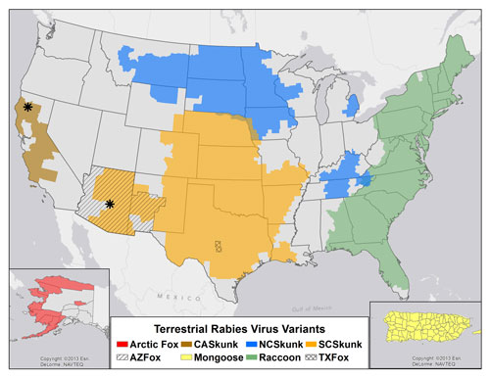
Distribution of Major Terrestrial Reservoirs of Rabies in the United States and Puerto Rico, 2013
Image courtesy of CDC
Notes:
Shown here is a map that details the distribution of major terrestrial rabies virus variants in the US

Slide 23
Rabies Virus Variants, VA
Two terrestrial wildlife rabies variants – raccoon and skunk
Spillover to other wild and domestic animals
Raccoon – endemic in most areas with cycling
Skunk – confined to southwest VA
Multiple bat variants
Occasional spillover
Notes:
In Virginia, 2 terrestrial mammal variants (raccoon and skunk) and multiple bat variants are endemic. Most animals laboratory confirmed with rabies in Virginia, regardless of species, will be diagnosed with the raccoon variant.

Slide 24
Rabies: Animal epidemiology and exposure risk

Slide 25
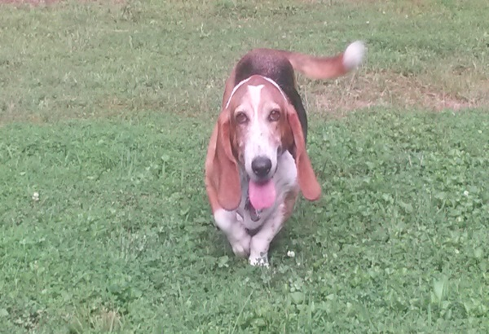
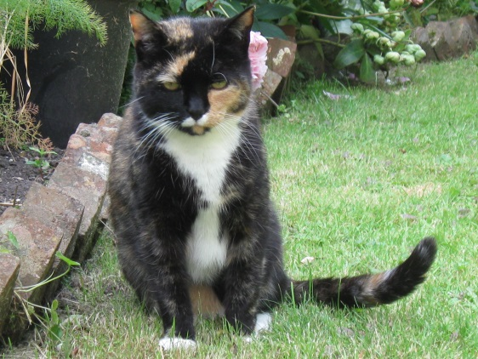
Dogs, cats, ferrets
The time between when a dog, cat or ferret is bitten and when that animal will show signs of disease has been studied with 6 months accepted as the upper limit
Typically 1-2 months, but can be as short as 10 days or as long as 6 months
Notes:
While any mammal can become ill with rabies, not all mammals are associated with the same risk of transmitting rabies and we have more information in some species than others in regard to how rabies manifests itself. For instance, the time between when a dog, cat or ferret is bitten and when that animal will show signs of disease has been established. Typically a dog, cat or ferret will start acting ill with clinical signs of rabies between 1 and 2 months after a dog, cat or ferret has been exposed to rabies. While a dog cat or ferret is incubating rabies, they are not shedding the virus in their saliva. It is only very close to the time when a dog, cat or ferret becomes ill with rabies and while they are symptomatic, that they are shedding the virus in their saliva.

Slide 26
Dogs, cats, ferrets
The time between when a dog, cat or ferret starts shedding virus in its saliva and when that animal starts acting sick and then dies is also well established
Typically a dog, cat or ferret will start shedding the virus in its saliva the same day it starts acting sick and will only live for a couple of days after that (may live as long as 8 days)
Notes:
Our knowledge of when a dog, cat or ferret will start shedding the virus in association with when that dog, cat or ferret will begin acting ill is also well known and that is why we have a definitive observation period for these animals if one of these animals bites a person (we would confine and observe for 10 days).

Slide 27
Rabies Shedding-Other Animals
For animals other than dogs, cats and ferrets, we do not know a definitive time period between when they start shedding the virus and when they start acting sick
This is why the only definitive observation times we have are for dogs, cats and ferrets
Notes:
For animals other than dogs, cats and ferrets, a definitive shedding period in relation to when that animal will become obviously ill with signs of rabies has not been established. This is why the only definitive observation period we have is for dogs, cats and ferrets. This does not mean that we respond to bites from any other animal species the same way, it is just that dogs, cats and ferrets are the only animals form which we have a definitive observation period.

Slide 28
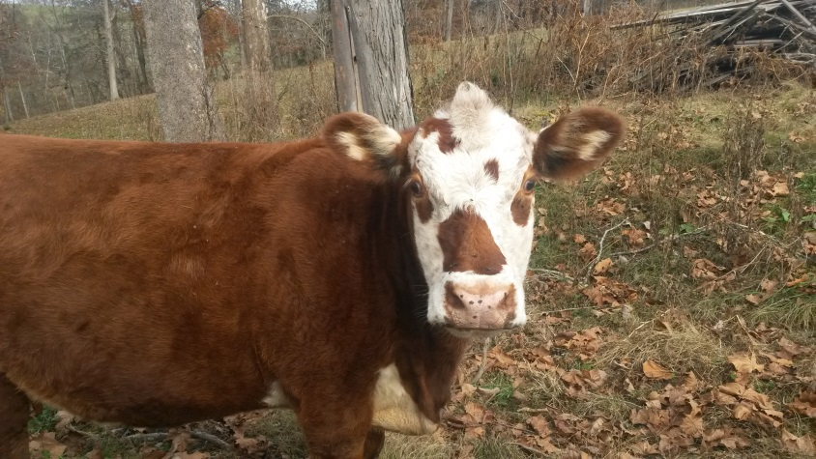
Rabies – risk of transmission by animal type
High risk
Carnivores (raccoons, skunks, foxes)
Large rodents (e.g., groundhogs in raccoon variant areas)
Opossums (in raccoon variant endemic areas)
Bats
Low risk
Small rodents (e.g., squirrels, chipmunks)
Rabbits, hares
Evaluate circumstances
Exotic animals/hybrids
Livestock
Notes:
While any mammal can become ill with rabies, there are certain animals we recognize as high risk for exposing people and domestic animals to rabies because they are often diagnosed with rabies and they are species that help maintain rabies in the environment. These animals include raccoons, foxes, skunks and bats. Bats are considered high risk not because a great percentage of bats tested every year are positive, but because the majority of human cases in the US in recent years have been diagnosed with a bat variant of the rabies virus. This is why there are some special considerations in regard to potential exposure to rabies via a bat. Historically, more opossums and larger rodents like groundhogs have been diagnosed with rabies in raccoon variant endemic areas than in areas of the country that are not endemic for that variant of the virus. That is why we consider opossums and large rodents like groundhogs in the high risk category in Virginia.
Also, there are animals that we consider low risk because they are rarely diagnosed with rabies and unless they are acting ill or oddly at the time when they bite someone, we would not considered them a source for rabies. These animals include small rodent and rabbits. The response to domestic animals other than dogs, cats and ferrets and the response to exotic animals that bite people is on a case by case basis and may include an observation period to help assess the need for any further concern about rabies exposure. For instance, while we do not have a definitive observation period for livestock, based on what we do know about livestock and rabies, it is not unusual for us to apply an observation time to livestock when those animals bite people.

Slide 29
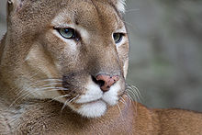
Rabies Risk by Animal Type
For those animals for which no observation time has been established and do not fit into either a distinctly high risk or low risk category, the response is based on consideration of a number of factors including the scientific family of the animal, circumstances of exposure, how the animal is housed and/or health of animal.
Notes:
For those animals for which no observation time has been established and do not fit into either a distinctly high risk or low risk category, the response is based on consideration of a number of factors including the scientific family of the animal, circumstances of exposure, how the animal is housed and/or health of animal. For instance, we would likely respond to a bite from a degus (a small, exotic rodent) the same way we would to a chipmunk bite, however, if someone was bitten by a kinkajou (a mammal in the same scientific family as the raccoon) we would likely use a high risk species for rabies as our model of response.

Slide 30
Rabies - Animal Epidemiology
Photo courtesy of DGIF

Slide 31
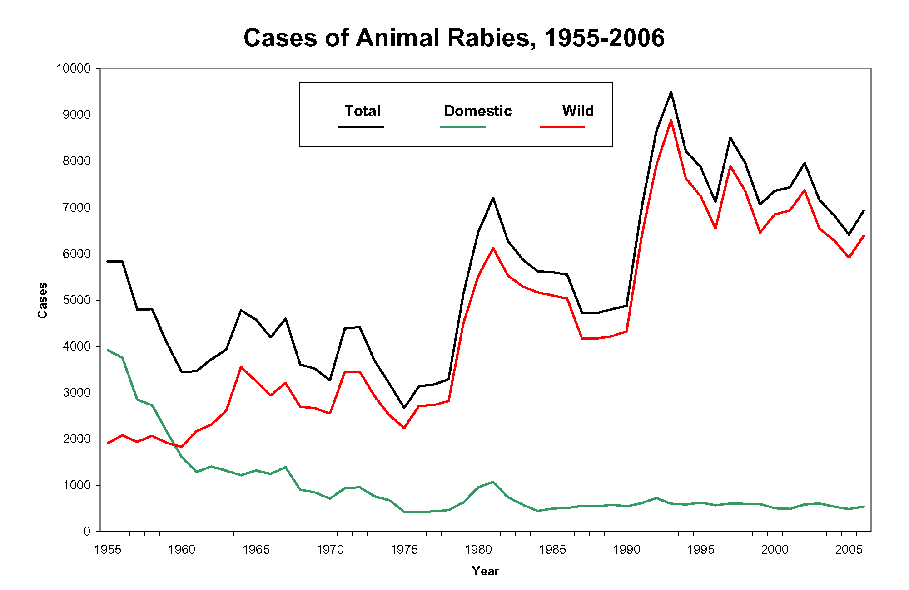
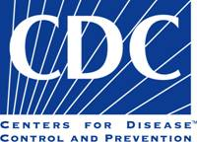
Rabies - Animal Epidemiology
Notes:
This chart depicts the general trends of laboratory confirmed cases of rabies in animals in the US. In the United States and other developed countries, rabies is primarily a disease that affects and is maintained by wildlife populations.
Rabies control programs, including extensive vaccination campaigns, implemented during the 1940s and 1950s resulted in a substantial decline of rabies in domestic animals in the US and all but eliminated the circulation of canine variants of the rabies virus in dogs by the 1960s and since 2004, no rabies case attributable to an indigenously acquired canine rabies virus variant has been reported.

Slide 32
Rabies – Wild Animal Epidemiology, US
Photos courtesy of CDC

Slide 33
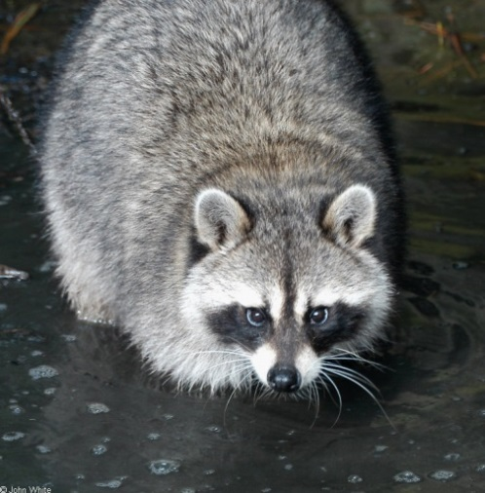
Wild Animal Rabies Epidemiology, US
Wildlife have accounted for > 90% of reported rabid animals in the United States since 1980
Raccoons, skunks, foxes and bats make up the bulk of rabid animals reported each year
Raccoons are the most
commonly diagnosed
species in Virginia
Photo courtesy of DGIF

Slide 34
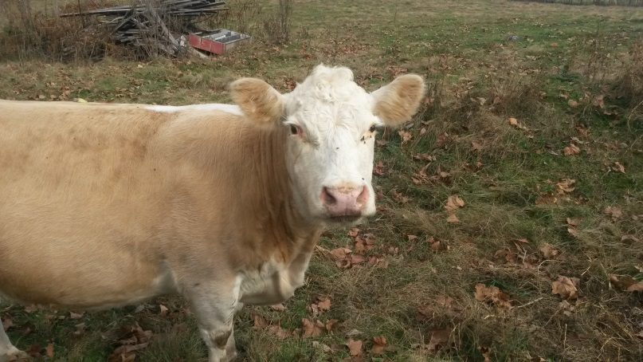
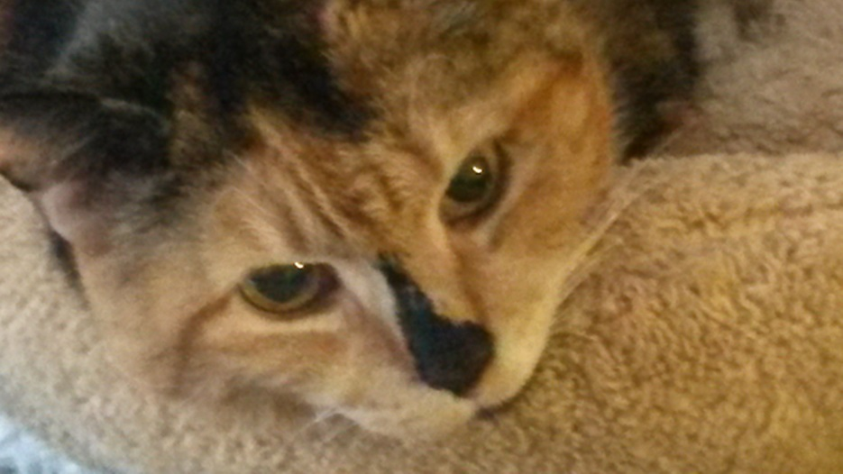
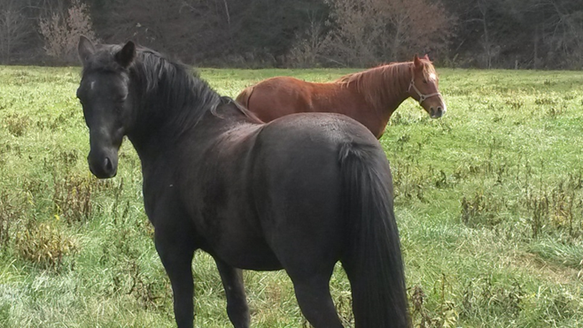
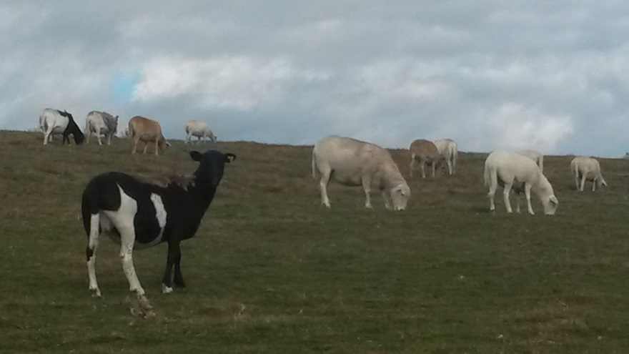
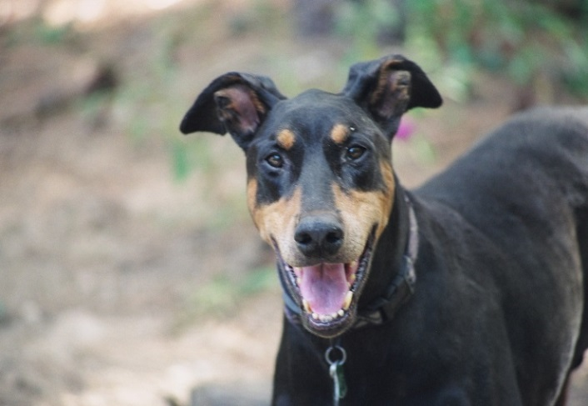
Rabies - Domestic Animal Epidemiology, US

Slide 35
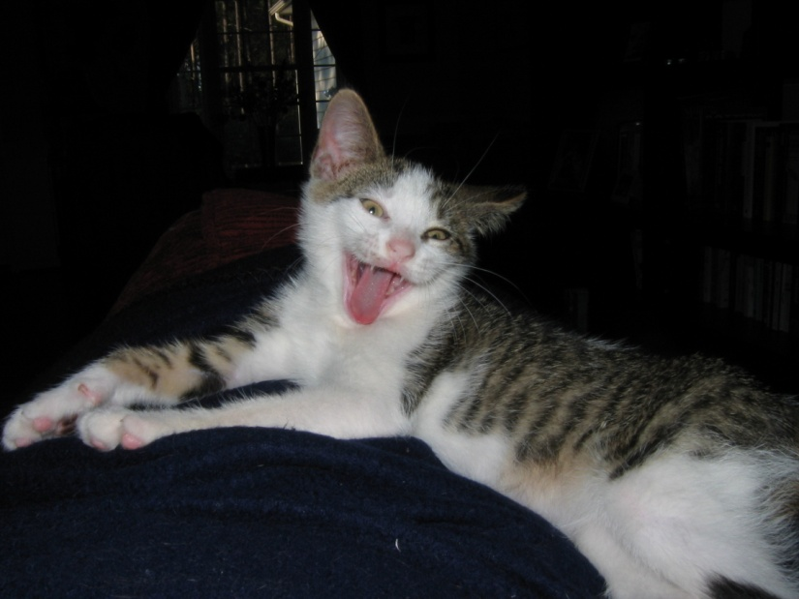
Domestic Animal Rabies Epidemiology, US
Domestic animals typically make up less than 10% of the total number of animals diagnosed with rabies each year in the US
Cats are the domestic animal most commonly diagnosed with rabies

Slide 36
Rabies Animal Epidemiology, Virginia
Two terrestrial wildlife rabies variants – raccoon and skunk
Spillover to other wild and domestic animals
Raccoon – endemic in most areas with cycling
Skunk – confined to southwest VA
Multiple bat variants
Occasional spillover
Notes:
In Virginia, 2 terrestrial mammal variants (raccoon and skunk) and multiple bat variants are endemic.

Slide 37
Animal Rabies Statistics VA, 2013-2015*
Animal | 2013 | 2014 | 2015
Raccoon | 249 | 236 | 263
Skunk | 115 | 162 | 121
Fox | 55 | 45 | 41
Bat | 16 | 23 | 15
Dog | 1 | 1 | 5
Cat | 37 | 28 | 38
Cow | 9 | 12 | 20
Horse | 0 | 0 | 3
*Statistics typically also include otter, coyote, deer, donkey, goat, badger, squirrel, pig, mongoose and other mammals

Slide 38
Rabies: Human epidemiology

Slide 39
Human Rabies Epidemiology, US
34 cases, 2003–13
20 infected with a bat variant
Some with exact exposure unknown
Foreign travel to countries where domestic animal rabies is more common is also a risk factor
Notes:
From 2003-2013, 34 cases of human rabies have been reported in this country, about 60% of whom were diagnosed with a bat variant of the virus. For US citizens, bat exposure and travel to a country where domestic animal rabies is common are the most common risk factors for illness.

Slide 40
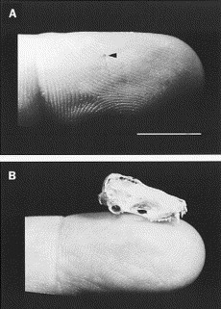
Human Rabies Epidemiology, Virginia Cases
1953 – veterinary hospital worker
Unknown exposure
1998 – prisoner in work program
Unknown exposure
Pipistrel/silver-haired bat variant
2003 – office worker
Unknown exposure
Raccoon variant
2009 – traveler to India
Exposed to dog
Image courtesy of CDC
Notes:
Four cases of human rabies have been reported in Virginia since the 1950s.

Slide 41
Rabies: Control and exposure response

Slide 42
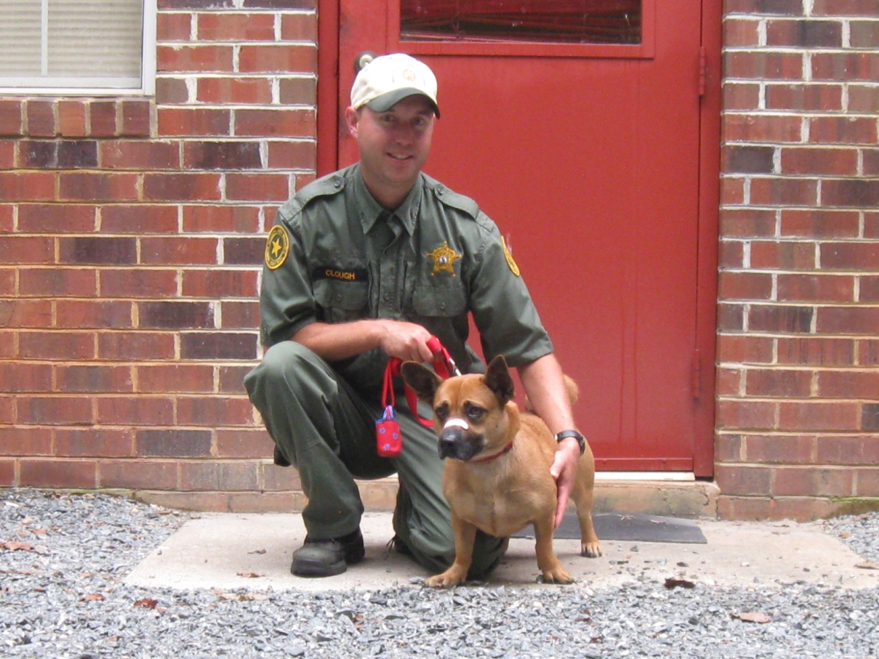
Rabies Control – Domestic Animals and Humans
Animal and human vaccination
Animal control
Pre- and postexposure management
Notes:
An important part of preventing rabies in people is preventing rabies in the domestic animal population. In addition, prompt responses to both human and domestic animal exposures and preemptive vaccination of both certain populations of people and animals is also important.

Slide 43
Rabies Control – Domestic Animal Vaccination
Virginia code requires dogs and cats to be vaccinated by 4 months of age
Booster dose given 1 year after initial vaccination
Thereafter, should vaccinate every year or every 3 years, depending on vaccine type
Encourage use of 3 year vaccine
Notes:
Virginia law requires that all dogs and cats 4 months of age and older are vaccinated for rabies and kept current. Using a vaccine labeled for 3 years duration is an effective way of increasing the proportion of immunized dogs and cats in any population.

Slide 44
Rabies Control – Domestic Animal Vaccination
Virginia code requires vaccine administration by currently licensed veterinarian or licensed veterinary technician under direct supervision
Veterinarians must practice in a licensed facility
Exception – rabies clinics outside licensed facility
Require the approval by the appropriate local health department and governing body
Governing body shall ensure a clinic is conducted at least once every 2 years
Notes:
The Code of Virginia also requires that rabies vaccines are administered by a veterinarian or by a licensed veterinary technician under direct supervision of a veterinarian. Veterinarians must practice in a licensed facility. Rabies clinics may be held outside of a licensed veterinary facility provided the local government has approved the clinic.
Excerpt from Code of Virginia section 3.2-6521: “All rabies clinics require the approval by the appropriate local health department and governing body. The licensed veterinarian who administers rabies vaccinations at the clinic shall (i) provide the owner or custodian a rabies vaccination certificate for each vaccinated animal and (ii) ensure that a licensed veterinary facility retains a copy of the rabies vaccination certificate. The sponsoring organization of a rabies clinic shall, upon the request of the owner or custodian, an animal control officer, a humane investigator, a law-enforcement officer, a State Veterinarian's representative, a licensed veterinarian, or an official of the Department of Health, provide the name and contact information of the licensed veterinary facility where a copy of the rabies vaccination certificate is retained. However, the county or city shall ensure that a clinic is conducted to serve its jurisdiction at least once every two years.”

Slide 45
Rabies Control – Human
What constitutes an exposure?
Any bite, scratch, or other situation where saliva or central nervous system tissue from a potentially rabid animal enters an open fresh wound or contacts a mucous membrane by entering the eye, mouth, or nose
Photo courtesy of Grace Woo
Notes:
Assessing and responding to human exposures is an important part of controlling rabies infection in people. Any human exposures should be discussed with the health department. The touching or handling of a potentially rabid animal or another animal or inanimate object that had contact with a rabid animal does NOT constitute an exposure unless wet saliva or CNS material from the animal entered a fresh open wound or had contact with a mucous membrane. If a dog, cat or ferret bites a person, then the animal should be observed for clinical signs of rabies for 10 days and tested if clinical signs consistent with rabies become evident in that dog, cat or ferret. If a person meets our definition of exposure to a high risk species for rabies, that high risk species should either be tested for rabies (and the person undergo rabies post-exposure prophylaxis if the animal tests positive or status cannot be determined) or, if the animal is not available for testing, the person should undergo rabies post-exposure prophylaxis (PEP). If a person meets our definition of exposure to a low risk species for rabies, then the circumstances of the interaction that led to the potential exposure should be evaluated and, if the low risk animal was acting ill or oddly at the time of the exposure, that animal should be tested if available and a recommendation made to the bite victim in accordance with the results of testing. If an odd/ill acting low risk animal is not available for testing, then we would recommend rabies PEP for those people who meet our definition of exposure. If a low risk species was acting normally at the time of the exposure, we would not recommend either testing or rabies PEP.

Slide 46
Rabies Control – Human
Bat Exposure
Small bites; may go unrecognized
Always ideal to test bat if available
PEP indicated in response to:
1. Known bite
2. Direct contact and bite cannot be ruled out
3. Situations where exposure may have gone unrecognized like bat found in the same room as a sleeping or mentally impaired or very young person
Notes:
The definition we use to assess bat exposures differs from the definition we use for larger, terrestrial mammals. People may know when they have been bitten by a bat, but most types of bats have very small teeth which may leave marks that disappear quickly. Whenever possible, any bat involved in a potential exposure to rabies should be captured and sent to a laboratory for rabies testing.
We would assess someone as potentially exposed to rabies via a bat if one of three situations occurs: (i) a person is bitten by a bat and knows he’s been bitten (ii) if a person has direct, bare skinned contact with a bat and cannot be sure he wasn’t bitten or (iii) if a person wakes up because a bat landed on him while he was sleeping or if a person awakened to find a bat in his room. (The same precautions should be used if you see a bat in a room with an unattended child, or see a bat near a mentally impaired or intoxicated person.)
In all of the situations described above, it is ideal if the bat in question could be captured safely and tested for rabies. If the bat is not available for testing or tests positive, then we would recommend rabies PEP for those who we had assessed as meeting our definition of exposure.
People can’t get rabies just from seeing a bat in an attic, in a cave, at summer camp, or from a distance while it is flying. In addition, people can’t get rabies from having contact with bat guano (feces), blood, or urine, or from touching a bat on its fur.

Slide 47
Rabies Control-Human
Scratches:
A scratch should be evaluated like any other open wound, i.e. did saliva or some other virus containing material (cerebral spinal fluid, brain) contaminate the wound while it was fresh. A scratch in and of itself is not an exposure unless the paws were soaked with saliva, e.g., cat is salivating/drooling
profusely or paws are visibly wet.

Slide 48
Rabies Control – Domestic Animals
What constitutes an exposure?
Any circumstance where saliva or central nervous system tissue from a potentially rabid animal did have or could have had direct contact with mucous membranes or a break in the skin of a domestic animal
Note: The actual witnessing of a bite or attack by a potentially rabid animal is not required for an exposure to have occurred, however, a suspect needs to be witness in close proximity….
Notes:
The exposure definition for domestic animals is very similar to the one used for people. The main exception is that, in Virginia, we would also consider a domestic animal exposed if that animal is found in close proximity to a high risk or known positive animal where it is thought likely that contact occurred.

Slide 49
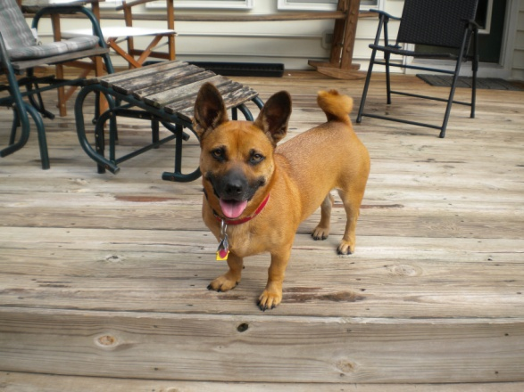
Rabies Control Guidelines for Humans
Human exposed to a dog, cat, or ferret
Any dog, cat, or ferret (vaccinated or unvaccinated) that bites a person must be confined for 10 days observation
Veterinary evaluation at first sign of illness
If thought to be rabies, euthanize and test
Do not vaccinate during confinement
Notes:
If a human is bitten by a dog, cat or ferret, that animal should be confined and observed for 10 days and evaluated by a veterinarian if illness occurs during the observation period. It is recommended that if a dog, cat or ferret (whether or not that dog, cat or ferret is current on its rabies vaccinations) bites a person, that dog, cat or ferret is confined and observed for 10 days. The dog, cat or ferret should be examined by a veterinarian if the animal becomes ill during the 10 day observation period and if clinical signs compatible with rabies have developed in that time, the dog, cat or ferret should be tested for rabies. If the dog, cat or ferret remains healthy throughout the 10 day observation period, then the animal can be released from confinement and the bite victim can be informed that no rabies PEP is necessary. It is recommended that dogs, cats and ferrets that are not current on their rabies vaccinations and need to be observed for 10 days, be vaccinated at the end of the confinement period in order to avoid confusing an adverse vaccine reaction with early clinical signs of rabies. Adverse vaccine reactions do not occur often, however, it is thought prudent to wait until the end of the confinement period, just to decrease the likelihood that a vaccine reaction could becomes a confounding factor during this time.

Slide 50
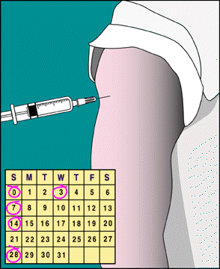
Rabies Control Guidelines for Humans
Pre exposure series
High risk occupations: DVMs, ACOs, LVTs
Antibody measurement every 2 years
Boosters if exposed or low titer (routine boosters not recommended)
Should not receive RIG
Post exposure series (for those
with no prior vaccination)
RIG plus 4 vaccinations
RIG plus 5 vaccinations in some pts.
Notes:
Vaccinations are available for people both for pre-exposure (this is recommended for people who are more likely to be exposed to rabies as part of their line of work) or post-exposure situations. People who are pre-exposure vaccinated should have antibody measurements every 2 years and receive one vaccine in response to a low antibody measurement or 2 vaccines 3 days apart of they are ever exposed to rabies. People who have never had rabies vaccine before, should receive rabies immune globulin (RIG) plus a series of 4 vaccinations if they are ever exposed. Some patients may still need RIG plus 5 vaccinations if they are immunocompromised.

Slide 51
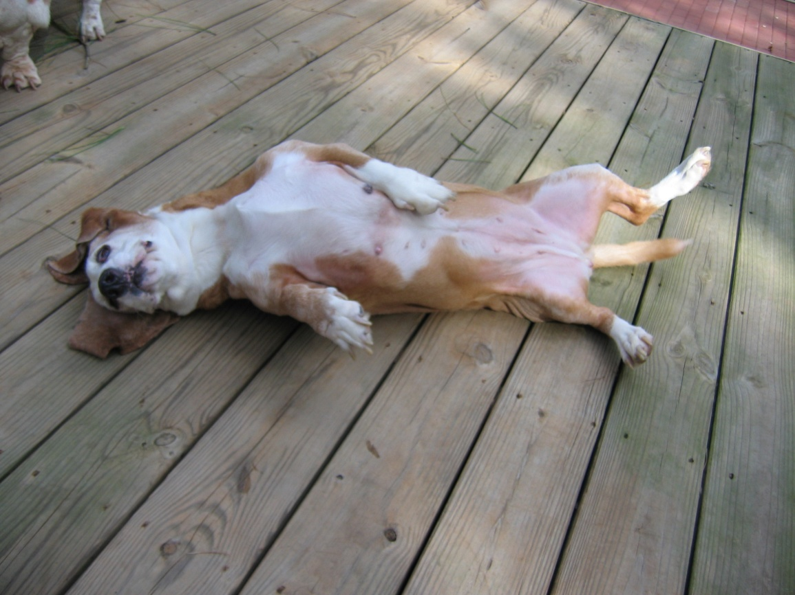
Domestic Animal Exposure
Confinement
House animal in a building, pen, or other escape-proof method or enclosure
Do not remove animal unless on leash and under control of responsible adult
Owner should notify Health Department at first sign of illness and take to veterinarian
Notes:
When dogs, cats or ferrets are exposed (dogs and cat are the most common domestic animals exposed) the health department will respond based on the vaccinations status of the dog, cat or ferret. If the rabies vaccinations status is current, the dog, cat or ferret should be given a booster does of vaccine and be placed in confinement the definition of which is seen here.

Slide 52
Domestic Animal Exposure
Strict isolation
House animal in a kennel at a veterinary hospital, animal control facility, commercial boarding establishment, or pen at home
Pen design should prevent direct contact between animal and human or other animal
Pen design should allow for feeding, watering, cleaning (see example in Guidelines)
District Health Director or designee should approve pen
Notes:
If a dog, cat or ferret meets our definition of exposure and has never been vaccinated, the animal should be placed in strict isolation the definition of which is seen here. In a situation where strict isolation will be used, the pen is to be approved by the health director or his designee and the pen is to be built by a date certain as determined by the local health director.

Slide 53
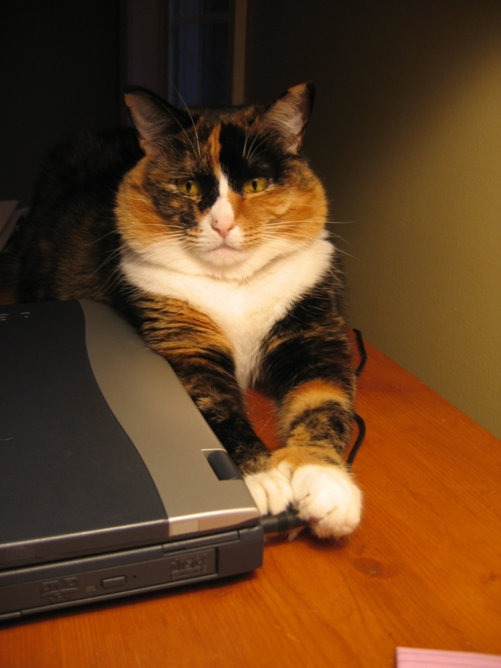
Domestic Animal Exposure
Vaccinated dog, cat, or ferret exposed to proven or suspected rabid animal
Should receive immediate booster of vaccine
Confine for 45 days observation
Veterinary evaluation at first
sign of illness
If thought to be rabies,
euthanize and test
Notes:
Procedure for vaccinated dog, cat and ferret exposed.

Slide 54
Domestic Animal Exposure
Unvaccinated dog, cat, or ferret exposed to proven or suspected rabid animal
If available, test exposing animal
If exposing animal unavailable or tests positive, the Code allows euthanize exposed animal or place in up to 6 months strict isolation; authority to isolate for less; current national guidelines recommend 4 months
Veterinary evaluation at first sign of illness
If thought to be rabies, euthanize and test
Vaccinate exposed animal before release from isolation
Notes:
Procedure for unvaccinated dog, cat and ferret exposed. The specific language in the Code of Virginia associated with the response when a dog or cat with no proof of current rabies vaccination meets the health department’s definition of exposure is in section 3.2-6522 and reads “Any dog or cat, for which no proof of current rabies vaccination is available, and that may have been exposed to rabies through a bite, or through saliva or central nervous system tissue, in a fresh open wound or mucous membrane, by an animal suspected to be rabid, shall be isolated in a pound, kennel, or enclosure approved by the local health department for a period not to exceed six months at the expense of the owner or custodian in a manner and by a date certain as determined by the local health director. A rabies vaccination shall be administered by a licensed veterinarian prior to release. Inactivated rabies vaccine may be administered at the beginning of isolation.” It is important to highlight and I have been discussing this with various health department for sometime when situations that may require a period of strict isolation come to my attention, that the Code instructs the health department to strict isolate for a period of time “not to exceed 6 months” which means we do have the authority to strict isolate for less than 6 months. It has always been VDH general policy to strict isolate for 6 months since it is very unlikely that a dog, cat or ferret will incubate for longer than that. However, the typical incubation time for dogs, cats and ferrets is 1-2 months which can be taken into consideration when making decisions about whether or not it is felt prudent to strict isolate for a full 6 months.

Slide 55
Domestic Animal Exposure
Dog, cat, or ferret with expired vaccination exposed to proven or suspected rabid animal
Immediate booster to exposed animal (unless euthanized)
If available, test exposing animal
If exposing animal unavailable, the Code allows for up to 6 months strict isolation for exposed animal, however, in most cases, boost and 45 days confinement will likely be recommended
Contact central office to discuss situations where vaccination is expired as procedure for current vaccinates may be used
Notes:
Procedure for expired vaccinate exposed.
The health department’s general guidance for some time has been that depending on factors such as the type of exposure, how recently the vaccination has expired and an animal’s vaccination history, the health department may decide to treat some expired vaccinates as currently vaccinated. In fact, while we have always treated these situations on a case by case basis and in some cases decided that proceeding with the protocol for currently vaccinated animals would be appropriate, based on some new research, it is likely that we will treat an increasing number of expired vaccinates using the same procedure as currently vaccinated animals that are exposed unless there is concern that an exposed animal is immunocompromised.

Slide 56
Domestic Animal Exposure
Livestock response similar to dog, cat and ferret if exposed to high risk species for rabies or carnivore confirmed with rabies
If the only rabid animal associated with a herd or flock is an herbivore, monitoring for a period of 30 days for additional rabid animals in the herd or flock should be sufficient
Herbivores are not efficient transmitters
Monitoring for exposures that occurred when index case was exposed
Notes:
We use a similar model for responding to livestock that are exposed to high risk species for rabies or laboratory confirmed rabid animal. The exception to this is that if the only rabid animal associated with a herd or flock is an herbivore, monitoring for a period of 30 days for additional rabid animals in the herd or flock should be sufficient to monitor the group for additional cases. Herbivores are not efficient transmitters of the rabies virus and so when these animals become ill with rabies, we are not worried that they are a source of rabies for their herd or flock mates, but we are monitoring the group to see if any other animals were similarly exposed when the index case was. In other words, the one herbivore that becomes rabid is a marker for the fact that a rabid animal exposed at least one member of the herd or flock sufficiently enough to cause disease. If that one herbivore has already gone through her incubation period and has become ill, then we are monitoring the group to see if any additional animals become ill. If any other animal in the herd or flock was similarly exposed when the index case was exposed, that other animal/those other animals should be roughly in the same stage/similar of her/their incubation period as the index case and should be showing clinical signs of disease relatively soon after the index case.

Slide 57
Rabies related laws in Virginia

Slide 58
Rabies related laws
Code of Virginia sections:
3.2-6521. Rabies inoculation of companion animals
3.2-6522. Rabid animals
3.2-6562.1 Rabies responsibility plan
18.2-313.1 Withholding information about a possibly rabid animal
54.1-3812. Release of records
www.virginia.gov to access Code of Virginia
Notes:
The main sections of the Code of Virginia are listed. An electronic version of the Code of Virginia can be accessed via www.virginia.gov

Slide 59
Rabies regulations
Rabies related Code sections modified and one section added as part of the 2010 General Assembly
Vaccine exemptions
The Board of Health, shall adopt regulations to implement the provisions of this act. Such regulations shall include a model plan that may be used by localities to comply with the requirements of § 3.2-6562.1 of this act.
Notes:
The amendments that were made to the Code of Virginia as part of the 2010 General Assembly session included language that now allows for rabies vaccine exemptions. In addition, the health department has been instructed to adopt regulations that, in part, create a mechanism or process of rabies vaccine exemptions and also include a model plan that localities can use all or in part to fulfill the requirements of new code section 3.2-6562.1 Rabies responsibility plan which was adopted by the General Assembly in 2010. These regulations are still in the approval process.

Slide 60
Rabies Regulations
Virginia Administrative Code
http://law.lis.virginia.gov/admincode/title12/agency5/chapter105
Definitions
Rabies Clinic Responsibilities
Model Plan
Exemption process
Guidance document developed
Standard application

Slide 61
Rabies Regulations
Definitions
Contains language in regard to “suspected rabid animal” whereby any animal to which an observation will be applied should be considered suspect until the end of that period of time
Rabies clinic records
Local health department to keep records associated with date, site, sponsoring organization and veterinarian associated with approved clinics

Slide 62
§ 3.2-6562.1. Rabies exposure; local authority and responsibility plan.
The local health director, in conjunction with the governing body of the locality, shall adopt a plan to control and respond to the risk of rabies exposure to persons and companion animals. Such plan shall set forth a procedure that promptly ensures the capture, confinement, isolation, or euthanasia of any animal that has exposed, or poses a risk of exposing, a person or companion animal to rabies. The plan shall identify the authority and responsibility of the local health department, law-enforcement officers, animal control officers, and any other persons with a duty to control or respond to a risk of rabies exposure. The plan shall provide for law-enforcement officers, animal control officers, and other persons to report to and be directed by the local health director for such purposes.
Notes:
Language of code section 3.2-6562.1 that speaks to the requirement of localities having a rabies responsibility plan.

Slide 63
Rabies Model Plan
Purpose
Parties to whom plan applies
Legal authority
Maintenance
Disclaimer
Memoranda of understanding
Attachments
Notes:
This slide details the sections in the proposed model plan and subsequent slides detail some of the language associated with responsibilities of animal control officers and health department personnel that is currently found in the model plan.

Slide 64
Model Plan Responsibilities
Animal control
Companion animal exposure assessment
Companion animal follow up
Communication with hd about companion animal illness, animals other than dogs, cats, ferrets and isolation situations
Facilitate submission of samples
Euthanasia of animals
Report potential human exposures to hd

Slide 65
Model Plan Responsibilities
Environmental health staff
Coordinate activities with animal control and communicate with animal control about animal vaccination status issues
Initiating contact with exposure victims
Notifying nursing staff and health director about human exposures and positive results
Coordinate submission of rabies samples
Documenting human and companion animal exposures

Slide 66
Model Plan Responsibilities
Nursing staff
Counseling exposure victims about rabies including discussing rabies PEP
Human exposure assessment
Maintain medical records of human exposure victim interactions/decisions
Notify human exposure victims about results of confinement

Slide 67
Model Plan Responsibilities
District epidemiologist
Coordinate records maintenance with nursing and EH staff
Health director
Provide medical advice and consultation in regard to human exposures
Provide medical advice to healthcare providers
Develop MOAs with locality animal controls

Slide 68
Rabies Vaccine Exemptions
The Board of Health shall, by regulation, provide an exemption to the requirements of subsection A if an animal suffers from an underlying medical condition that is likely to result in a life-threatening condition in response to vaccination and such exemption would not risk public health and safety. For the purposes of § 3.2-6522, such exemption shall mean that the animal is considered not currently vaccinated for rabies. For the purposes of §§ 3.2-5902, 3.2-6526, and 3.2-6527, such exemption shall be considered in place of a current certificate of vaccination.
Notes:
This slide contains an excerpt from the Code of Virginia section 3.2-6521 which speaks to, among other things, the requirement for dogs and cats to be vaccinated. The language that appears on this slide was added by the 2010 General Assembly. We are now in the process of promulgating regulations to create a process whereby rabies vaccine exemptions can be granted that will allow a person to be in compliance with local licensing laws without having to present a current rabies certificate.

Slide 69
Rabies Vaccine Exemptions
Mechanism for exemption in regulation language:
Dog or cat’s DVM applies to local health department
Standardized form
Reviewed and decision made to grant or deny by local health director in conjunction with state public health DVM
If granted, certificate issued
http://www.vdh.virginia.gov/epidemiology/DEE/Rabies/rahp.htm
Notes:
The mechanism for granting a rabies vaccine exemption in Virginia is detailed in this slide.

Slide 70
Rabies: Basic messages for the general public

Slide 71
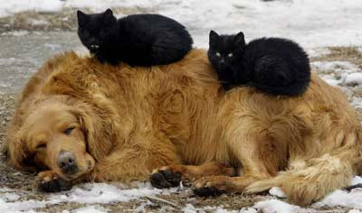
Rabies Control Messages for the Public
Keep rabies vaccinations up-to-date on dogs, cats, and ferrets
Supervise pets so they do not come into contact with wild animals
Call animal control to remove strays
Teach children never to handle unfamiliar animals
Notes:
Do not handle, feed, or unintentionally attract wild animals with open garbage cans or litter.

Slide 72
Rabies Control Messages for the Public
Enjoy wild animals from afar
Never adopt wild animals
Do not encourage wild animals to come close to/into your house
Avoid leaving pet food outside
Keep trash inside or use lids on trash
Do not relocate wildlife
Call DGIF or licensed rehabber for support

Slide 73
Rabies Control Messages for the Public
If you’ve been bitten…
Decrease the chance of infection by washing the wound with soap and water
Capture the animal if this can be done SAFELY
Call animal control or local hd

Slide 74
Rabies Resources
www.vdh.virginia.gov
Rabies Control page
www.vdh.virginia.gov/LHD/index.htm
www.cdc.gov/rabies
www.nasphv.gov
Code of Virginia
http://lis.virginia.gov/000/src.htm
Notes:
Web addresses for the Virginia Department of Health (where both rabies information and directory of local health departments can be found), the CDC’s rabies page, the National Association of State Public Health Veterinarians (where the Animal Rabies Compendium can be found) and the electronic version of the Code of Virginia.

Slide 75
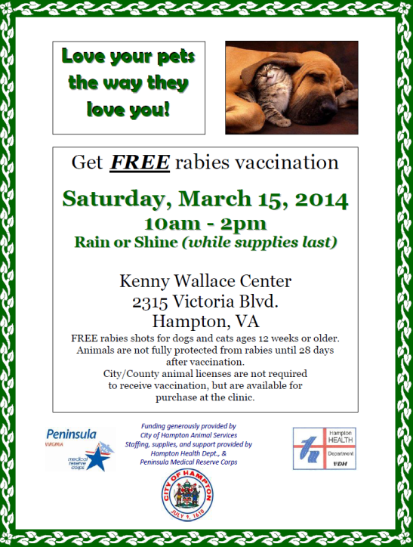
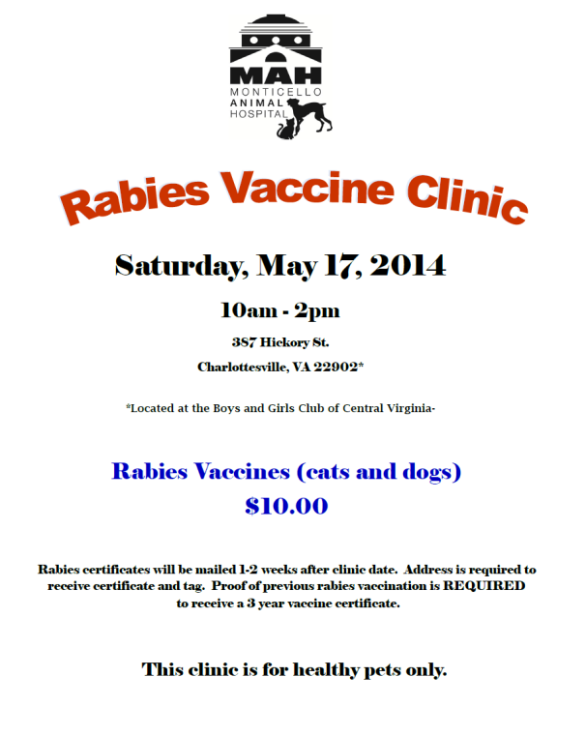
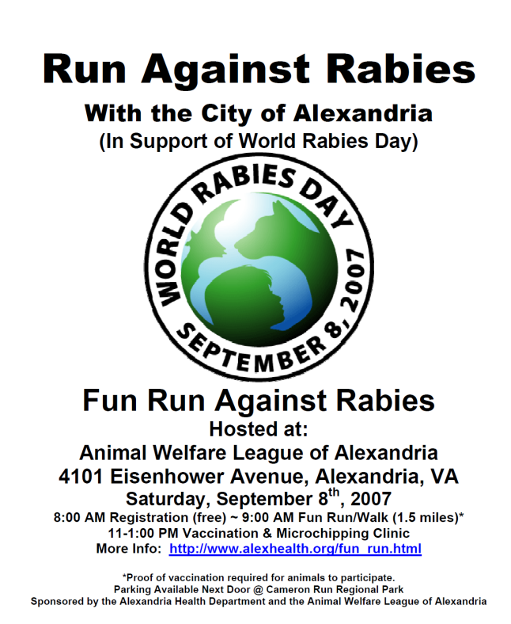
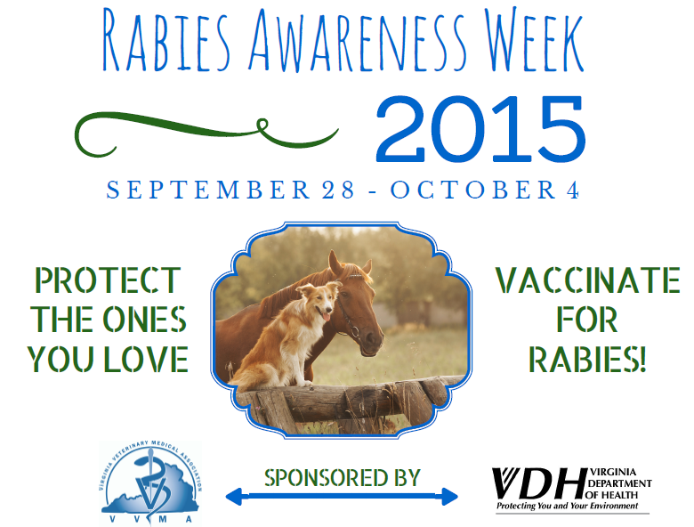
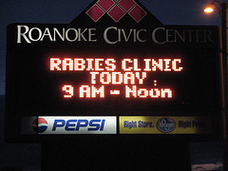
Rabies Campaigns
Notes:
Rabies Awareness Week is a statewide campaign that VDH has been cosponsoring with the Virginia Veterinary Medical Association for many years to promote greater awareness about rabies in the Commonwealth. This year’s week runs from September 28-October 4. This week is held during the same time as World Rabies Day (WRD) which is Sept 28. WRD is a global campaign that is sponsored, in part, by the CDC to help raise awareness about rabies on a global scale. Many health departments and other partners in rabies prevention and control will hold rabies clinics or other events during this week to highlight the importance of rabies awareness

Slide 76
Questions?

