Slide 1
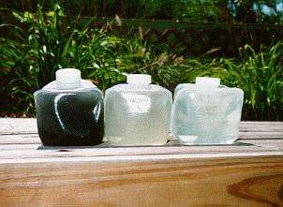
Onsite Sewage and Water
Click on the microphone where shown in each slide to listen to the narrative
Duke Price
March, 2015

Slide 2
Question 2
How often, if ever, should a septic tank be pumped?
5-7 years

Slide 3
Question 3
The first groundwater protection rule established in America in:
1610 – “There shall be no man or woman dare to wash any unclean linen, …nor rinse or make clean any kettle, pot or pan,…within twenty feet of the well.” (AGWT, 2003)

Slide 4
Big Picture
States must comply with federal environmental protection laws
Pollutant levels are set for drinking water (public)
Boil water notices
Wastewater treatment standards are also set (Clean Water Act)
Primary, secondary, tertiary treatment

Slide 5
Virginia has five physiographic provinces
West to East
Cumberland Plateau
Valley and Ridge
Blue Ridge
Piedmont
Coastal plain

Slide 6
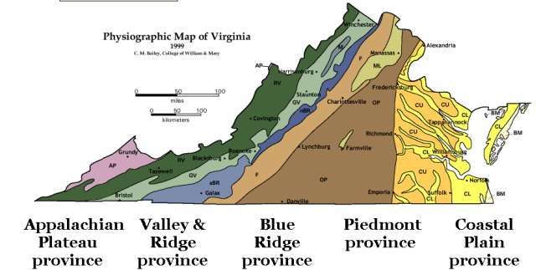

Slide 7
Onsite = Out-of-site (not out-of-mind)
All sewage systems require maintenance
Our private well water is recycled
Recent advances in onsite sewage systems.

Slide 8
Maintenance
No different than other elements of home
HVAC, exterior, roof
Primary: septic tank
Secondary: bio-filter, attached growth,
Soil based absorption systems

Slide 9
What’s in Wastewater?
1. Water (99 Percent)
2. Organics & Nutrients
3. Fats, Oils, and Grease (FOG)
4. Inorganics and other solids
(Hair, cloth)
5. Virus and Bacteria
6. Heavy Metals
7. Ammonium, Phosphates
Notes:
‹#›
10
Because as you might have expected, wastewater has some things in it that can cause disease and sickness. And it effects the receiving environment--the absorption area. We measure these constituents by determining BOD, FOG, and TSS.
BOD5 stands for “ biochemical oxygen demand”. The BOD test models aerobic waste treatment. It measures oxygen taken up during the oxidation of organic matter. It provides us insight on how strong the wastewater is and how much of the ecosystem’s resources must be devoted to getting rid of the organics. Organics means having carbon compounds. BOD testing has its widest application in measuring waste strength and in evaluating the efficiency of treatment processes.
TSS stands for “Total Suspended Solids” and relates to the solids from organics or inorganics that “cloud” the wastewater. It measures the tiny particles that don’t settle out.
FOG is derived from body oils, soaps, and cooking. The organic components in general come from toilet waste and garbage disposals.
Heavy metals can come from clothing (mechanic) and various cleaners.

Slide 10
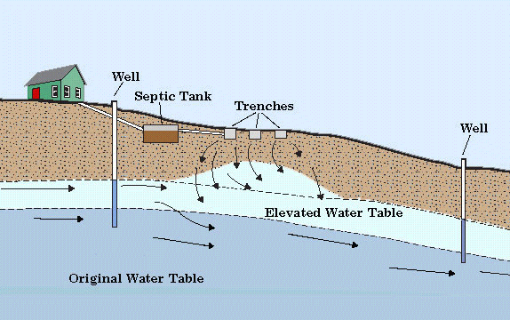
Why do we regulate? (The Hydrologic Cycle)

Slide 11
Community
Sewage – cluster systems
One owner
Loudoun, Franklin Counties
Water – public water supplies
Testing, maintenance
Office of Water Programs

Slide 14
System Failure
Notes:
‹#›
15

Slide 17
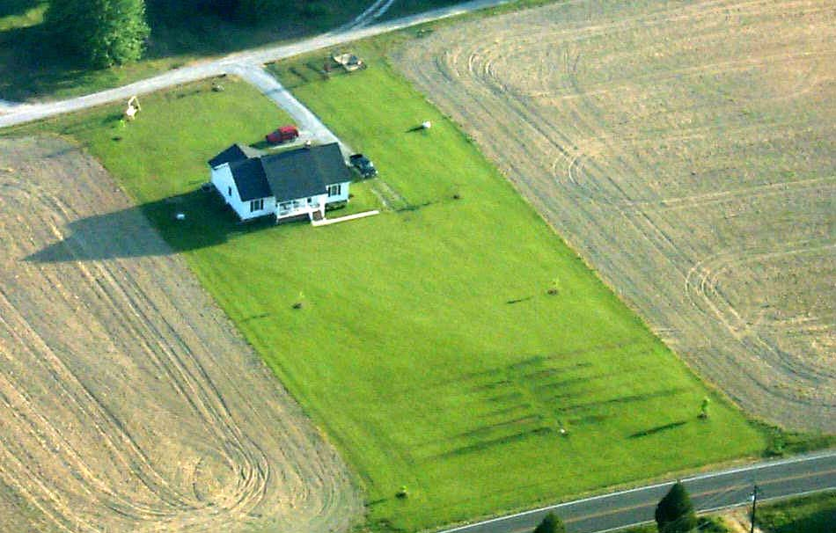
Notes:
‹#›
19
Talk about concept of creeping failure with a sewage system disposing of septic tank effluent.
Talk about pretreated systems that do the work for the soil.

Slide 18
What is a well?
A deep hole or shaft sunk into the earth to obtain water, oil, gas, or brine (dictionary.com)
i.e., man’s attempt to get water from stone

Slide 19
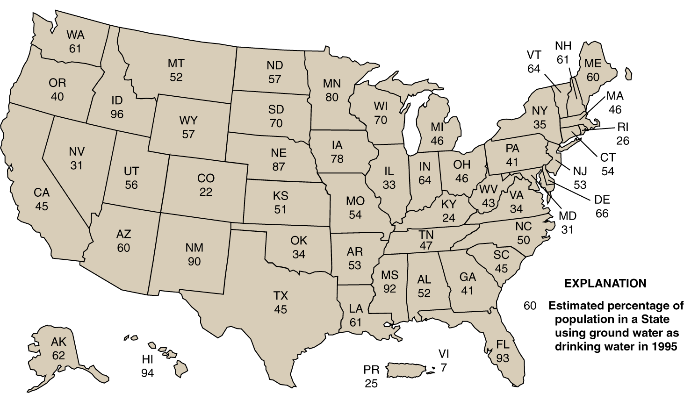
Ground Water Use in the United States (1995)
Notes:
‹#›
21
Ground water is an important source of drinking water for every State. (U.S. Geological Survey, 1998.)

Slide 20
DOH website
http://www.vdh.virginia.gov/

