Slide 1

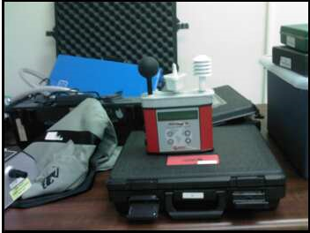
INDUSTRIAL HYGIENE
Dr. Leonard Vance
Notes:
The man in the photo on the left is Mike Miller, CIH, of the VCU Office of Environmental Health & Safety [OEHS]. See http://www.vcu.edu/oehs/ . VCU has an excellent industrial hygiene program. The photo on the right is of typical IH equipment.

Slide 2
WHAT IS
INDUSTRIAL HYGIENE
IDENTIFICATION,
EVALUATION, &
CONTROL OF
TOXIC SUBSTANCES & HARMFUL PHYSICAL AGENTS IN THE WORKPLACE &
IN THE ENVIRONMENT

Slide 3
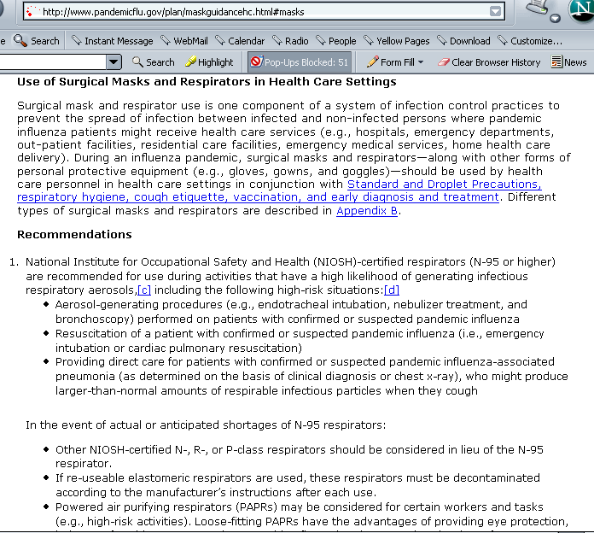
Notes:
A typical online notice received from a listserve. Relates to the IH issue of respiratory protection.

Slide 4
TOXIC SUBSTANCES
  CHEMICALS
  MICROBIOLOGICAL AGENTS
HARMFUL PHYSICAL AGENTS
  NOISE
  RADIATION
  ERGONOMICS/REPETITIVE MOTION
  HOT & COLD ENVIRONMENTS
Notes:
This slide lists the agents injurious to health that are the primary subject matter of Industrial Hygiene.

Slide 5
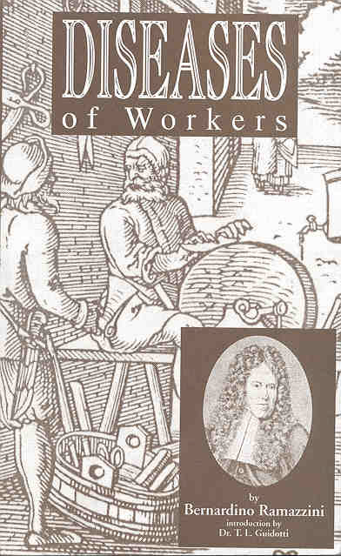
Notes:
Ramazzini is referred to as the father of occupational medicine. He published the first book on it in 1700 in Latin – De Morbis Artificum.

Slide 6
Occupational Health Team
Occupational Physicians - Dr. Compton
Industrial or ”occupational” Hygienists
Occupational Health Nurse
Microbiologist
Engineers
Safety Personnel
Ergonomists
Chemists & Lab Personnel
radiation, toxicology, epidemiology
Notes:
“industrial hygiene” is a term used in the US. The rest of the world use the term “occupational hygiene”. Industrial hygienists are frequently also chemists, engineers, biologists, health physicists, toxicologists, and physicians.

Slide 7
Industrial Hygiene Subject Matter
What, How much, What is to be done???
Identification of Hazards
  experience
  study
  defined by client
Evaluation of Hazards
  Monitoring: sample collection & analysis
Control of Hazards
  engineering, admin., work practices, PPE

Slide 8
Typical IH Problems
Survey flooded building for mold
Health Hazard Survey/analysis in factory
Indoor Air Quality (IAQ) evaluation
Monitor asbestos/Pb removal at VCU
Lead Inspection - adult/child protection
Noise survey, printing plant
OSHA/EPA Compliance consultation

Slide 9
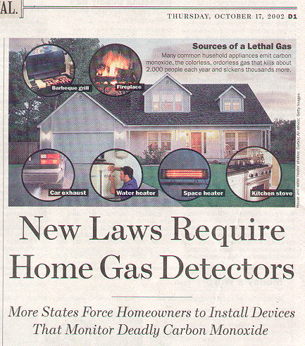
Notes:
Industrial hygiene today is viewed as including the worker’s home as well as the workplace.

Slide 10
Exposures to What
Infectious agents
Dusts
  Asbestos, silica
Volatile organic compounds
  Benzene, ethylene oxide
Metals
  Pb, Hg
Pesticides/herbicides
Radiation

Slide 11
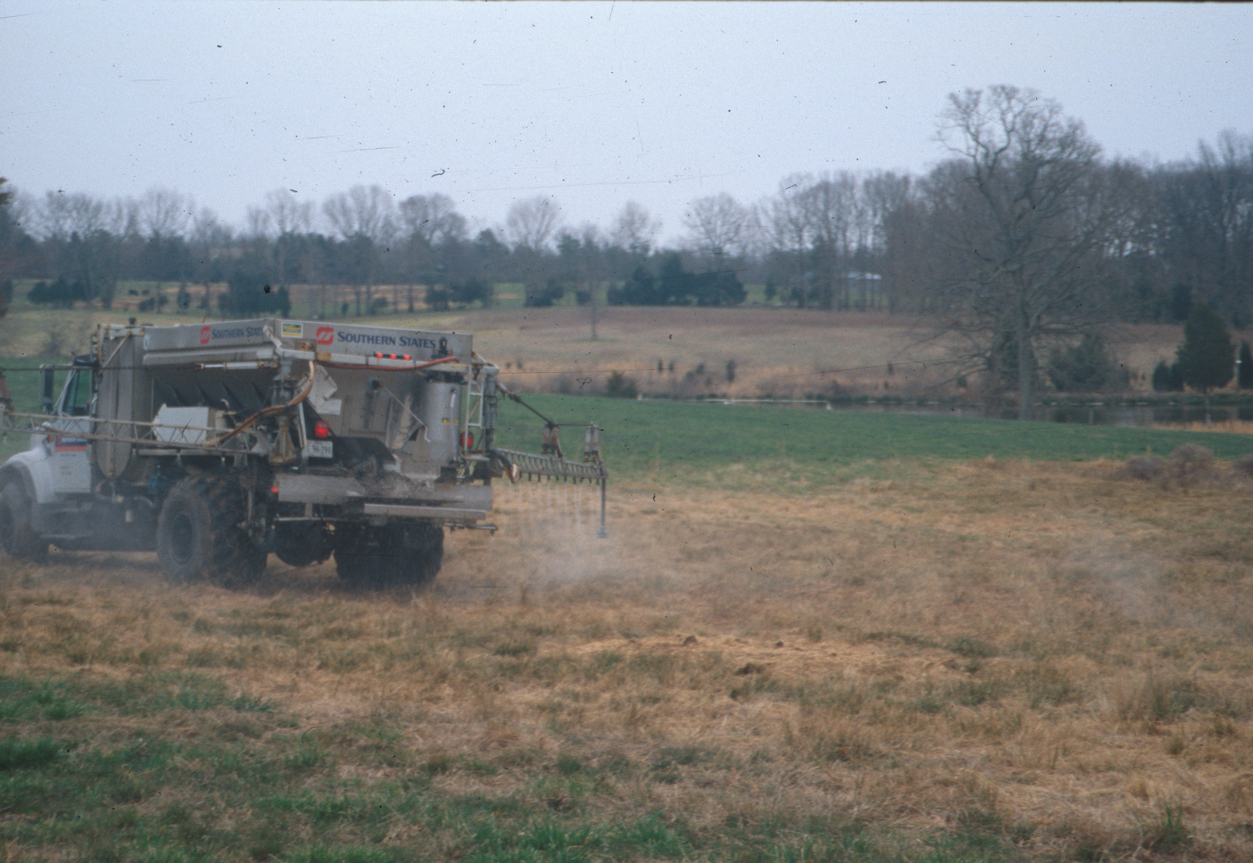
Notes:
This is the Southern States truck spraying Roundup [glyphosphate herbicide] on Dr. Vance’s farm preparatory to sod planting orchard grass. Farmers spend billions of dollars on agrichemicals every year.

Slide 12
Exposure Limits (Nomenclature)
Occupational exposure limits [OELs]
  Generic for PEL, TLV, STEL
OSHA PEL’s (permissible exposure limits)
OSHA STEL’s (short term, 15 minutes)
OSHA ceilings (instantaneous limits)
OSHA BEI’s (biological exposure indices)
ACGIH TLV’s (threshold limit values)
Notes:
Some exposure limits have force of law, e.g., OSHA PELs. Others are concensus standards that are not enforcible by regulatory agencies, e.g., ACGIH TLVs.

Slide 13
The Legal Framework
OSHA Standards – www.osha.gov
PEL Permissible Exposure Limit
STEL Short Term Exposure Limit
Monitoring
Methods of Control
Respirators
Hazard Communication
Medical Surveillance
Recordkeeping

Slide 14
OSHA BENZENE STANDARD
Permissible Exposure Limits
  1 ppm; 8 hour TWA
  5 ppm 15 min. STEL
Monitoring
Methods of Control
Respirators
Medical Surveillance
  Next slide
Hazard Communication
Employee Notification
Recordkeeping
Notes:
OSHA standards include numeric exposure limits for chemicals as well as work practice requirements, such as the provision of warning signs and labels or training and education.

Slide 15
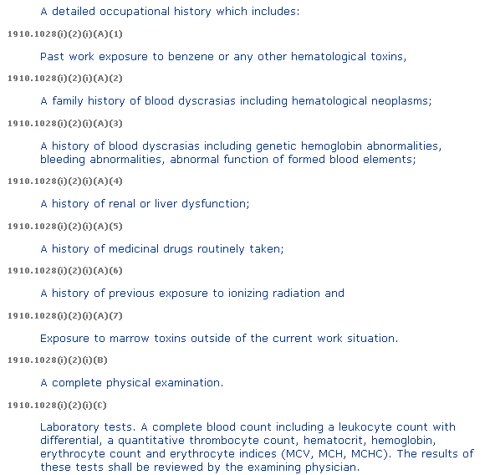
Notes:
This is the medical surveillance provision in the OSHA benzene standard. Exposed workers must undergo medical surveillance. Benzene exposure is associated with leukemia.

Slide 16
OSHA Benzene Standard on Web
http://www.osha.gov/pls/oshaweb/owadisp.show_document?p_table=STANDARDS&p_id=10042

Slide 17
MONITORING
Air Monitoring
  personal
  area
  real time
  Laboratory Analysis
Noise
Lead - XRF
Radiation
Hot & Cold

Slide 18
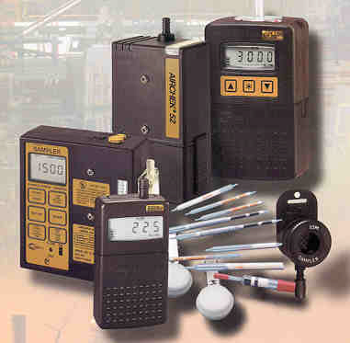
Notes:
Air monitoring pumps and sample collection media. See http://www.skcinc.com/

Slide 19
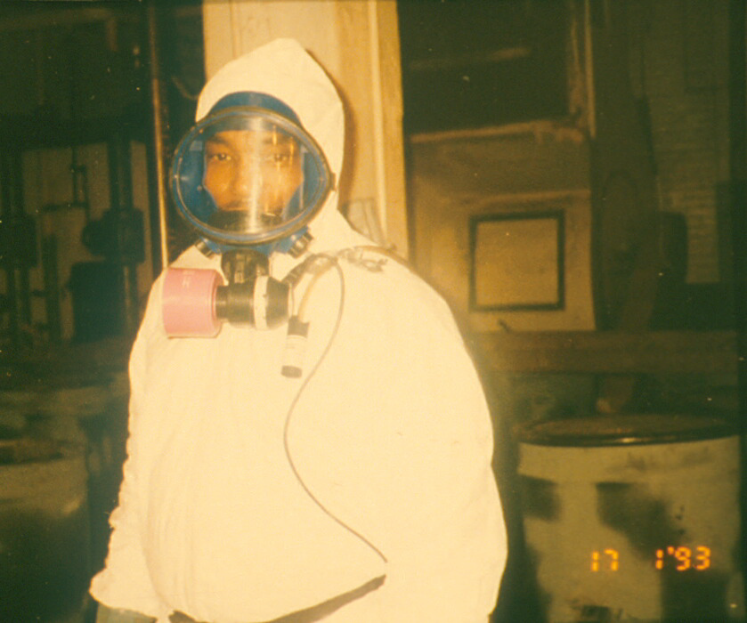
Notes:
An asbestos abatement worker in full protective gear in West Hospital c. 1993. The respirator is a PAPR – powered air purifying respirator.

Slide 20
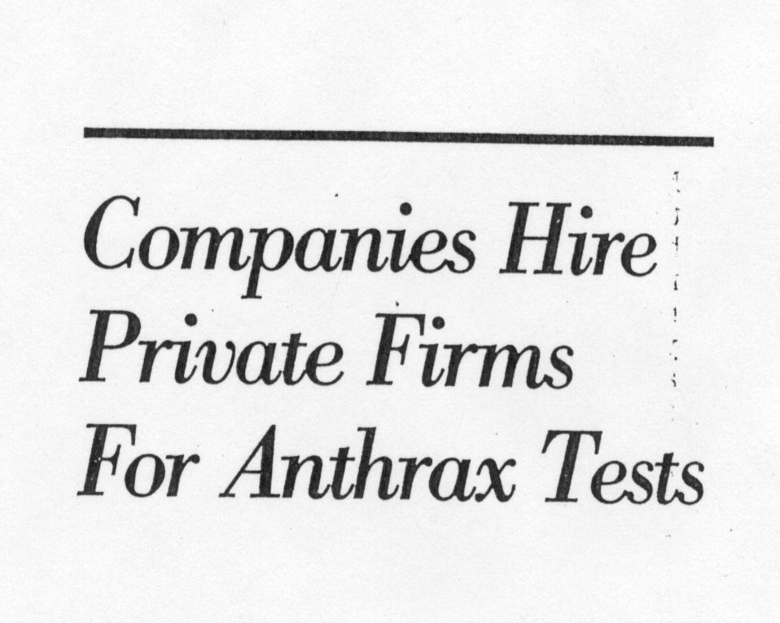
Notes:
New industrial hygiene issues come up all the time, such as this one on Northern Virginia several years ago.

Slide 21
Methods of Control
Engineering Controls
Administrative Controls
Work Practices
Personal Protective Equipment
Notes:
This is the “hierarchy of controls”. Controls should, and sometimes are required by law to, be implemented in the order given. Why?

Slide 22
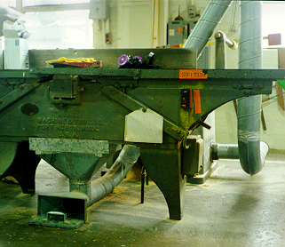
Engineering Controls
Notes:
This is an example of an engineering control, an exhaust ventilation device in his case. The duct intake on the floor collects and exhausts wood dust to an air pollution control device such as a cyclone.

Slide 23
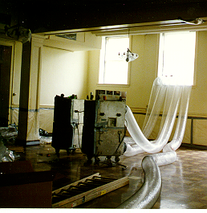
Negative pressure containment
Notes:
These are 4 2000ft3/min negative air machines used to filter and exhaust contaminated air during environmental cleanup in buildings [e.g., asbestos or Pb]. They place the area being cleaned under negative pressure so contaminants don’t escape to the surroundings. They have HEPA [high efficiency particulate Air] filters. Photo taken during asbestos removal at a Richmond church.

Slide 24
Administrative Controls
Employee Rotation
Ergonomic Hazards
Noise – rotation used.
Lead – rotation allowed.
Carcinogen Issue - Prohibition
Notes:
Employee rotation is prohibited by OSHA for workers exposed to carcinogens. But it is routinely used for noise and ergonomic issues. These controls use management practices.

Slide 25
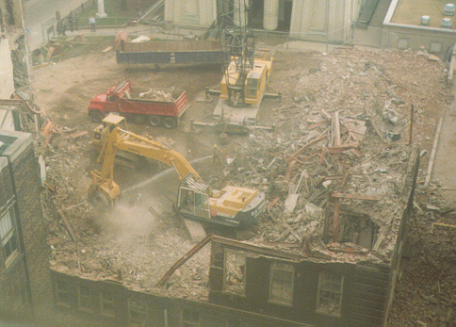
Work Practices
Notes:
Wetting down the dust is used as a way of lowering dust levels in the air. Photo taken from West Hospital during construction of Medical Education Bldg.

Slide 26
Personal Protective Equipment
Respirators
Protective Clothing
Protective eyeglasses, shoes, gloves, etc.
Hardhats
Notes:
PPE is the least preferred method of protecting workers, but it is used when necessary. Engineering controls are the most preferred method. They eliminate/remove the hazard.

Slide 27
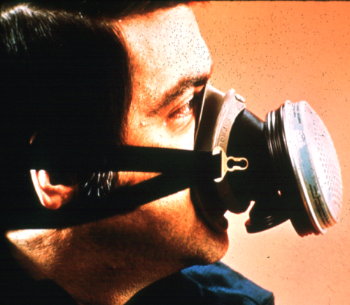
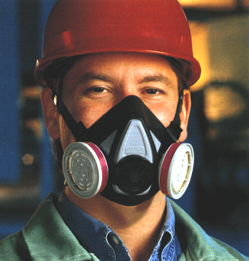
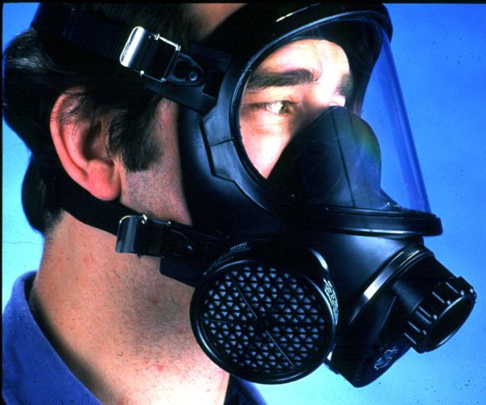
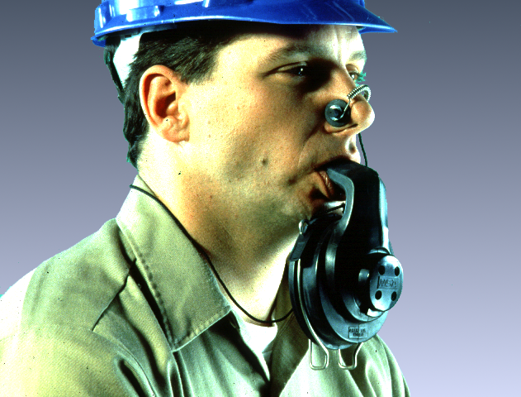
Respirators
Air purifying Resp [APR]
Quarter Mask
Half Mask
Half mask negative pressure
Full Facepiece
Mouthpiece/Nose Clamp
(no fit test required)
Full face neg pressure APR
Escape resp.

Slide 28
RESPIRATORS
Use & Limitations
Air purifying v. supplied air
Selection
Protection Factors
IDLH Atmospheres
Fit testing, Fit factors
Written Respirator Program

Slide 29
Hazard Communication
Placarding & Labeling
Material Safety Data Sheets
Training & Education
Chemical List
OSHA Std: 29 CFR 1910.1200
(UN) Globally Harmonized System
  International hazcom standard
Notes:
The Material Safety Data sheets (MSDs) are important reminders to workers of potential hazards.

Slide 30
Medical Surveillance
Done by physician, nurse, audiologist
need to know
  what worker is exposed to
  levels of exposure - IH role
various medical tests
  pulmonary function tests
  blood lead levels, etc.
Notes:
Part of a pre-employment physical assessment as well as period assessments, when necessary.

Slide 31
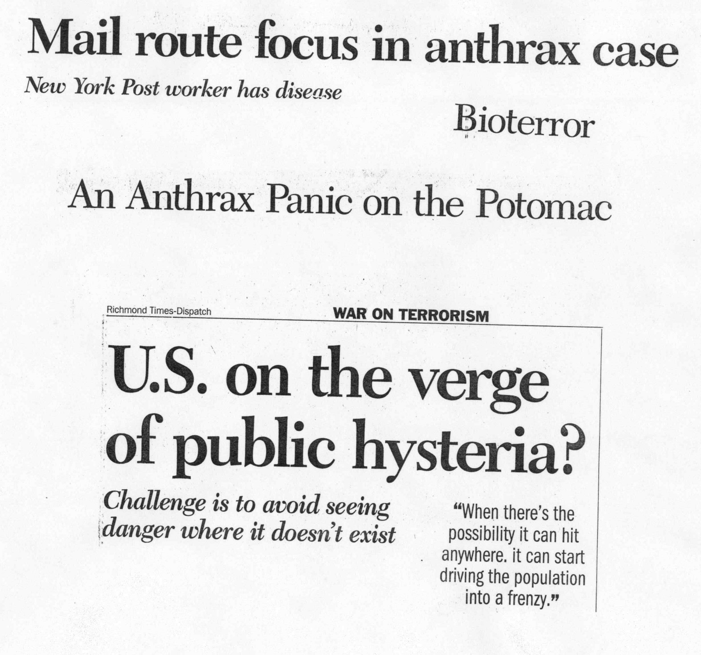

Slide 32
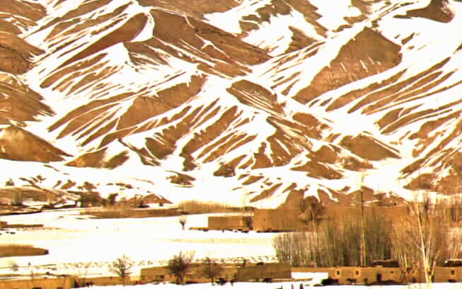
Hot & Cold Environments
Notes:
Hot environment: http://www.osha.gov/pls/oshaweb/owadisp.show_document?p_table=NEWS_RELEASES&p_id=10863
Cold environment: http://www.osha.gov/as/opa/cold_weather_prep.html
Hot and cold environments are among the “harmful physical agents” addressed by industrial hygienists.

Slide 33
ETHICS
IH WORKS FOR, REPORTS TO, & IS PAID BY EMPLOYER.
DUTY: PROTECT WORKERS
CONFLICTS INEVITABLE

Slide 34
Some Ethical Issues
Who will determine whether to sample
who will sample
where will samples be collected
who will analyze
who will determine what is to be done
methods of control
Notes:
Certified industrial hygienists are required to have continuing education in ethics as a condition of certification.

Slide 35
Why Learn about IH
Prevent injury and illness!
Why learn about public health?
Protect Safety & Health of Workers/Public
Deal with public concerns/hysteria
Avoid Liability
Promote better relations among
  workers
  management
  community
  government

Slide 36
References
www.aiha.org
www.acgih.org
www.abih.org
www.osha.gov
www.cdc.gov.niosh
The Occupational Environment - Its Evaluation, Control, and Management; DiNardi, S. R. , 3rd Ed.; AIHA, 2011; “White Book”
Notes:
OSHA is the regulator. NIOSH is a research and educational agency within CDC. Both were created in 1970 by the Occupational Safety and Health Act. AIHA, ACGIH, and ABIH are professional associations similar to APHA. APHA does have an occupational health caucus.

Slide 37
Homework
Explain how the UN globally harmonized system has affected the US federal OSHA standard (See link on topic page).
What happened during June, 2012, concerning diesel exhaust? What changed? (See link on topic page)
Notes:
Get online!

Slide 38
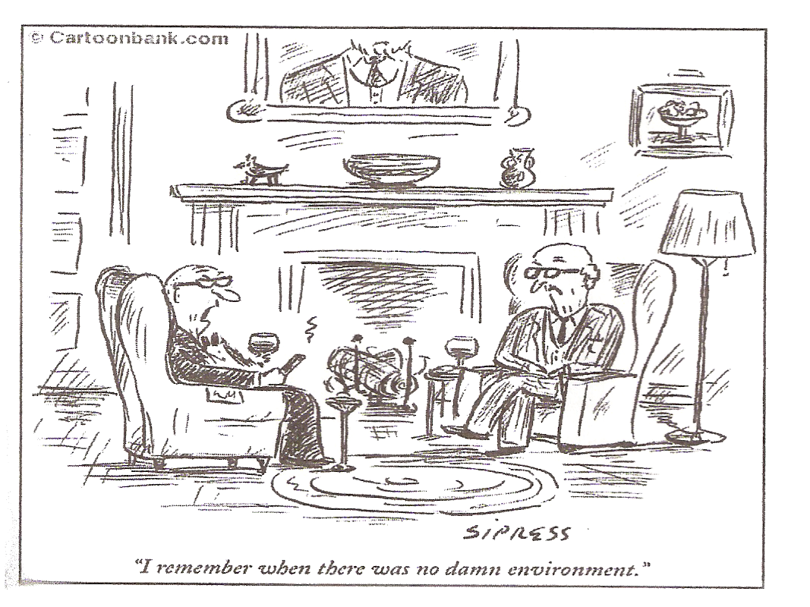
Notes:
OSHA and NIOSH came into existence in 1970. Before that, there was almost no federal presence in worker health and safety. Most of the federal environmental law structure began in 1970. OSHA and EPA were created in 1970 with the passage of the Occupational Safety and Health Act and the Clean Air Act.

