Slide 1

Autism Spectrum Disorder

Slide 2
Day #2 as Director
Your Congresswoman has 2 grandchildren with autism spectrum disorder and included a promise to “to do more testing for autism” in her campaign. She has representatives of a company that has a panel of markers for autism asking to schedule a meeting with you so that you can become her state professional advocate to add this testing to the newborn screen.

Slide 3
Autism Spectrum Disorder
What Do You Need To Know?
ASD symptoms vary but involve abnormalities in social responsiveness and communication
Early warning signs:
  loss of language or social skills at any age
  the child does not
    babble or coo by 12 months of age
    gesture (point, wave, grasp, etc.) by 12 months
    say single words by 16 months of age
    say two-word phrases on his or her own (rather than just repeating what someone says to him or her) by 24 months of age
Notes:
Autism spectrum disorders are defined completely on the basis of three areas of behavioral impairment:
Impairments in social interaction.
Children with classic autism are unable to "read" other people, ignoring them and often strenuously avoiding eye contact
they do not comfort others or seek comfort and do not share interests with others, such as bringing toys or pictures to their parents
prefers to be by himself, engaging in his own, often repetitive, activities. The lack of functional or spontaneous make-believe play is characteristic.
Impairments in communication.
Children with autism fail to develop reciprocal communication either by speech, gestures, or facial expressions.
young children fail to use eye gaze or pointing to communicate and direct their parent’s attention.
When children with autism learn to talk, they display stereotypic speech that may involve echolalia, pronoun reversal, and unusual inflections and intonations. Unlike typically developing children who begin talking using one-word utterances, children with autism may begin talking in "chunks" composed of commercials, movies, or others' speech.
Repetitive and stereotypic behaviors. Infants may stare or rock. Toddlers may have motor "stereotypies" such as movements of fingers, twirling strings, flicking pages of books, or licking. Repetitive whole body movements may include spinning and running back and forth. The repetitive behaviors often have a visual component such as holding the fingers to the side of the face and watching them with a sideways glance.

Slide 4
Screening and Early Identification
AAP Recommended Surveillance and Screening Algorithm
  Evaluate risk factors:
    Is there a sibling with autism spectrum disorders?
    Are parents concerned?
    Are other caregivers concerned?
    Are you, as the child’s physician, concerned?
  If at least two risk factors present and child is at least 18 months old, administer ASD specific screening tool.
        Johnson et al., 2007

Slide 5
Prevalence
On March 27, 2014, the CDC released new data on the prevalence of autism in the United States.
This surveillance study identified 1 in 68 children (1 in 42 boys and 1 in 189 girls) as having autism spectrum disorder (ASD)

Slide 6
What causes ASD?
Caused by interacting factors
  genetic changes
  interacting genes
  epigenetic factors (influences on genes)
  environmental
Notes:
Autism is highly heritable, yet the underlying genetic causes are largely unknown

Slide 7
Genetic Etiology
Microscopic chromosomal abnormalities (up to 5%)
    Prader-Willi, Angelman
Copy number variants (submicroscopic chromosome deletions or duplications) found on microarrays (10% to 35%??)
Single-gene conditions (less than 5%)
    Fragile X, Rett syndrome, Cowden syndrome
Gurrieri 2012

Slide 8
Important Genes
Gene mapping in consanguineous families or families with multiple persons with ASD
Across >12 linkage studies, most consistent evidence for 7q22-q32, but not in largest study
Genome wide association studies
Autism Genome Project Consortium
Notes:
The Autism Genome Project (AGP) Consortium represents more than 50 centres in North America and Europe. In an ongoing effort, the international AGP Consortium is collecting ASD families for ongoing genetic studies. The first phase of this initiative involved examining genetic linkage and chromosomal rearrangements in 1,168 families having at least two ASD individuals (PMID: 17322880). In this second phase of the project, we collected more families and genotyped them to examine for Copy Number Variation (CNVs) and SNPs affecting risk for ASD.

Slide 9
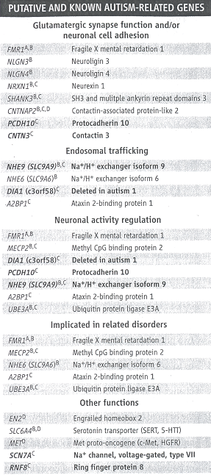
More than 100 genes have been associated with ASD

Slide 10
Genetic testing approaches
Microarray to identify CNVs
  Proposed for Newborn Screening (Nat Genet. 2014 Oct;46(10):1046-8. doi: 10.1038/ng.3106. Reaching a CNV milestone. Beaudet AL)
  CNVs may result in a mild phenotype, stigmatization?
Notes:
It has been proposed that we look for CNVs in NBS to identify autism at an early stage. This would allow early support and intervention which has been proven beneficial in autism.
Some argue that a portion of CNVs result in a mild phenotype so diagnosing these would result in stigmatization of a large group of people and do more harm than good.

Slide 11
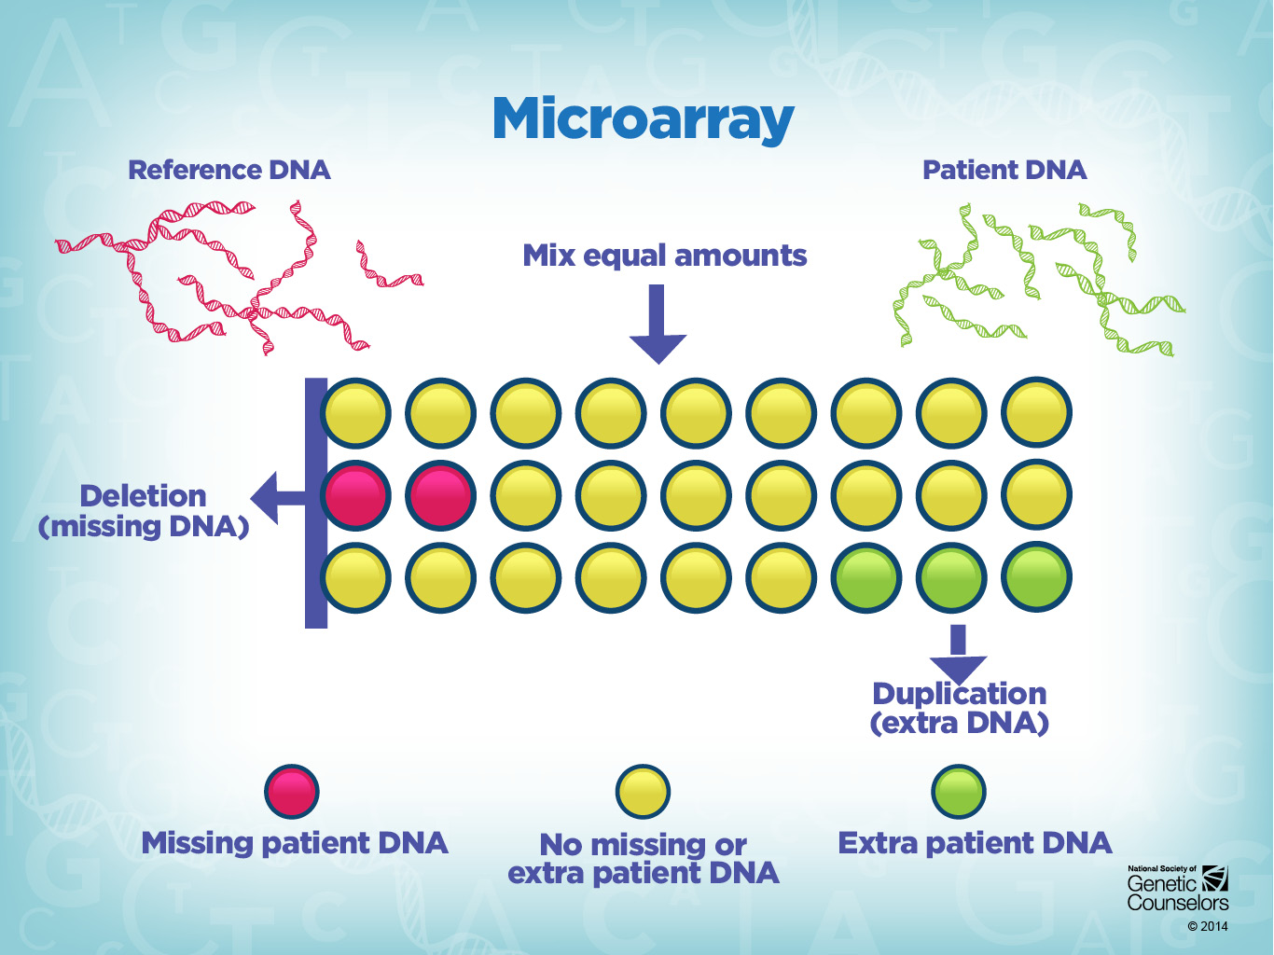
Notes:
Microarray
One way to test for missing or extra genetic material is through a technology called microarray. DNA microarrays can be used to measure changes at the chromosome level (for example, deletions or duplications that are too small to be seen with a karyotype), or changes at the gene level (variations in single DNA bases - also called single nucleotide polymorphisms or SNPs).
Microarrays can be designed to target specific areas of the genome. For example, if we think of the whole genome as a book, a microarray could be designed to proof-read chapter 4 of the book, and report on any spelling or grammar errors, or duplicated or missing words.
Florescent probes attached to strands of DNA are used to create different color combinations, indicating how much DNA is present. Because the results of a microarray analysis are too small to be seen even by a standard microscope, a special machine known as a scanner is used to read the results.
The de novo occurrence of a copy number variation is not absolute evidence of its pathogenicity. Distinguishing characteristics of pathogenic CNVs include (1) de novo event not found in either parent or inherited from an affected parent, (2) deletions or duplications which include genes known to be expressed in the brain, (3) large CNVs, and (4) deletions, as opposed to duplications

Slide 12
Genetic testing approaches
Next-generation sequencing to identify single gene disorders
  ApolloGen’s Autism Spectrum Disorder panel analyzes 101 genes
  GeneDx panel analyzes 63 genes
Notes:
We could potentially avoid the ethical dilemma of identifying mild phenotypes if we us NGS either as part of NBS or as part of a work-up in children with suspected ASD

Slide 13
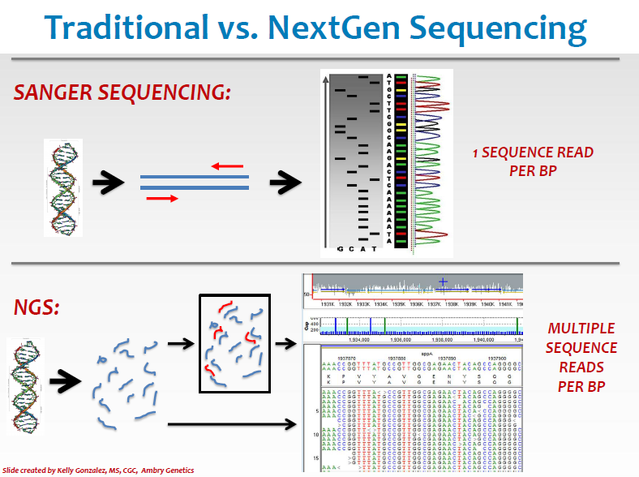

Slide 14
Genetic testing approaches
Clinical genetics evaluation could make testing more targeted or suggest testing would not be helpful
  assess family history, environmental influences(e.g., alcohol exposure in pregnancy), syndromic appearance (e.g., tuberous sclerosis, Cowden)

Slide 15
“Even with an extensive clinical workup, physicians can expect to identify a genetic cause in less than 25% of ASD patients.”
The chance for a sibling to have autism in such cases is 10% to 20%.
Gurrieri 2012

Slide 16
Do I do an autism genetic test?
Consider genetic counseling referral for syndromes and targeted testing
Where do you put resources – early identification, services, research, other?

Slide 17
What Makes a Good Public Health Test?
Analytic validity – if there is a genetic cause for ASD, how likely is the genetic test to pick it up?
Clinical validity – What proportion of ASD can be attributed to genes?
Clinical utility – If your genetic test is positive, does this change your medical management?
Ethical Implications – Are there individual or community ethical concerns (e.g., privacy, stigma, stereotype, insurance discrimination)
For more information about the ACCE model, check out the CDC website: http://www.cdc.gov/genomics/gtesting/ACCE/index.htm

Slide 18
Recall Your Task
Your Congresswoman has 2 grandchildren with autism spectrum disorder and included a promise to “to do more testing for autism” in her campaign. She has representatives of a company that has a panel of markers for autism asking to schedule a meeting with you so that you can become her state professional advocate to add this testing to the newborn screen.

Slide 19
What Public Health Genomic Competencies Apply?
Competencies
Maintain up-to-date knowledge on genetic advances and technologies
Collaborate with health agencies and organizations, academic, research, private and commercial enterprises to identify and solve genomic-related problems
Identify ethical and medical limitations to genetic testing, including uses that don't benefit the individual
Participate in strategic policy planning and development related to genetic testing or genomic programs

Slide 20
Which essential public health services would you recommend?
(See Framework on Next Slide for Ideas)

Slide 22
A Potential Action Plan
Public Health Service:
  Inform, educate and empower people about health issues
You decide to invite a medical geneticist to attend the meeting between your congresswoman and the genetic testing company representatives to discuss the clinical and public health utility of adding routine genetic testing.

