Slide 1
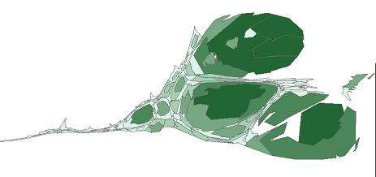

Introduction to GIS & Public Health
Jeff Stover
Director, Health Informatics & Integrated Surveillance Systems
Division of Disease Prevention
Virginia Department of Health
EPID-600
May 2013
Notes:
1
Read scenario

Slide 3
Overview
  GIS defined
  The geographic foundation for PH
  Public Health GIS history and use
    visualization
  Geocoding & Data Management
  GIS & Privacy

Slide 4
What is GIS?
A geographic information system is an integrated collection of computer software and data used to view and manage information about geographic places, analyze spatial relationships, and model spatial processes.¹
A computer-assisted system for the capture, storage, retrieval, analysis and display of spatial data.²
Computer-based systems for integrating and analyzing geographic data.³
1 A to Z GIS. ESRI Press.
2 Clarke, 1986. p. 175
3 Cromley and McLafferty. 2002

Slide 5
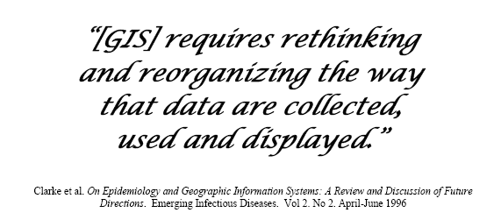

Slide 6
The Geographic Foundation for Public Health
Answers the basic question… “where?”
  Where do people live?
  Where are the agents of disease or specific health-related events?
  Where can we intervene to eliminate/reduce risks or to improve health service delivery?
People and the factors that cause disease are dispersed, often unevenly, across communities and regions.

Slide 7
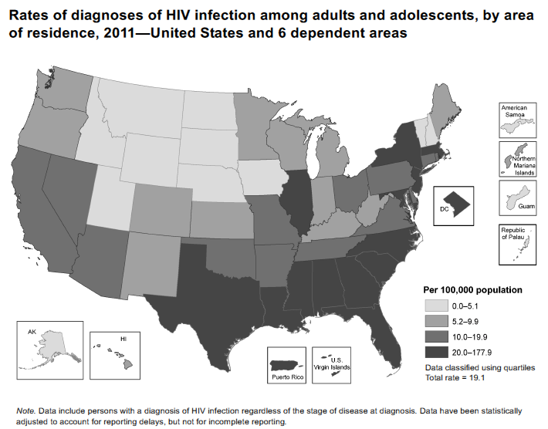
http://www.cdc.gov/hiv/library/reports/surveillance/2011/surveillance_Report_vol_23.html

Slide 8
GIS at VDH
  Beginnings
    1970’s
    Internal reports
  Late 1990’s
    ODW
  OASIS
    HIV/STD
  Office of Epidemiology
    Fish advisories
    Environmental Epi
  Enterprise GIS
    EP&R
  H1N1

Slide 9
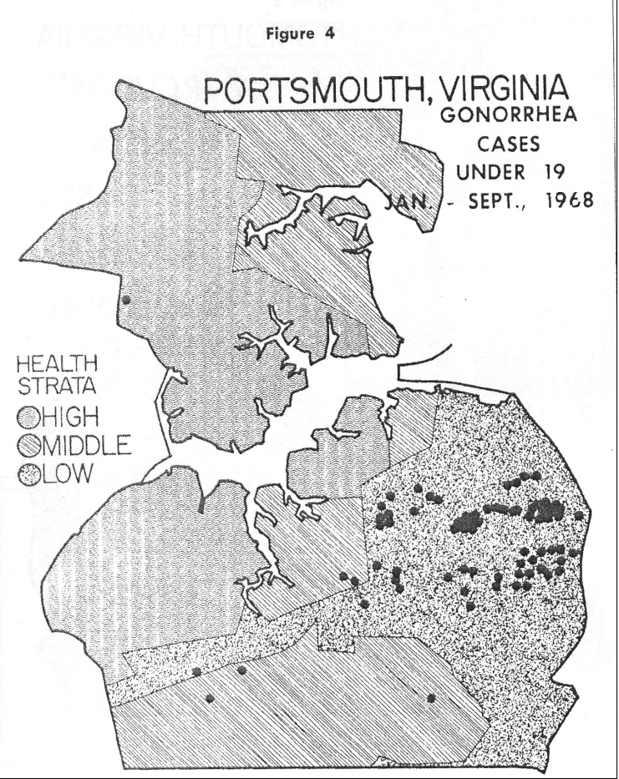

Slide 10
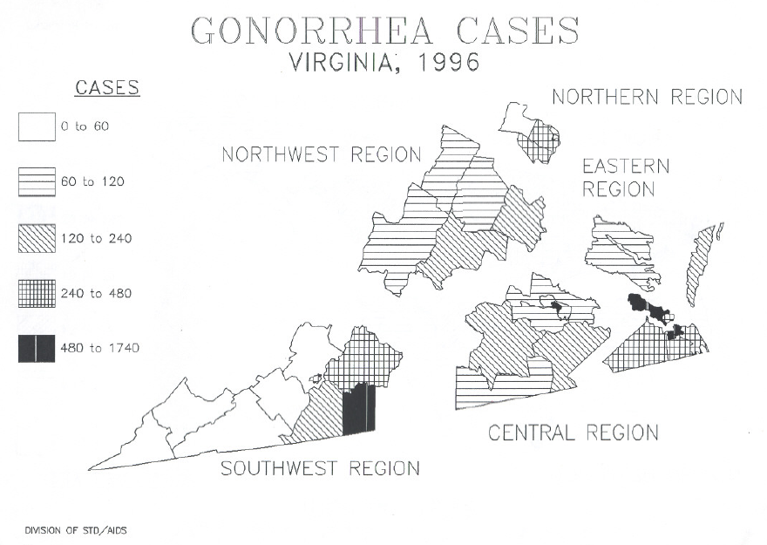

Slide 11
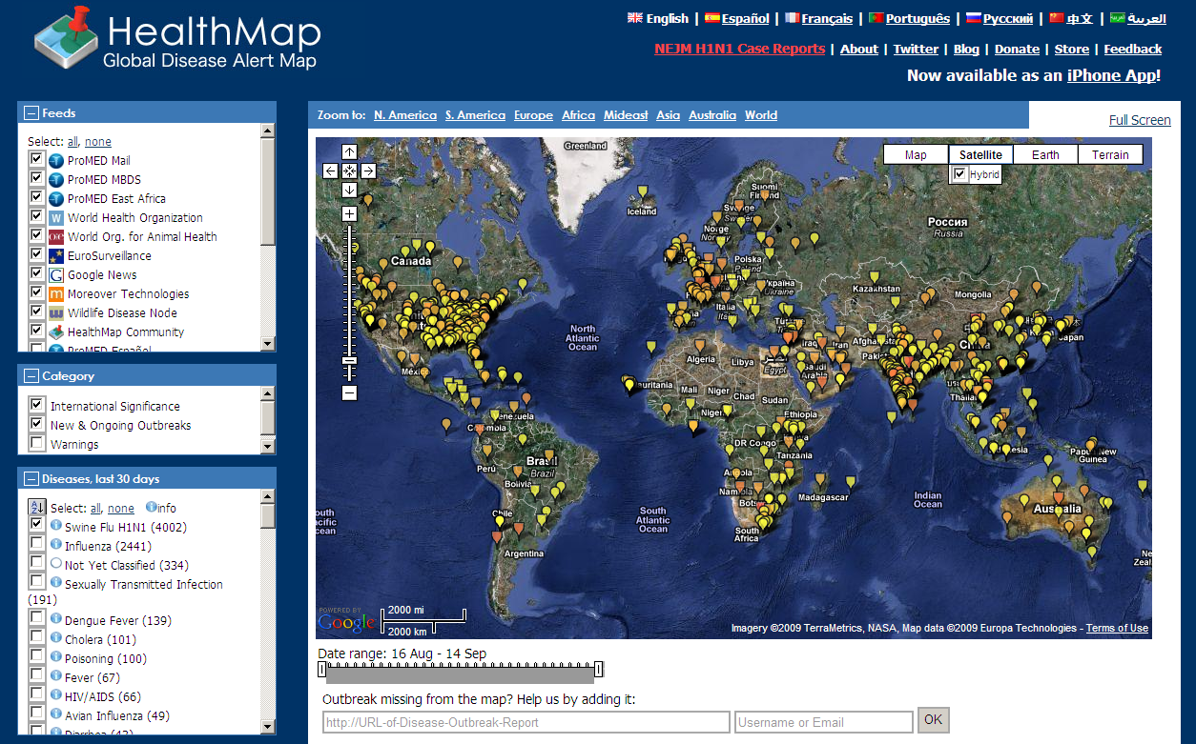
http://www.healthmap.org/en

Slide 12
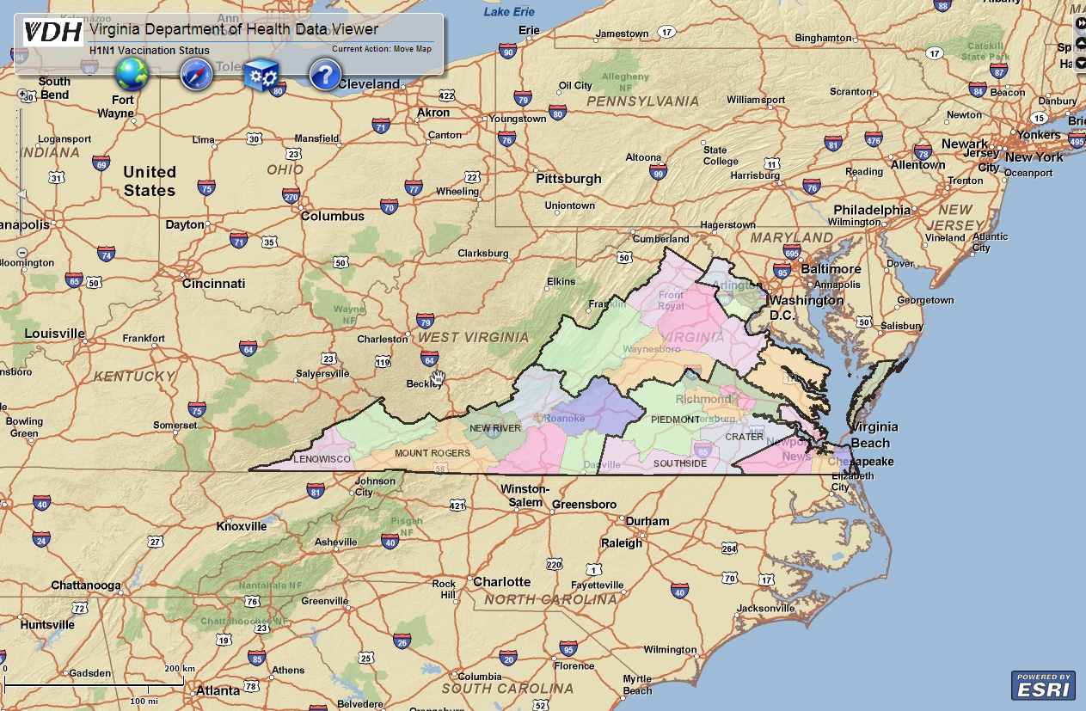

Slide 13
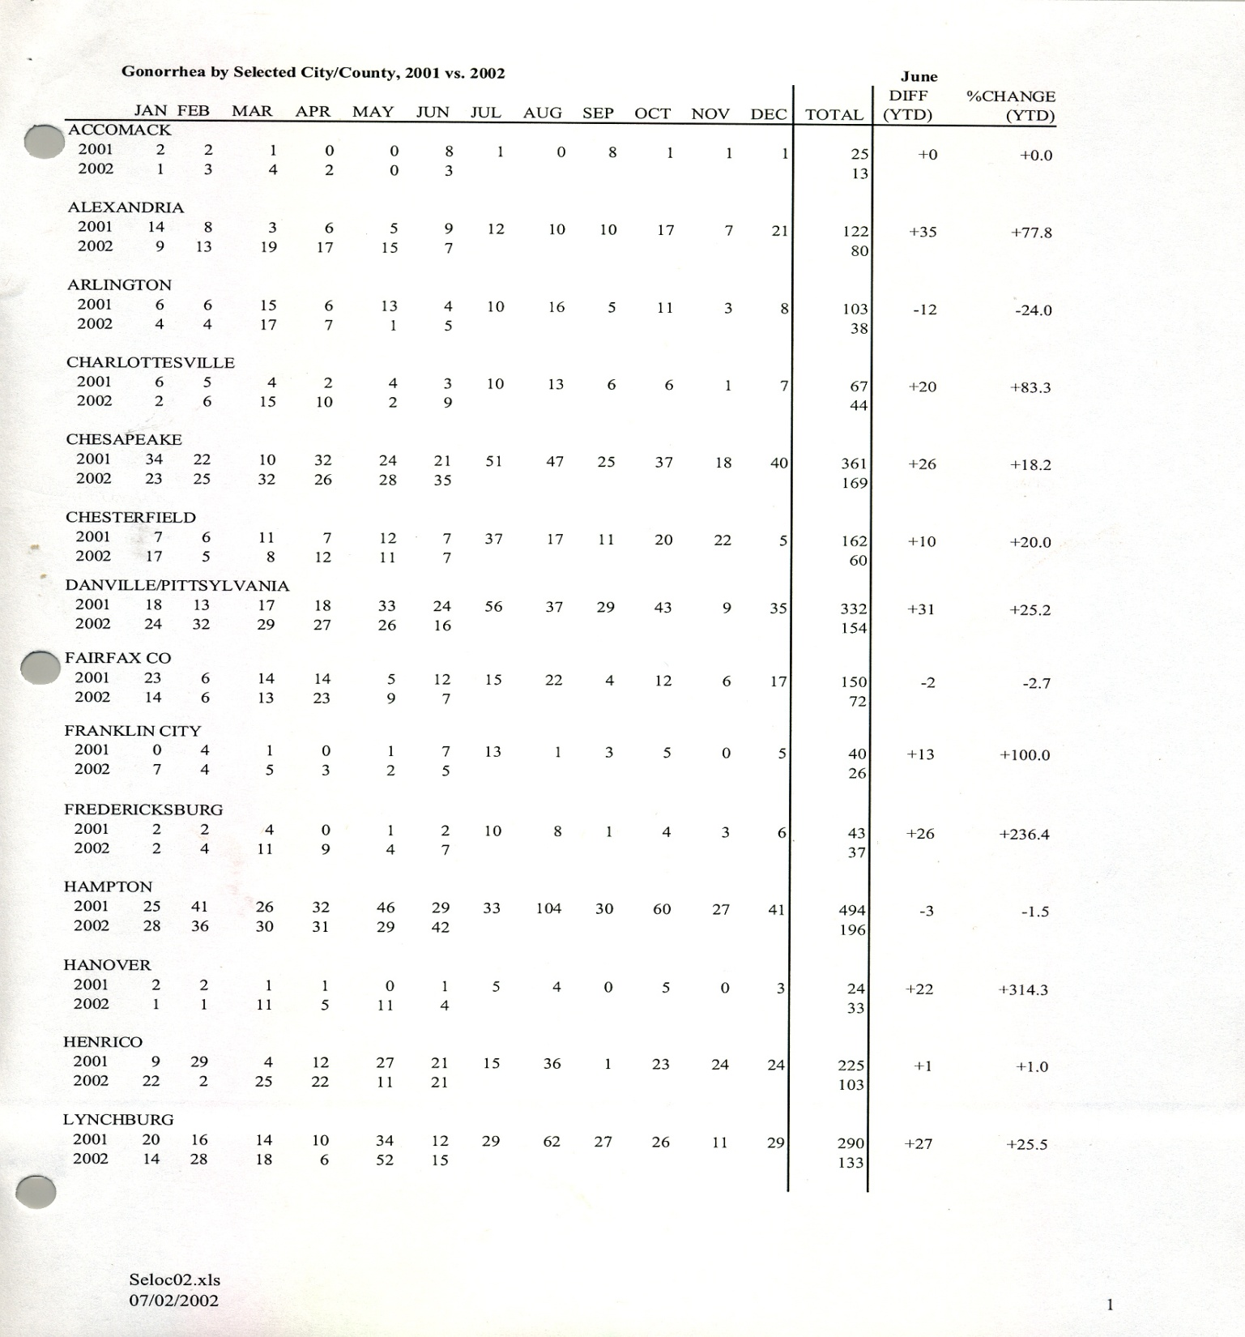

Slide 14
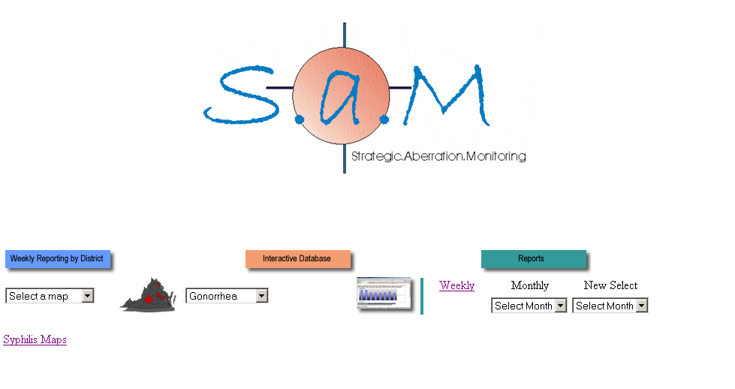

Slide 15
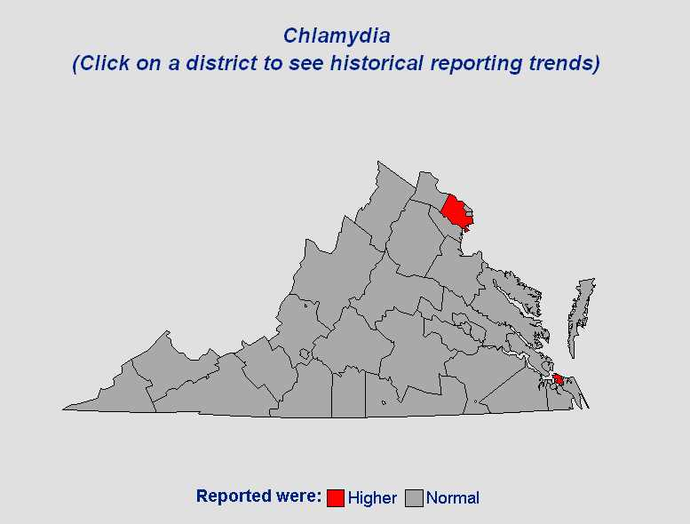
District: Fairfax
Reported: 50
A rollover on the district
shows the name and the
reported number of cases
Note: A lower than normal reporting week would also appear on the map

Slide 16
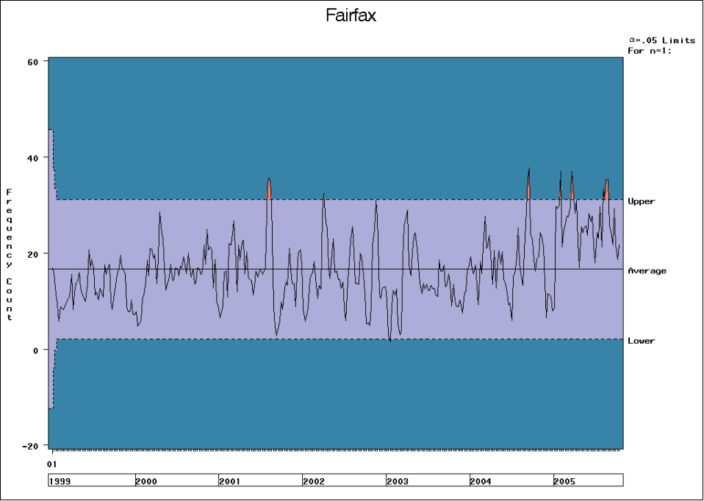

Slide 17
Does GIS provide “added value”?
Is GIS more than just maps (“eye candy”)?
GIS is a tool for understanding how spatial relationships can and/or do affect an outcome [e.g., public health].

Slide 18
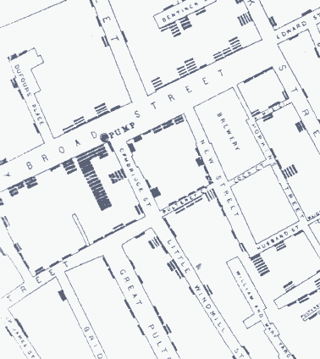

Slide 19
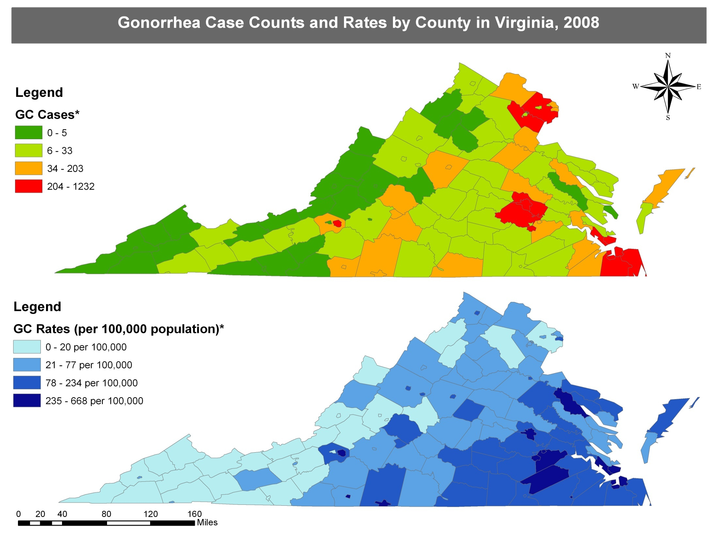

Slide 20
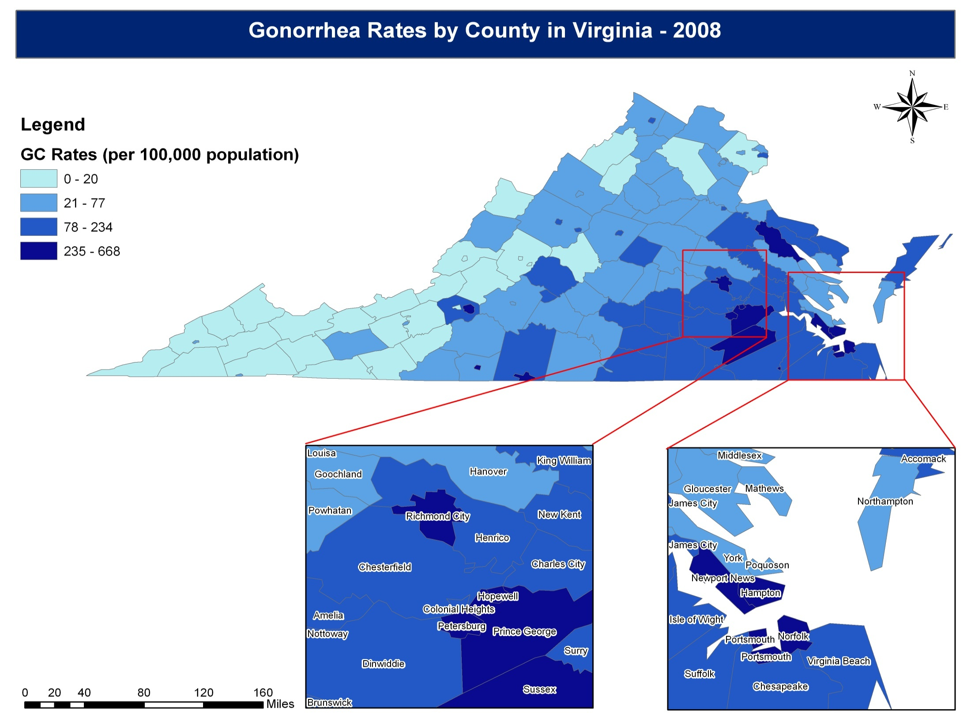

Slide 22
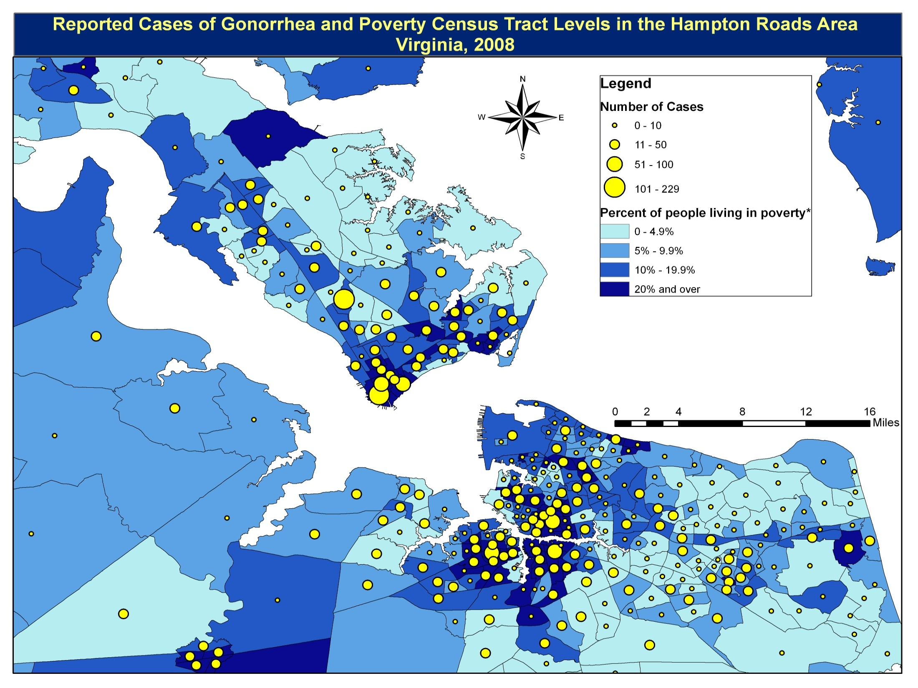

Slide 24
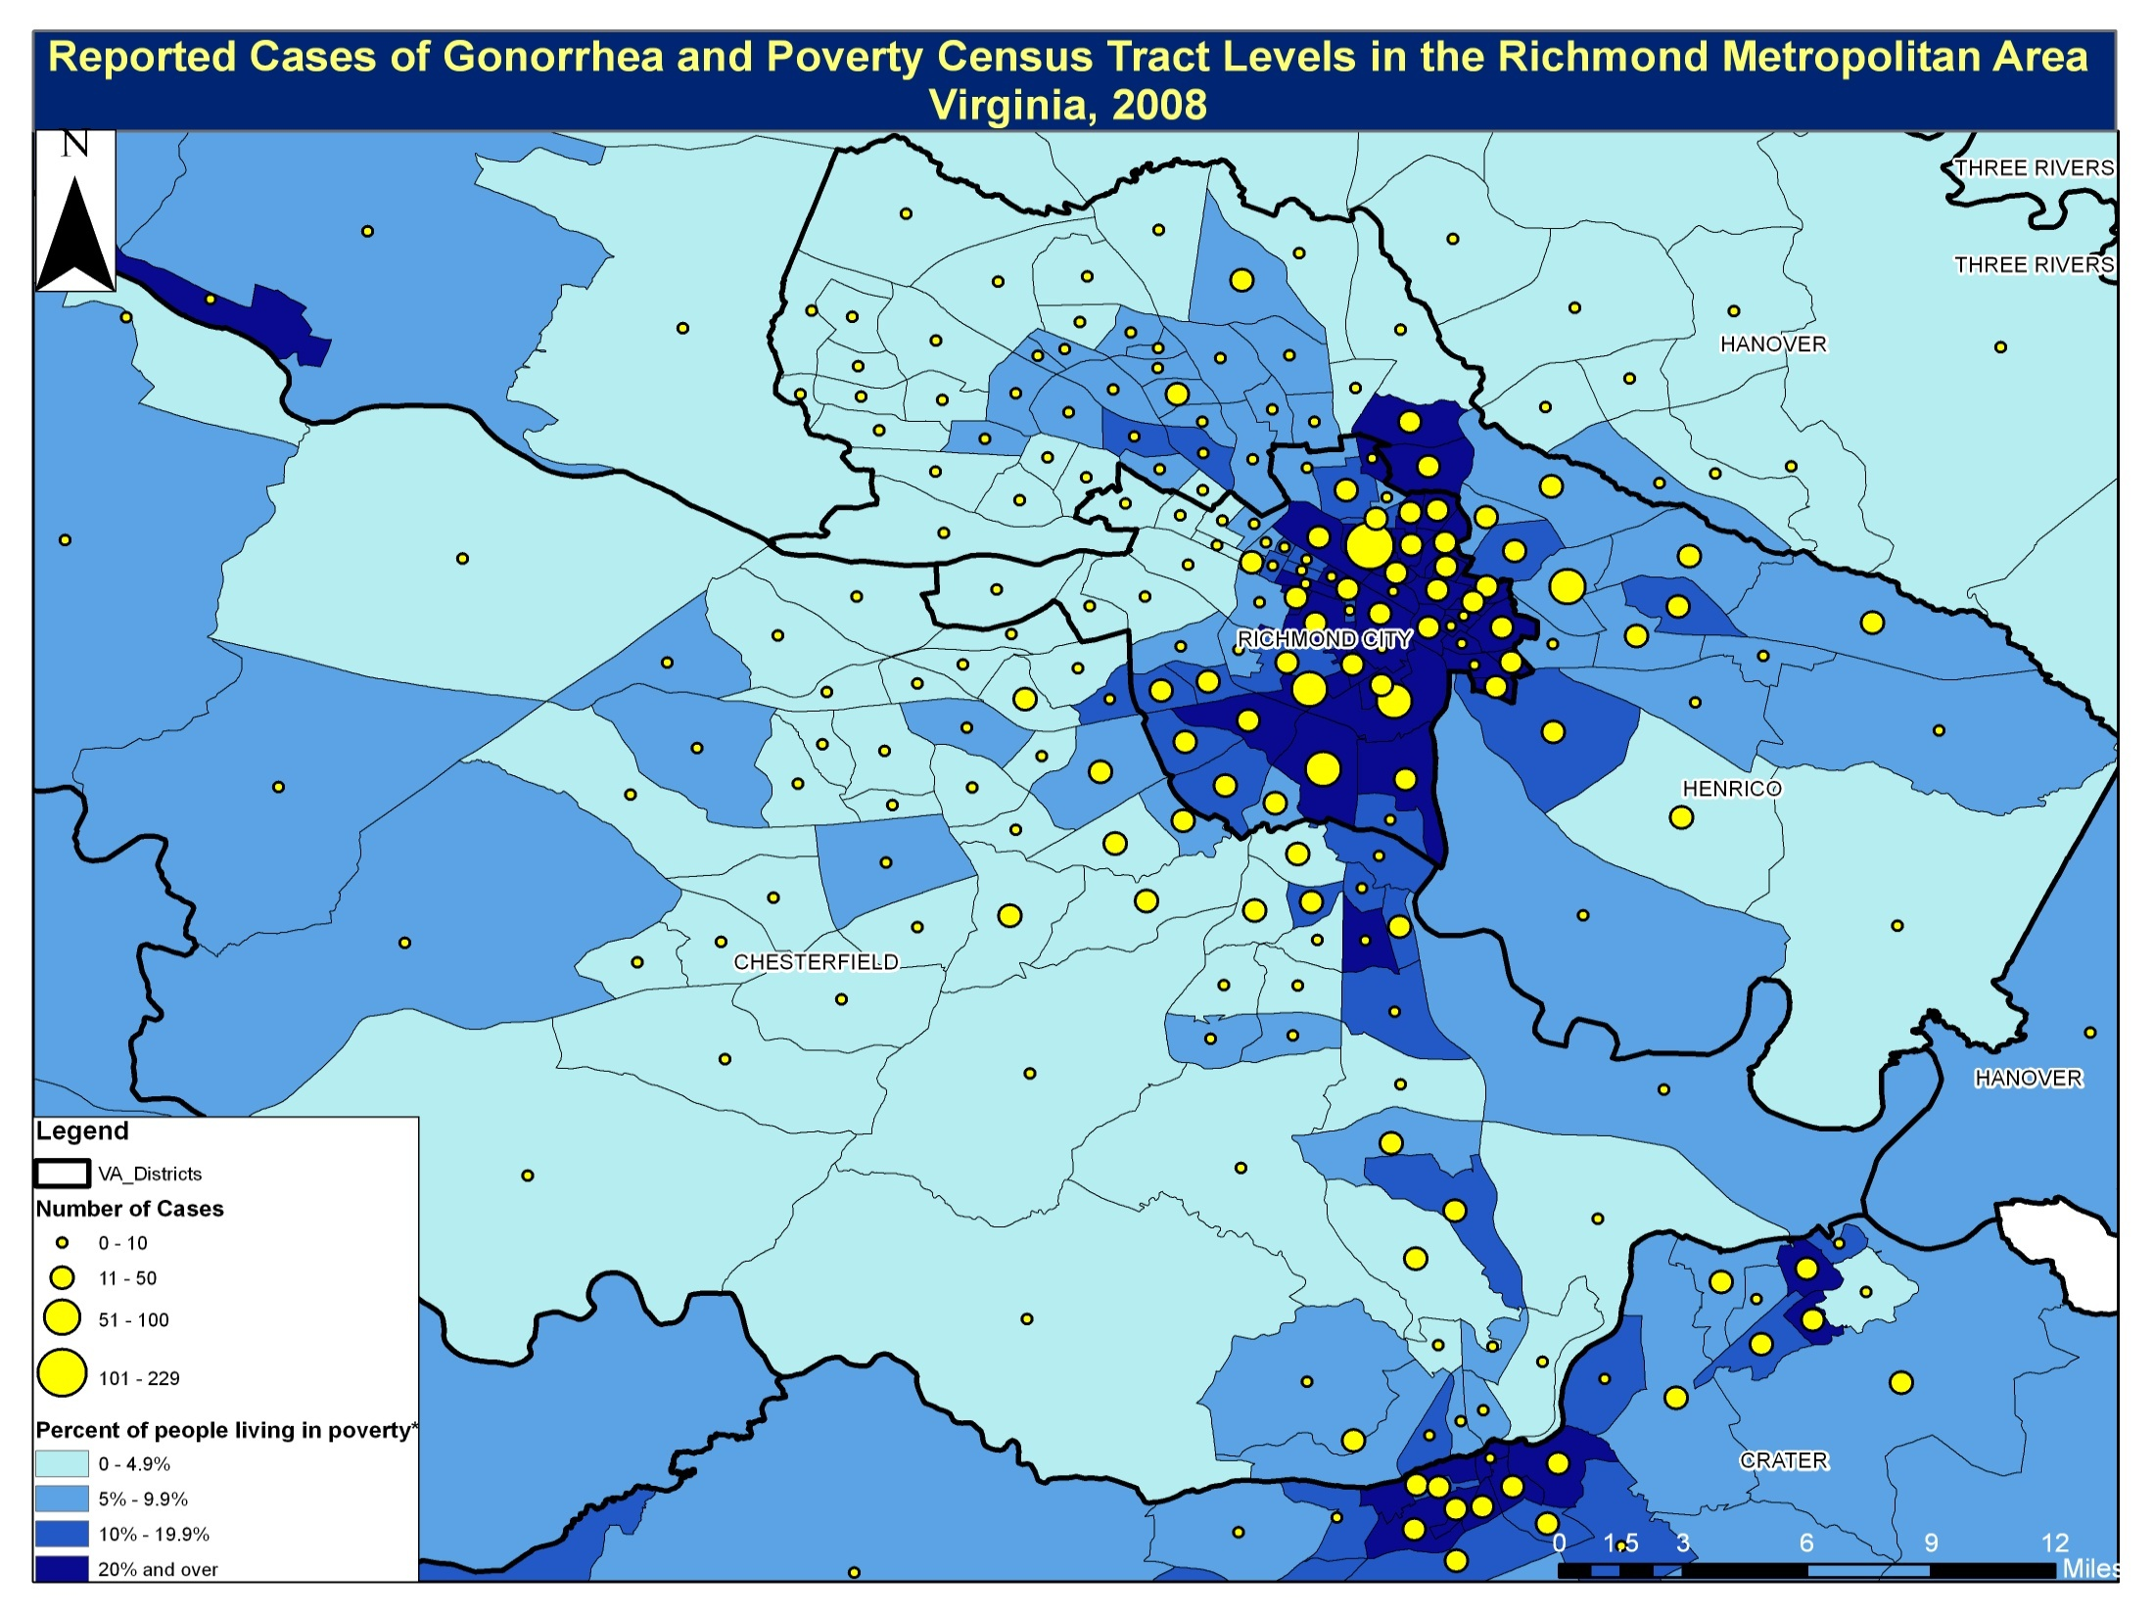

Slide 25

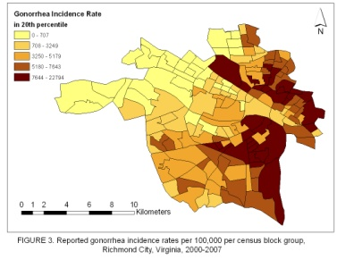
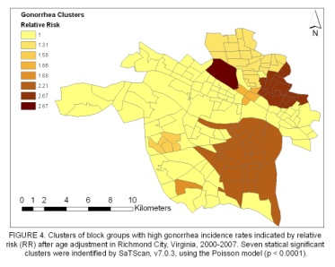
Spatial Analysis of Gonorrhea Incidence in Richmond, Virginia, 2000-2007
Qian Zhang, Oana Vasiliu, Chris Delcher, Jeff Stover
Health Informatics and Integrated Surveillance Systems, Division of Disease Prevention, Virginia Department of Health, Richmond, Virginia
Summary
Introduction: In Virginia, Richmond city has been historically recognized as a locality with one of the highest gonorrhea rates in the country. The aim of this presented population-based study on gonorrhea is to identify statistically significant geographic clusters. Methods: We analyzed reported gonorrhea diagnoses (n=8,643) between 2000 and 2007 in the city of Richmond, Virginia. Gonorrhea cases were geocoded and mapped to block groups (n=163). Gonorrhea incidence rates for each block group were calculated. A spatial scan statistics is conducted to identify core areas with elevated rates. Results: The average yearly incidence rate of gonorrhea in Richmond was 681 per 100,000. Of the total number of cases, 85.9% were under the age of 35, and 84.9% were Black. Seven clusters with higher-than-expected rates (p=0.0001) were identified. The most likely cluster was located on the northeastern part of the City, with an annual incidence rate of 1449.4 per 100,000. Cases occurred in this cluster represented 21 percent (1084 cases) of the total number of gonorrhea cases in Richmond over 8 years. Conclusion: there is sufficient evidence about the existence of statistically significant gonorrhea clusters in Richmond, Virginia. The spatial scan analyses at the block group level provide geographic details that can improve STI surveillance and interventions.
Results
Geocoding
Figure 1: GeoStan TM Data Flow Chart
9,979 cases extracted
Missing address (N=587, 6%)
9,359 cases with addresses
Error in match codes (N=639, 7%)
8,652 cases inside boundary
Outside city boundary (N=104, 1%)
8,756 cases with valid addresses
Age < 10 years old (N=9, 0.1%)
Introduction
A total of 8,643 cases (86.6% of extracted) included
TABLE 2. Gonorrhea clusters identified by spatial scan statisctics using SaTScan ver. 7.0.3.,Richmond, Virginia, 2000-2007. Core areas were defined as those with 10 % of its population at risk.
Gonorrhea is the second most common sexually transmitted diseases (STD) caused by the bacterium Neisseria gonorrhoeae. Untreated gonorrhea may lead to complications such as pelvic inflammatory disease (PID), epididymitis, or even life-threatening blood infections. It is estimated that more than 700,000 persons each year were infected with gonorrhea in this country. [1] In 2006, the rate of reported gonorrheal infections was 120.9 cases per 100,000 persons, [2] which far exceed the Healthy People 2010 goal to reduce gonorrhea incidence to 19 per 100,000 population.[3]
Richmond City is a metropolitan area located in the center region of Virginia. It has been recognized with consistently the highest gonorrhea rates in Virginia. [4] In 2006, Richmond's gonorrhea rate was 458.3 cases per 100,000; this is about five times the state average of 85.5 cases per 100,000 persons and four times the national average. [2,5]
Gonorrhea infections, similar to other types of infectious diseases, do not follow the random pattern of occurrence spatially. Identification of areas with elevated disease burdens could greatly enhance the efficacy and effectiveness of sexually transmitted infections (STIs) prevention for public health agencies.
Using geographic mapping to describe the distribution of STDs has gained increased attention in the arena of public health. [6-11] As early studies indicated, the transmission of gonorrhea depends on relative small proportion of a population named “core groups”, [12-14] which are composed of geographically clustered repeated cases.[9]
Reported gonorrhea diagnoses (n=9,979) between 2000 and 2007 in the city of Richmond, Virginia were extracted. Among the reported cases, 584 cases (6 percent) were excluded due to the missing addresses. Among those with a residential address, approximately 93.2 percent (8756 cases) were successful geocoded. The cases that could not be geocoded included those with post office addresses, uncompleted or other unlocatable addresses or non residential addresses, such as jails, juvenile detention center, veteran affairs medical care, shelter, homeless etc. Additional exclusion criteria for this analysis were cases with a reported residential address outside the geographic boundary of Richmond City, representing 1.2 percent (104 cases) of 8756 cases, and 9 cases younger than age 10, representing 0.1 percent of cases (Figure 1).
 | Number of Blocks | Population | Observed | Expected | Relative Risk | LLR | p value
Most Likely Clusters | 15 | 15,288 | 1840 | 778 | 2.67 | 560.85 | 0.0001
Secondary Clusters | 26 | 17,347 | 1668 | 843 | 2.21 | 358.86 | 0.0001
 | 4 | 4,807 | 476 | 262 | 1.86 | 72.57 | 0.0001
 | 22 | 22,538 | 1048 | 823 | 1.31 | 31.43 | 0.0001
 | 1 | 1,759 | 162 | 87 | 1.88 | 26.03 | 0.0001
 | 3 | 3,771 | 245 | 157 | 1.58 | 21.36 | 0.0001
 | 1 | 494 | 48 | 17 | 2.87 | 19.27 | 0.0001
 | 1 | 494 | 48 | 17 | 2.87 | 19.27 | 0.0001
b
Demographics
TABLE 1. Demographic characteristics of reported cases of gonorrhea in Richmond City, Virginia, 2000-2007 (N=8643).
The most likely cluster
 | N | %
Gender
Male | 4062 | 47.00
Female | 4574 | 52.92
Unknown | 7
Age
<15 | 164 | 1.90
15-19 | 2523 | 29.19
20-24 | 2812 | 32.53
25-39 | 2289 | 26.48
>39 | 855 | 9.89
Race
White | 331 | 3.83
Black | 7341 | 84.94
Hispanic | 34 | 0.39
Asian | 12 | 0.14
Other | 20 | 0.23
Unknown | 905 | 10.47
Materials & Methods
A. Data Extraction and Geocoding
As an infectious disease, gonorrhea is mandated by state law to be reported to the city/county health department within three days of suspected or confirmed diagnosis. Health departments and private providers in Virginia use an Epi-1 form (the Virginia Department of Health Confidential Morbidity Report) to report each gonorrhea case. All collected information was input into the STD Management Information System (STDMIS) database at the Virginia Department of Health (VDH).
Reported cases from January, 2000 to December, 2007, from Richmond city, Virginia, were extracted from STDMIS. Each case was geocoded to its reported residential address by using Census GeoStanTM version 1.0. Geocoding produced x-and y-coordinates for valid addresses and these coordinates were used to construct incidence maps.
A gonorrhea case is defined as positive for Neisseria gonorrhoeae confirmed by laboratory examination of penile, vaginal, urethral, rectal or pharyngeal specimen using a nucleic acid amplification test. This analysis excluded cases with age of 10 years and under at diagnosis, since these patients were not routinely considered being infected through their risky sex behaviors.
B. Mapping
Cases were mapped onto a layer file containing Richmond city’s block groups by using ArcMap version 9.2. The layer file was downloaded from the U.S. census TIGER/LINE shape files. Gonorrhea incidence rates were calculated as the number of reported cases in the block group divided by the population of the block group. Census Bureau estimates for the population of each census block group in 2000 was the denominator.
C. Spatial Statistics Analysis
Spatial scan analysis was used to identify high gonorrhea rate clusters using indirect standardization method. Under the null hypothesis, the incidence of gonorrhea follows a Poisson distribution, and the probability of a case being diagnosed in a particular block group is proportional to the age-adjusted population in the block group. Cases in each block group were further stratified into five age groups (10-14, 15-19, 20-24, 25-39, and above 39). Since the only block group level population data available from the U.S. census web site were those stratified by gender and age in very small intervals (from 0 to 85 and over), variables were downloaded and merged to obtain values for a larger age groups. Population at risk was set as 10% of the block group population. Monte Carlo procedure was fixed as 9999 random replications.
The largest secondary cluster
By using SaTScan adjusting for age groups, seven statistically significant (p <0.0001) high gonorrhea clusters (core areas) were identified. As indicated in Figure 4, these clusters comprised 72 of the total 163 block groups and covered approximately 39 percent of total city areas.
The mostly likely cluster was located on the northeast part of Richmond City. It comprised 15 census block groups and spanned 2.85 square miles (7.38 km²) with an annual incidence rate of 1449.4 per 100,000. Cases occurred in this cluster represented 21 percent (1084 cases) of the total number of gonorrhea cases in Richmond over 8 years.
Among the six secondary clusters identified, the largest cluster was about 11.95 square miles (30.95 km²) on the southeast side of the City, which comprised 26 block groups, 16 percent of the total 163 block groups analyzed. This core area was responsible for 19.3 percent or 1668 cases over the 8 years, had an average rate of 1237.7 per 100,000. The relative risk of this cluster is 2.214. The second largest cluster was located in the northern part of Richmond City. It included 22 block groups and spanned 5.70 square miles (14.76 km²) with an annual rate of disease of 795.9. The relative risk within this cluster was 1.310 with an observed number of 1048 cases diagnosed during 2000-2007, compared with 823 expected cases. The third largest cluster was recognized as a sole block group also located in the northern part, with an area of 1.52 square miles (3.94 km²). Although it is merely responsible for 0.6 percent of the total cases, the relative risk was high (RR=2.870).
Of the total number of cases, 85.9% were under the age of 35, and 84.9% were Black. Females account for about 52.9% of all cases. The average of the subjects was 24.8 ±9.1 years (Table 1).
Conclusion
The average yearly rate of gonorrhea in Richmond City was 681 cases per 100,000. Figure 2. indicated the temporal trend of the reported gonorrhea cases. The highest incidence rate per block group is 22,794 per 100,000, with the mean of 8634 cases per 100,000. Figure 3 showed the most gonorrhea cases resided in the east side of the city, with high incidence rate associated with approximately 32 block groups.
The study has shown the presence of seven clusters of gonorrhea in Richmond, Virginia. Out of these seven clusters detected in the analysis, three covers fair large areas. The study has also demonstrated that using the existing health data, the spatial scan statistic and GIS can provide public health agencies with necessary feed back about the prevalence of statistically significant clusters of gonorrhea in the region, and thus enabling them to design more effective strategy to contain this scope. Further analysis will be focused on determine the most important risk factors which affect disease distributions.

Slide 26
Spatial Analysis of Gonorrhea Incidence in Richmond, Virginia, 2000-2007
Summary
Introduction: In Virginia, Richmond city has been historically recognized as a locality with one of the highest gonorrhea rates in the country. The aim of this presented population-based study on gonorrhea is to identify statistically significant geographic clusters. Methods: We analyzed reported gonorrhea diagnoses (n=8,643) between 2000 and 2007 in the city of Richmond, Virginia. Gonorrhea cases were geocoded and mapped to block groups (n=163). Gonorrhea incidence rates for each block group were calculated. A spatial scan statistics is conducted to identify core areas with elevated rates. Results: The average yearly incidence rate of gonorrhea in Richmond was 681 per 100,000. Of the total number of cases, 85.9% were under the age of 35, and 84.9% were Black. Seven clusters with higher-than-expected rates (p=0.0001) were identified. The most likely cluster was located on the northeastern part of the City, with an annual incidence rate of 1449.4 per 100,000. Cases occurred in this cluster represented 21 percent (1084 cases) of the total number of gonorrhea cases in Richmond over 8 years. Conclusion: there is sufficient evidence about the existence of statistically significant gonorrhea clusters in Richmond, Virginia. The spatial scan analyses at the block group level provide geographic details that can improve STI surveillance and interventions.

Slide 27
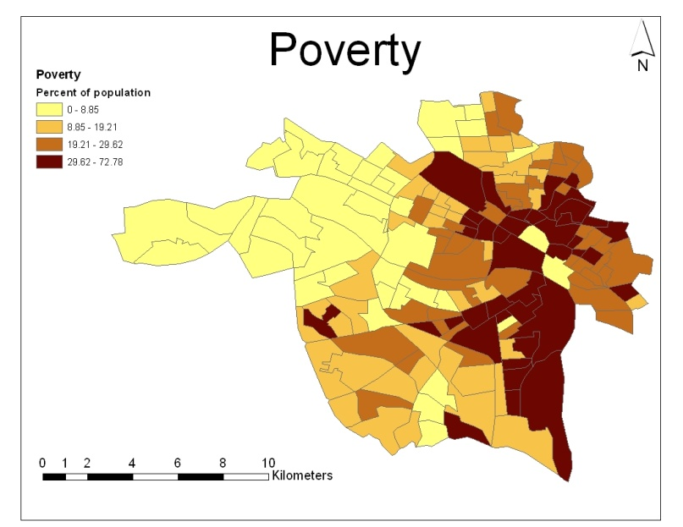
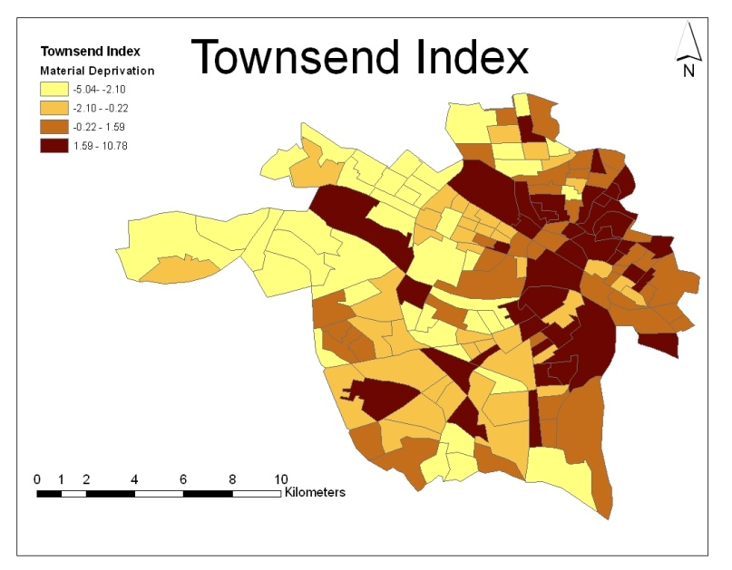
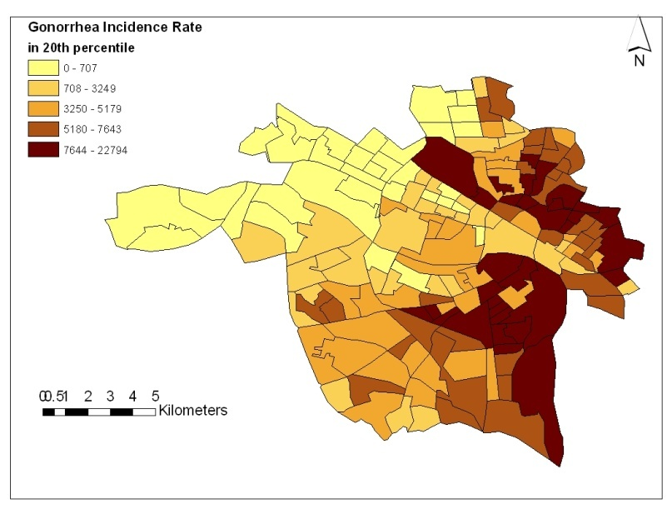
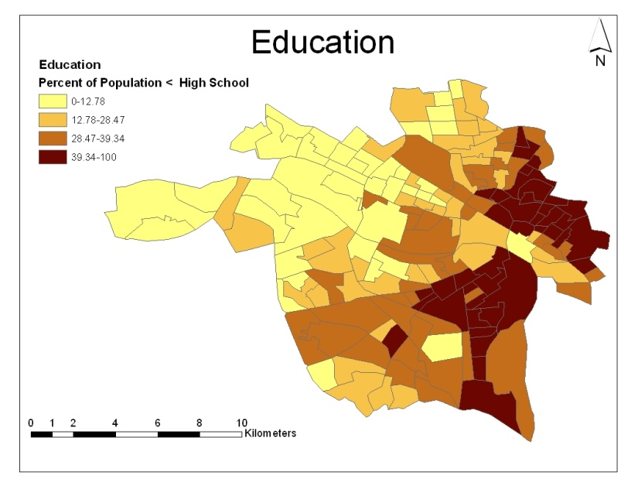
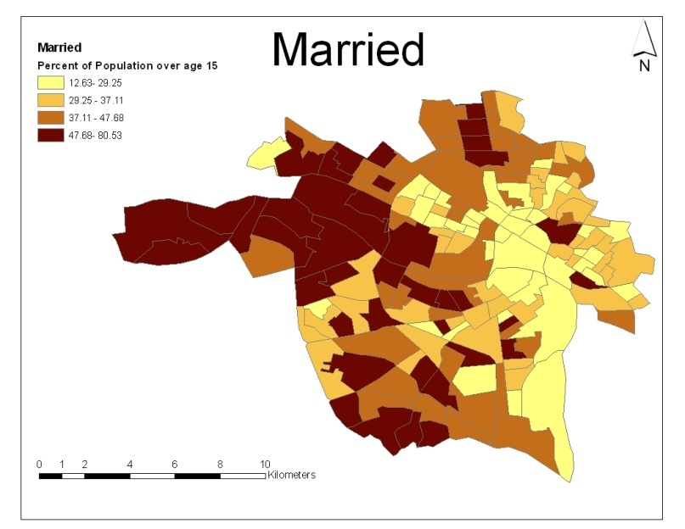

Gonorrhea
Education

Slide 28

Clusters identified by spatial scan statistics using SaTScan
The second largest cluster
Most likely cluster
The largest cluster
` | Blocks | Population | Observed | Expected | RR | LLR* | p value
 |  |  | Cases | Cases
Most Likely Clusters | 15 | 15,288 | 1840 | 778 | 2.67 | 560.85 | 0.0001
Secondary Clusters | 26 | 17,347 | 1668 | 843 | 2.21 | 358.86 | 0.0001
 | 4 | 4.807 | 476 | 262 | 1.86 | 72.57 | 0.0001
 | 22 | 22,538 | 1048 | 823 | 1.31 | 31.43 | 0.0001
 | 1 | 1,759 | 162 | 87 | 1.88 | 26.03 | 0.0001
 | 3 | 3,771 | 245 | 157 | 1.58 | 21.36 | 0.0001
 | 1 | 494 | 48 | 17 | 2.87 | 19.27 | 0.0001

Slide 29
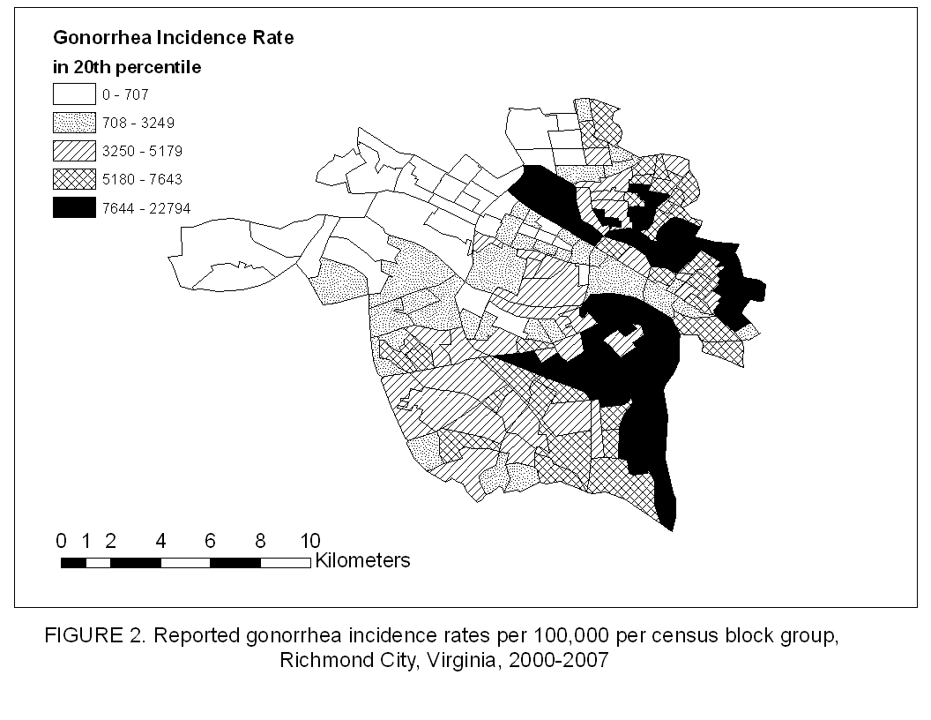

Spatial Analysis of Gonorrhea Incidence in Richmond, Virginia, 2000-2007

Slide 30
Geocoding
&
Data Management

Slide 31
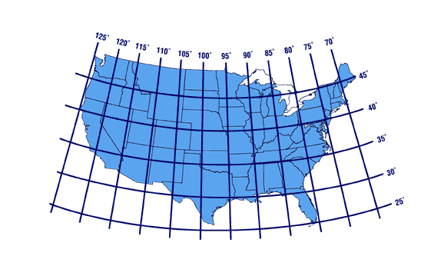
What is Geocoding?
Street Database
    Address:
    920 Main St.
    Richmond, VA 23220
905 Main St. X1, Y1
910 Main St. X2, Y2
920 Main St. X3, Y3
930 Main St. X4, Y4
940 Main St. X5, Y5
    Longitude (X3): -77.451723
Latitude (Y3): 37.550164

Slide 32
Healthy People 2010: Increase the proportion of all major national, state, and local health data systems that use geocoding to promote nationwide use of geographic information systems (GIS) at all levels.

Slide 33
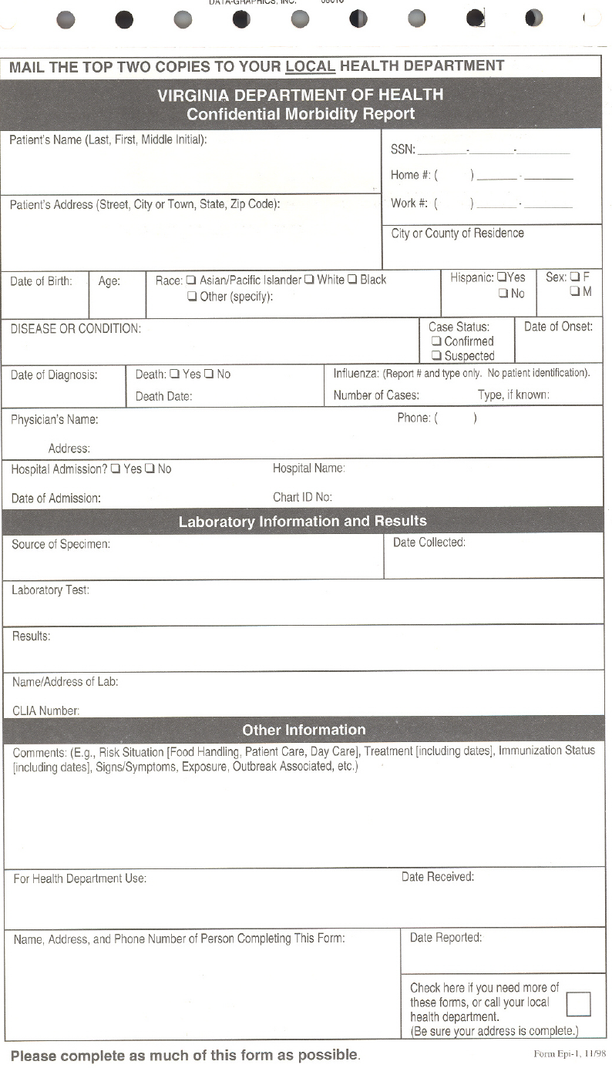
John Snow
0139 Vibrio cholerae Dr.
Richmond, VA, 23231

Slide 34
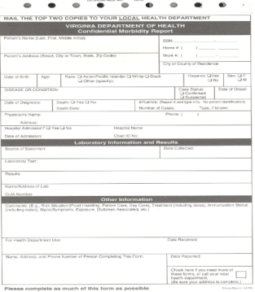
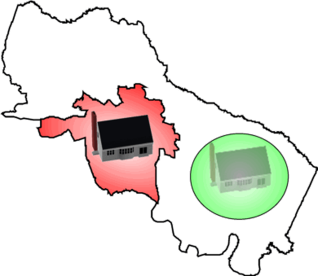
Reporting Form
Address:
0139 Vibrio Cholerae Dr.
Richmond, VA, 23231
Henrico
Richmond
Morbidity
Notes:
34

Slide 35
Independent cities
In Virginia, under state constitutional changes after the American Civil War (1861-1865), beginning in 1871, cities became politically independent of the counties. For many practical purposes, an independent city in Virginia since then has been comparable to a county. Many agencies of the U.S. Government consider Virginia's independent cities to be county-equivalents.
http://en.wikipedia.org/wiki/Lost_counties%2C_cities%2C_and_towns_of_Virginia#Independent_cities

Slide 36
Virginia is divided into independent cities and counties, which function in the same manner. According to the US Census Bureau, independent cities are considered county-equivalent.[58] Under Virginia law, all municipalities incorporated as cities are independent of any county. As of 2006, thirty-nine of the forty-two independent cities in the United States are in Virginia. Virginia does not have any political subdivisions, such as villages or townships, for areas of counties that are not within the boundaries of incorporated towns. There are hundreds of other unincorporated communities in Virginia, sometimes informally called towns.[59]
http://en.wikipedia.org/wiki/Virginia#Cities_and_towns

Slide 37
Name | Street | City | County | St | Zip
A Movable Feast | 1318 E Cary St | Richmond | Richmond City | VA | 23219
Azalea Food Market & Deli | 211 Azalea Ave. | Richmond | Richmond City | VA | 23227
Blimpie | 13969 Raised Anter | Midlothian | Richmond City | VA | 23112
Bogey's Bagels | 13520 Midlothian Trnpk | Midlothian | Richmond City | VA | 23113
Boychiks Deli | 4024-B Cox Rd | Richmond | Richmond City | VA | 23233
Café 1602 | 1602 Rolling Hill Dr | Richmond | Richmond City | VA | 23229
Carla's Kitchen | 920 W Grace St | Richmond | Richmond City | VA | 23220
Street_new | City_new | St | Zip_new | Longitude | Latitude | Census Block | FIPS | County_new | Code
1318 E CARY ST | RICHMOND | VA | 23219-4155 | -77.432889 | 37.534887 | 517600305001095 | 51760 | RICHMOND CITY | S80 AS0
211 AZALEA AVE | RICHMOND | VA | 23227-3621 | -77.424351 | 37.602463 | 510872008043000 | 51087 | HENRICO | S80 AS0
13969 RAISED ANTLER CIR | MIDLOTHIAN | VA | 23112-2005 | -77.663853 | 37.402642 | 510411010061024 | 51041 | CHESTERFIELD | S80 AS0
13520 MIDLOTHIAN TPKE | MIDLOTHIAN | VA | 23113-4214 | -77.649450 | 37.503059 | 510411009151016 | 51041 | CHESTERFIELD | S80 AS0
4024-B COX RD | RICHMOND | VA | 23233 | -77.619700 | 37.624400 | 51087200115 | 51087 | HENRICO | E022ZC5X
1602 ROLLING HILLS DR | RICHMOND | VA | 23229-5012 | -77.546885 | 37.601315 | 510872001043022 | 51087 | HENRICO | S80 AS0
920 W GRACE ST | RICHMOND | VA | 23220-4125 | -77.451723 | 37.550164 | 517600403001003 | 51760 | RICHMOND CITY | S80 AS0

Slide 38
Business Process Flowchart for Geocoding STD Morbidity:
City of Richmond, Chesterfield County and Henrico County, Virginia – 2006.

Slide 39
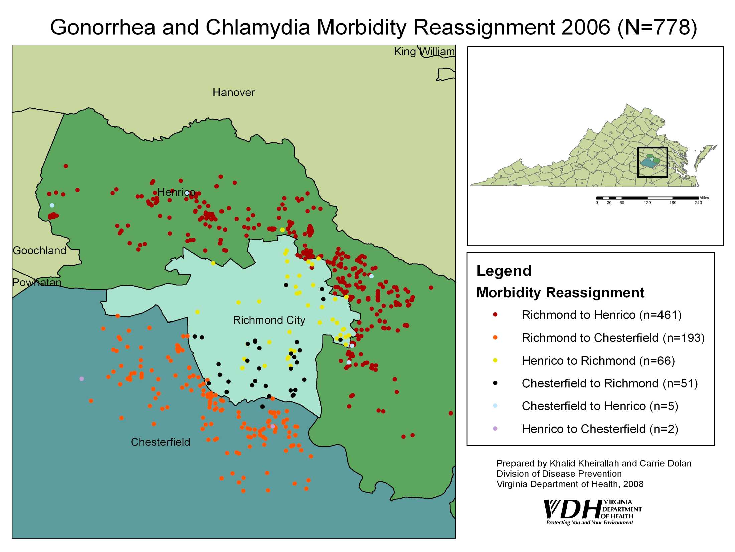

Slide 40
Net Gonorrhea and Chlamydia Morbidity Reassignment Percentages:
City of Richmond, Chesterfield County and Henrico County: 2002-2006

Slide 41
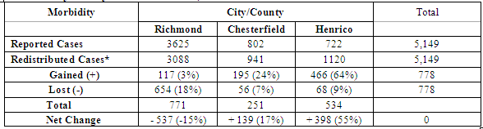
Distribution of Gonorrhea and Chlamydia Based on Geocoded Morbidity Assignments in the Tri-city/county Richmond Area^, 2006
*Non-geocodable cases (n=471) were retained within the city/county of initial morbidity report and are included in the
redistributed case counts for each city/county above. Hence, the total Reported Cases and Redistributed Cases are equal.
^ The Tri-City/County Richmond Area is comprised of the city of Richmond and the counties of Chesterfield and Henrico.

Slide 42
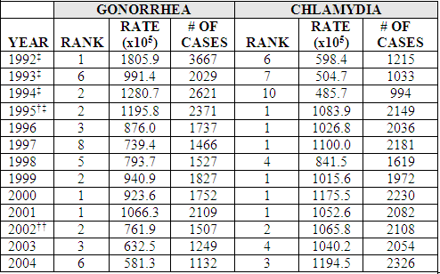
Ranking of Richmond, VA, based on National Summary of Gonorrhea and Chlamydia Rates among Cities >200,000 Population: 1992-2004*
* Data in this table was extracted from annual CDC Sexually Transmitted Disease Surveillance reports 9-21
‡ Data from 1992-1995 for chlamydia rankings is based on non-rank tables requiring manual calculation
† The Virginia Department of Health initiated increased chlamydia screening criteria (6/7/1995)22
†† Geocoding was implemented for all data beginning in January 2002

Slide 43
Check it out!
Stover, J., Kheirallah, K., Delcher, C., Dolan, C., Johnson, L.
Improving Surveillance of Sexually Transmitted Diseases Through Geocoded Morbidity Assignment
Public Health Reports - OASIS Suppl. Nov/Dec 2009. Vol 124. No. 5.

Slide 44
GIS
&
Privacy

Slide 45
Data Confidentiality
Geo-masking
  moving the point locations
  Transformations:
    Translation: shift all points a fixed distance and direction
    Scale: expand or contract all points by a scaling factor
    Rotation: rotate all points by a fixed angle about a pivot point
Random perturbation:
  Relocate randomly from original
  Most commonly used method
  Maps for public release – equivalent visual pattern
  Where is the point?
    Is it now in a lake?
    Urban vs rural
Aggregation
  Loss of geographic information
  Artificial boundaries
  Assumed homogeneity
Reverse geocoding
  432 of 550 (79%) patients in Boston
    Brownstein et al NEJM 2006

Slide 46
Random Perturbation in a GIS
Original
Detail
Geomasked
Stinchcomb, D.

Slide 47
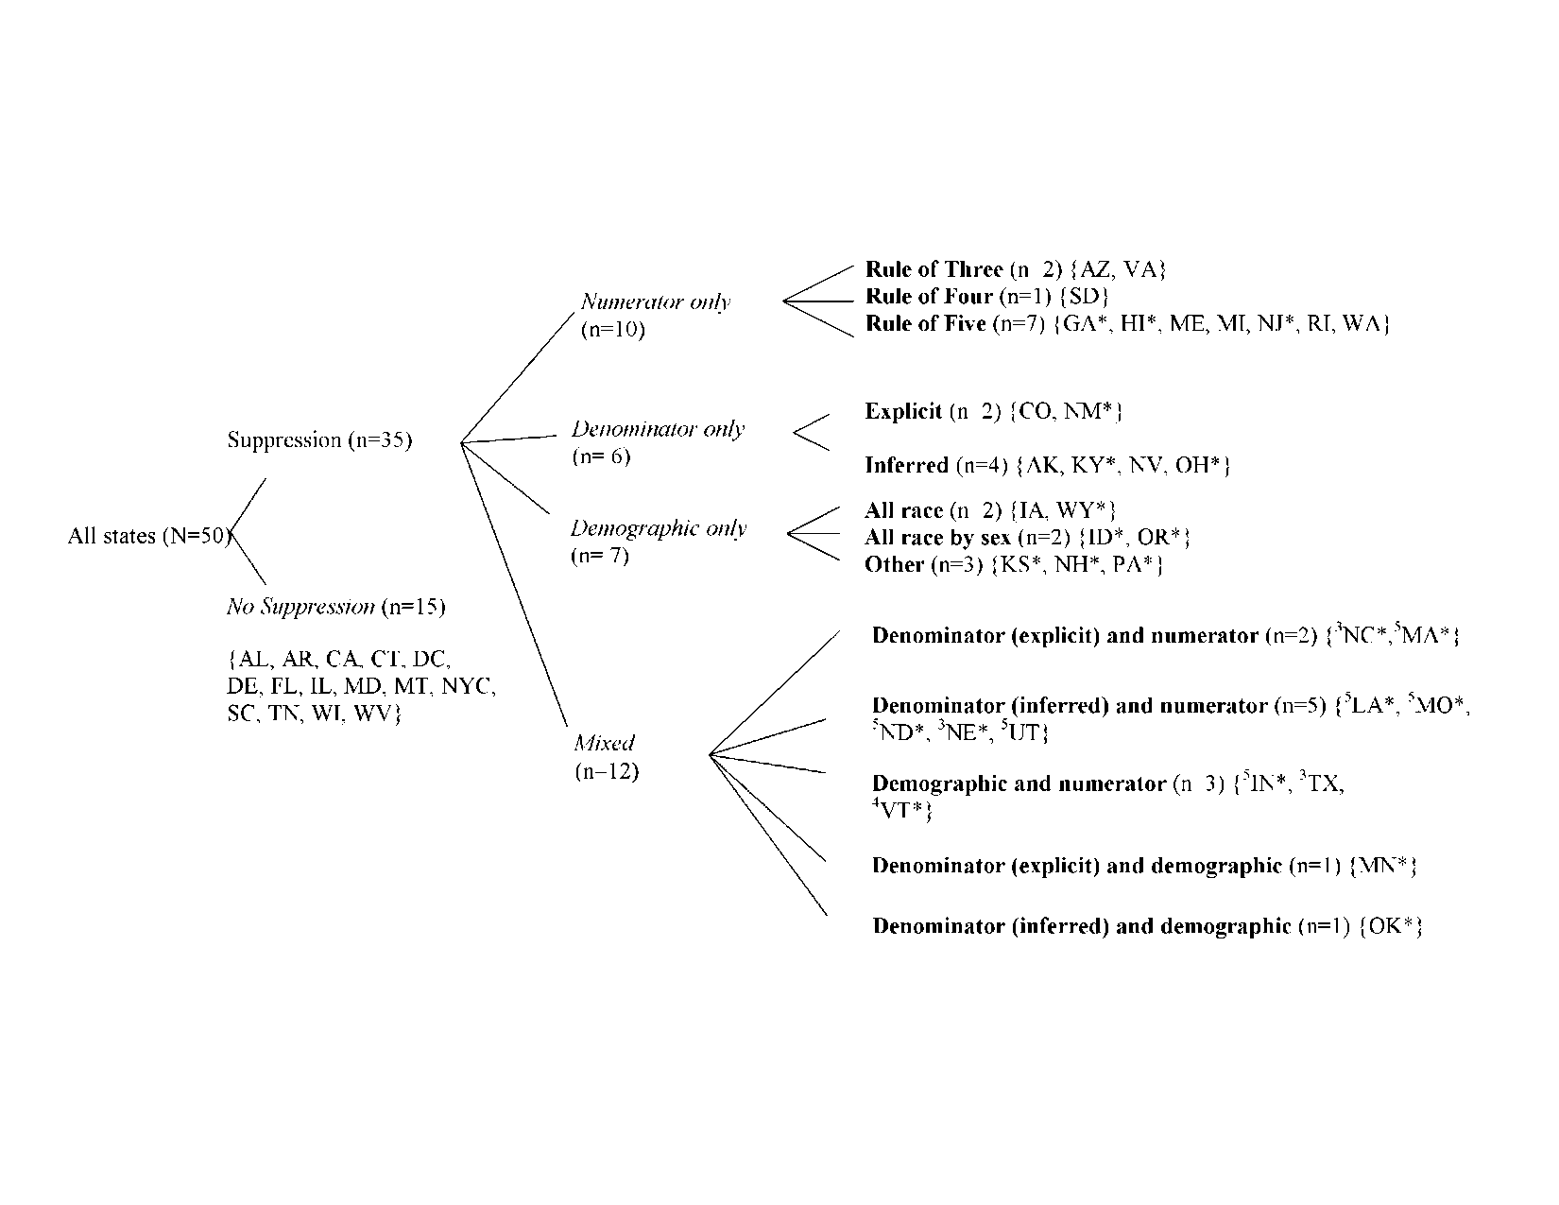
Notes:
47

Slide 48
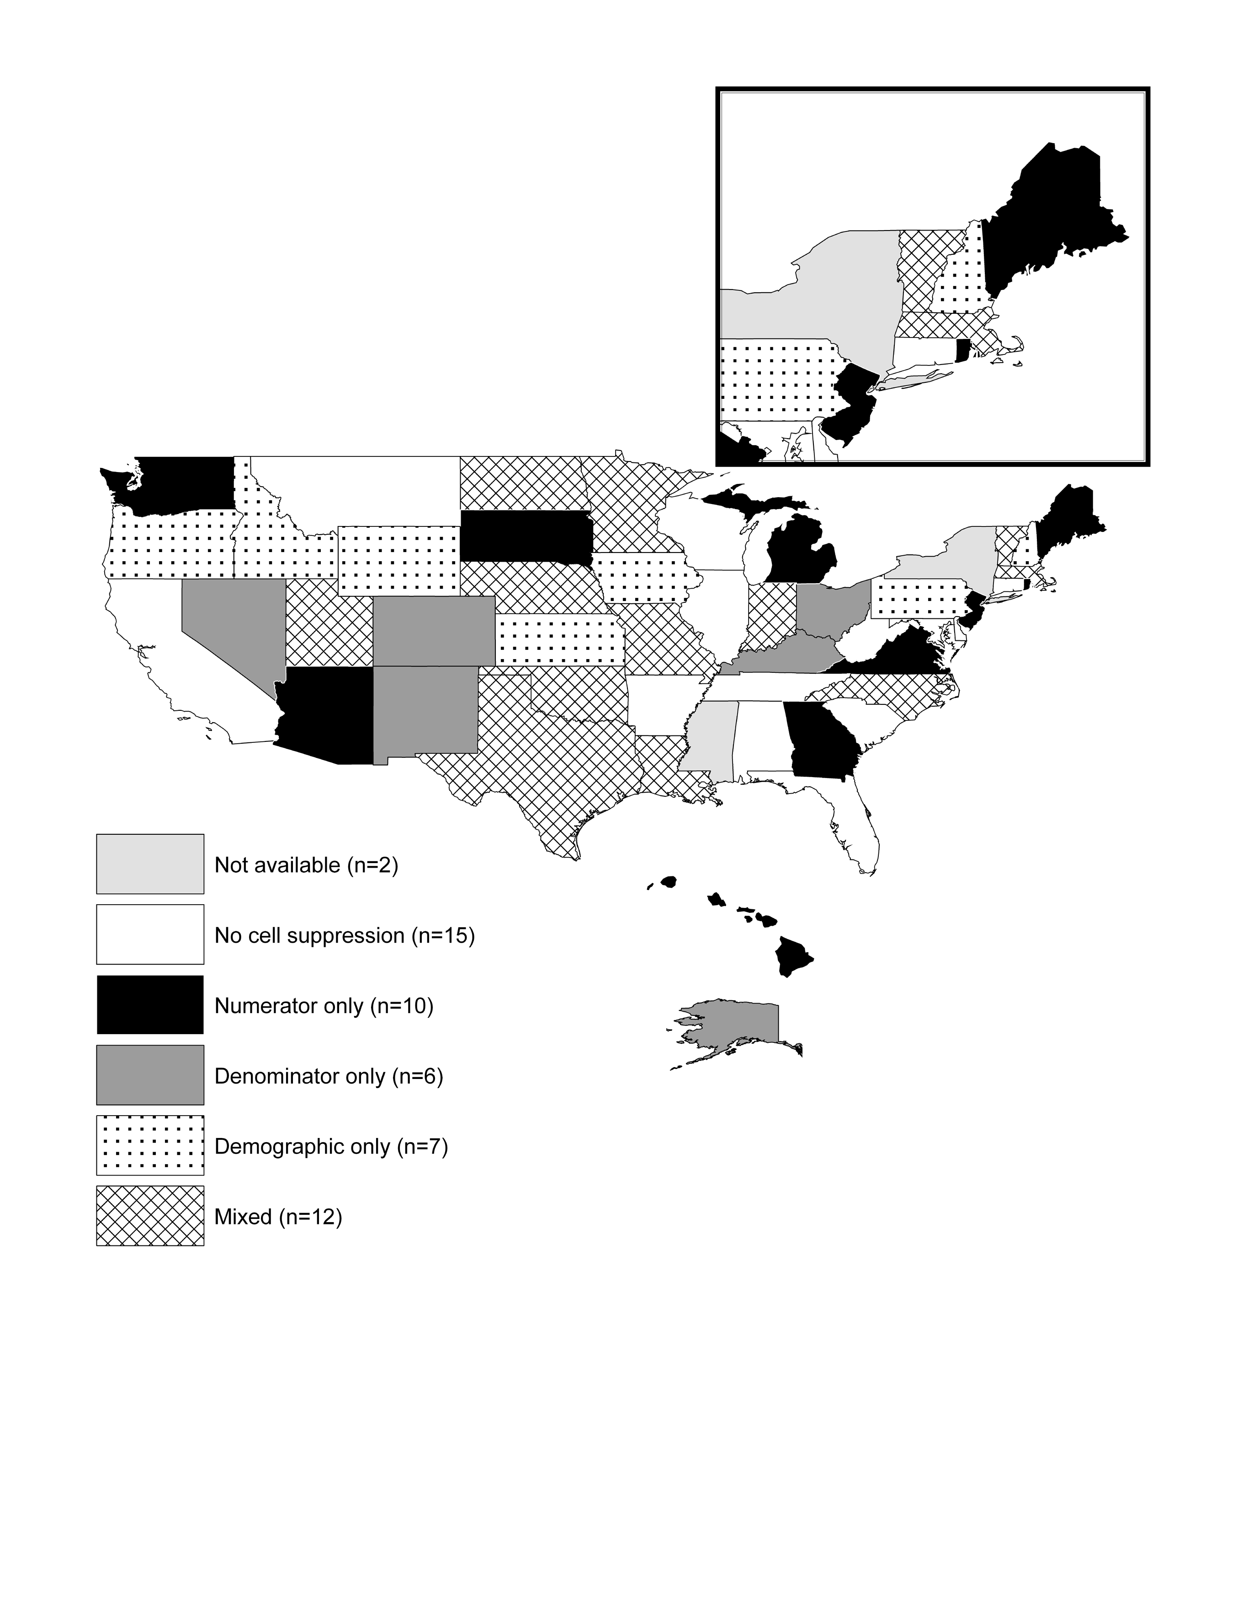
Notes:
48

Slide 49
Confidentiality
GIS is fairly new to STD surveillance
Technology has outpaced confidentiality standards
Is geocoded and/or mapped data easily identifiable?
  Use of rates, ranges, etc.
  Randomization of points, offsets
Need to establish guidance for users and recipients
  Data sharing agreements

Slide 50
“Mapping communicable diseases at detailed geographic scales raises significant concerns about privacy and confidentiality.”
Cromley and McLafferty, Guilford Press 2002.

Slide 51
“CDC recommends that data be released in the form that is closest to microdata and that still preserves confidentiality.”
CDC/ATSDR Policy on Releasing and Sharing Data

Slide 52
“Protected Health Information…[means] any information, whether oral, written, electronic, visual, pictoral, physical, or any other form, that related to an individual’s past, present, or future…condition, treatment, services…which reveals the identity of the individual…or where there is a reasonable basis to believe such information could be utulized to reveal the identity of that individual….this definition should be interpreted broadly.”
Model State Public Health Privacy Act

Slide 53
CDC Comments on Disclosure of Confidential Information
“Those assessing the risk that confidential information will be disclosed should recommend the statistical methods to be used for disclosure protection (e.g. suppression, random perturbations, recoding, top- or bottom-coding.) The recommended methods should balance the risk of disclosure against the possibility that reducing the risk of disclosure will also reduce the usefulness of the data for public health practice and research.”
This requires staff trained to assess such risks.

Slide 54
From CDC Guidelines for HIV/AIDS Surveillance, Appendix C: Security and Confidentiality
“Geographic information systems (GIS) allow for relatively accurate dot-mapping. Care must be taken that graphic (like numeric) presentation of data cannot permit the identification of any individual by noting pinpoint observations of HIV cases at, for example, the county, ZIP code, or census tract level.”
“Generally speaking, only aggregated HIV/AIDS surveillance data should be released outside the HIV/AIDS surveillance unit through published reports, grant applications, grant progress or planning reports, correspondence, newsletters, public meeting, or press releases.”

Slide 55
From CDC Guidelines for HIV/AIDS Surveillance, Appendix C: Security and Confidentiality
“In developing a data release policy, state and local HIV/AIDS surveillance programs should be mindful that, given the location of a particular case-patient, less obvious data elements could be linked together to identify an individual. For example, when releasing data on a community with relatively few members of a racial/ethnic group or age group, surveillance staff should be careful that release of aggregate data on the distribution of HIV-infected individuals by these categories could not suggest the identity of an individual.”
“As a rule, CDC will not release aggregated data in tables when cell size is three or less (on a national level.)”

Slide 56
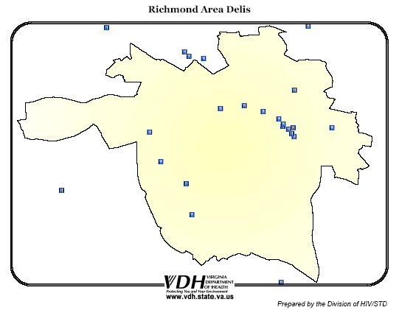

Slide 57
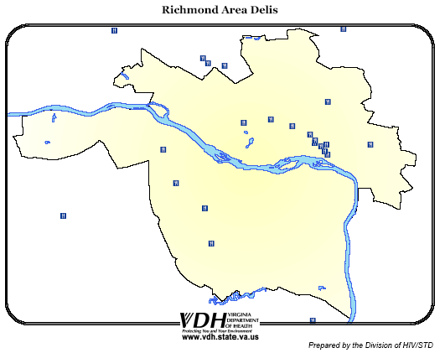

Slide 58
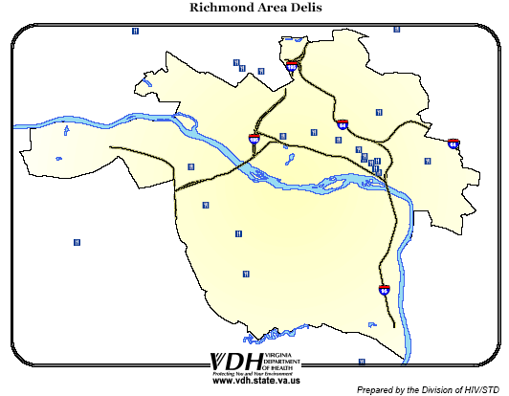

Slide 59
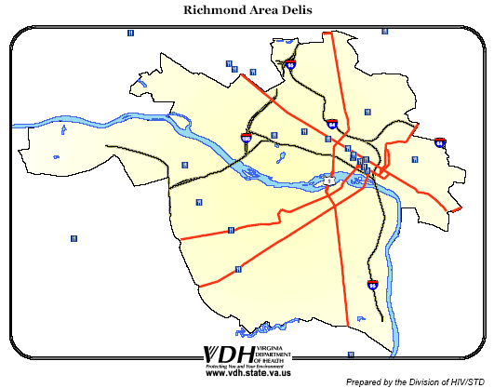

Slide 60
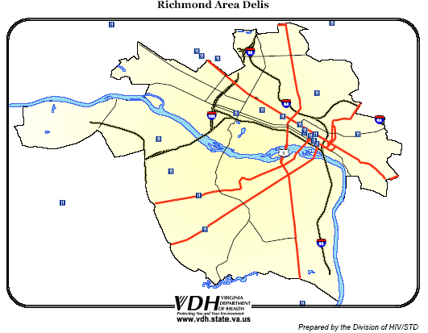

Slide 61
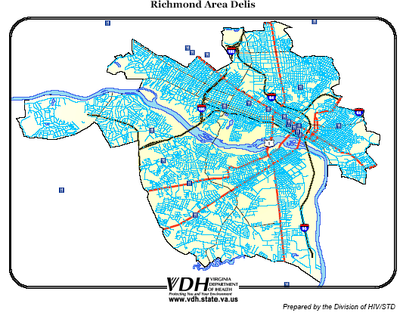

Slide 62
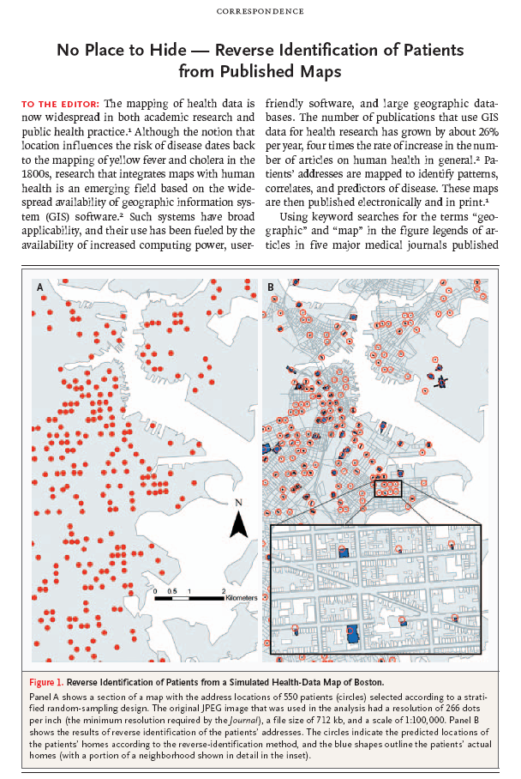
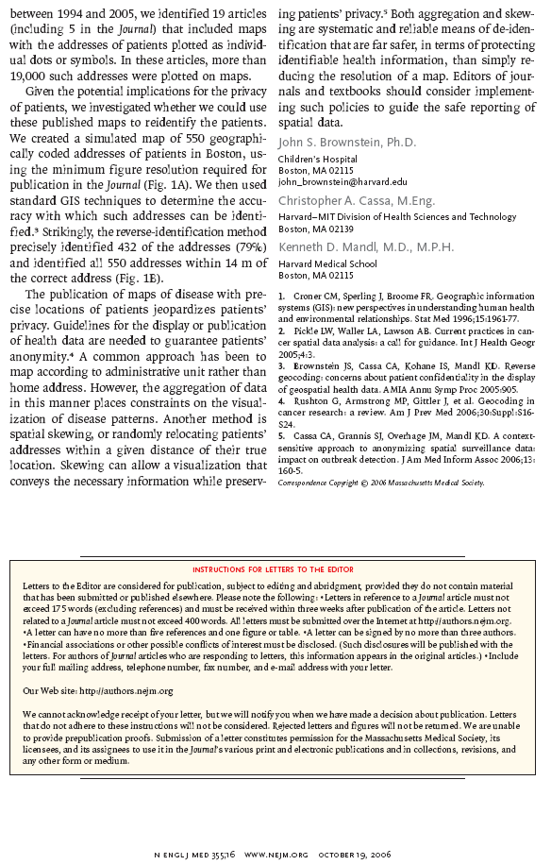

Slide 63
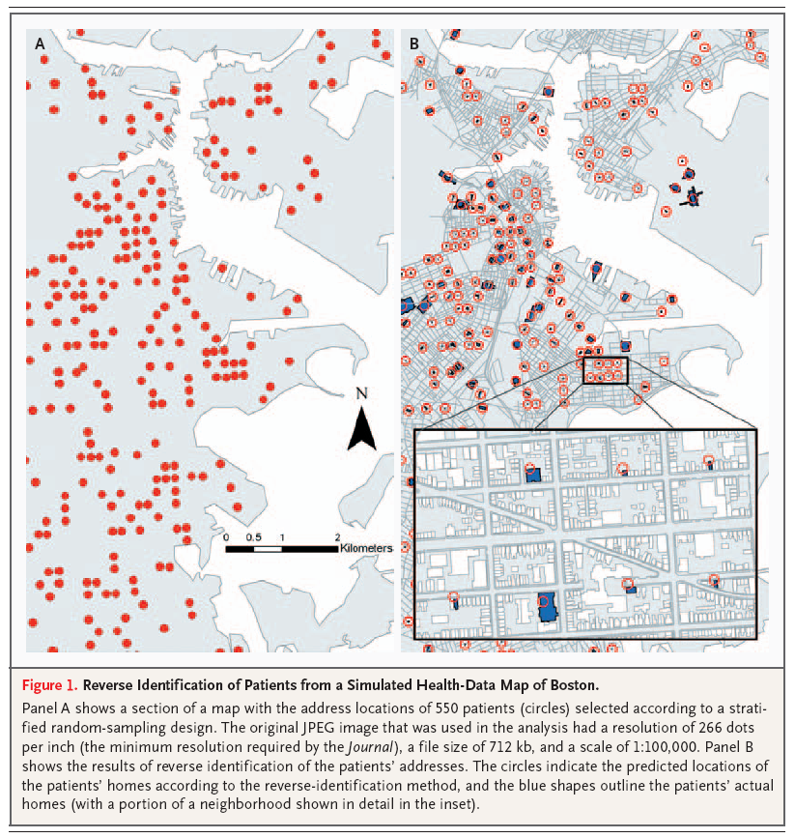

Slide 64
No Place to Hide
human health and map integration are now widespread, due to GIS availability
GIS-related research has grown by ~26% annually (4x more than human health research in general)
19 articles from 5 journals w/ >19,000 addresses
Reverse identification resulted in:

Slide 65
No Place to Hide
Reverse identification resulted in:
  Identification of 432 of 550 (79%) geographically coded addresses
  All addresses identified within 14m of correct address
Guidelines needed to guarantee patient anonymity
Aggregation of data, spatial skewing should become part of journal requirements

Slide 66
Your public health career…
be open to new tools
be flexible
be “cutting edge”
be visionary
be an opportunist

Slide 67
“The best way to predict the future is to create it”
Jeff Stover, MPH
Director, Health Informatics & Integrated Surveillance Systems
Division of Disease Prevention – Office Of Epidemiology
Virginia Department of Health
TEL: 804-864-7961
FAX: 804-864-7983
Jeff.stover@vdh.virginia.gov

