Slide 1
Tuberculosis
Introduction to Public Health/Communicable Diseases/Tuberculosis
An Old Disease – New Twists
A Continuing Public Health Challenge
Jane Moore, RN, MHSA
TB Consultant
Virginia Department of Health
Division of TB Control & Newcomer Health
2017

Slide 2
Tuberculosis – Old Disease
May have evolved from M bovis; acquired by humans from domesticated animals ~15,000 years ago
Endemic in humans when stable networks of 200-440 people established (villages) ~ 10,000 years ago; Epidemic in Europe after 1600 (cities)
354-322 BC - Aristotle – “When one comes near consumptives… one does contract their disease… The reason is that the breath is bad and heavy…In approaching the consumptive, one breathes this pernicious air. One takes the disease because in this air there is something disease producing.”

Slide 3
Tuberculosis
1882 – Robert Koch – “one seventh of all human beings die of tuberculosis and… if one considers only the productive middle-age groups, tuberculosis carries away one-third and often more of these…”

Slide 4
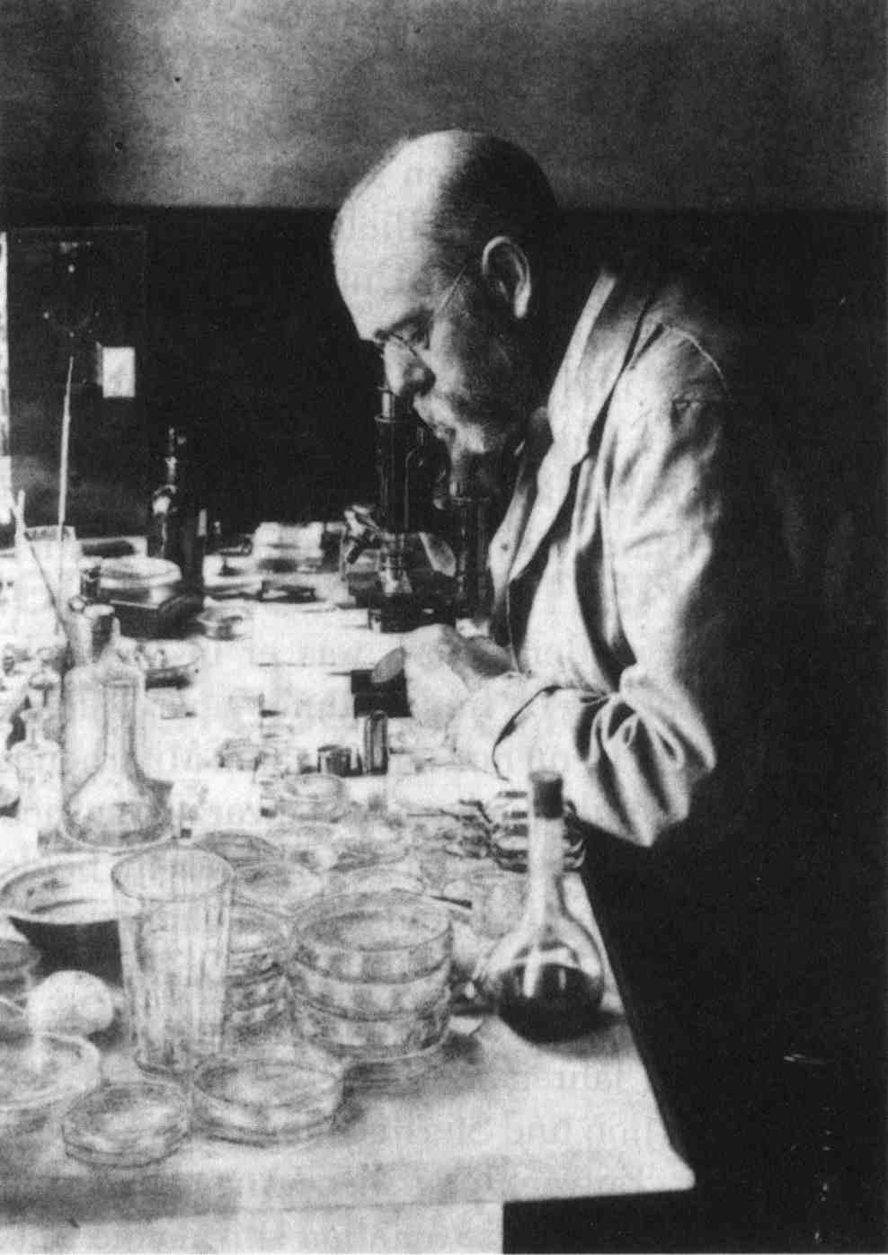
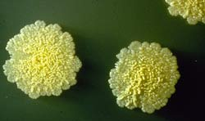
M tuberculosis as causative agent for tuberculosis
Robert Koch
1886

Slide 5
TB in the US – 1882-2016
1900-1940 TB rates decreased in the US and Western Europe before TB drugs available
Better nutrition, less crowded housing
Public health efforts
Earlier diagnosis
Limit transmission to close contacts
TB sanatoria
Surgery

Slide 6
TB in the US – 1882-2016
1940s-1960s TB specific antimicrobial agents
Single drugs – use produced resistance
Multiple drugs
1960s-1980s TB considered a non-problem
TB treatment moved to private sector
Loss of TB-specific public health infrastructure

Slide 7
TB in the US – 1882-2016
1990s TB re-emerges as a threat
TB-HIV co-infection
Drug-resistant TB
Globalization allows TB to travel
1990s Increased support for TB prevention and control
Funding for public health efforts (case management, contact investigation, directly observed therapy
Better diagnostic and patient management tools
2016
Lowest number of reported cases in US

Slide 8
TB in the United States: 2016
9,546 new cases reported in 2016
Lowest incidence rate of 2.9/100,000
US born rate declined 8.4% to 1.1/100,000
Foreign born rate declined 3.2% to 14.6/100,000
Notes:
2.7% decrease in the number of cases compared to 2015
Foreign born incidence rate remains 13.7 times higher than usborn
Epidemiologic modeling by CDC suggests if the decline in TB continues to at this pace it will not be possible to eliminate TB in this century

Slide 9
TB in the US
Continuing challenges
Reliable access to TB drugs
Emerged as major issue during late 2012 and 2013
Regulatory requirements limit access to international supplies
Loss of expertise
Clinical
Laboratory
Program
Concentration of remaining cases in difficult to reach populations
Need to address large pool of persons with TB infection

Slide 10
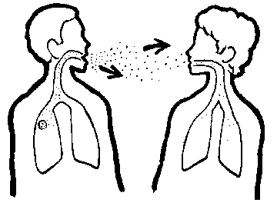
TB: Airborne Transmission

Slide 11
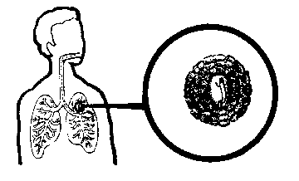
TB Invades/Infects the Lung
Effective immune
response
Infection limited
to small area of lung
Immune response
insufficient

Slide 12
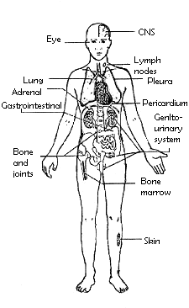
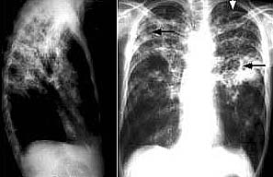
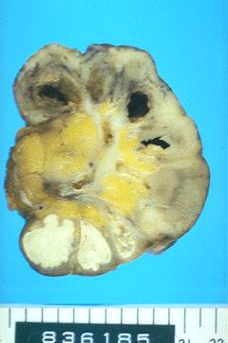
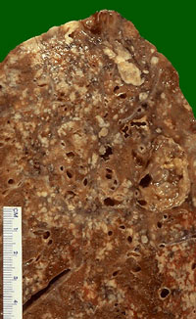
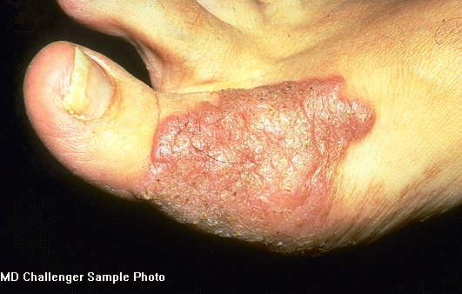
TB – A Multi-system Infection

Slide 13
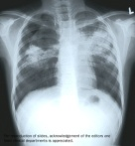
Natural History of TB Infection
Exposure to TB
No infection
(70-90%)
Infection
(10-30%)
Latent TB
(90%)
Active TB
(10%)
Never develop
Active disease
Untreated
Treated
Die within 2 years
Survive
Die
Cured

Slide 14
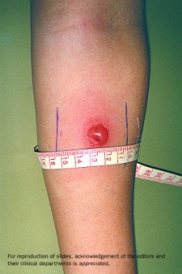
Latent TB vs. Active TB
Latent TB (LTBI) (Goal = prevent future active disease)
= TB Infection
= No Disease
= NOT SICK
= NOT INFECTIOUS
Active TB (Goal = treat to cure, prevent transmission)
= TB Infection which has
progressed to TB Disease
= SICK (usually)
= INFECTIOUS if PULMONARY (usually)
= NOT INFECTIOUS if not PULMONARY (usually)

Slide 15
Treatment
Most TB is curable, but…
Four or more drugs required for the simplest regimen
6-9 or more months of treatment required
Person must be isolated until non-infectious
Directly observed therapy to assure adherence/completion recommended
Side effects and toxicity common
May prolong treatment
May prolong infectiousness
Other medical and psychosocial conditions complicate therapy
TB may be more severe
Drug-drug interactions common

Slide 16
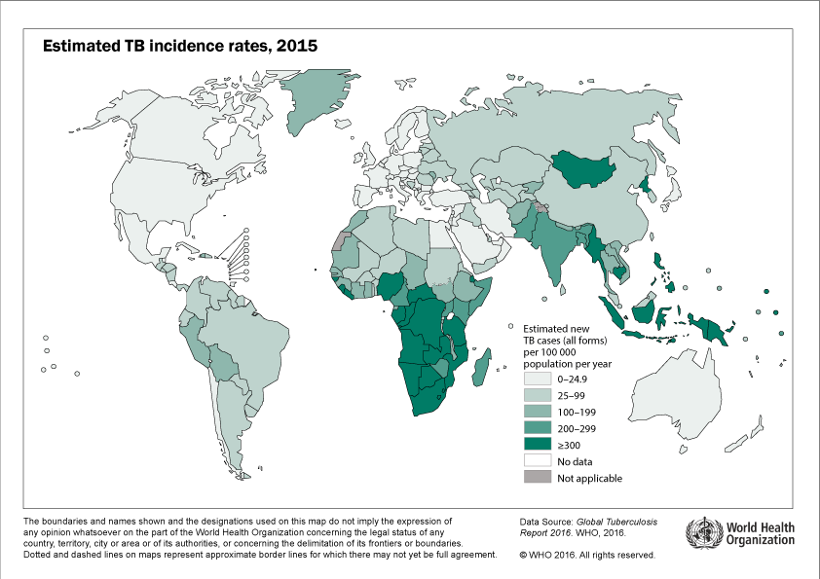
Notes:
In 2015, 14 million active tB cases were reported.
1.8 million deaths among people with TB
480,000 mdr cases reported

Slide 17
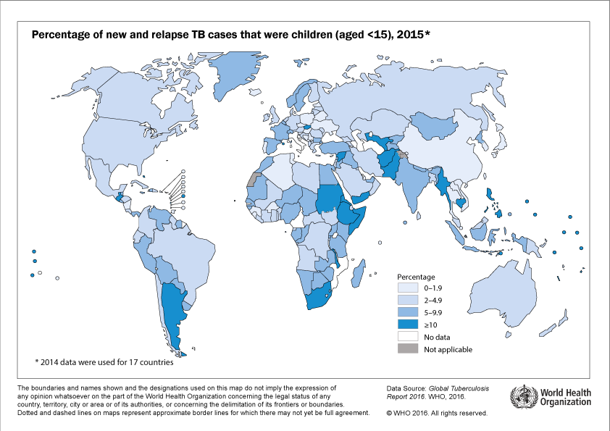

Slide 18
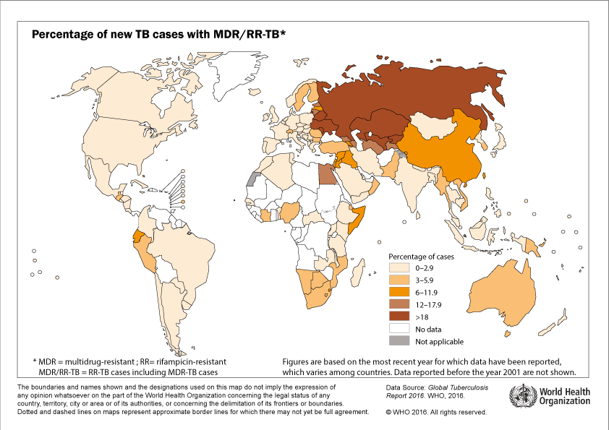

Slide 19
TB Case Rate per 100,000 VA and US: 2012-2016
Year | Virginia TB Cases | Virginia TB Rate | US TB Cases | US TB Rate
2012 | 235 | 2.9 | 9,951 | 3.2
2013 | 179 | 2.2 | 9,582 | 3.0
2014 | 198 | 2.4 | 9,412 | 3.0
2015 | 212 | 2.5 | 9,563 | 3.0
2016 | 205 | 2.4 | 9,546 | 2.9
Notes:
Virginia saw a decrease of 3.3% in the number of cases and 3.8% in the rate from 2015-2016
For the United States, the number of cases decreased 2.7% and the rate declined 3.4%

Slide 20
TB – continues as a public health issue in the United States
Old public health concepts (isolation of infectious individuals, closely monitored treatment, recognition and preventive treatment for infected contacts,) are still critical, but will not eradicate TB
Care providers not familiar with signs/symptoms of TB
Diagnosis delayed
Inappropriate treatment
Drug resistance due to improper use of drugs
Must address both US born and newcomer populations
Older, remote exposure
Incarcerated, homeless, history of drug , alcohol use
Newcomers from high TB prevalence areas

Slide 21
Challenges to Public Health System
Public health workers must:
Educate, coordinate care with private sector
Identify support services (food, housing)
Treat TB in geriatric populations
Treat TB in children
Deal with alcohol, drug abusing, incarcerated and/or homeless patients
Manage TB in patients with underlying medical conditions
Provide culturally appropriate care for non-English speaking/non-literate populations
Treat TB cases with drug- resistant TB

Slide 22
VA TB Cases by Region: 2007-2016
Notes:
High Low
Northwest 27 (2006) 12 (2013)
Southwest 22 (2004) 9 (2013)
Central 52 (2005) 29 (2011)
Eastern 82 (2005) 22 (2013)

Slide 23
VA TB Cases by Race/Ethnicity: 2007-2016

Slide 24
VA TB Cases by Age Group: 2007-2016
Notes:
Largest decline this year was among those age 64 and older.

Slide 25
VA Foreign vs. US Born TB Cases: 2007-2016
Notes:
FB are now 81% of Virginia cases compared to 68% in the US

Slide 26
VA Foreign Born TB Cases by Years in the US at Start Treatment: 2007-2016
Notes:
Will not add up to total FB as some people did not start treatment.

Slide 27
VA TB Cases Top Five Countries of Origin: 2007-2016
2007 | 2008 | 2009 | 2010 | 2011 | 2012 | 2013 | 2014 | 2015 | 2016
Philippines | India | Ethiopia | Ethiopia | India | India | Ethiopia | India | Philippines | India
El Salvador | Viet Nam | Viet Nam | Viet Nam | Ethiopia | Mexico | India | Viet Nam | India | Philippines
India | Philippines | India | India | Philippines | Philippines | Viet Nam | S. Korea | Ethiopia | Ethiopia
Bolivia | Ethiopia | Philippines | Philippines | Viet Nam | South Korea | Philippines | Ethiopia | Korea | Viet Nam
Mexico | Mexico | Nepal | South Korea | Mex,ChinaNepal | Viet Nam | El Salvador | El Salvador & Philippines | Peru | El Salvador

Slide 28
Addressing the Challenges – TB Control in the US
Current TB Control efforts will not achieve the US goal of < 1 case per million persons
Continued surveillance and active prevention measures needed
Need to address latent TB infection
Reportable?
Challenges of long treatment
How to reach the foreign born populations
Predicting who with TB infection will develop active disease

Slide 29
Addressing the Challenges – TB Control in the US
Local, state and federal programs have separate but closely related activities
Guidelines, Laws and Regulations
Guidelines – treatment, contact investigation, prevention – data driven/expert opinion – some are a decade old
Laws – local or state – case reporting, isolation of infectious individuals
Regulations - local or state – implement laws
Federal laws/regulations – travel restrictions, entry into the US – no interstate restrictions
International travel regulations – WHO – limited

Slide 30
Elements of a Tuberculosis Control Program
X-ray
Inpatient care
Targeted testing/
LTBI treatment
Clinical
Services
Pharmacy
Medical evaluation
and follow-up
Non-TB medical
services
Social
services
Laboratory
Interpreter/
translator
services
HIV testing and
counseling
Patient
education
Data collection
DOT
Coordination of
medical care
Epidemiology
and Surveillance
Contact
investigation
Home
evaluation
Case
Management
Provider Education & Training
Outbreak
Investigation
Data analysis
Housing
Data for national
surveillance report
Follow-up/treatment
of contacts
Isolation,
detention
QA, QI for case
management
Consultation &
technical assistance
Program evaluation &
planning
Federal TB
Control Program
State TB Control Program
Guidelines
Information for public
State statutes,
regulations,
policies, guidelines
Funding
National surveillance
Training
Technical assistance
Funding

Slide 31
VA Laws and Regulations
VA statute and implementing regulations
TB (suspected and confirmed) reportable
HCP and laboratory responsible for reporting
Treatment plan signed by HD required prior to hospital discharge
Antimicrobial sensitivity testing required
M.tb isolate must be submitted to state laboratory
HD can require patient to appear for examination, counseling
Limited ability to require treatment
Detention order possible if failure to cooperate puts others at risk
http://www/vdh.virginia.gov/tb

Slide 32
Laws and regulations vs. Guidelines
Guidelines
Not laws
Current PHS TB guidelines
Evidence based
Extensively reviewed by experts
Intended to guide, not dictate
Often become standard of care
Exceptions may be justified, should be documented
http://www.vdh.virginia.gov/tb
http://www.cdc.gov/tb

Slide 33
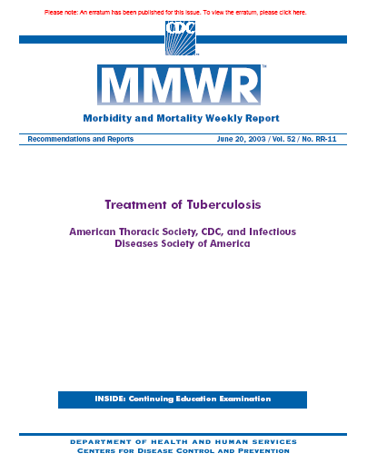
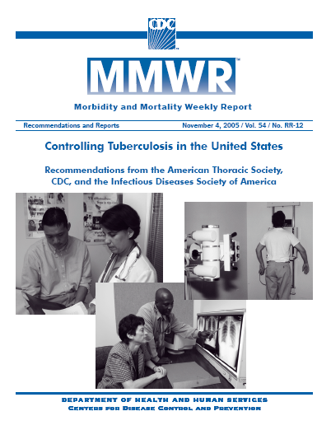
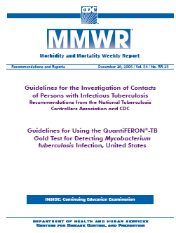
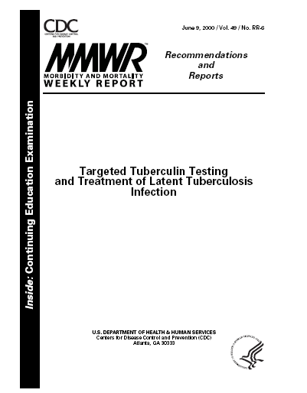
VDH TB Prevention and Control Policies and Procedures
Based on USPHS/CDC, ATS, IDSA and Pediatric “Red Book” guidelines
Adapted to address uniquely Virginia issues

Slide 34
Questions?
Thank you
Jane Moore
Jane.moore@vdh.virginia.gov

