Slide 1
Psychiatric and neurological conditions
Briana Mezuk, PhD bmezuk@vcu.edu

Slide 2
Leading causes of DALY worldwide:
Psychiatric disorders and related health conditions
100,000
Adapted from Murray & Lopez The Lancet (1997)

Slide 3
A brief survey
Q1: What is the most common psychiatric disorder in the general population?
Q2: Are men and women equally likely to develop a psychiatric disorder?
Q3: Do most disorders onset >30 years of age?
Q4: What proportion of people with a psychiatric disorder get treatment?

Slide 4
Lifetime (*12mon) prevalence of psychiatric disorders by gender
Externalizing
Internalizing
%
Notes:
Int J Methods Psychiatr Res. 2012 Aug 1. doi: 10.1002/mpr.1359. [Epub ahead of print]
Twelve-month and lifetime prevalence and lifetime morbid risk of anxiety and mood disorders in the United States.
Kessler RC, Petukhova M, Sampson NA, Zaslavsky AM, Wittchen HU.
Drug Alcohol Depend. 2004 Jun 11;74(3):223-34.
The 12-month prevalence and trends in DSM-IV alcohol abuse and dependence: United States, 1991-1992 and 2001-2002.
Grant BF, Dawson DA, Stinson FS, Chou SP, Dufour MC, Pickering RP.
JAMA. 2004 May 5;291(17):2114-21.
Prevalence of marijuana use disorders in the United States: 1991-1992 and 2001-2002.
Compton WM, Grant BF, Colliver JD, Glantz MD, Stinson FS.
Biol Psychiatry. 2005 Jun 1;57(11):1442-51.
Patterns and predictors of attention-deficit/hyperactivity disorder persistence into adulthood: results from the national comorbidity survey replication.
Kessler RC, Adler LA, Barkley R, Biederman J, Conners CK, Faraone SV, Greenhill LL, Jaeger S, Secnik K, Spencer T, Ustün TB, Zaslavsky AM.
Psychol Med. 2006 May;36(5):699-710. Epub 2006 Jan 26.
Prevalence, subtypes, and correlates of DSM-IV conduct disorder in the National Comorbidity Survey Replication.
Nock MK, Kazdin AE, Hiripi E, Kessler RC.

Slide 5
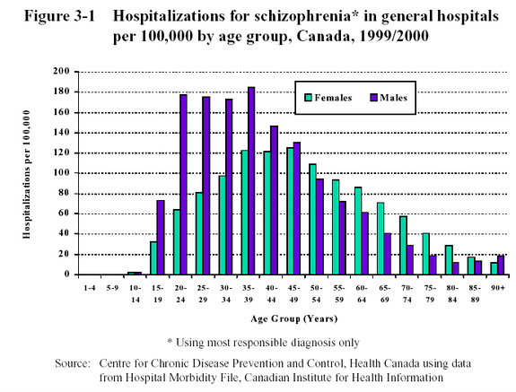
Age of onset of schizophrenia

Slide 6
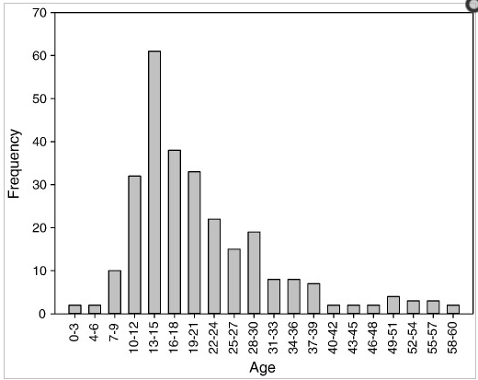
Age of onset: major depression
J Affect Disord. Apr 2012; 138(1-2): 173–179.

Slide 7
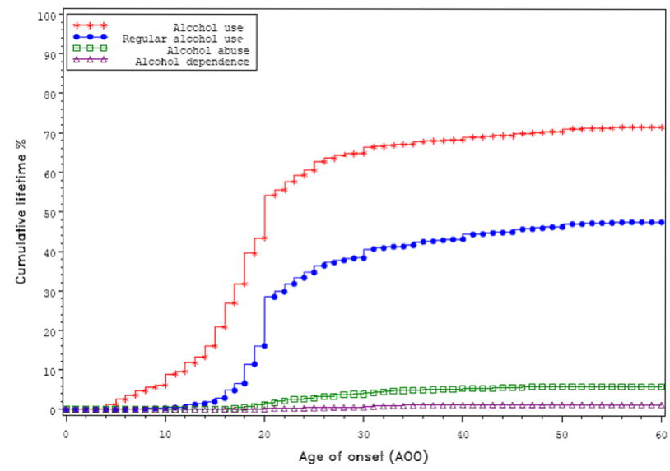
Age of onset: Alcohol abuse/dependence
Addiction. Aug 2009; 104(8): 1313–1323.

Slide 8
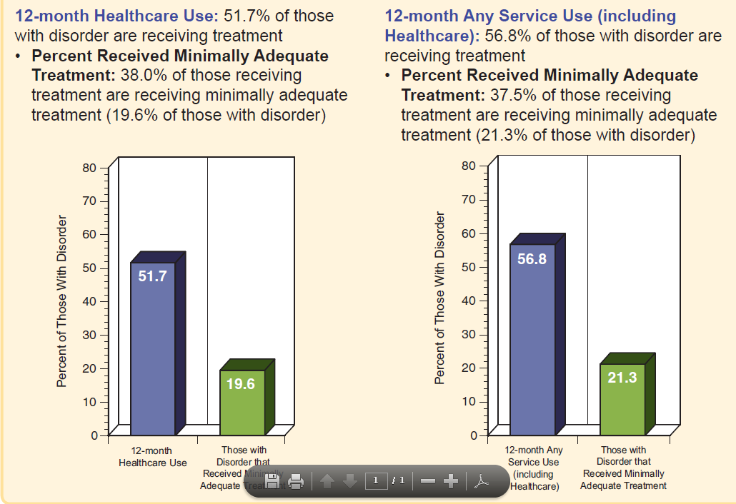
Major depressive disorder
Wang et al. 2005
Notes:
MD cases in treatment are (1) more educated, (2) more wealthy, and (3) have more severe symptomology than MD cases in the community.
Other health issues that you study in which it is reasonable to think that cases in clinics would be different than cases in the general community?

Slide 9
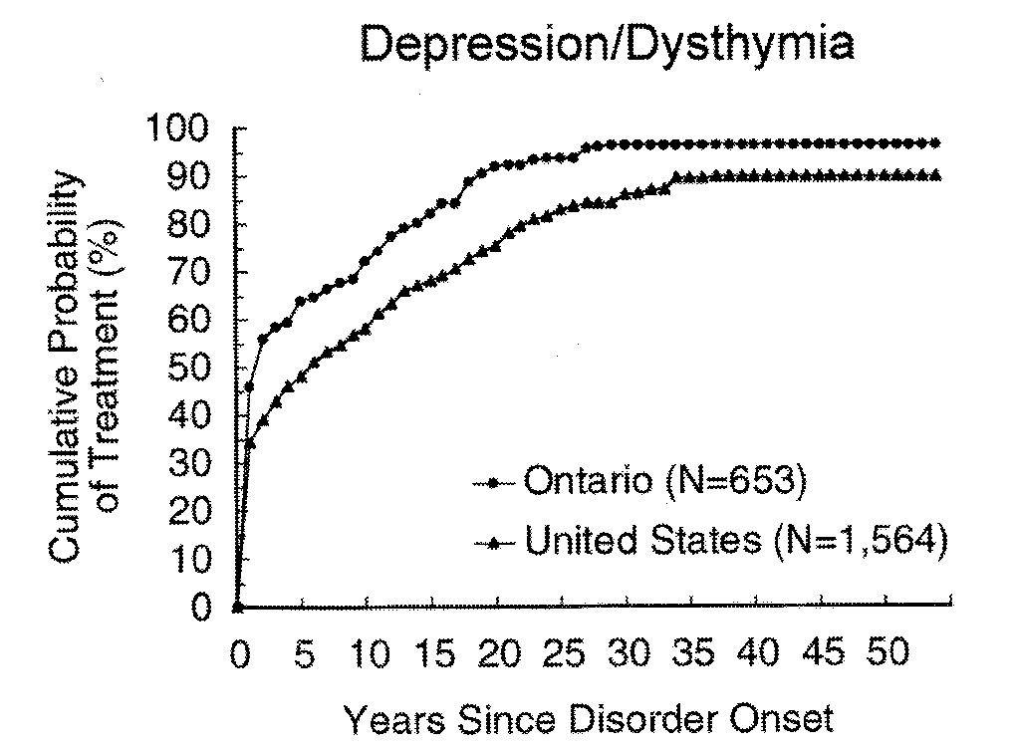
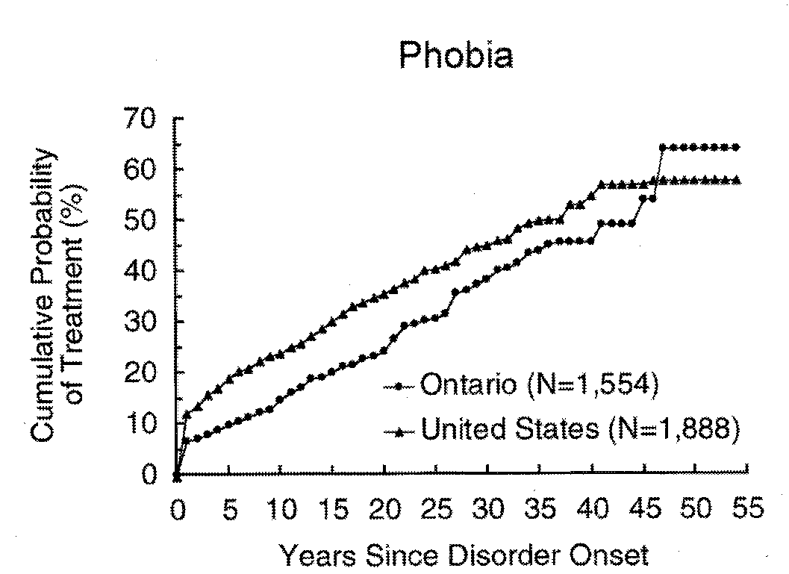
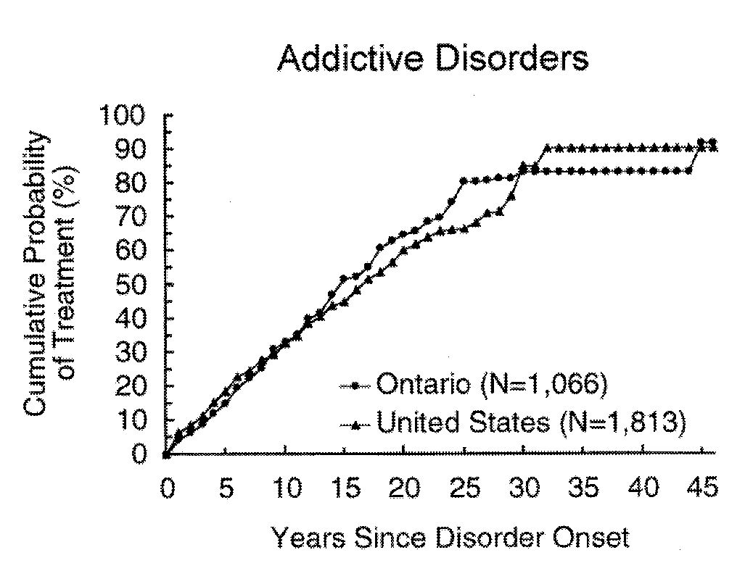
Time from disorder onset to first treatment* contact
Notes:
Am J Psychiatry. 1998 Oct;155(10):1415-22.
Psychiatric disorder onset and first treatment contact in the United States and Ontario.
Olfson M, Kessler RC, Berglund PA, Lin E.

Slide 10
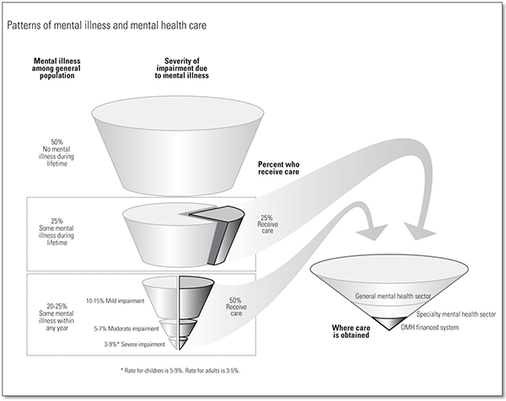
Pathways to mental health care

Slide 11
A brief survey
Q1: What is the most common psychiatric disorder in the general population? Major depression
Q2: Are men and women equally likely to develop a psychiatric disorder? Yes, but…
Q3: Do most disorders onset >30 years of age? No
Q4: What proportion of people with a psychiatric disorder get treatment? ~50%, but depends on the disorder

Slide 12
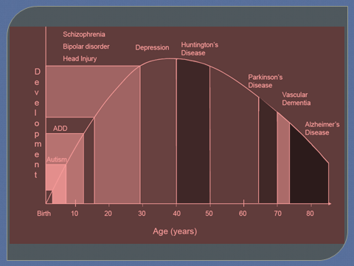
Outline for today
Orientation to psychiatric epidemiology
Three conditions across the lifespan
  Childhood: Autism
  Adulthood: Schizophrenia
  Later adulthood: Dementia

Slide 13
Getting oriented to psychiatric epidemiology

Slide 14
Getting oriented to psychiatric epidemiology
Population: N>1 individuals having some characteristic in common (e.g., geography, religious affiliation, gender, race)
  Demography: study of the size/density/distribution of populations (Census)
  Epidemiology: study of the distribution and determinants of disease in a population
Group: N>1 individuals bound together by a community of interest or function
  Sociology: Study of human groups
History of psychiatric epidemiology is rooted in sociology
  Strongest predictors of psychiatric disorders are social factors (e.g., exposure to trauma/violence/abuse; social disruptions like divorce/widowhood/unemployment; peer and family influences) and expression of distress (psychopathology) is influenced by social factors
Notes:
Reliability: the degree to which 2 or more assessments agree (whether multiple raters of a case, the same test given at different times, items on a scale that are addressing the same construct). Quantifiable: r^2, alpha, kappa, inter-rater agreement
Validity: the degree to which a measure captures the construct it is purporting to assess; the degree to which a metric matches with the “true state” of the world. Not readily quantifiable (content validity, construct validity)
Reliability is a pre-requisite for validity. Measures cannot be valid indicators if they are not reliable indicators.

Slide 15
Key concepts of the developmental framework that can be applied to epidemiologic research
Psychopathology often starts early in life
Developmental appropriateness is key
  Separation anxiety as a 16 month old vs. 16 year old
Dimensional approach to psychopathology
  Shyness vs. social anxiety
  Grief or “demoralization” vs. depression

Slide 16
Key concepts of the developmental framework that can be applied to epidemiologic research
Acute vs. cumulative events
  Acute events can beget more events (ex. Lose home in hurricane -> have to move -> lose social ties -> financial insecurity -> family disruption)
  Acute events aren’t always acute (ex. Divorce)
Continuities vs. discontinuities across developmental periods
  Conduct disorder and ASPD
  Social isolation and psychotic disorder
The effects of etiologic factors may be age-dependent
  Sensitive periods (ex. Institutionalization, parental loss)
The consequences of psychopathology may be age-dependent
Development is a life-long process
  Age – Period – Cohort

Slide 17
Implications of the developmental framework for study design
Longitudinal studies key to understand the “Natural history”
  Incidence
  Course
  Recurrence
Statistical methods that can adequately model
  Context (family, peer, neighborhood)
  Continuities/discontinuities
  Change over time
Samples of both normative and non-normative processes
  Community sample vs. trauma exposed
    Romanian orphan study

Slide 18
Childhood: Autism

Slide 19
What kids do
Developmental period | Activities
0-5 | Attachment to caregivers Fine & gross motor Language Differentiate self from environment Self-control and compliance
5-10 | School adjustment (attendance, conduct) Academic achievement (learning to read, math) Socializing with peers Rule-governed conduct (prosocial conduct)
10-18 | Successful transition to secondary school Academic achievement/higher-order skills Involvement in prosocial extracurricular activities Forming close relationships within & across gender Forming cohesive sense of self-identity
Adapted from Masten & Coatsworth. American Psychologist (1998)

Slide 20
Issues specific to assessing children
Clinical appraisal combined with psychometrically-robust measures is the best way to identify psychopathology in children <3
Several domains of mental development need to be investigated
Relationship context (parent/child) needs to be included in the assessment
Diagnostic classification should include individual psychopathology as well as developmental and relational aspects
Multiple source of information (parent, teacher, questionnaire, observation) is needed
Skovgaard et al. 2004

Slide 21
Autism
Case definition
Risk factors (including things that are NOT risk factors)
  An example of bad science: immunizations and autism
  Gestational characteristics
  Parental characteristics
Methodologic issues: Explaining epidemics of “non-communicable” disorders
  Diagnostic changes
  Social changes

Slide 22
DSM-IV Autism
A. A total of six (or more) items from 1-3 with at least two from 1 and one each from 2 & 3:
(1) qualitative impairment in social interaction, as manifested by at least two of the following:
  (a) marked impairment in the use of multiple nonverbal behaviors such as eye-to-eye gaze, facial expression, body postures, and gestures to regulate social interaction
  (b) failure to develop peer relationships appropriate to developmental level
  (c) a lack of spontaneous seeking to share enjoyment, interests, or achievements with other people (e.g., by a lack of showing, bringing, or pointing out objects of interest)
  (d) lack of social or emotional reciprocity
(2) qualitative impairments in communication as manifested by at least one of the following:
  (a) delay in, or total lack of, the development of spoken language (not accompanied by an attempt to compensate through alternative modes of communication such as gesture or mime)
  (b) in individuals with adequate speech, marked impairment in the ability to initiate or sustain a conversation with others
  (c) stereotyped and repetitive use of language or idiosyncratic language
  (d) lack of varied, spontaneous make-believe play or social imitative play appropriate to developmental level
(3) restricted repetitive and stereotyped patterns of behavior, interests, and activities, as manifested by at least one of the following:
  (a) encompassing preoccupation with one or more stereotyped and restricted patterns of interest that is abnormal either in intensity or focus
  (b) apparently inflexible adherence to specific, nonfunctional routines or rituals
  (c) stereotyped and repetitive motor mannerisms (e.g., hand or finger flapping or twisting, or complex whole body movements)
  (d) persistent preoccupation with parts of objects
B. Delays or abnormal functioning in at least one of the following areas, with onset prior to age 3 years: (1) social interaction, (2) language as used in social communication, or (3) symbolic or imaginative play.
Notes:
In addition, had Asperger’s syndrome (new in DSMIV), Rett syndrome (new in DSMIV) and PDD-NOS and childhood disintegrative disorder

Slide 23
DSM5 Autism Spectrum criteria
A-C must be met
Persistent deficits in social communication and social interaction across contexts, not accounted for by general developmental delays and manifest by all of the following:
  Deficits in social-emotional reciprocity
  Deficits in nonverbal communicative behaviors used for social interaction
  Deficits in developing and maintaining relationships
Restricted, repetitive patterns of behavior, interests or activities as manifested by at least two of the following:
  Stereotyped or repetitive speech, motor movements, or use of objects
  Excessive adherence to routines, ritualized patterns of verbal or nonverbal behavior, or excessive resistance to change
  Highly restricted, fixated interests that are abnormal in intensity or focus
  Hyper- or hypo-reactivity to sensory input or unusual interest in sensory aspects of environment
Symptoms must be present in early childhood but may not become fully manifest until social demands exceed limited capacities
Notes:
Also have social communication disorder in DSM5 to replace PDD NOS

Slide 24
What does the “autism spectrum” look like?
http://youtu.be/FeGaffIJvHM
http://youtu.be/Iu7C5clA4q0

Slide 25
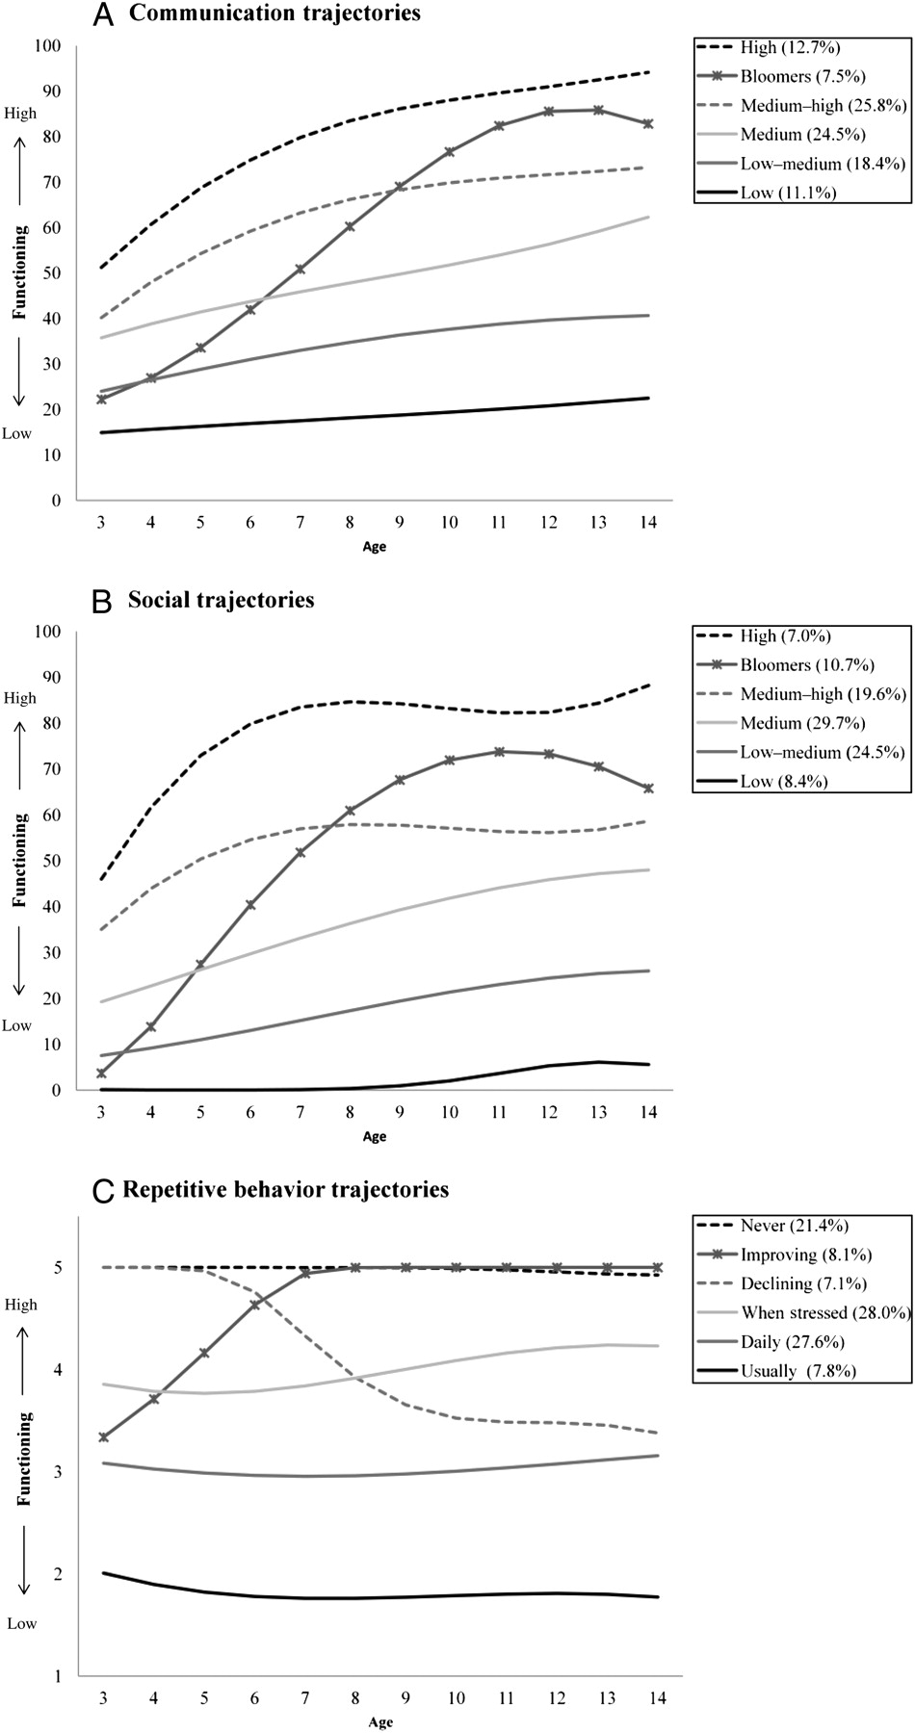
Symptom trajectories based by age
Fountain C et al. Pediatrics 2012;129:e1112-e1120
Notes:
(A) Modeled communication, (B) social, and (C) repetitive behavior symptom trajectories based on CDER scores by age.

Slide 26
Symptom trajectories based by age
Fountain C et al. Pediatrics 2012;129:e1112-e1120
Notes:
(A) Modeled communication, (B) social, and (C) repetitive behavior symptom trajectories based on CDER scores by age.

Slide 27
Symptom trajectories based by age
Fountain C et al. Pediatrics 2012;129:e1112-e1120
Notes:
(A) Modeled communication, (B) social, and (C) repetitive behavior symptom trajectories based on CDER scores by age.

Slide 28
Descriptive epidemiology
4:1 M to F ratio
Diagnosed between ages 1 – 5 years
Heritability between 50 – 75%
  Sticky issue: Singleton vs. multiple births comparable for developmental disorders?

Slide 29
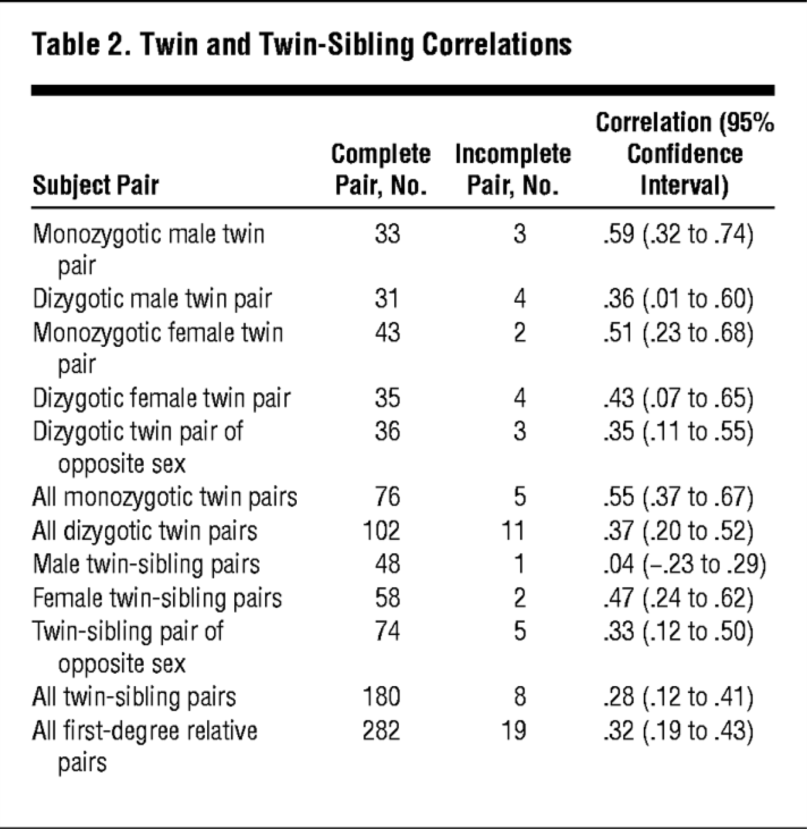
Arch Pediatr Adolesc Med. 2007;161(4):372-377. doi:10.1001/archpedi.161.4.372

Slide 30
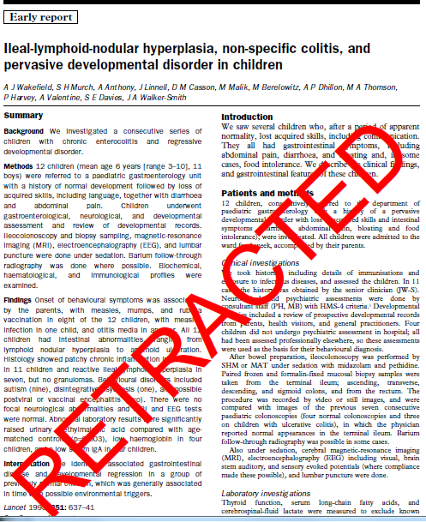
Bad science: Immunizations and autism

Slide 31
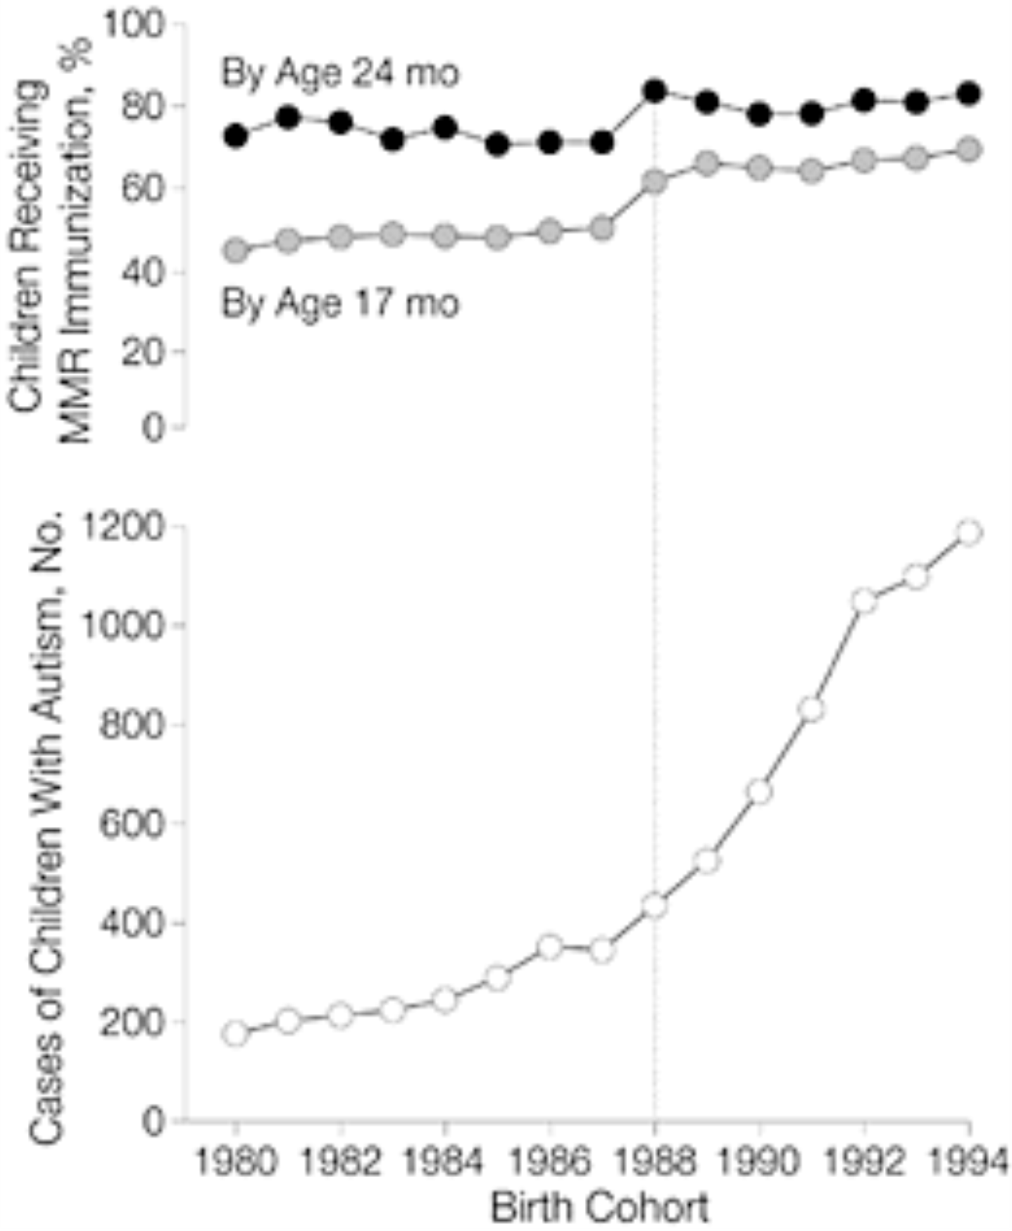
JAMA. 2001;285(9):1183-1185. doi:10.1001/jama.285.9.1183

Slide 32
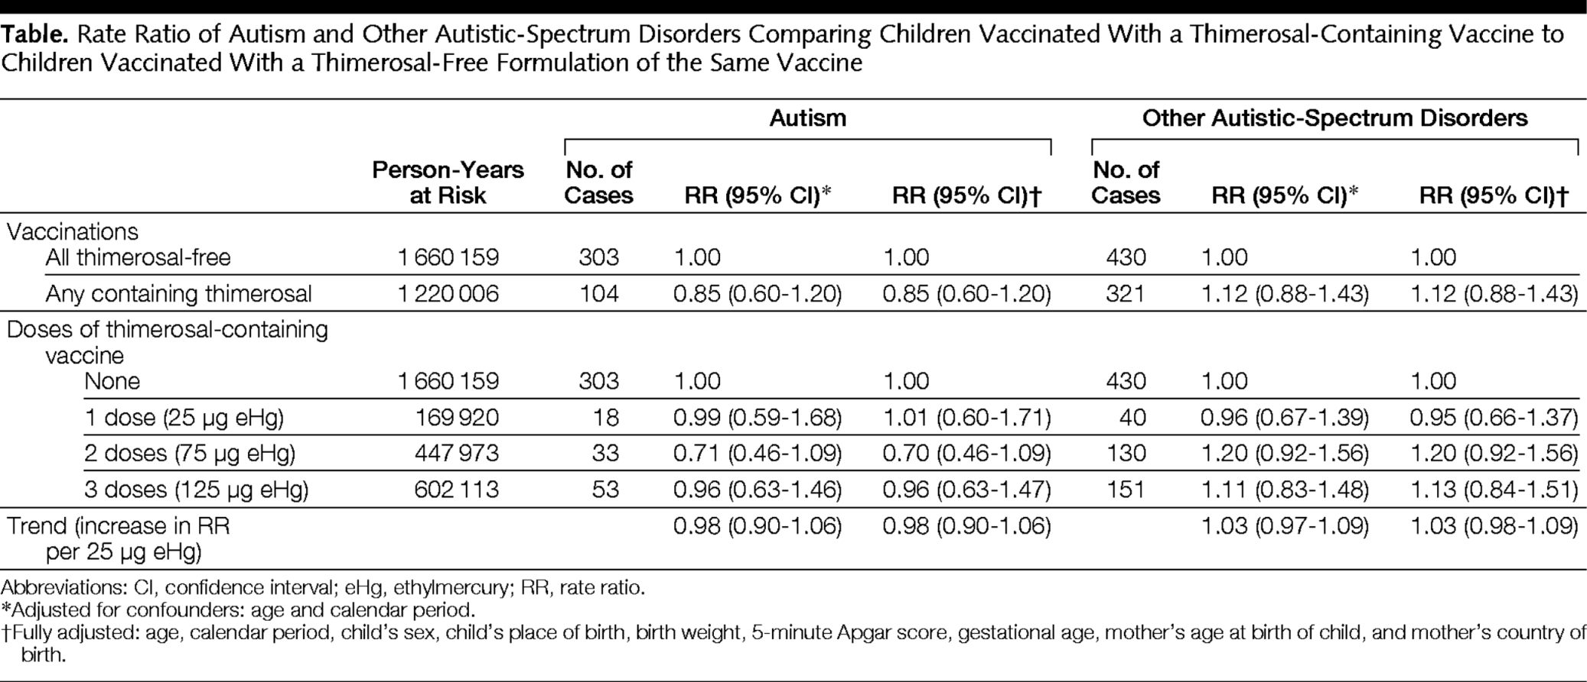
Immunizations and autism
Themerosal exposure and relative risk of ASD
JAMA. 2003;290(13):1763-1766. doi:10.1001/jama.290.13.1763

Slide 33
Actual risk factors
Gestational characteristics
Breech position
Low Apgar score at 5 minutes
Pre-term birth
ART
Birth order (1st or only)
Birth spacing

Slide 34
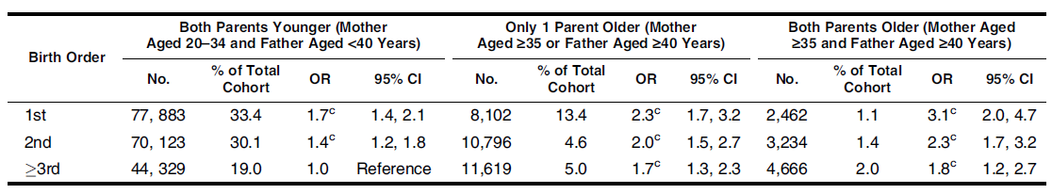
Birth order
Durkin et al., 2008
Notes:
Causal vs. non-causal explanation of birth order:
ASD was highest for firstborn children and declined with increasing birth order is a pattern also observed for other childhood disorders, including type I diabetes and atopy, and is cited as support for the ‘‘hygiene hypothesis.’’ According to this hypothesis, firstborn children are exposed to fewer infections from other children early in childhood and, because of delayed immunologic challenge, may be more likely to develop autoimmune responses including those that may adversely affect neurodevelopment (29).
Another possible factor that could lead to the observed birthorder effect is exposure to potentially neurotoxic, fat-soluble chemicals accumulated in maternal tissue that have been
passed to offspring transplacentally or through breast milk (30). Because of accumulation over a lifetime, the load of such neurotoxins transmitted might be expected to be highest
for firstborn children, particularly when combined with advanced maternal age.
Another possible explanation for the observed birth order effect is ‘‘stoppage’’ or a tendency for parents of 1 child with ASD not to have subsequent children
because of the demands of parenting a child with a disability or concerns about genetic susceptibility (31), thus increasing the likelihood in the cohort as a whole that a child with ASD
will have a low birth order.

Slide 35
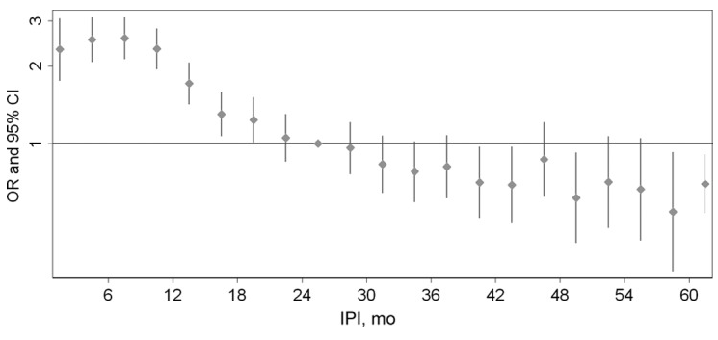
Birth spacing
Inter-pregnancy interval
Cheslack-Postava et al. 2011
Notes:
Pediatrics. 2011 Feb;127(2):246-53. Epub 2011 Jan 10.
Closely spaced pregnancies are associated with increased odds of autism in California sibling births.
Cheslack-Postava K, Liu K, Bearman PS.
Source
Robert Wood Johnson Foundation Health and Society Scholars, Columbia University, New York, New York, USA. kc2497@columbia.edu
Abstract
OBJECTIVE:
To determine whether the interpregnancy interval (IPI) is associated with the risk of autism in subsequent births.
METHODS:
Pairs of first- and second-born singleton full siblings were identified from all California births that occurred from 1992 to 2002 using birth records, and autism diagnoses were identified by using linked records of the California Department of Developmental Services. IPI was calculated as the time interval between birth dates minus the gestational age of the second sibling. In the primary analysis, logistic regression models were used to determine whether odds of autism in second-born children varied according to IPI. To address potential confounding by unmeasured family-level factors, a case-sibling control analysis determined whether affected sibling (first versus second) varied with IPI.
RESULTS:
An inverse association between IPI and odds of autism among 662 730 second-born children was observed. In particular, IPIs of <12, 12 to 23, and 24 to 35 months were associated with odds ratios (95% confidence intervals) for autism of 3.39 (3.00-3.82), 1.86 (1.65-2.10), and 1.26 (1.10-1.45) relative to IPIs of ≥ 36 months. The association was not mediated by preterm birth or low birth weight and persisted across categories of sociodemographic characteristics, with some attenuation in the oldest and youngest parents. Second-born children were at increased risk of autism relative to their firstborn siblings only in pairs with short IPIs.
CONCLUSIONS:
These results suggest that children born after shorter intervals between pregnancies are at increased risk of developing autism; the highest risk was associated with pregnancies spaced <1 year apart.

Slide 36
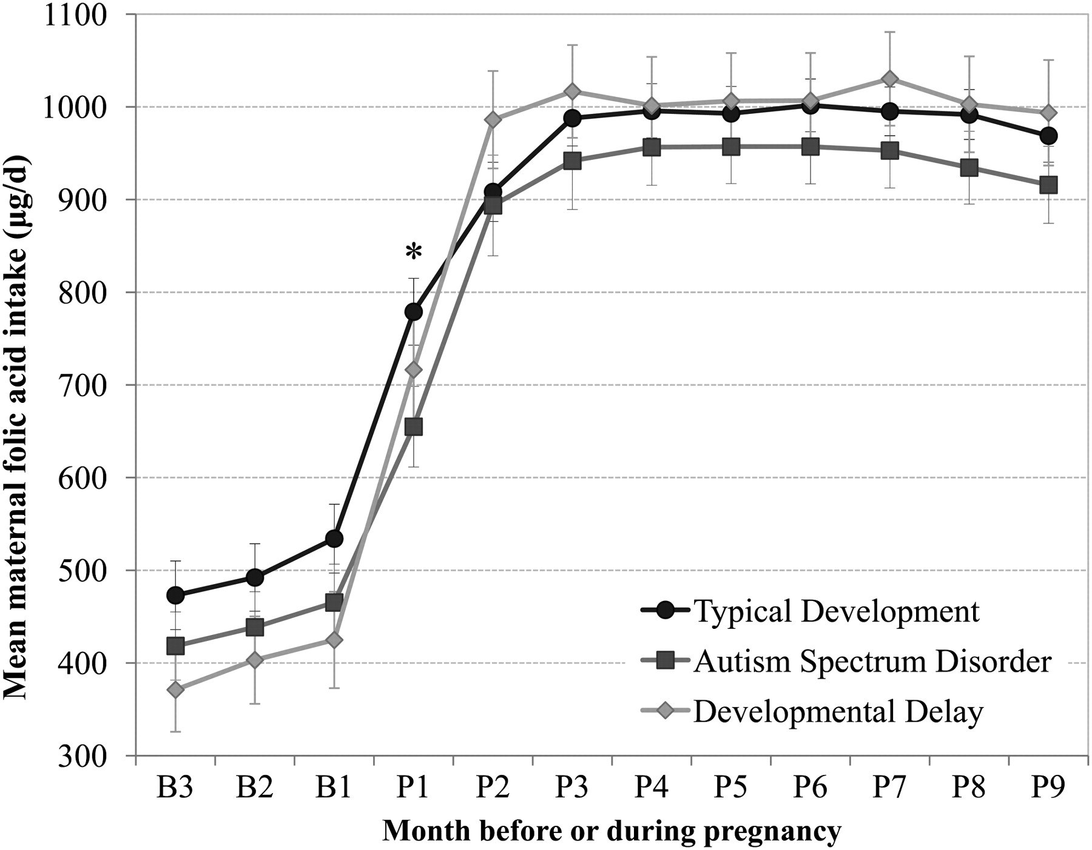
Maternal folic acid intake by pregnancy month for mothers of typically developing children and mothers of children with autism spectrum disorder or developmental delay.
Schmidt R J et al. Am J Clin Nutr 2012;96:80-89
Notes:
Mean (±SEM) maternal folic acid intake by pregnancy month for mothers of typically developing children and mothers of children with autism spectrum disorder or developmental delay. Maternal folic acid intake (μg/d) represents total intake reported from vitamins, supplements, and cereal. *Two-sided P < 0.01, Wilcoxon 2-sample test. B, month before pregnancy; P, month of pregnancy.

Slide 37
Parental characteristics
Maternal age
Paternal age
Parental psychopathology

Slide 38
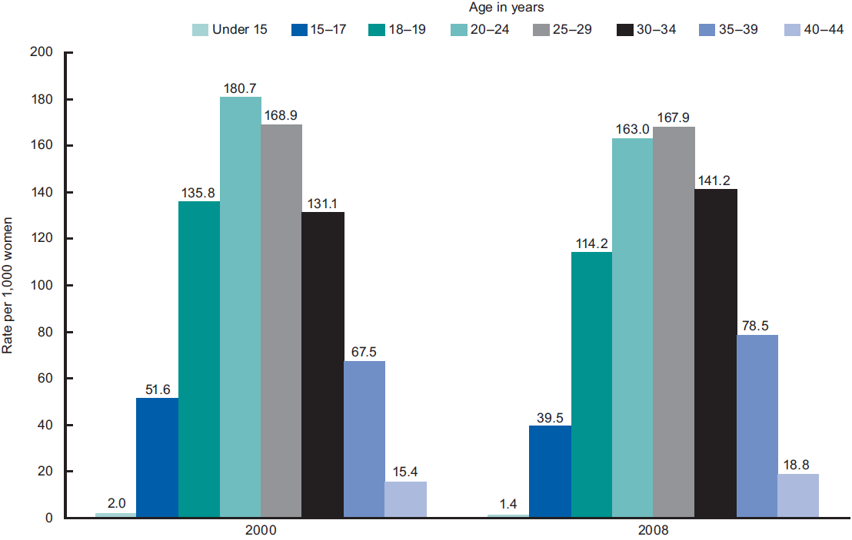
Increasing maternal age in the past decade
Notes:
Mean maternal age in the United States has increased steadily since the 1970s, particularly for firstborn children, for whom mean maternal age at delivery increased by 3.8
years between 1970 and 2004.

Slide 39
Parental & maternal age and risk of ASD
Relative odds
REF
Durkin et al., 2008

Slide 40
Unpacking paternal age
Older parents are more educated
Older partners make older parents
  Assortative mating of the socially-awkward?
Older parents are more likely to have short-spaced births
  Nutritional deficiency?
More likely to use assisted reproductive technologies to conceive

Slide 41
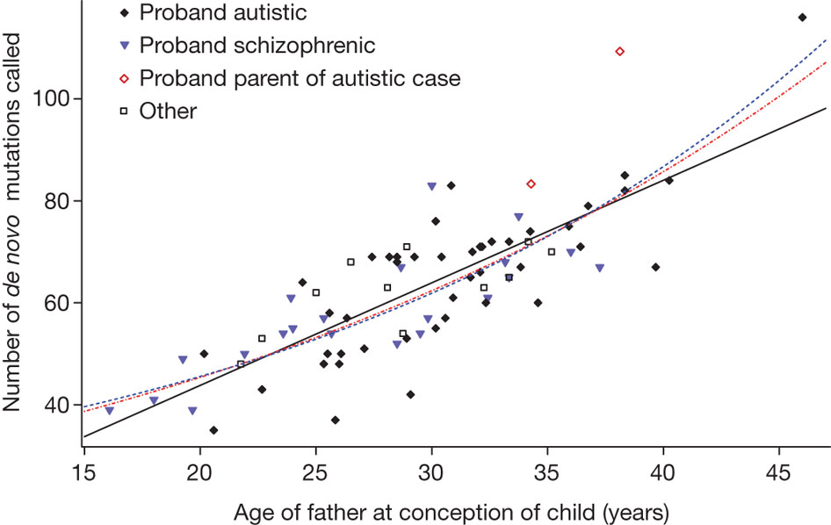
Father’s age and number of de novo mutations
A Kong et al. Nature 488, 471-475 (2012) doi:10.1038/nature11396

Slide 42
Epidemics in the context of social factors
Diagnostic changes and social desirability
Social status
Social networks
Access to healthcare goods
What sorts of population patterns would indicate a social effect?

Slide 43
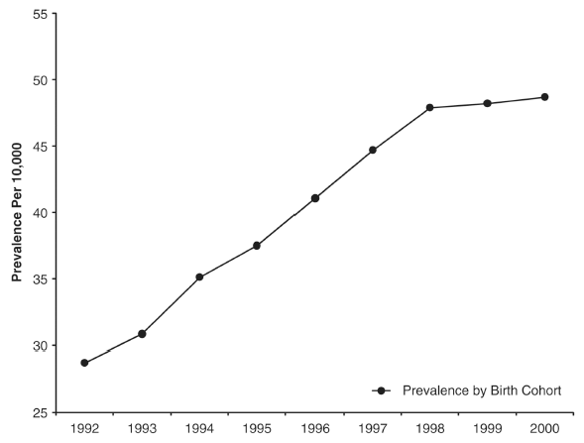
Prevalence of autism in California
DSM-IV
King & Bearman ASR 2011
Notes:
Prevalence has increased 10-fold since 1970
Individual risk factors alone are unlikely to have produced this dramatic increase in such a short period of time

Slide 44
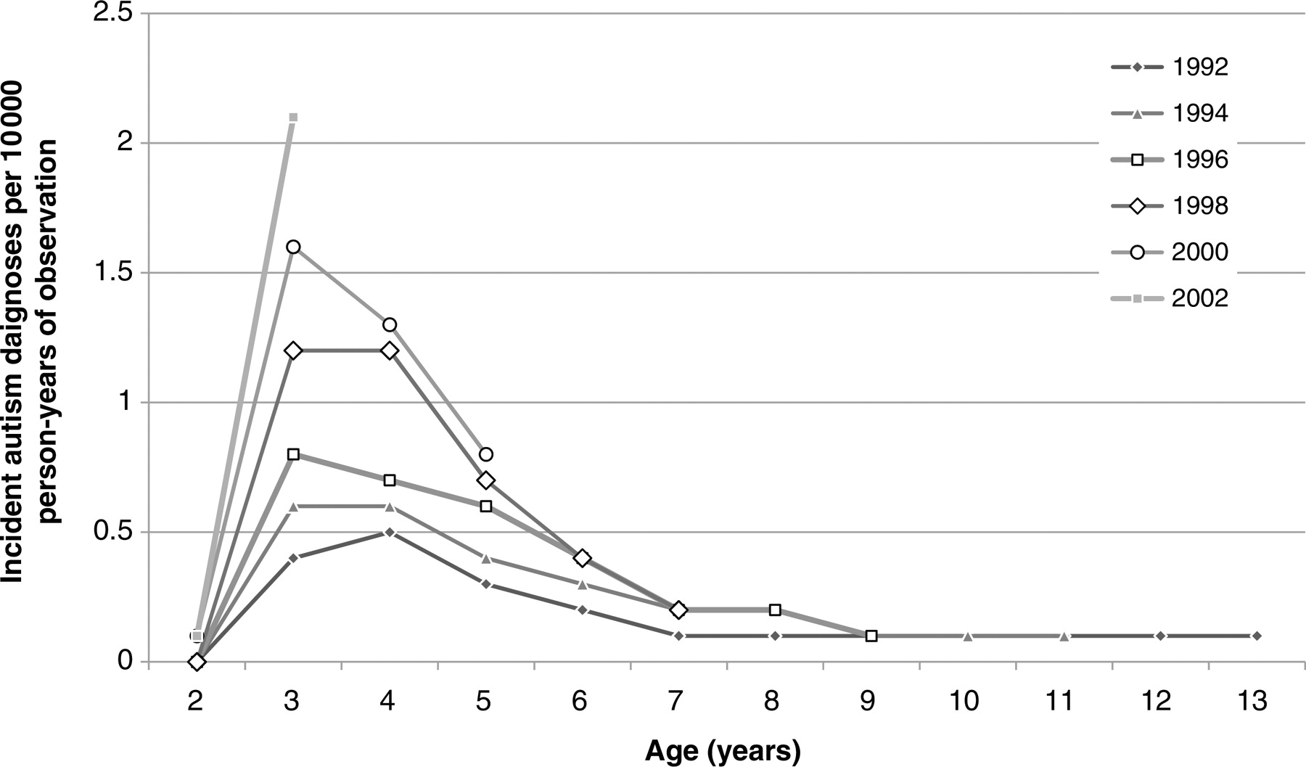
Age-specific incidence of autism diagnosis by birth cohort in California: 1992–2003.
Keyes K M et al. Int. J. Epidemiol. 2012;41:495-503
Notes:
Age-specific incidence of autism diagnosis by birth cohort in California among those born 1992–2003

Slide 45
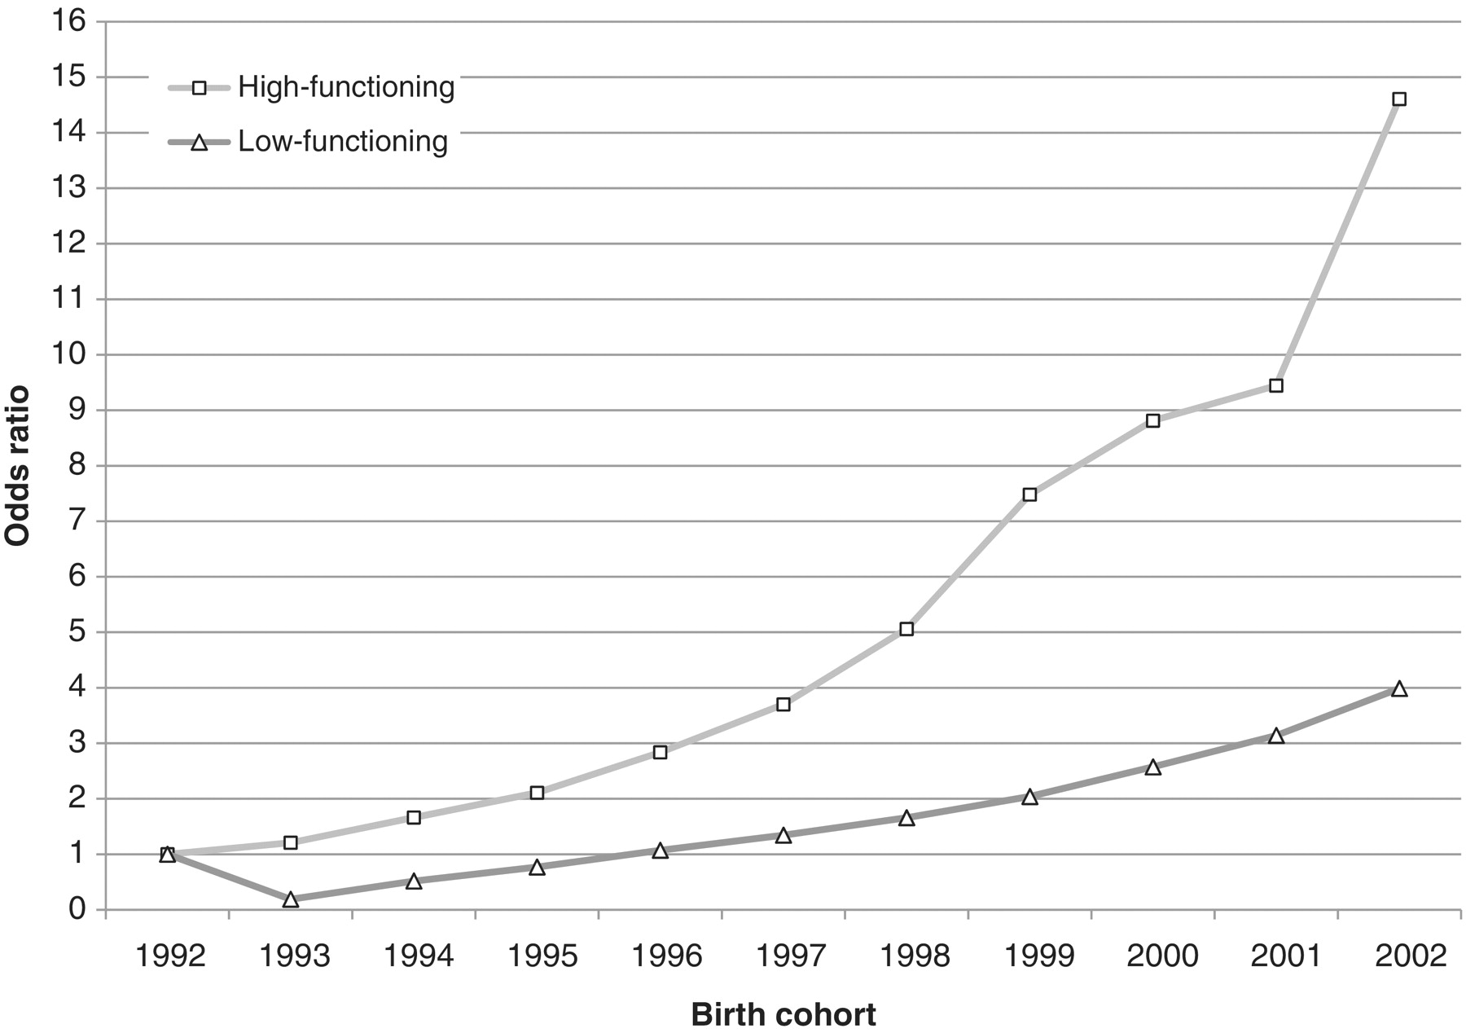
Cohort effects in autism diagnosis in California from 1994 to 2005 by child's functioning
Keyes K M et al. Int. J. Epidemiol. 2012;41:495-503
Notes:
Cohort effects in autism diagnosis in California from 1994 to 2005 by child's functioning (functioning defined by a global index on two dimensions relevant to autism: social interaction, and communication and language, both recorded on the CDER diagnostic and evaluation instrument at the time of intake. Those above the 80th percentile were considered high-functioning children with autism, those in the 20th to 79th percentile were considered mid-functioning, and those below the 20th percentile were considered low-functioning children with autism) at the time of diagnosis

Slide 46
Social desirability
Initial hypotheses about the origin of autism involved the notion of “refrigerator mothers” – failure of mother to properly bond with the child (1950s & 60s)
“The difference between the plight of prisoners in a concentration camp and the conditions which lead to Autism and schizophrenia in children is, of course, that the child has never had a previous chance to develop much of a personality.” (Bettelheim, The Empty Fortress: Infantile Autism and the birth of the self, 1972)
Leo Kanner (1949): hypothesize that mothers of autistic children had “just happening to defrost enough to produce a child.”

Slide 47
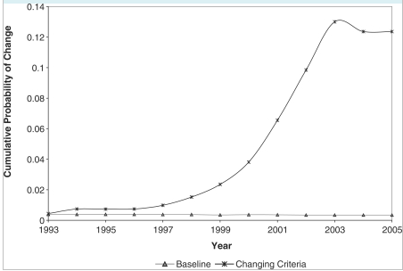
Cumulative incidence due to changing diagnostic criteria
King & Bearman IJE 2009
Notes:
Int J Epidemiol. 2009 Oct;38(5):1224-34. Epub 2009 Sep 7.
Diagnostic change and the increased prevalence of autism.
King M, Bearman P.
Source
Institute for Social and Economic Research and Policy, Columbia University, New York, NY 10027, USA.
Abstract
BACKGROUND:
Increased autism prevalence rates have generated considerable concern. However, the contribution of changes in diagnostic practices to increased prevalence rates has not been thoroughly examined. Debates over the role of diagnostic substitution also continue. California has been an important test case in these controversies. The objective of this study was to determine the extent to which the increased prevalence of autism in California has been driven by changes in diagnostic practices, diagnostic substitution and diagnostic accretion.
METHODS:
Retrospective case record examination of 7003 patients born before 1987 with autism who were enrolled with the California Department of Developmental Services between 1992 and 2005 was carried out. Of principal interest were 631 patients with a sole diagnosis of mental retardation (MR) who subsequently acquired a diagnosis of autism. The outcome of interest was the probability of acquiring a diagnosis of autism as a result of changes in diagnostic practices was calculated. The probability of diagnostic change is then used to model the proportion of the autism caseload arising from changing diagnostic practices.
RESULTS:
The odds of a patient acquiring an autism diagnosis were elevated in periods in which the practices for diagnosing autism changed. The odds of change in years in which diagnostic practices changed were 1.68 [95% confidence interval (CI) 1.11-2.54], 1.55 (95% CI 1.03-2.34), 1.58 (95% CI 1.05-2.39), 1.82 (95% CI 1.23-2.7) and 1.61 (95% CI 1.09-2.39). Using the probability of change between 1992 and 2005 to generalize to the population with autism, it is estimated that 26.4% (95% CI 16.25-36.48) of the increased autism caseload in California is uniquely associated with diagnostic change through a single pathway--individuals previously diagnosed with MR.
CONCLUSION:
Changes in practices for diagnosing autism have had a substantial effect on autism caseloads, accounting for one-quarter of the observed increase in prevalence in California between 1992 and 2005.
The cumulative adjusted probability of an average individual experiencing a change in diagnosis in a given year. The baseline probability, which takes into account changes in the underlying population distribution, is represented by the line marked with a triangle, and ranges from 0.003 to 0.004. The adjusted probability of observing a change allowing for observed revisions of diagnostic practices is represented by the line marked with an asterisk. In 2005, the cumulative probability of change allowing for new practices was 0.13

Slide 48
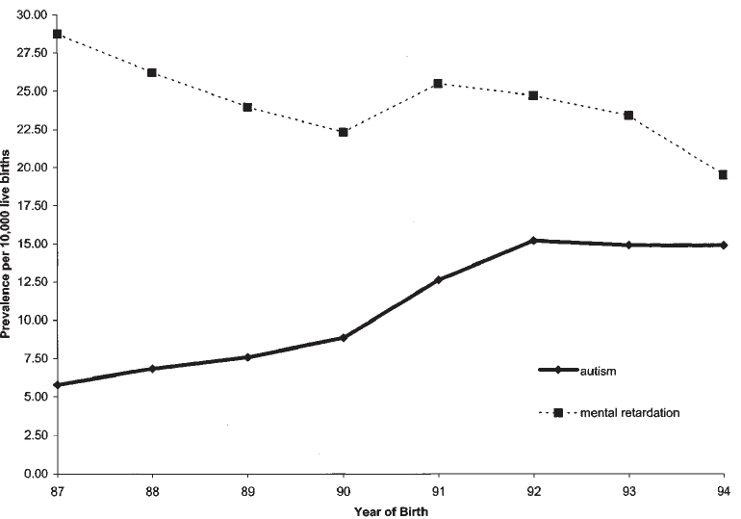
Diagnostic switching
Croen et al. 2002
Notes:
During the study period, prevalence increased from 5.8 to 14.9 per 10,000, for an absolute change of 9.1 per 10,000. The pattern of increase was not influenced by maternal
age, race/ethnicity, education, child gender, or plurality. During the same period, the prevalence of mental retardation without autism decreased from 28.8 to 19.5 per 10,000, for
an absolute change of 9.3 per 10,000.

Slide 49
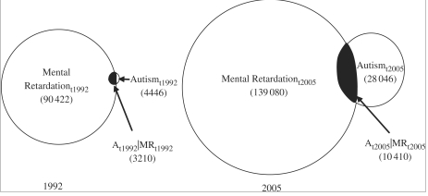
Changes in “Comorbidity” between Autism & MR over time
King & Bearman IJE 2009
Notes:
The changing diagnostic world in California between 1992 and 2005. The number of cases of autism and MR both expand, though the proportion of autism cases is increasing at a much greater rate. As this is happening, the rate of co-morbidity within the autism population is decreasing, though the number of co-morbid cases is increasing, as is co-morbidity within the population with MR. Represented in the non-shaded portion of the MR circles is MR*, the number of cases of MR without co-morbidity

Slide 50
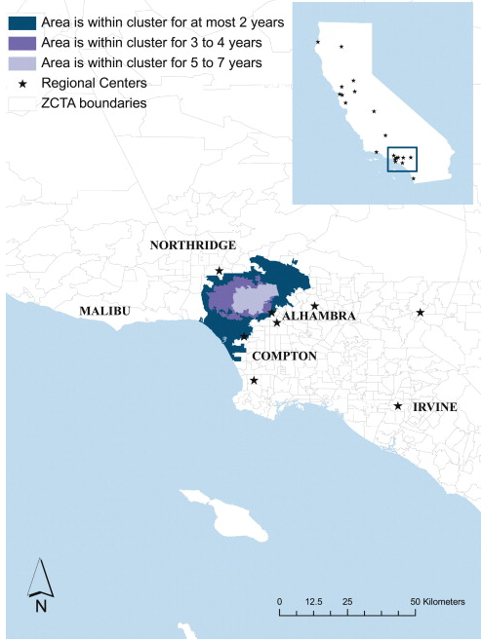
Geographic clustering of autism
So what types of risk factors cluster in space?
Notes:
Health Place. 2010 May;16(3):539-46. Epub 2010 Jan 22.
The spatial structure of autism in California, 1993-2001.
Mazumdar S, King M, Liu KY, Zerubavel N, Bearman P.
Source
Institute for Social and Economic Research and Policy Columbia University, New York, NY, USA. soumyamazumdar@yahoo.com
Abstract
This article identifies significant high-risk clusters of autism based on residence at birth in California for children born from 1993 to 2001. These clusters are geographically stable. Children born in a primary cluster are at four times greater risk for autism than children living in other parts of the state. This is comparable to the difference between males and females and twice the risk estimated for maternal age over 40. In every year roughly 3% of the new caseload of autism in California arises from the primary cluster we identify-a small zone 20 km by 50 km. We identify a set of secondary clusters that support the existence of the primary clusters. The identification of robust spatial clusters indicates that autism does not arise from a global treatment and indicates that important drivers of increased autism prevalence are located at the local level.

Slide 51
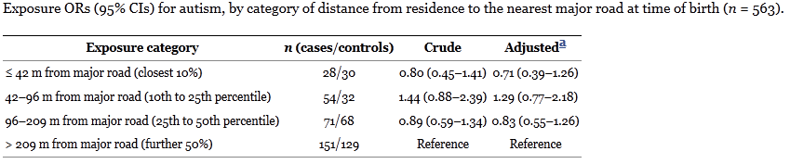
Particulate matter exposure in utero & autism
Volk et al. 2011
Notes:
Environ Health Perspect. 2011 June; 119(6): 873–877.
Published online 2010 December 16. doi: 10.1289/ehp.1002835
PMCID: PMC3114825
Research
Children’s Health
Residential Proximity to Freeways and Autism in the CHARGE Study
Heather E. Volk,¹ Irva Hertz-Picciotto,² Lora Delwiche,² Fred Lurmann,³ and Rob McConnell⁴
Author information ► Article notes ► Copyright and License information ►
See "A Research Strategy to Discover the Environmental Causes of Autism and Neurodevelopmental Disabilities" in volume 120 on page a258.
This article has been cited by other articles in PMC.
Go to:
Abstract
Background
Little is known about environmental causes and contributing factors for autism. Basic science and epidemiologic research suggest that oxidative stress and inflammation may play a role in disease development. Traffic-related air pollution, a common exposure with established effects on these pathways, contains substances found to have adverse prenatal effects.
Objectives
We examined the association between autism and proximity of residence to freeways and major roadways during pregnancy and near the time of delivery, as a surrogate for air pollution exposure.
Methods
Data were from 304 autism cases and 259 typically developing controls enrolled in the Childhood Autism Risks from Genetics and the Environment (CHARGE) study. The mother’s address recorded on the birth certificate and trimester-specific addresses derived from a residential history obtained by questionnaire were geocoded, and measures of distance to freeways and major roads were calculated using ArcGIS software. Logistic regression models compared residential proximity to freeways and major roads for autism cases and typically developing controls.
Results
Adjusting for sociodemographic factors and maternal smoking, maternal residence at the time of delivery was more likely be near a freeway (≤ 309 m) for cases than for controls [odds ratio (OR) = 1.86; 95% confidence interval (CI), 1.04–3.45]. Autism was also associated with residential proximity to a freeway during the third trimester (OR = 2.22; CI, 1.16–4.42). After adjustment for socioeconomic and sociodemographic characteristics, these associations were unchanged. Living near other major roads at birth was not associated with autism.
Conclusions
Living near a freeway was associated with autism. Examination of associations with measured air pollutants is needed.

Slide 52
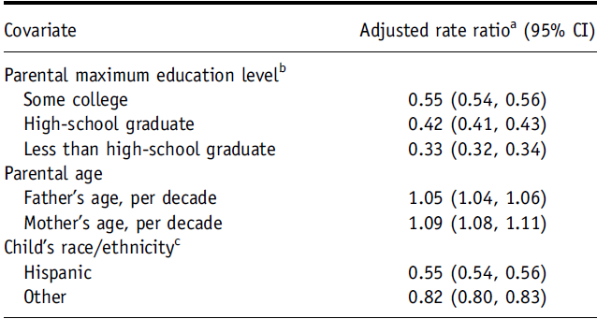
Contributions to geographic clustering
Notes:
Autism Res. 2010 Feb;3(1):19-29.
Geographic distribution of autism in California: a retrospective birth cohort analysis.
Van Meter KC, Christiansen LE, Delwiche LD, Azari R, Carpenter TE, Hertz-Picciotto I.
Source
Department of Public Health Sciences, School of Medicine, and Medical Investigations of Neurodevelopmental Disorders Institute, University of California-Davis, One Shields Avenue, Davis, CA 95616, USA. vanmeter@pobox.com
Abstract
Prenatal environmental exposures are among the risk factors being explored for associations with autism. We applied a new procedure combining multiple scan cluster detection tests to identify geographically defined areas of increased autism incidence. This procedure can serve as a first hypothesis-generating step aimed at localized environmental exposures, but would not be useful for assessing widely distributed exposures, such as household products, nor for exposures from nonpoint sources, such as traffic. Geocoded mothers' residences on 2,453,717 California birth records, 1996-2000, were analyzed including 9,900 autism cases recorded in the California Department of Developmental Services (DDS) database through February 2006 which were matched to their corresponding birth records. We analyzed each of the 21 DDS Regional Center (RC) catchment areas separately because of the wide variation in diagnostic practices. Ten clusters of increased autism risk were identified in eight RC regions, and one Potential Cluster in each of two other RC regions.After determination of clusters, multiple mixed Poisson regression models were fit to assess differences in known demographic autism risk factors between the births within and outside areas of elevated autism incidence, independent of case status.Adjusted for other covariates, the majority of areas of autism clustering were characterized by high parental education, e.g. relative risks >4 for college-graduate vs. nonhigh-school graduate parents. This geographic association possibly occurs because RCs do not actively conduct case finding and parents with lower education are, for various reasons, less likely to successfully seek services.

Slide 53
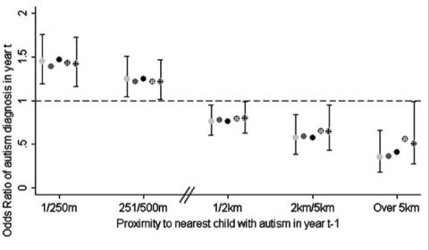
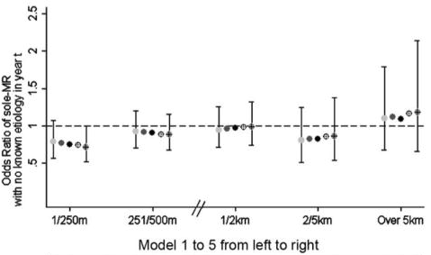
Geographical clustering of autism vs MR
Liu et al. AJS 2010

Slide 54
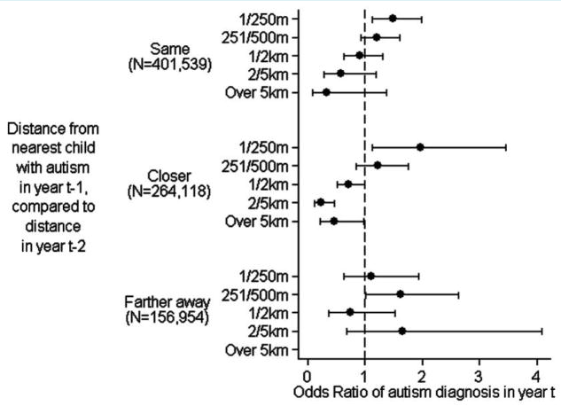
Relationship between proximity and autism diagnosis according to whether the index case moved
Same distance apart over 2-yr period
Moved closer to each other over 2-yr period
Moved farther apart over 2-yr period
Liu et al. AJS 2010
Notes:
As shown in figure 4, residing in close proximity to a child with autism within the past two years has no effect on subsequent autism risk if the neighboring family with autism moved away. In contrast, residing in very close proximity (less than 250 meters) has a statistically significant effect when the nearest neighbor with autism did not move away. The significant positive effect is also observed in the group who had a shorter distance to a child with autism in year t − 1 than in year t − 2. This group of children consists of those whose nearest neighbor with autism had moved closer, those who had a new neighbor with autism move into their close proximity, or those who had a neighbor in closer proximity receive an autism diagnosis in year t − 1.²³
Effect of two-year lagged proximity on autism diagnosis in year t by whether the child was (1) the same distance to the nearest child with autism in the two consecutive years, (2) a shorter distance to the nearest child with autism in year t – 1 than in year t –2, and (3) a longer distance to the nearest child with autism in year t – 1 than in year t – 2.

Slide 55
Social desirability by social class

Slide 56
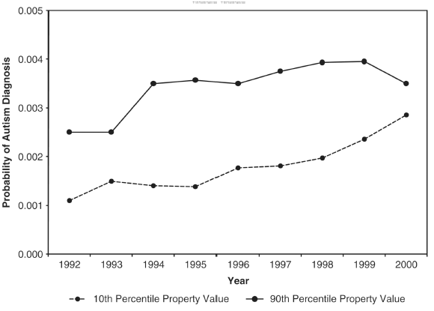
Influence of socioeconomic status:
Autism by property value
King & Bearman ASR 2011
Notes:
Change in prevalence of autism has not been uniform across communities/all subgroups
Figure shows the probability of diagnosis for children receiving Medi-Cal residing in communities at the bottom decile (dashed line) compared with the top decile (solid line) of
property value.

Slide 57
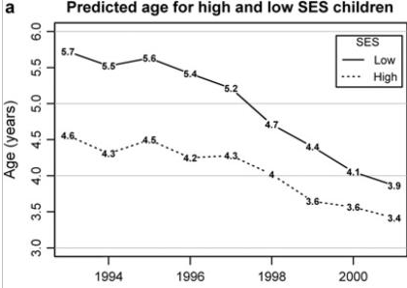
SES and age of autism diagnosis
Fountain et al. 2011

Slide 58
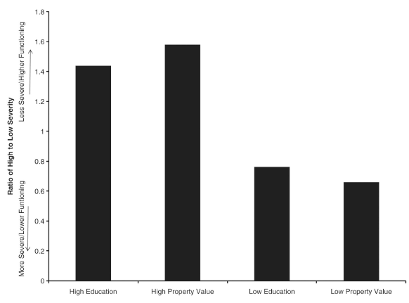
Socioeconomic status and severity of autism diagnosis
King & Bearman ASR 2011

Slide 59
Summary
Social factors and autism
Higher socioeconomic status is associated with:
  Geographic clustering
  Earlier detection
  Less severe forms
    Consistent (in a way) with Larsson et al. (2004): They did not find an association between parental age or SES and autism, but cases of autism included in the study were more severe (inpatient at children’s psychiatric hospital), which we know is NOT strongly associated with higher SES

Slide 60
Summary
Despite being a non-communicable disease, the autism epidemic has many features common to infectious diseases
  Epidemic increase + saturation of susceptible individuals
  Geographic clustering
When looking for the factors that are underlying an epidemic of a non-contagious disease, need to focus on risk factors that
  Influence incidence, not prevalence
  Have increased over time (either quantitatively or qualitatively)
  Aggregate in birth cohorts
  Match the social patterning of the condition
    Ex: more prevalent among higher-functioning (less-severe) children with autism

Slide 61
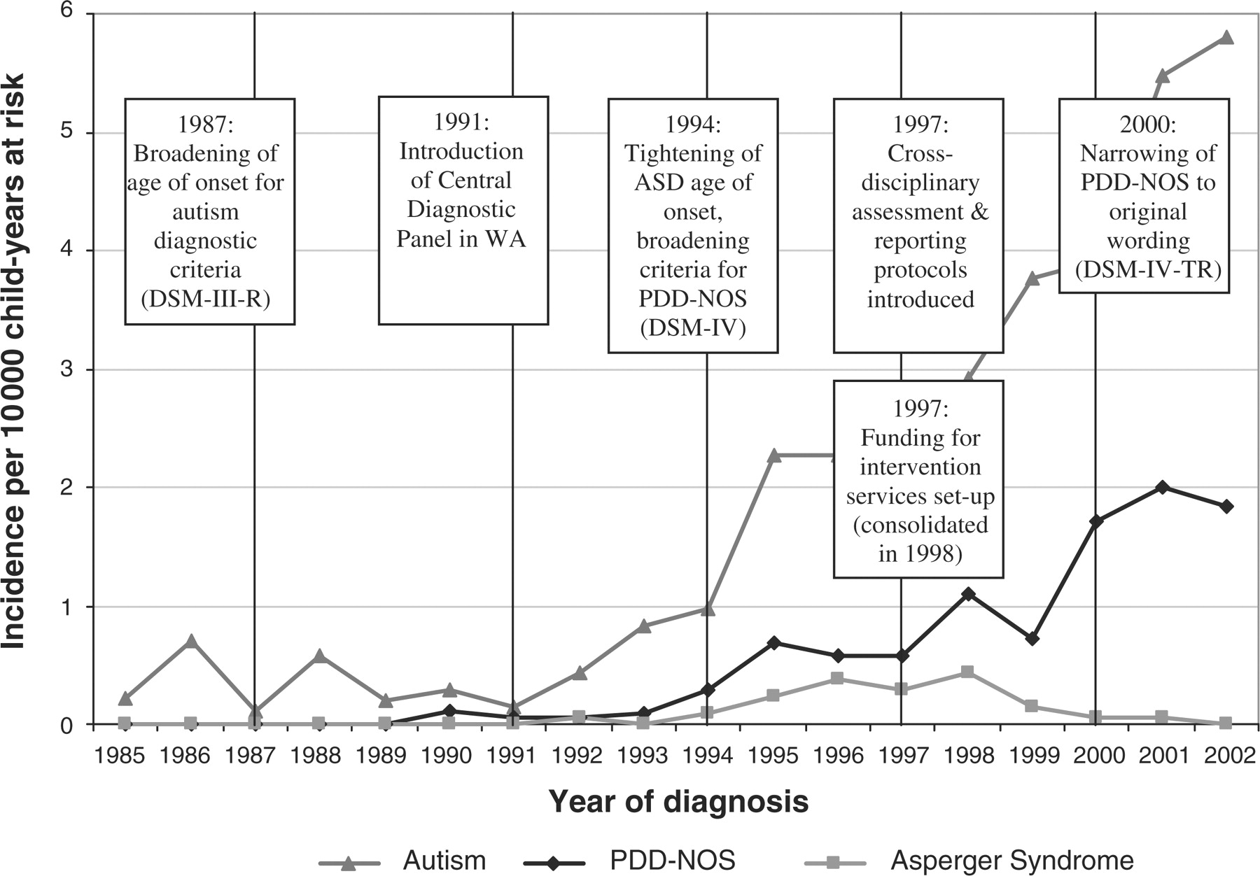
Incidence and significant events in the diagnosis of ASD (1985-2002) among children ≤8 years old.
Nassar N et al. Int. J. Epidemiol. 2009;38:1245-1254
Notes:
Incidence and significant events in the diagnosis of ASD between 1985 and 2002 among children ≤8 years of age in WA

Slide 62
Summary
Increasing prevalence of autism is a function of:
  Detection of milder cases
  Earlier detection (P=IxD)
  Broadening definition of caseness
  Diagnostic practices (switching with MR)
Some risk factors for autism are more prevalent:
  Older maternal & paternal age
  Use of ART
Both sets of factors produce social patterning
Genetic liability X environmental exposures also likely
At least 25% of increase due to these factors

Slide 63
Young adulthood: Schizophrenia

Slide 64
Notes:
http://www.wordle.net/create

Slide 65
Schizophrenia
Two or more of the following, each present for a significant portion of time during a 1-month period
  Delusions (false beliefs)
  Hallucinations (false perceptions)
  Disorganized speech
  Grossly disorganized or catatonic behavior
  Negative symptoms (affective flattening, avolition)
Positive symptoms

Slide 66
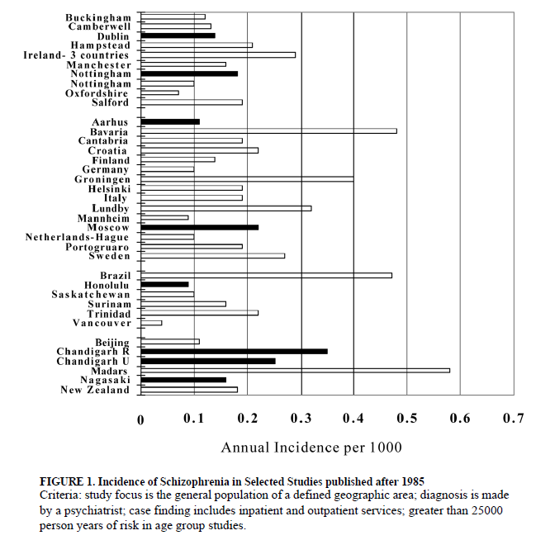
Incidence
Notes:
Mean age of onset: 15 - 24

Slide 67
Prevalence
%

Slide 68
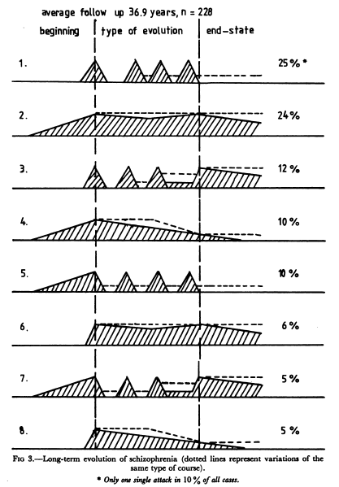
Course

Slide 69
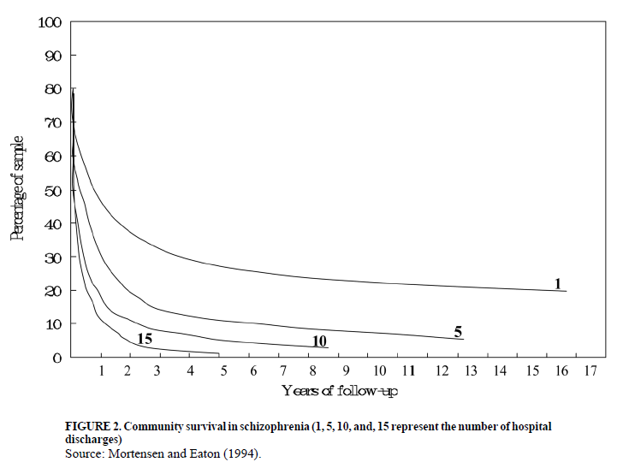
Course
Notes:
Since chronic cases end up in hospitals more often, until we had longitudinal studies that followed ppl post-discharge it wasn’t appreciated that a sizable portion of SZ remain in the community/have a favorable outcome

Slide 70
Methodological issues
How do you study a disease with an incidence of 0.2/1000 (or 1/5000) people per year and a prevalence of 0.5 – 1.5%?
  Community-based sampling
    Inefficient & Expensive
  Sample people at high-risk
    Not generalizable
    “High risk” families are rare
  Identify people at first treatment-contact
    First treatment-contact ≠ First symptomatic
    Assumes most people will be treated (~17% of SZ in US are not)
    Reliance on ICD diagnoses
    How to identify comparison population?
  Gold standard: Data from nation-wide registries (Denmark, Sweden, UK)

Slide 71
Risk factors
Family history
Paternal age
Obstetric complications
Cannabis
Urbanicity
Ethnicity

Slide 72
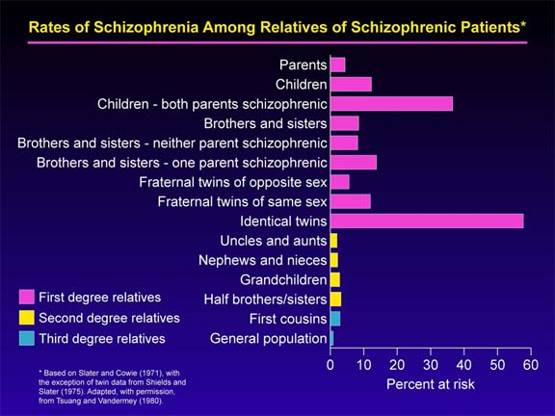
Family history

Slide 73
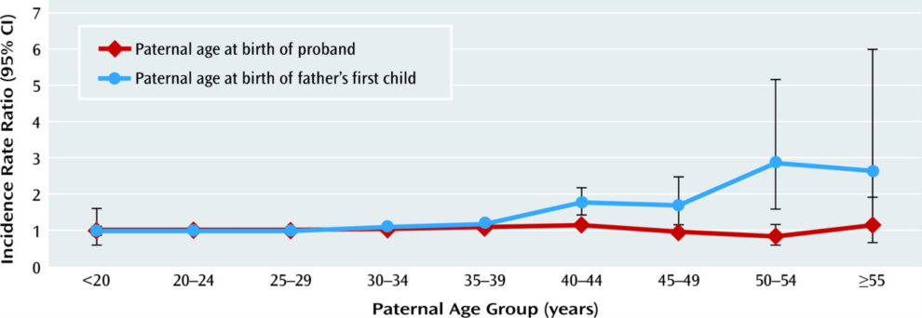
Paternal age and risk of schizophrenia
Mutually Adjusted Incidence Rate Ratiosª of Schizophrenia Among 1.2 Million Second- or Later-Born Probands Born in Denmark in 1955—1992,^{b} by Paternal Age at Proband's Birth and at Birth of Father's First Child
ª Adjusted for proband sex and age, calendar time, urbanicity at birth, family psychiatric history in father, mother, or siblings, maternal age at the proband's birth, and maternal age at the birth of the mother's first child.
^{b} Probands were followed up for development of schizophrenia in 1970—2007.

Slide 74
Father’s age and number of de novo mutations
A Kong et al. Nature 488, 471-475 (2012) doi:10.1038/nature11396

Slide 75
Obstetric complications
RR
Byrne et al. Schizophrenia Res 2007

Slide 76
Cannabis
Risk (%) of psychotic symptoms
Henquet et al. BMG 2005

Slide 77
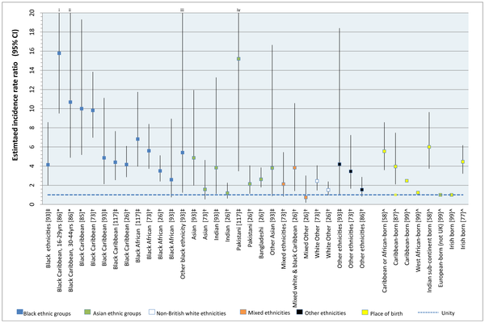
Ethnicity & Migration
Notes:
Kirkbride JB, Errazuriz A, Croudace TJ, Morgan C, et al. (2012) Incidence of Schizophrenia and Other Psychoses in England, 1950–2009: A Systematic Review and Meta-Analyses. PLoS ONE 7(3): e31660. doi:10.1371/journal.pone.0031660

Slide 78
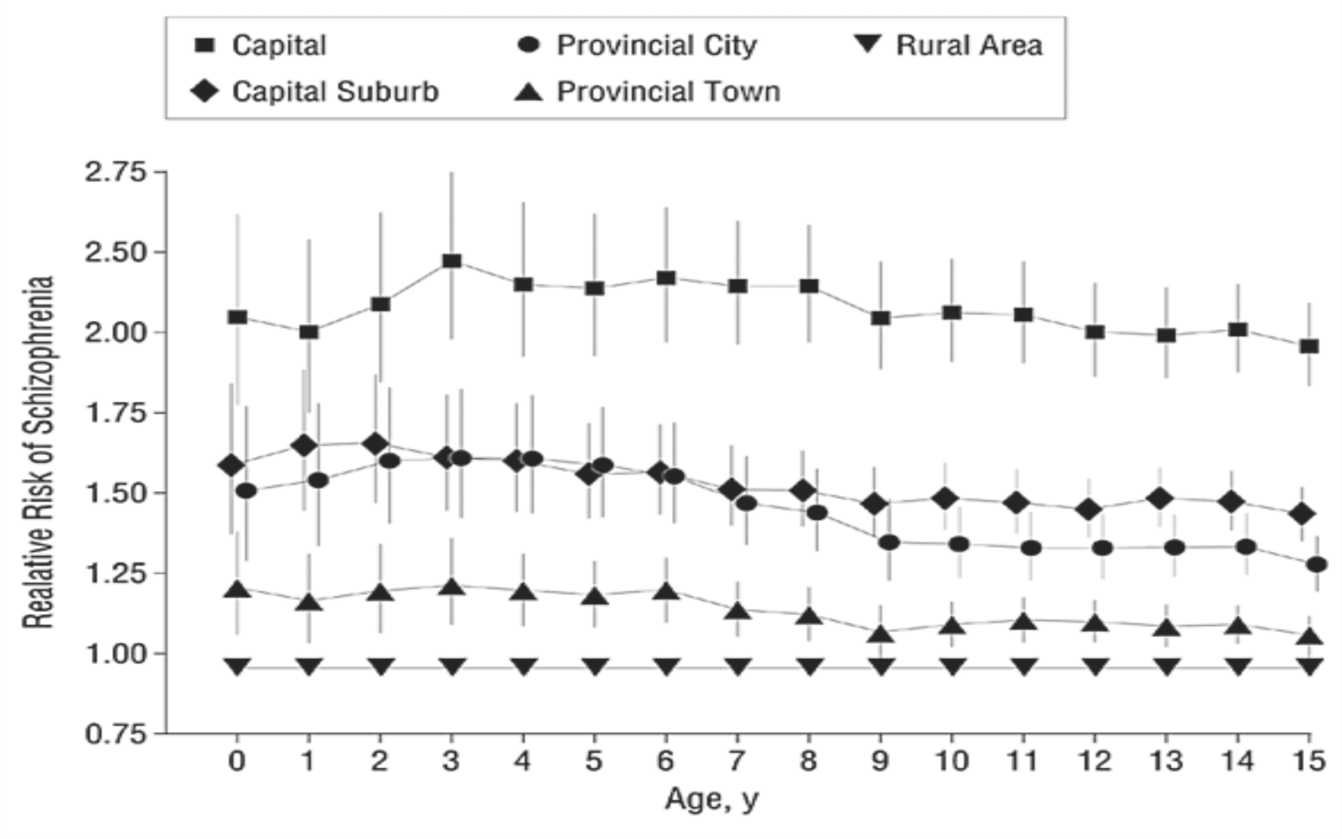
Urbanicity
Relative risk of schizophrenia according to urbanicity and age at residence. Urbanicity from birth to the 15th birthday enters separately in these 16 models. Age 0 indicates the time at birth, etc. Vertical lines indicate 95% confidence intervals. To avoid the confidence intervals from overlapping graphically, the age scale for the capital suburb was moved slightly to the left and the age scale for the provincial city was moved slightly to the right. Estimates of relative risks were adjusted for age and its interaction with sex, calendar year of diagnosis, and mental illness in a parent or sibling. Further adjustment for change of the municipality would reduce the effect of urbanicity only slightly.

Slide 79
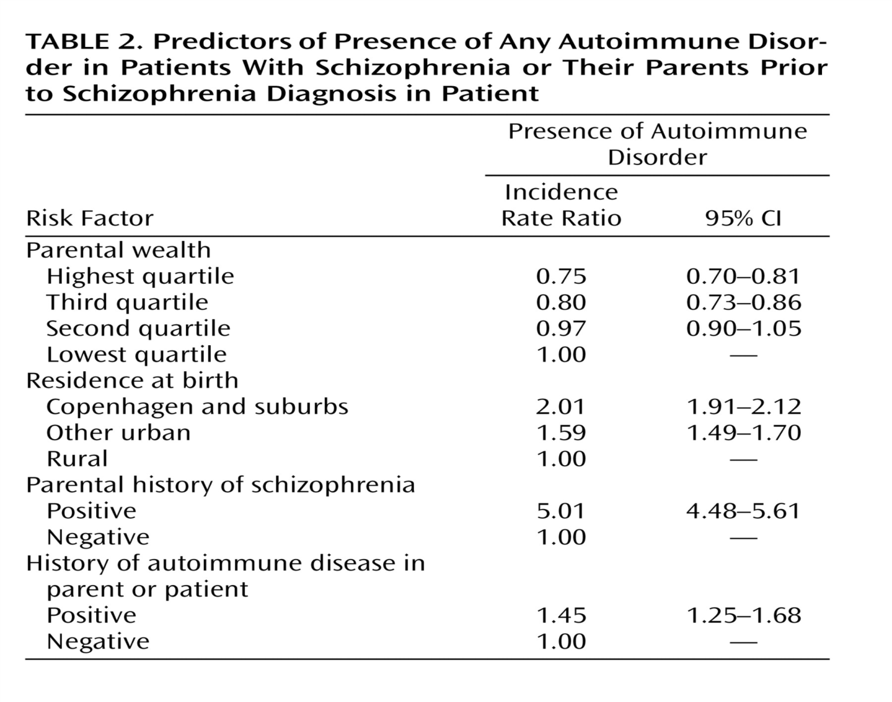
Emerging risk factors
Autoimmune disorders
Eaton et al. Am J Psychiatry. 2006;163(3):521-528.

Slide 80
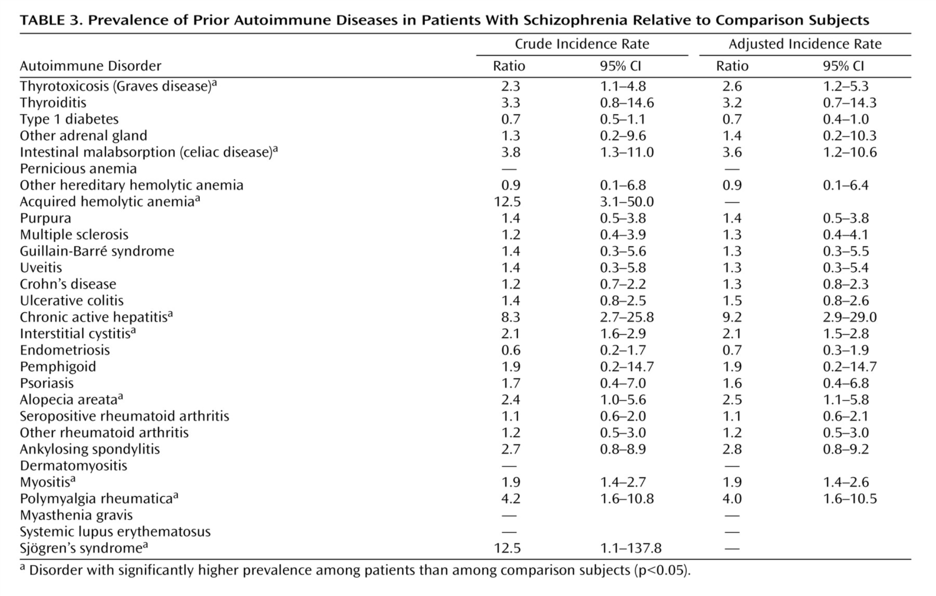
Autoimmune disorders
Eaton et al. Am J Psychiatry. 2006;163(3):521-528.
Notes:
Why focus on celiac disease? BC you can control it with diet.

Slide 81
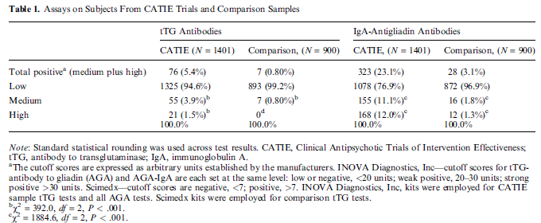
Gluten antibodies

Slide 82
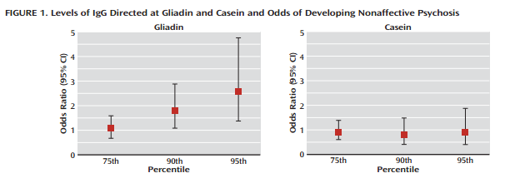
Maternal antibodies (from neonatal blood spots) and risk of SZ in offspring
Karlsson 2012
Notes:
Am J Psychiatry. 2012 Jun;169(6):625-32. doi: 10.1176/appi.ajp.2012.11081197.
Maternal antibodies to dietary antigens and risk for nonaffective psychosis in offspring.
Karlsson H¹, Blomström Å, Wicks S, Yang S, Yolken RH, Dalman C.
Author information
Abstract
OBJECTIVE:
The authors analyzed archival dried blood spots obtained from newborns to assess whether levels of immunoglobulin G (IgG) directed at dietary antigens were associated with a later diagnosis of a nonaffective psychotic disorder.
METHOD:
The study population consisted of individuals born in Sweden between 1975 and 1985 with verified register-based diagnoses of nonaffective psychoses made between 1987 and 2003 and comparison subjects matched on sex, date of birth, birth hospital, and municipality. A total of 211 case subjects and 553 comparison subjects consented to participate in the study. Data on factors associated with maternal status, pregnancy, and delivery were extracted from the Swedish Medical Birth Register. Levels of IgG directed at gliadin (a component of gluten) and casein (a milk protein) were analyzed in eluates from dried blood spots by enzyme-linked immunosorbent assay. Odds ratios were calculated for levels of IgG directed at gliadin or casein for nonaffective psychosis.
RESULTS:
Levels of anti-gliadin IgG (but not anti-casein IgG) above the 90th percentile of levels observed among comparison subjects were associated with nonaffective psychosis (odds ratio=1.7, 95% CI=1.1-2.8). This association was not confounded by differences in maternal age, immigrant status, or mode of delivery. Similarly, gestational age at birth, ponderal index, and birth weight were not related to maternal levels of anti-gliadin IgG.
CONCLUSIONS:
High levels of anti-gliadin IgG in the maternal circulation are associated with an elevated risk for the development of a nonaffective psychosis in offspring. Research is needed to identify the mechanisms underlying this association in order to develop preventive strategies.

Slide 83
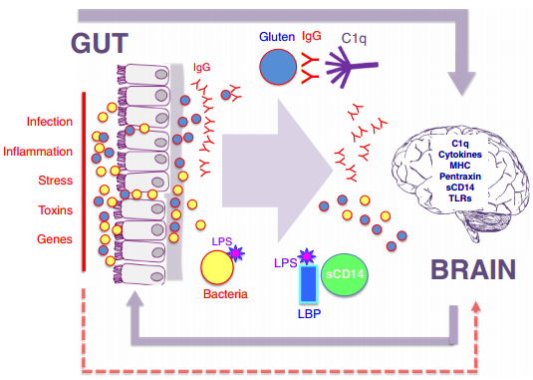
Notes:
Schizophr Res. 2014 Jul 14. pii: S0920-9964(14)00319-3. doi: 10.1016/j.schres.2014.06.027. [Epub ahead of print]
Autoimmune diseases, gastrointestinal disorders and the microbiome in schizophrenia: more than a gut feeling.
Severance EG¹, Yolken RH², Eaton WW³.
Author information
Abstract
Autoimmunity, gastrointestinal (GI) disorders and schizophrenia have been associated with one another for a long time. This paper reviews these connections and provides a context by which multiple risk factors for schizophrenia may be related. Epidemiological studies strongly linkschizophrenia with autoimmune disorders including enteropathic celiac disease. Exposure to wheat gluten and bovine milk casein also contribute to non-celiac food sensitivities in susceptible individuals. Co-morbid GI inflammation accompanies humoral immunity to food antigens, occurs early during the course of schizophrenia and appears to be independent from antipsychotic-generated motility effects. This inflammation impacts endothelial barrier permeability and can precipitate translocation of gut bacteria into systemic circulation. Infection by the neurotropic gut pathogen, Toxoplasma gondii, will elicit an inflammatory GI environment. Such processes trigger innate immunity, including activation of complement C1q, which also functions at synapses in the brain. The emerging field of microbiome research lies at the center of these interactions with evidence that the abundance and diversity of resident gut microbiota contribute to digestion, inflammation, gut permeability and behavior. Dietary modifications of core bacterial compositions may explain inefficient gluten digestion and how immigrant status in certain situations is a risk factor for schizophrenia. Gut microbiome research in schizophrenia is in its infancy, but data in related fields suggest disease-associated altered phylogenetic compositions. In summary, this review surveys associative and experimental data linking autoimmunity, GI activity and schizophrenia, and proposes that understanding of disrupted biological pathways outside of the brain can lend valuable information regarding pathogeneses of complex, polygenic brain disorders.

Slide 84
Later adulthood: Dementia

Slide 85
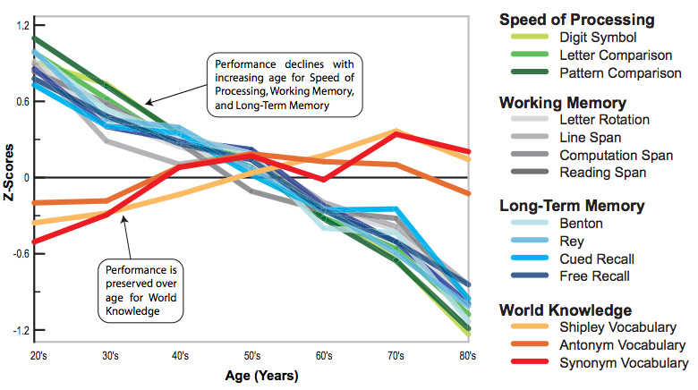
Schaie & Willis, 2011

Slide 86
Another brief survey
Q1. What is the strongest predictor of dementia?
Q2. Approximately what percent adults 65+ have dementia?
Q3. Is dementia more common among women or men?
Q4. What is the most common cause of dementia?

Slide 87
Another brief survey
Q1. What is the strongest predictor of dementia?
    AGE: Risk of dementia increases exponentially with age. Incidence doubles every 5 years after age 65.
Q2. Approximately what percent adults 65+ have dementia?
Q3. Is dementia more common among women or men?
Q4. What is the most common cause of dementia?

Slide 88
Another brief survey
Q1. What is the strongest predictor of dementia?
    AGE: Risk of dementia increases exponentially with age. Incidence doubles every 5 years after age 65.
Q2. Approximately what percent adults 65+ have dementia?
  ~10%. Prevalence age 85+ is ~25-30%
Q3. Is dementia more common among women or men?
Q4. What is the most common cause of dementia?

Slide 89
Another brief survey
Q1. What is the strongest predictor of dementia?
    AGE: Risk of dementia increases exponentially with age. Incidence doubles every 5 years after age 65.
Q2. Approximately what percent adults 65+ have dementia?
  ~10%. Prevalence age 85+ is ~25-30%
Q3. Is dementia more common among women or men?
  In the US, the ratio of women to men with dementia is ~ 2 to 1.
Q4. What is the most common cause of dementia?

Slide 90
Another brief survey
Q1. What is the strongest predictor of dementia?
    AGE: Risk of dementia increases exponentially with age. Incidence doubles every 5 years after age 65.
Q2. Approximately what percent adults 65+ have dementia?
  ~10%. Prevalence age 85+ is ~25-30%
Q3. Is dementia more common among women or men?
  In the US, the ratio of women to men with dementia is ~ 2 to 1.
Q4. What is the most common cause of dementia?
    Alzheimer’s disease. Estimated that 50-75% of cases are caused by AD.

Slide 91
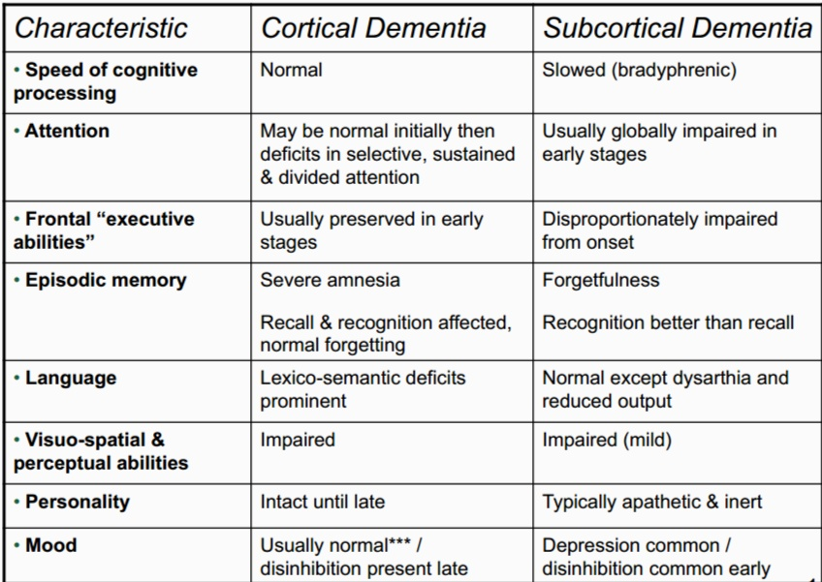
Alzheimer’s Dementia
Vascular dementia
Craik & Tulving “The Handbook of Memory” (2005)

Slide 92
Dementia Alzheimer’s Type
Essential feature: memory impairment (amnesia) PLUS at least one of the following:
  Aphasia
  Apraxia
  Agnosia
  Disturbance in executive functioning
Deficits must be sufficiently severe to cause impairment in occupational / social functioning (IADLs / ADLs)
Impairment must represent a decline from a previously higher level of functioning

Slide 93
Vascular dementia
More sudden onset vs. AD
Unlike Alzheimer's disease, vascular dementia may progress in a 'stepped' manner.
Plateaus may last years or forever
More awareness of impairment and more prone to depression than those with AD

Slide 94
Other types of dementia
Lewy-body dementia
Alcohol-related dementia
Parkinson’s-related dementia
Frontotemporal dementia
Dementia due to medical conditions
  HIV
  Syphilis
  Vitamin deficiencies
  Huntington’s disease

Slide 95
Mild Cognitive Impairment
Normal Cognition | Mild cognitive impairment | Dementia
Mild impairment in a cognitive domain
Little or no functional difficulties
2 types of MCI: Amnestic (aMCI) or non-amestic (nMCI)
Petersen, 2011; Gauthier et al., 2006

Slide 96
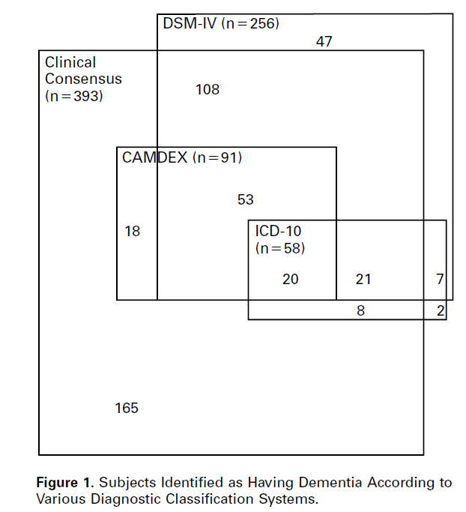
Erkinjunnti, NEJM (1997)

Slide 97
DSM – V changes
Dementia/Delirium ➔ “Neurocognitive disorders”
Two subcategories:
  Minor neurocognitive disorder (MCI)
  Major neurocognitive disorder (dementia)
Etiological subtypes recognized
Memory impairment not necessary for diagnosis of neurocognitive disorder (major or minor)

Slide 98
Testing for cognitive impairment
Verbal Memory
Auditory Verbal Learning Test (AVLT):
  15 items, 5 trials
  drum – curtain – bell – coffee – school – parent – moon – garden – hat – farmer – nose – turkey – color – house – river
Hopkins Verbal Learning Test (HVLT):
  12 items, 3 trials
  fork – rum – pan – pistol – sword – spatula – bourbon – vodka – pot – bomb – rifle – wine
  Semantic clusters

Slide 99

Testing for Cognitive Impairment
Non-verbal memory
Notes:
Rey–Osterrieth Complex Figure Test

Slide 100


Copy task
Welsh et al., 1993
Notes:
Rey–Osterrieth Complex Figure Test
http://www.boredpanda.com/alzheimers-disease-self-portrait-paintings-william-utermohlen/

Slide 101

Visuo-spatial ability

Slide 102

Processing Speed

Slide 103

Inhibition

Slide 104

Flexibility, inhibition, scanning
Notes:
Trails A and B

Slide 105

Alzheimer’s pathology

Slide 106


Slide 107


Slide 108
AD pathology hypotheses
BAPtists: amyloid beta fragment accumulation leads to plaques and cell death
TAUists: Phosphorylation of tau proteins leads to breakdown of microtubules and cell death.
Inflammists?:

Slide 109


Slide 110
Pathology over the life course
Normal cognition
MCI
AD
Inflammation
Tau
Amyloid (Abeta)
Adapted from Albert, 2010

Slide 111

Start of noticeable functional changes. “Forgetful”
Average life span after onset of AD is ~ 7 years

Slide 112
Epidemiology of dementia
Prevalence (moderate to severe dementia)
  65+: 7 - 10% (in the US)
  85+: 20 - 30% (in the US)
Incidence
  Doubles every ~5 yrs after age 65
  65 - 70 : 5-10 per 1,000 person years
  85+: 75 per 1,000 person years
  Unclear whether incidence continues to rise after 90
Corrada et al., 2010

Slide 113
Mortality
Alzheimer’s alone is the 5th leading cause of death of those 65+
Median survival:
  AD ~ 7.1 years (95% CI: 6.7–7.5 years)
  VaD ~ 3.9 years (95% CI: 3.5–4.2 years)

Slide 114

http://www.biostat.jhsph.edu/project/globalAD/
Brookmeyer, Johnson, Ziegler-Graham, & Arrighi, (2007)
Notes:
http://www.biostat.jhsph.edu/project/globalAD/

Slide 115


Slide 116
Epidemiology
Mild Cognitive Impairment
Prevalence: 3% to 19% in adults older than 65 years.
  Prevalence of aMCI ~11%
  Prevalence of nMCI ~ 5%
a-MCI progresses to AD: 10% to 15% per year, compared with 1% to 2% of age-matched individuals without a-MCI
2 year dementia risk of 11–33%
  >50% progress to dementia within 5 years
Gauthier et al., 2006; Ganguli et al., 2004; Petersen, 2011

Slide 117
Epidemiology
Mild Cognitive Impairment
Risk for progression a-MCI with memory impairment
  To any dementia: 4.78 (95% CI=2.78-8.07)
  For Alzheimer’s disease: 5.92 (95% CI=3.20-10.91)
  For vascular dementia: 1.61 (95% CI=0.37-7.00) for VaD.
Ravaglia et al., 2008

Slide 118
MCI to dementia progression
Factors that predict a more rapid progression or greater likelihood of dementia
  APOE e4 allele
  Low MRI hippocampal volume/enlarged ventricles
  Higher age
  Less education
  Hypometabolism on PET scan in parietal/temporal
  Decreased cerebrospinal levels of B-amyloid
  Psychological signs, including depression
Imaging should not yet be used in clinical care, given the lack of standardization
Petersen, 2011

Slide 119

Zanetti et al., 2006

Slide 120

Age & Gender

Slide 121
Early vs. late onset Alzheimer’s
Early (<65 yrs)
Rare (<10%)
Prominent apraxia, language, or executive dysfunction more common
More heritable/familial - PSEN1, PSEN2, APP
Personality changes more common
Faster progression
Late (>65 yrs)
90% of AD cases
Primary memory dysfunction
More recall/recognition dysfunction
Increased risk related to APOE gene mutations

Slide 122
APOE
Allelic frequency
0-20% for *E2,
60-90% for *E3
10-20% for *E4 (Singh et al., 2006)
Genotype | Frequency | Risk AD
ε4/ε4 | ~2% | ~15 times higher
ε4/ε3 | ~24% | ~3-4 times higher
ε4/ε2 | ~2% | Normal risk?
ε3/ε3 | ~61% | ---
ε3/ε2 | ~11% | Decreased risk
ε2/ε2 | <1% | Decreased risk

Slide 123
Education
Education is protective for AD
Relative risk for low vs. high education: 1.80 (95% CI 1.43, 2.27)
Relative risk for low/medium vs. high education: 1.44 (95% CI 1.24 – 1.67)

Slide 124
Late life depression
“Depression without sadness”
  Unexplained somatic complaints (e.g., insomnia, fatigue, cognition, psychomotor), without endorsement of low mood/guilt
  Irritability, anhedonia, hopelessness
Heterogeneous etiology
  Vascular-related
  Cognitive impairment/dementia
  Neurological (e.g., PD)
Gallo & Rabins AFPM 1999

Slide 125

Suicide risk in later life

Slide 126
Frailty
Geriatric syndrome indicating vulnerability to functional decline
  Cumulative burden: sum of diseases and health conditions, including psychiatric conditions
  Functional domains: accumulation in deficits in physical (i.e., balance), nutritive (i.e., weight loss), cognitive (i.e., memory impairments), and sensory (i.e., vision loss) domains
  Biological syndrome: syndrome characterized by weight loss, exhaustion, inactivity, slowness, and weakness
Prevalence of frailty among adults 65+: 10.9%–20.3%
Cigolle et al. JAGS 2009

Slide 127

Mezuk et al. 2012

Slide 128

Lohman, Dumenci, Mezuk 2013

Slide 129

Vascular dementia

Slide 130


Slide 131
Can cognitive and functional reserve be built in later life?
Cognitive training: ACTIVE trial
Physical activity
Social/mental engagement: Experience Corps

Slide 132
Cognitive Reserve
Nun Study – Lifestyle and cognitive activity predict function with AD
Education as a surrogate for reserve as a buffer in face of progressive neuropathology (Stern et al., 1999)
London taxi drivers – Environmental experiences have neurotrophic effect

Slide 133
Advanced Cognitive Training for Independent and Vital Elderly (ACTIVE) Trial
Notes:
Group differences in ACTIVE

Slide 134
Summary
Understanding the epidemiology and pathology of psychiatric disorders gets more, not less, complicated in later life
  Medical comorbidity
Burden of dementia, frailty and suicide risk (primarily among white men) increases substantially >65
Life course framework still applies!

