Slide 1
Hypertension and Stroke
Presented by: Carrie Miller, MPH
Ahmed Alquthami, MD, MHSA

Slide 2
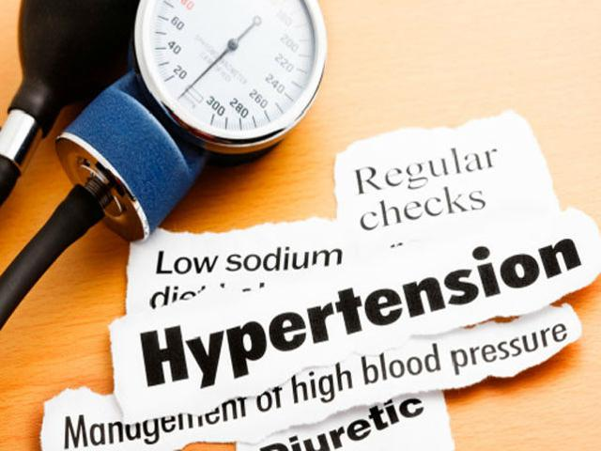
Introduction
Hypertension & Stroke
Background
Pathophysiology
Significance
Descriptive Epidemiology
Causes
Prevention and control measures
Current research

Slide 3
Background
Pathophysiology
Significance
Descriptive Epidemiology
Causes
Prevention and control measures
Current research

Slide 4

Background - Hypertension¹
Definition
Clinical diagnosis (SBP < 120, DBP < 80)
Epidemiological research
Classification

Slide 5
Background - Hypertension¹
Stage | JNC IV (1988) | JNC V (1993) | JNC VI (1997) | JNC VII (2003)
Optimal
SBP/DBP |  |  | <120 / <80
Normal
SBP/DBP | - / <85 | <130 / <85 | <130 / <85 | <120 / <80
HIgh Normal
SBP/DBP | - / 85 - 89 | 130 -139 / 85 - 89 | 130 - 139 / 85 - 89
Pre-HTN
SBP/DBP |  |  |  | 120 - 139 / 80 - 89

Slide 6
Background - Hypertension
HTN | JNC IV (1988) | JNC V (1993) | JNC VI (1997) | JNC VII (2003)
Stage 1 (mild) | - / 90 - 104 | 140 - 159 / 90 - 99 | 140 - 159 / 90 - 99 | 140 - 159 / 90 - 99
Stage 2 (moderate) | - / 105 - 114 | 160 - 179 / 100 - 109 | 160 - 179 / 100 - 109 | ≥ 160 / ≥ 100
Stage 3 (severe) | - / ≥ 115 | 180 - 209 / 110 - 119 | ≥ 180 / ≥ 110
Stage 4 (very severe) |  | ≥ 210 / ≥ 120
Types:
Primary (essential) HTN (95%)
Secondary HTN (5%)

Slide 7
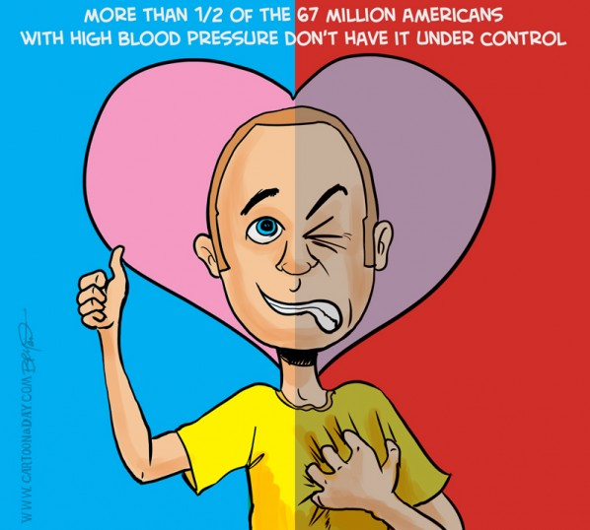
Background - Stroke
Definition
Clinical diagnosis
Classification

Slide 8
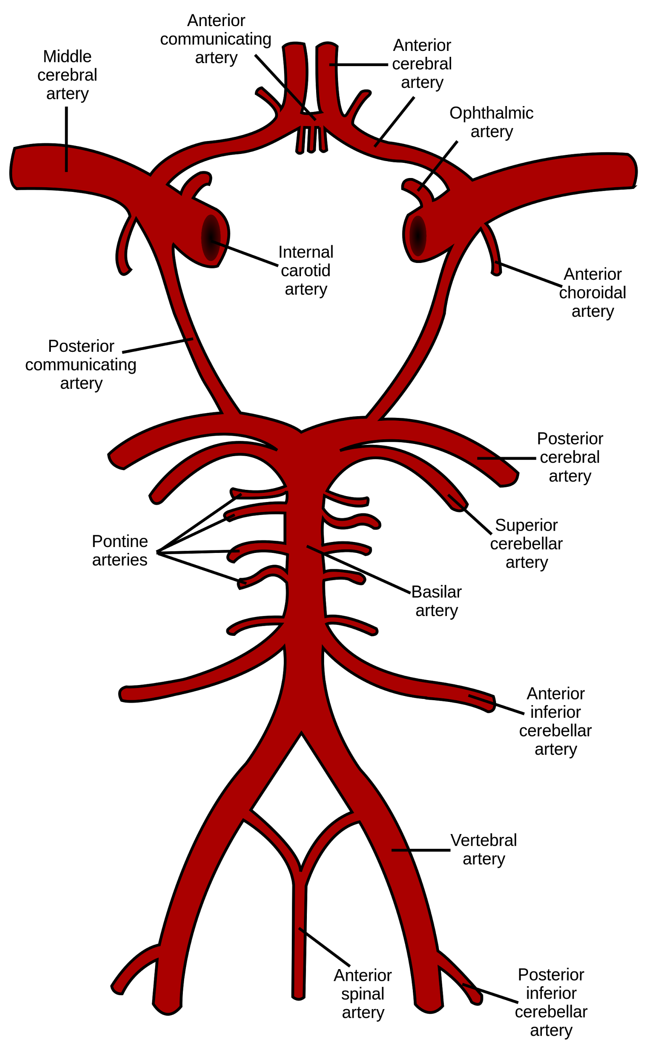
Background - Stroke²
Brain Ischemia (87%)
Thrombosis
Embolism
Decreased perfusion
Cerebral Hemorrhage (13%)
Subarachnoid hemorrhage
Intracerebral hemorrhage

Slide 9
Background
Pathophysiology
Significance
Descriptive Epidemiology
Causes
Prevention and control measures
Current research
Notes:
Now shifting in gear to the pathophysiology of HTN and stroke to better understand these conditions

Slide 10
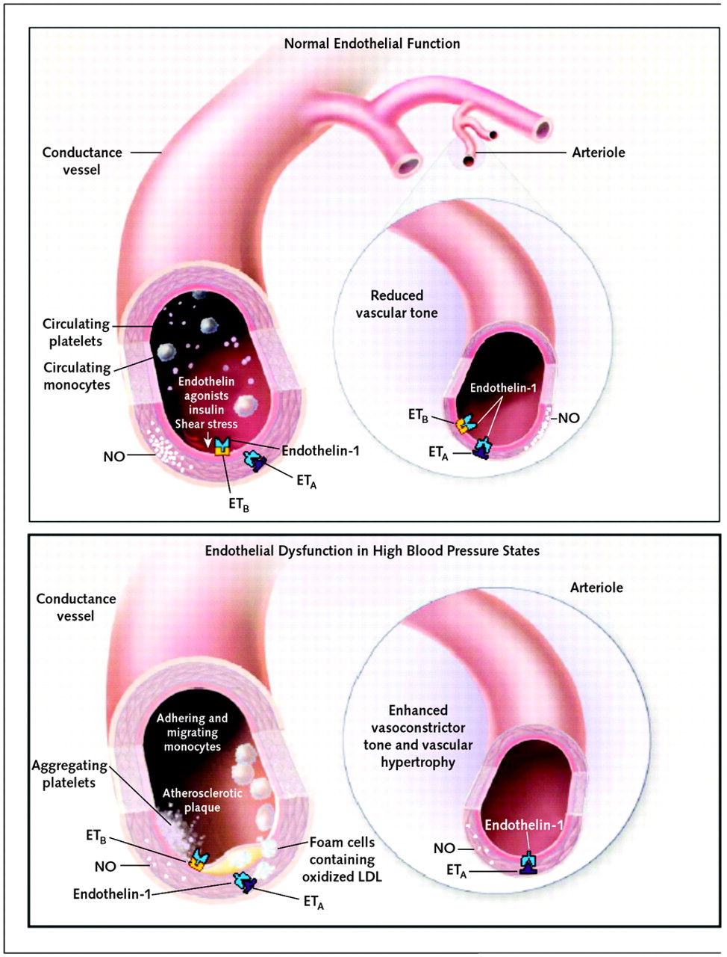
Pathophysiology - Hypertension
CO = SVR * HR
MAP = CO * TPR
Factors affecting MAP:
Sympathetic nervous system
Renin-angiotensin system
Impaired natriuresis (ess. HTN)

Slide 11
Pathophysiology - Stoke
Vascular Anatomy
Anterior circulation
Posterior circulation
Blood pressure physiology in the Brain
Common Stroke Syndromes

Slide 12
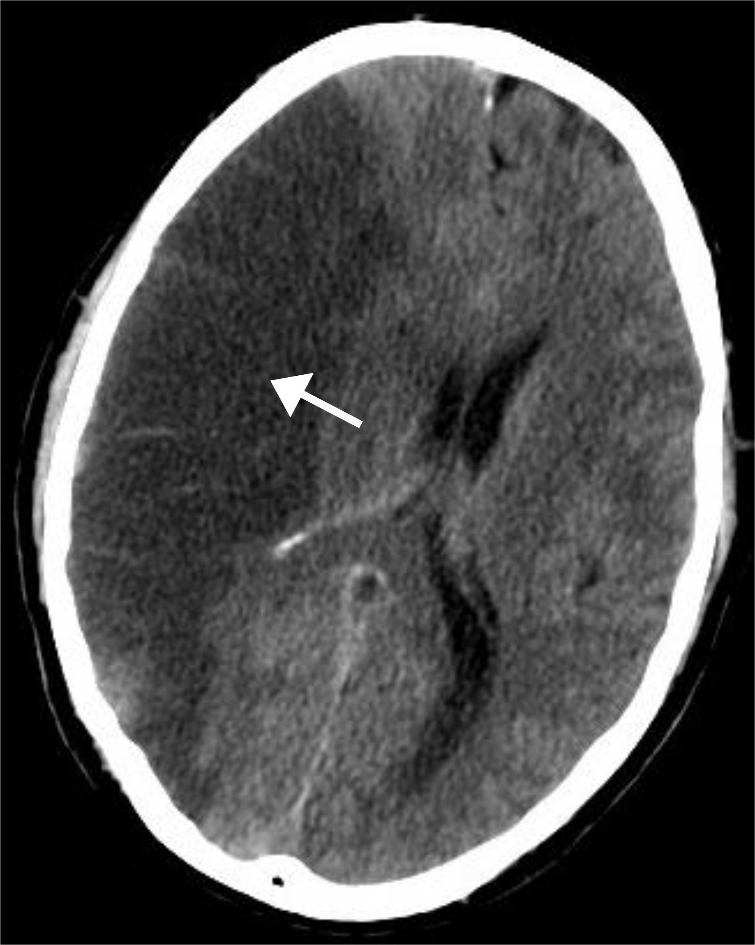
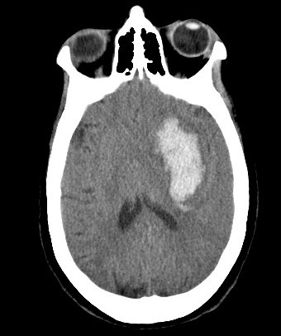
Pathophysiology - Stoke

Slide 13
Background
Pathophysiology
Significance
Descriptive Epidemiology
Causes
Prevention and control measures
Current research

Slide 14
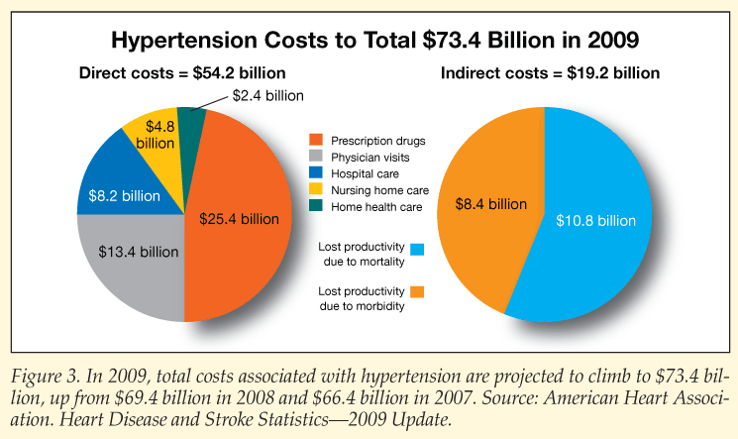
Disease Burden - Hypertension
Morbidity (80 million, 32.5% (2011-2012))³
Mortality (27,853, 8.9 (2011))³
Costs

Slide 15

Disease Burden - Stroke
Morbidity (6.4 million, 2.7% (2012))⁵
Mortality (128,978, 40.8 (2013))⁵
Costs (2011):⁴
Total costs: $33.6 billion
Direct costs: $17.5 billion
Ave. expense of patient for any service: $4,692
Projected costs to triple, from $71.6 billion to $184.1 billion in 2030

Slide 16
Background
Pathophysiology
Significance
Descriptive Epidemiology
Causes
Prevention and control measures
Current research

Slide 17
Descriptive Epidemiology - HTN
Framingham H. Study | 35y - 64y (%) | 65y - 94y (%)
Optimum | 5.1 | 18.5
Normal | 18.1 | 29.0
High Normal | 39.4 | 52.5
Prevalence (32.5%)
High risk groups
Geographic trends
Time trends
ARIC Study | White (%) | AA (%)
Men | 17 | 27
Female | 16 | 30

Slide 18
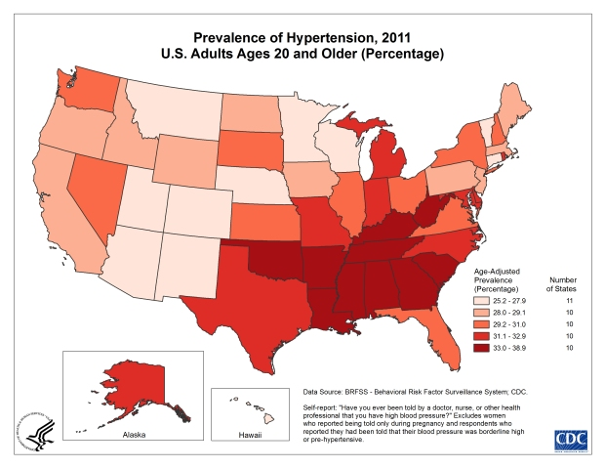
Descriptive Epidemiology - HTN
Centers for Disease and Control and Prevention. Hypertension Facts. accessed on Feb. 25, 2015 from: http://www.cdc.gov/hypertension/facts.htm
Notes:
CDC maps showing the time and geographic trends of hypertension

Slide 19
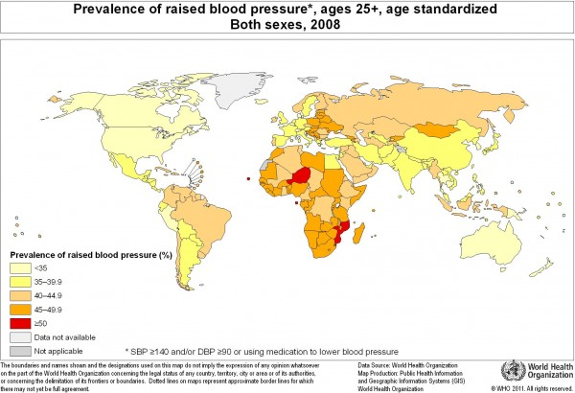
Descriptive Epidemiology - HTN
National Institutes of Health. High Blood Pressure, a Global Threat. accessed on Feb. 25 2015 from: http://directorsblog.nih.gov/2013/04/04/high-blood-pressure-a-global-health-threat/
Notes:
Global map of hypertension prevalence showing the highest two countries are Niger and Mozambique
In general you can see that the african continent in general has a higher prevalence rates than the rest of the world except for Egypt
Then you can see in Asia Mongolia and Uzbekistan
In Europe you can see the eastern european countries have a higher prevalence than western european countries

Slide 20
Descriptive Epidemiology - Stroke
Incidence (795,000)
Prevalence (2.7%)
High risk groups
Geographic trends
Time trends

Slide 21
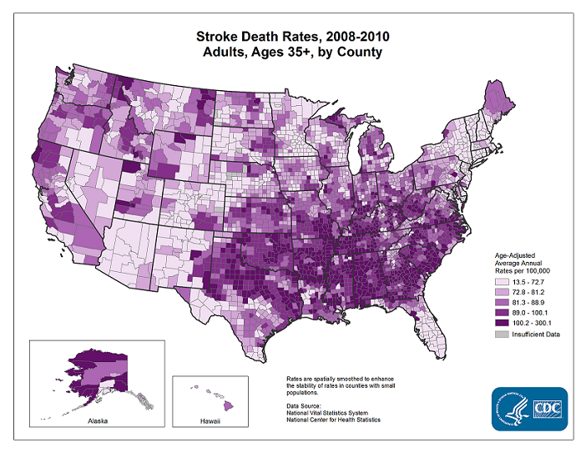
Descriptive Epidemiology - Stroke
Centers for Disease and Control and Prevention. Stroke Facts. accessed on Feb. 25, 2015 from: http://www.cdc.gov/stroke/facts.htm
Notes:
CDC map showing the geographic trends of stroke, esipcially the stroke belt: Southeast states with the highest mortality rates (60 per 100,000) North carolina, South carolina, Georgia, Alabama, Arkansas, Louisiana, Mississippi, and Tennessee

Slide 22
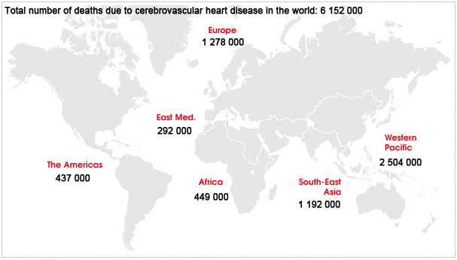
Descriptive Epidemiology - Stroke
World Heart Federation. Global Facts and Map. accessed on Feb. 25 2015 from: http://www.world-heart-federation.org/cardiovascular-health/global-facts-map/global-facts-map-on-cerebrovascular-disease/
Notes:
Global map of stroke mortality, you can see the western pacific countries has a higher mortality from stroke than the whole world
The Western Pacific Region, one of the six regions of the World Health Organization, is home to approximately 1.8 billion people, more than one-fourth of the world's population. It stretches over a vast area, from China in the north and west, to New Zealand in the south, and French Polynesia in the east. It consists of 37 countries
Then Europe has the second most mortality rates in the world

Slide 23
Background
Pathophysiology
Significance
Descriptive Epidemiology
Causes
Prevention and control measures
Current research

Slide 24
Causes - Hypertension
Genetic Factors
Obesity
Salt intake
Potassium intake
Alcohol intake
Physical activity
Gender | weight (BMI) | Risk of HTN
Male | overweight | 2.1
 | obese | 2.7
Female | overweight | 2.4
 | obese | 3.9
INTERSALT | BP | BP change
Na⁺ | SBP | 3 - 6 mmHg
 | DBP | 0 - 3 mmHg
K⁺ | SBP | 2.0 mmHg
 | DBP | 1.1 mmHg

Slide 25
Causes of Stroke
Modifiable Risk Factors
Strong:
* Hypertension (age 50 years)
* Atrial fibrillation (age 50 - 59 years)
Moderate:
* Cigarette smoking
* DM
* Dyslipidemia (high total cholesterol)
* Obesity

Slide 26
Background
Pathophysiology
Significance
Descriptive Epidemiology
Causes
Prevention and control measures
Current research

Slide 27
Prevention - Primary (HTN)
To prevent development of HTN:
Quit smoking
Maintain a healthy weight
Be physically active
Reduce sodium intake
Limit Alcohol

Slide 28
Prevention - Secondary (HTN)
To detect and initiate treatment measures:
Get blood pressure checked (at doctor’s office or convenient locations)
Called “the silent killer” because HTN has no symptoms

Slide 29
Prevention - Tertiary (HTN)
To control blood pressure:
Lower bp via modifiable lifestyle factors
Adhere to prescribed medications
Get checked regularly

Slide 30
Prevention - Primary (Stroke)
To prevent stroke:
Reduce modifiable risk factors:
Diet/exercise
Quit smoking
Maintain a healthy weight
Limit Alcohol
Take aspirin (women only, unless previous stroke)
Prevent and/or treat chronic conditions that increase stroke risk (HTN, high cholesterol, CVD, and diabetes)

Slide 31
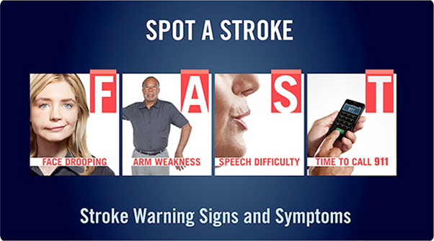
Prevention - Secondary (Stroke)
Early detection and swift treatment in the event of stroke is imperative to preventing death and disability.

Slide 32
Prevention - Tertiary (Stroke)
Therapeutic and rehabilitative measures following a stroke:
Occupational and physical therapy
Nursing care
Speech therapy
Counseling

Slide 33
Background
Pathophysiology
Significance
Descriptive Epidemiology
Causes
Prevention and control measures
Current research

Slide 34

Research - Hypertension
The Million Hearts Hypertension Control Challenge
Part of larger Million Hearts initiative to prevention 1 million heart attacks and strokes by 2017.
The Million Hearts® Hypertension Control Challenge work with healthcare providers and health systems to achieve hypertension control rates at or above 70%.

Slide 35

Research - Stroke
The WISEWOMAN (Well-Integrated Screening and Evaluation for WOMen Across the Nation) program
CDC Division for Heart Disease and Stroke Prevention (DHDSP)
22 WISEWOMAN programs across 21 states
WISEWOMAN provides screening for heart disease and stroke risk factors and lifestyle programs for many low-income, uninsured, or under-insured women aged 40–64 years

Slide 36
Conclusion
Despite advances in medical treatment of HTN and public health campaigns to reduce the prevalence of HTN, the condition remains a significant public health problem.
Enhanced efforts to prevent, treat and control HTN are needed to the prevalence of HTN and subsequent consequences, such as stroke.

Slide 37
Questions?

Slide 38
References
¹Remington, P.L., Brownson, R.C., & Wegner, M., V. Chronic Disease Epidemiology and Control (3rd ed).
Washington, DC: American Public Health Association (p.335 – 362)
²Remington, P.L., Brownson, R.C., & Wegner, M., V. Chronic Disease Epidemiology and Control (3rd ed).
Washington, DC: American Public Health Association (p.400 – 409)
³Centers for Disease and Control and Prevention. Hypertension
(http://www.cdc.gov/nchs/fastats/hypertension.htm)
⁴Mozaffarian D, Benjamin EJ, Go AS, et al. Heart disease and stroke statistics—2015 update: a report from the
American Heart Association. Circulation. 2015 ;e29-322.
⁵Centers for Disease and Control and Prevention. Cerebrovascular Disease or Stroke
(http://www.cdc.gov/nchs/fastats/stroke.htm)

