Slide 1
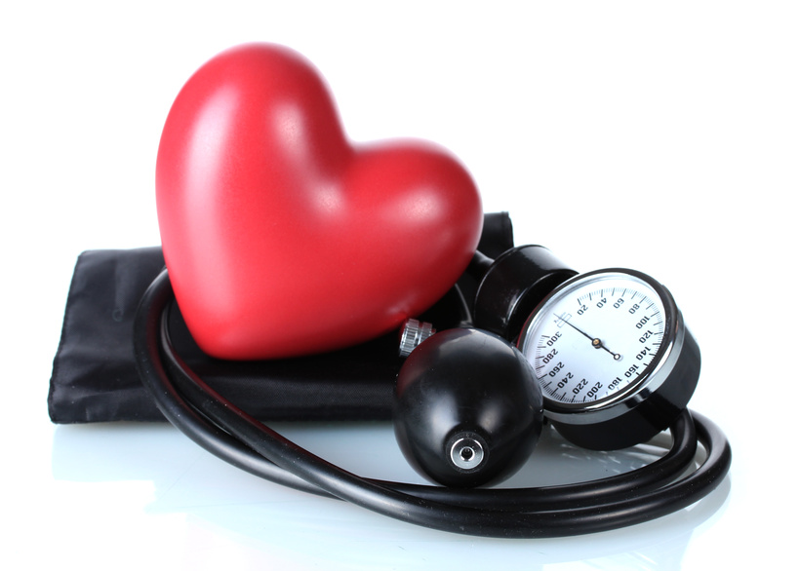
Hypertension and Stroke
Chronic Disease Epidemiology
Asmi Shah

Slide 2
What is Hypertension?
Otherwise known as High Blood Pressure
Blood pressure is the measurement of force applied to artery walls
Rises and falls throughout the day
“Silent Killer”
No warning signs or symptoms
Notes:
http://www.cdc.gov/bloodpressure/about.htm

Slide 3
Measuring Blood Pressure
Quick and painless
Measured in two numbers – Systolic and Diastolic
Systolic – pressure in blood vessels when heart contracts
Diastolic – pressure in vessels when your heart relaxes
Measured in millimeters of mercury (mmHg)
Normal - 120/80 mmHg
Notes:
http://www.cdc.gov/bloodpressure/diastolic_systolic.htm

Slide 4
BP Measurement Techniques
“White Coat” Hypertension
Office BP Measurement
Ambulatory BP Monitoring
Importance of patient BP monitoring
Establishes diagnosis, monitors response to therapy
Average 10/5 mmHg lower than office readings
Closer correlation with target organ damage
Notes:
Dr. Waybe Barbee, PhD, Professor, Emergency Medicine and Physiology
http://www.commed.vcu.edu/Chronic_Disease/hypertension/2012/controversiesBMJ_2.pdf

Slide 5
Effects of High Blood Pressure
Hardens the arteries which decrease flow of blood and oxygen to the heart
Reduced flow can cause…
Chest pain (angina)
Heart Failure – disability of heart to pump blood and oxygen to organs
Heart Attack – blood supply to heart is blocked, heart muscle cells die from lack of oxygen
Stroke – bursting or blocking arteries that supply blood and oxygen to brain
Notes:
http://www.cdc.gov/bloodpressure/diastolic_systolic.htm

Slide 6
Hypertension – Facts and Statistics Overview
67 million American adults (1/3)
69% with first heart attack, 77% with first stroke, and 74% of people with chronic heart failure have high BP
Major risk factor of kidney disease
Primary or contributing cause of 348,000 American deaths in 2009
Costs nation $47.5 billion annually in direct medical expenses
$3.5 billion in lost productivity
Only 47% control their high blood pressure
Almost 30% of American adults have pre-hypertension (higher BP than normal but not HBP range)
Reducing sodium intake can reduce HBP by 11 million and save $18 billion annually
Notes:
http://www.cdc.gov/bloodpressure/facts.htm

Slide 7
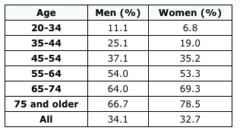
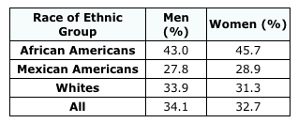
Blood Pressure Levels
Notes:
http://www.cdc.gov/bloodpressure/facts.htm

Slide 8
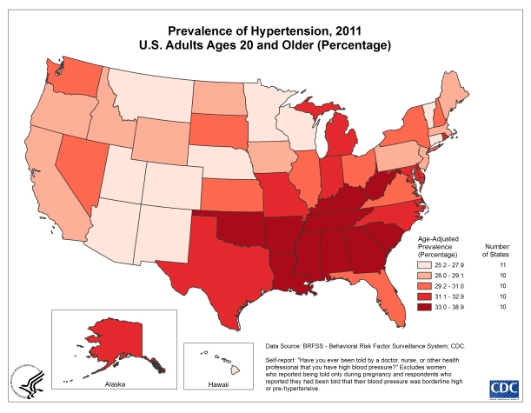
Prevalence of Hypertension, 2011 U.S. Adults Ages 20+ (Percentage)
Notes:
http://www.cdc.gov/dhdsp/data_statistics/fact_sheets/fs_bloodpressure.htm

Slide 9
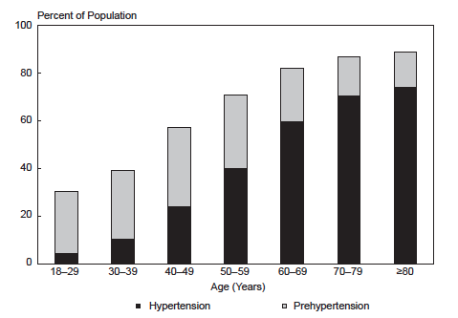
Prevalence of Hypertension and Prehypertension by Age, U.S., 1999-2008
Notes:
http://www.nhlbi.nih.gov/resources/docs/2012_ChartBook.pdf

Slide 10
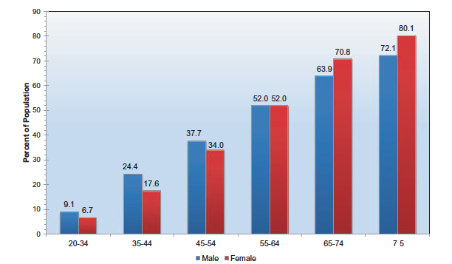
Prevalence of High Blood Pressure in Adults ≥20 years of age by Age and Sex, 2007-2010
Notes:
http://circ.ahajournals.org/content/early/2013/12/18/01.cir.0000441139.02102.80

Slide 11
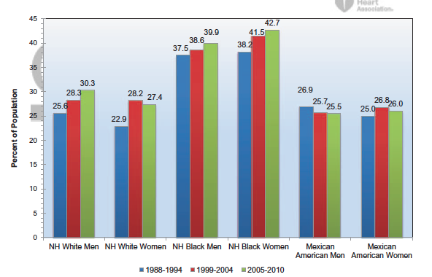
Age-Adjusted Prevalence Trends for High Blood Pressure In Adults ≥20 Years of Age by Race/Ethnicity and Sex
Notes:
http://circ.ahajournals.org/content/early/2013/12/18/01.cir.0000441139.02102.80

Slide 12
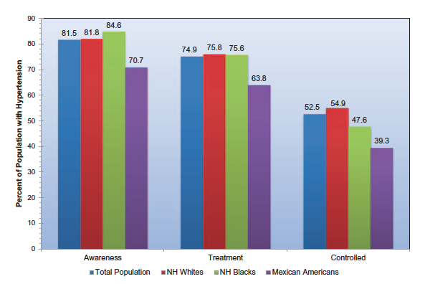
Extent of Awareness, Treatment, and Control of High Blood Pressure by Race/Ethnicity and Age
Notes:
http://circ.ahajournals.org/content/early/2013/12/18/01.cir.0000441139.02102.80

Slide 13
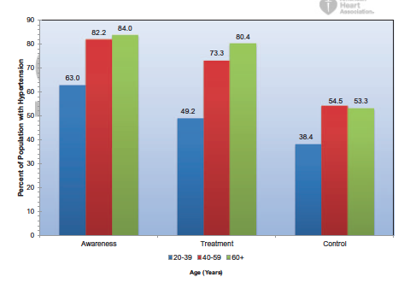
Extent of Awareness, Treatment and Control of High Blood Pressure by Age
Notes:
http://circ.ahajournals.org/content/early/2013/12/18/01.cir.0000441139.02102.80

Slide 14
Hypertension – Risk Factors for Developing HBP
Family history
Advanced age
Gender
Physical inactivity
Poor diet/High salt intake
Overweight/Obesity
Too much alcohol
Possible contributing factors
Stress
Smoking and second hand smoke
Sleep apnea
Notes:
http://www.heart.org/HEARTORG/Conditions/HighBloodPressure/UnderstandYourRiskforHighBloodPressure/Understand-Your-Risk-for-High-Blood-Pressure_UCM_002052_Article.jsp

Slide 15
Secondary Hypertension
Secondary Hypertension – HBP caused by a pre-existing problem
In 5-10% of high blood pressure cases, the HBP is caused by a pre-existing problem
Factors that lead to secondary hypertension
Kidney abnormality
Aorta abnormality
Narrowing of certain arteries
Notes:
http://www.heart.org/HEARTORG/Conditions/HighBloodPressure/UnderstandYourRiskforHighBloodPressure/Understand-Your-Risk-for-High-Blood-Pressure_UCM_002052_Article.jsp

Slide 16
High Blood Pressure Left Untreated
Damage to heart and coronary arteries
Stroke
Kidney damage
Vision loss
Erectile dysfunction
Memory loss
Fluid in the lungs
Chest pain
Peripheral artery disease
Notes:
http://www.heart.org/HEARTORG/Conditions/HighBloodPressure/WhyBloodPressureMatters/Why-Blood-Pressure-Matters_UCM_002051_Article.jsp

Slide 17
Hypertension Mortality
Primary cause of death for 61, 762 Americans in 2009
Listed as a primary or contributing cause of death in about 348, 102/2.4 million US deaths in 2009
2009 high blood pressure mortality:
27,668 male deaths (44.8% of deaths from HBP)
20,286 white males
6,574 black male
34,094 female deaths (55.2% of deaths from HBP)
26,201 white females
6,951 black females
From 1999-2009 the death rate from HBP increased 17.1%
488,000 people diagnosed with HBP were discharged from short-stay hospitals in 2010. discharges include people both living and dead:
216,000 males and 272,000 females
The estimated direct and indirect cost of HBP in 2009 was $51 billion
Notes:
http://www.heart.org/idc/groups/heart-public/@wcm/@sop/@smd/documents/downloadable/ucm_319587.pdf

Slide 18
Hypertension Mortality
Trends in Mortality From All Causes and Cardiovascular Disease Among Hypertensive and Nonhypertensive Adults in the United States (Earl Ford, American Heart Association)
10,852 participants aged 25-74 years of the NHANES I Follow-Up Study (1971-1975)
12,420 participants of the NHANES III Study (1988-1994)
Mean follow up times were 17.5 and 14.2 years respectively
In each cohort, mortality rates higher as follows…
Hypertensive adults > Nonhypertensive adults
Hypertensive men > Hypertensive women
Hypertensive blacks > Hypertensive whites
Notes:
http://circ.ahajournals.org/content/123/16/1737.full

Slide 19
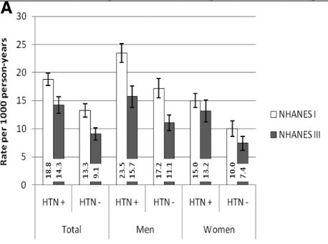
Age-Adjusted Mortality Rate from all Causes Among Adults 25-74 years of Age by Sex
Notes:
http://circ.ahajournals.org/content/123/16/1737.full

Slide 20
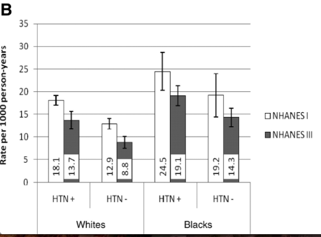
Age-Adjusted Mortality Rate from all Causes Among Adults 25-74 years of Age by Race

Slide 21
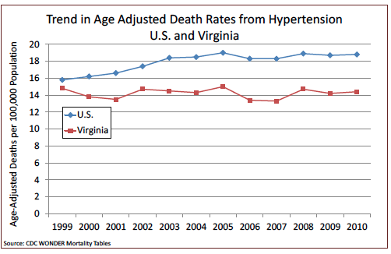
Trend in Age Adjusted Death Rates from Hypertension: U.S. and Virginia
Notes:
http://www.vdh.virginia.gov/ofhs/prevention/collaborative/documents/2013/pdf/Hypertension%20Burden%20Report%20.pdf

Slide 22
Hospital Discharge/Ambulatory Care Visits
From 2000-2010, number of inpatient discharges from short-stay hospitals with HBP → 457,000-488,000
Years 2000-2007, frequency of hospitalizations for adults aged >18 years with hypertensive emergency increase from 101 to 111 per 100,000 in 2007
Number of essential hypertension visits for 2010 was 43,436,000
In 2010, 280,000 hospitalizations had first listed diagnosis of essential hypertension
Notes:
http://circ.ahajournals.org/content/early/2013/12/18/01.cir.0000441139.02102.80

Slide 23
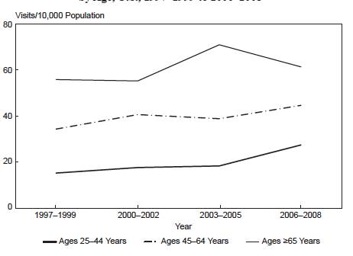
Emergency Department Visit Rates for Hypertension by Age, U.S., 1997-1999 to 2006-2008
Notes:
http://www.nhlbi.nih.gov/resources/docs/2012_ChartBook.pdf

Slide 24
Costs for US and Virginia
The estimated direct and indirect cost of HBP for 2010 is $46.4 billion
Projections show that by 2030, the total cost of HBP could increase to an estimated $274 billion
Notes:
http://circ.ahajournals.org/content/early/2013/12/18/01.cir.0000441139.02102.80
http://www.vdh.virginia.gov/ofhs/prevention/collaborative/documents/2013/pdf/Hypertension%20Burden%20Report%20.pdf

Slide 25
Prevention and Treatment (Lifestyle Modifications for SBP Reduction)
Weight reduction (5-20 mmHg/10 kg weight loss)
Adopt DASH eating plan (8-14 mmHg)
Dietary Sodium Reduction (2-8 mmHg)
Physical Activity (4-9 mmHg)
Moderation of alcohol consumption (2-4 mmHg)
Notes:
http://www.heart.org/HEARTORG/Conditions/HighBloodPressure/PreventionTreatmentofHighBloodPressure/Medications-and-Blood-Pressure_UCM_301888_Article.jsp

Slide 26
Medical Treatments
Diuretics - decreased potassium, weakness, leg cramps, attacks of gout, increased blood sugar level, impotence
Beta blockers – insomnia, cold extremities, depression, slow heartbeat asthma
ACE inhibitors – skin rash, loss of taste, hacking cough
Angiotensin II receptor blockers - dizziness
Calcium channel blockers – swollen ankles, palpitations, constipation, headache
Alpha blockers – fast heart rate, dizziness
Peripheral adrenergic inhibitors – diarrhea, heartburn
Blood vessel dilators – headaches, swelling around eyes, heart palpitations pain in joints
Notes:
http://www.heart.org/HEARTORG/Conditions/HighBloodPressure/PreventionTreatmentofHighBloodPressure/Types-of-Blood-Pressure-Medications_UCM_303247_Article.jsp

Slide 27
What is Stroke?
Otherwise known as Cerebrovascular Disease
Occurs when the blood supply to the brain is blocked or when a blood vessel in the brain ruptures, causing brain tissue to die
Often leads to a sudden feeling of numbness or weakness on half of the body
4th leading cause of death in the US and is a major cause of adult disability
About 800,000 people in the US have a stroke each year
Three types
Ischemic, Hemorrhagic and Transient Ischemic
Notes:
http://www.cdc.gov/stroke/types_of_stroke.htm

Slide 28
3 Types of Stroke
Ischemic – made up 85% of all strokes
Artery that supplies oxygen rich blood to the brain becomes blocked
Cause by blood clots which lead to blockages
Hemorrhagic Stroke
Occurs when artery in the brain leaks blood or ruptures (breaks open). The leaked blood puts too much pressure on brain cells, which damages them
Caused by high blood pressure and aneurysms
Transient Ischemic Attack (TIA)
“Mini stroke” – blood flow to the brain is blocked for a short time, less than 5 minutes
Warning sign of a future stroke

Slide 29
Signs and Symptoms
Sudden numbness or weakness in the face, arm, or leg, especially on one side of body
Sudden confusion, trouble speaking, or difficulty understanding speech
Sudden trouble seeing in one or both eyes
Sudden trouble walking, dizziness, loss of balance, or lack of coordination
Sudden severe headache with no known cause

Slide 30
Acting F.A.S.T. Is Key for Stroke
Most effective stroke treatments are only available if the stroke is recognized and diagnosed within 3 hours of the first symptoms
F – FACE: Ask person to smile. Does one side of face drop?
A – ARMS: Ask the person to raise both arms, Does one arm drift downward?
S – SPEECH: Ask the person to repeat a simple phrase. Is their speech slurred or strand?
T – TIME: If you observe any of these signs, call 911 immediately
Notes:
http://www.cdc.gov/stroke/signs_symptoms.htm

Slide 31
Prevalence of Stroke
Estimated 6.8 million Americans >20 years of age had a stroke
Projections show that by 2030, an additional 3.4 million people aged ≥18 years will have had a stroke, a 20.5% increase in prevalence from 2012. The highest increase is projected to be in Hispanic men
Older adults, blacks, people with lower levels of education, and people living in the southeastern United states according to data from BRFSS 2006-2010
Notes:
http://circ.ahajournals.org/content/early/2013/12/18/01.cir.0000441139.02102.80

Slide 32
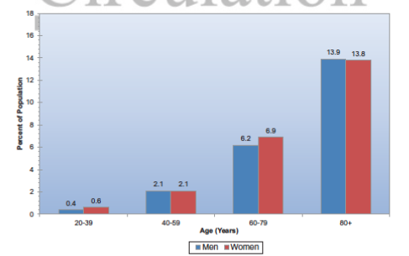
Prevalence of Stroke by Age and Sex, in US, 2007-2010

Slide 33
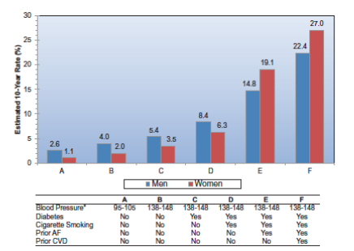
Estimated 10-year Stroke Risk in Adults 55 of Age According to Levels of Various Risk Factors

Slide 34
Stroke Incidence
Each year, 795,000 people experience a new or recurrent stroke. Approximately 610,000 of these are first attacks, and 185,000 are recurrent attacks (NINDS, 1999)
Women have a higher lifetime risk of stroke than men. Lifetime risk of stroke among those 55-75 years of age is 1/5 for women and 1/6 for men
Women however have a lower age-adjusted stroke incidence than men

Slide 35
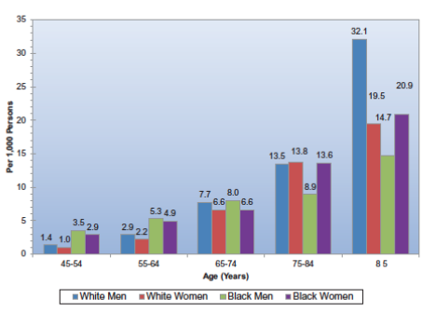
Annual Rate of All First-Ever Strokes By Age, Sex, and Race, 1999

Slide 36
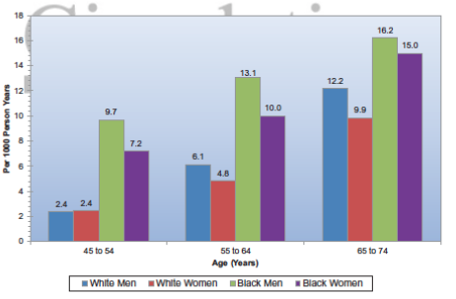
Age-Adjusted Incidence of Stroke/Transient Ischemic Attack by Race and Sex, Ages 45-74, 1987-2001
Notes:
http://circ.ahajournals.org/content/early/2013/12/18/01.cir.0000441139.02102.80
Atherosclerosis Risk in Communities Study Cohort, 1987-2001

Slide 37
Stroke Mortality
Stroke accounted for 1/19 deaths in the United States in 2010
The number of deaths with stroke as an underlying cause in 2010 was 129,476
Approximately 55% of stroke deaths in 2010 occurred out of the hospital (NCHS, 2010)
More women than men die of stroke each year because of the larger number of elderly women
Women accounted for almost 60% of US stroke deaths in 2010

Slide 38
Stroke Mortality Continued
From 2000-2010, the annual stroke death rate decreased 35.8% and the actual number of stroke deaths declined 22.8%
Conclusions about changes in stroke death rates from 1981-2009 are as follows:
There was a greater decline in stroke death rates in men than in women, with a male to female ratio that decreased from 1.11 to 1.05 (age adjusted)
Stroke death rates declined more in people aged 45-64 years (-51.7%) than in those >65 years of age (-48.3%) or those aged 18-44 years (-37.8%)
Notes:
The decline in stroke mortality over the past several decades, a major improvement in population health observed for both sexes and all race and age groups, is the result of reduced stroke incidence and lower case fatality rates. The significant improvements in stroke outcomes are concurrent with cardiovascular risk factor control interventions. The hypertension control efforts initiated in the 1970s appear to have had the most substantial influence on the accelerated decline in stroke mortality, with lower blood pressure districutions in the population

Slide 39
Stoke Mortality Continued
In 2002, death certificate showed that the mean age at stroke death was 79.6 years; however, males had a younger mean age stroke death than females
Blacks, American Indian/Alaska Natives, and Asian/Pacific Islanders had younger mean ages than whites, and the mean age at strok death was also younger among Hispanics than non-Hispanics
Geographic disparity – higher rates in the Southeastern United States, known as the “stroke belt” – NC, SC, GA, TN, MS, AL, LA, AK
The overall average stroke mortality is 20% higher in the stroke belt than in the rest of the nation and 40% higher in the stroke buckle (NC, SC, GA)

Slide 40
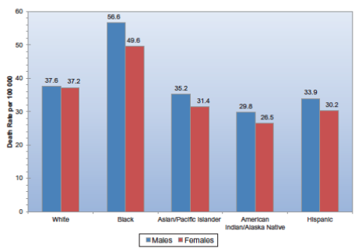
Age-Adjusted Death Rates for Stroke by Sex and Race/Ethnicity, 2010

Slide 41
Stroke Risk Factors
High Blood Pressure
Diabetes Mellitus
Disorders of Hearth Rhythm
High Blood Cholesterol and Other Lipids
Smoking
Physical Inactivity
Nutrition
Family History and Genetics
Chronic Kidney Disease

Slide 42
Awareness of Stroke Warning Signs and Risk Factors
In 2009 (NHIS), a study was conducted on patients admitted to an ED with possible stroke to determine their knowledge of the signs, symptoms, and risk factors of stroke
Of the 163 patients able to respond, 39% did not know a single sign or symptom. Patients ≥65 years of age were less likely than those ≥65 years old to know a sign or symptom of stroke, 43% did not know a single risk factor
51.2% of subjects were aware of 5 stroke warning symptoms and would first call 911 if they thought someone was having a stroke
Awareness of all 5 stroke warning symptoms and calling 911 was higher among whites than blacks and Hispanics (55.9%, 47.1%, 36.5%), and women than men (53.6% vs 48.6%), and people with higher versus lower educational attainment
Overall, almost 40% of patients did not know the signs, symptoms, and risk factors for stroke

Slide 43
Barriers to Stroke Care
NHIS data from 2000-2006, elderly Mexican American and non-Hispanic black stroke survivors had less access to physician care and medications than whites; however for patients aged 45-64 years, these differences were present only for specialist care. Lack of health insurance conferred the highest adjusted odds for reduced access in both age groups
Data from the GWTG (Get With the Guideline) Stroke Program found that less than half of patients presenting with stroke symptoms received imaging within the recommended 25 minutes of hospital arrival. These groups included older age, being female, non-white race, having DM, and arrival by means other than EMS

Slide 44
Hospital Discharges/Ambulatory Care Visits
Data from 2010 (NHDS) showed the average length of stay for discharges with stroke as the first listed diagnosis was 6.1 days, compared with 9.5 days in 1990
2010, men and women accounted for roughly the same number of hospital stays for stroke in the 18-44 year old age group. Among people 45-64 years of age, 57.1% of stroke patients were men. After 65-84 years of age, 53.4% of stroke patients were women, where as among ≥85 years of age, women constituted 66.2% of all stroke patients
2010, for first listed stroke diagnosis in…
ED: 671, 000, Outpatient department visits: 257,000 and physician office visits: 2,207,000

Slide 45
Costs
The direct and indirect cost in 2010 - $36.5 billion
Estimated direct medical cost (2010) - $20.6 billion. Includes hospital outpatient or office based provider visits, hospital inpatient stays, ED visits, prescribed medicines, and home health care
Mean expense per patient for direct care for any type of service - $5455
Mean lifetime cost of ischemic stroke - $140,048 (includes inpatient care, rehabilitation, follow up care)
Between 2012-2030, total direct medical stroke-related costs are projected to triple, from $71.6 billion to $184.1 billion, with the majority from those 65-79 years of age
During 2001-2005, average cost for outpatient stroke rehabilitation services and medications the first year after inpatient rehabilitation discharge was $11,145. The corresponding average yearly cost of medication was $3376, whereas the average cost of yearly rehabilitation service utilization was $7,318

Slide 46
Stroke Treatments
If you have a stroke, you may
Receive emergency care
Treatment to prevent another stroke
Rehabilitation to treat the side effects of stroke
Emergency Care
Brain scans will show what type of stroke occurred
Doctors involved: neurologist, neurosurgeon
Treating ischemic stroke within 3 hours – type of thrombolytic called Tissue Plasminogen Activator (breaks up blood clots and improves the changes of recovering)
Patients who receive tPA more likely to recover fully or have less disability than patients who do not receive the drug
Less likely to need long term care in nursing home
Most victims however do not get to the hospital in time

Slide 47
Emergency Care – Procedure/Surgery Treatments
Endovascular Procedures – used to treat certain hemorrhagic strokes
Less invasive, less dangerous than surgical
Long tube inserted into major artery in leg or arm, goes to weak spot or break in vessel → tube installs device (coil) which repairs damage or prevents bleeding
Surgical Treatment – also used to hemorrhagic strokes. If bleeding is caused by ruptured aneurysm, a metal clip put in place to stop blood loss

Slide 48
Treatments – Preventing Another Stroke and Rehabilitation
Preventing another stroke
If you’ve have a stroke, you are at high risk for another
¼ stroke survivors has another stroke within 5 years
The risk of stroke within 90 days of a TIA may be as high as 17%, with the largest risk during the first week
Stroke Rehabilitation
May need rehab to recover
Speech therapy, Physical Therapy, Occupational Therapy

Slide 49
Recovery
Recovery can take weeks, months, years
May recover fully or have long-term or lifelong disabilities
Some problems may continue after having a stroke
Paralysis, trouble with thinking, awareness, attention, learning, judgment, and memory, problems understanding or forming speech, trouble controlling or expressing emotions, numbness to strange sensations, pain in hands and feet, trouble chewing and swallowing, problems with bladder and bowel control, depression

Slide 50
Areas of Future Research
Detect other potentially modifiable risk factors such as elevated cholesterol and body weight
Promote specific interventions to high risk populations; Guidelines are needed to tailor interventions to a variety of subpopulations
National initiatives with community based research to provide individual and population level support to ensure patients are properly screened, treated, and monitored for primary risk factors

