Slide 1
Hypertension & Stroke
KATE GILMORE
CHRONIC DISEASES
FEBRUARY 18, 2013

Slide 2
Hypertension
Notes:
"Systolic" refers to blood pressure when the heart beats while pumping blood. "Diastolic" refers to blood pressure when the heart is at rest between beats.
Stage 1
140–159
Or
90–99
Stage 2
160 or higher
Or
100 or higher

Slide 3
Hypertension
High blood pressure – current guidelines for defining:
Normal [SBP<120 mmHg and DBP<80 mmHg]
Prehypertension [SBP 120-139 and DBP 80-89 mmHg]
Hypertension [SBP >=140 mmHg and DBP >=90 mmHg]
Defined by levels that are above those which blood-pressure lowering interventions have been shown to reduce the risk of stroke and coronary heart disease
Therefore definitions change/shift accordingly
Arbitrary, but useful for making clinical treatment decisions
Notes:
"Systolic" refers to blood pressure when the heart beats while pumping blood. "Diastolic" refers to blood pressure when the heart is at rest between beats.
Stage 1
140–159
Or
90–99
Stage 2
160 or higher
Or
100 or higher

Slide 4
Types of Hypertension
When HBP has no known cause, it is often called essential hypertension, primary hypertension, or idiopathic hypertension.
When another condition causes HBP, it's sometimes called secondary hypertension.
Some people only have high systolic blood pressure. This condition is called isolated systolic hypertension (ISH). Many older adults have this condition. ISH can cause as much harm as HBP in which both numbers are too high.
Pulmonary hypertension: Abnormally high blood pressure in the arteries of the lungs

Slide 5
Prevalence of Hypertension
About 1 in 3 U.S. adults—an estimated 68 million people—have high blood pressure.
Less than half (46%) of people with high blood pressure have their condition under control.
Almost 30% of American adults have prehypertension—Prehypertension raises your risk of developing high blood pressure.
Centers for Disease Control and Prevention (CDC).

Slide 6
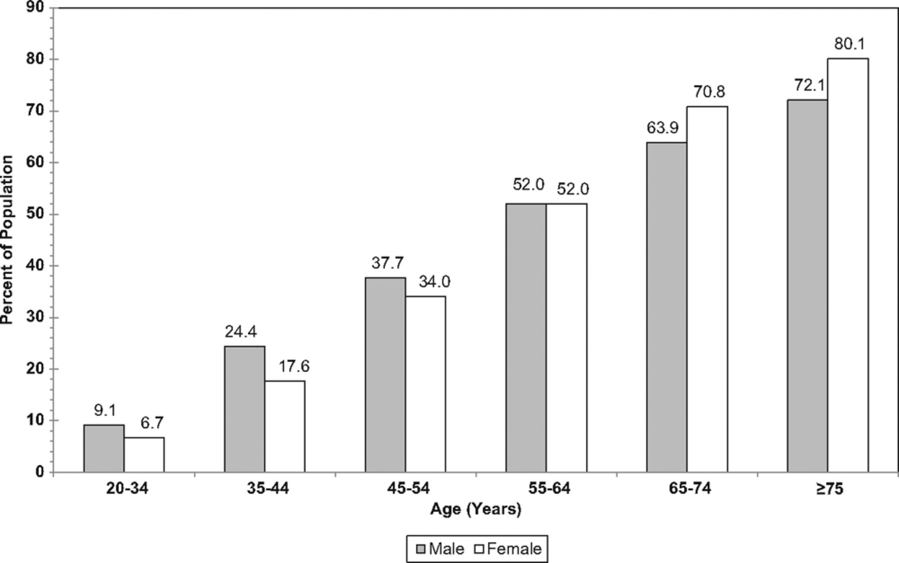
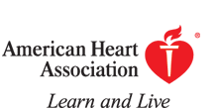
Prevalence of high blood pressure in adults ≥20 years of age by age and sex (National Health and Nutrition Examination Survey: 2007–2010).
Go A S et al. Circulation 2013;127:e6-e245
Copyright © American Heart Association
Notes:
Prevalence of high blood pressure in adults ≥20 years of age by age and sex (National Health and Nutrition Examination Survey: 2007–2010). Hypertension is defined as systolic blood pressure ≥140 mm Hg or diastolic blood pressure ≥90 mm Hg, if the subject said “yes” to taking antihypertensive medication, or if the subject was told on 2 occasions that he or she had hypertension. Source: National Center for Health Statistics and National Heart, Lung, and Blood Institute.

Slide 7
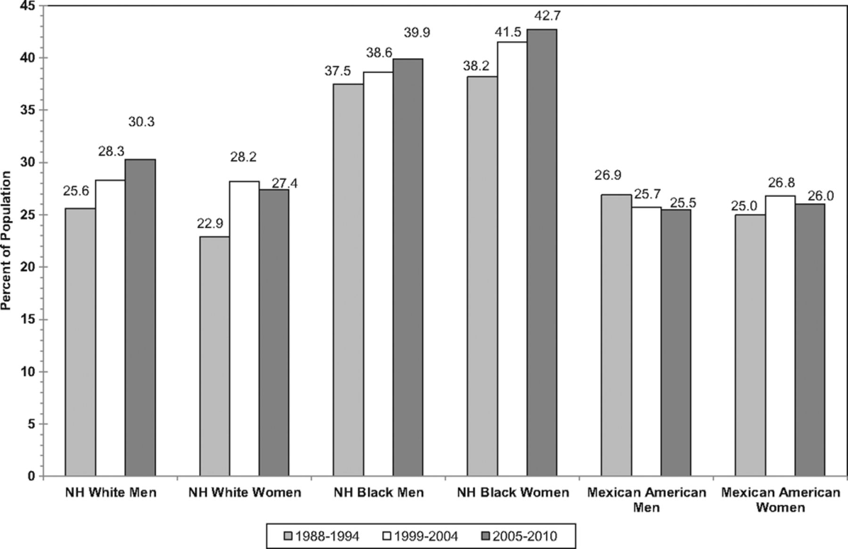
Age-adjusted prevalence trends for high blood pressure in adults ≥20 years of age by race/ethnicity, sex, and survey (National Health and Nutrition Examination Survey: 1988–1994, 1999–2004, and 2005–2010).
Go A S et al. Circulation 2013;127:e6-e245
Copyright © American Heart Association
Notes:
Age-adjusted prevalence trends for high blood pressure in adults ≥20 years of age by race/ethnicity, sex, and survey (National Health and Nutrition Examination Survey: 1988–1994, 1999–2004, and 2005–2010). NH indicates non-Hispanic. Source: National Center for Health Statics and National Heart, Lung and Blood Institute.

Slide 8
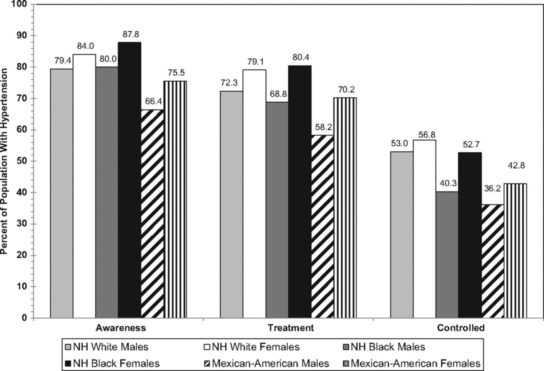
Extent of awareness, treatment, and control of high blood pressure by race/ethnicity and sex (National Health and Nutrition Examination Survey: 2007–2010).
Go A S et al. Circulation 2013;127:e6-e245
Copyright © American Heart Association
Notes:
Extent of awareness, treatment, and control of high blood pressure by race/ethnicity and sex (National Health and Nutrition Examination Survey: 2007–2010). NH indicates non-Hispanic. Source: National Center for Health Statistics and National Heart, Lung, and Blood Institute.

Slide 9
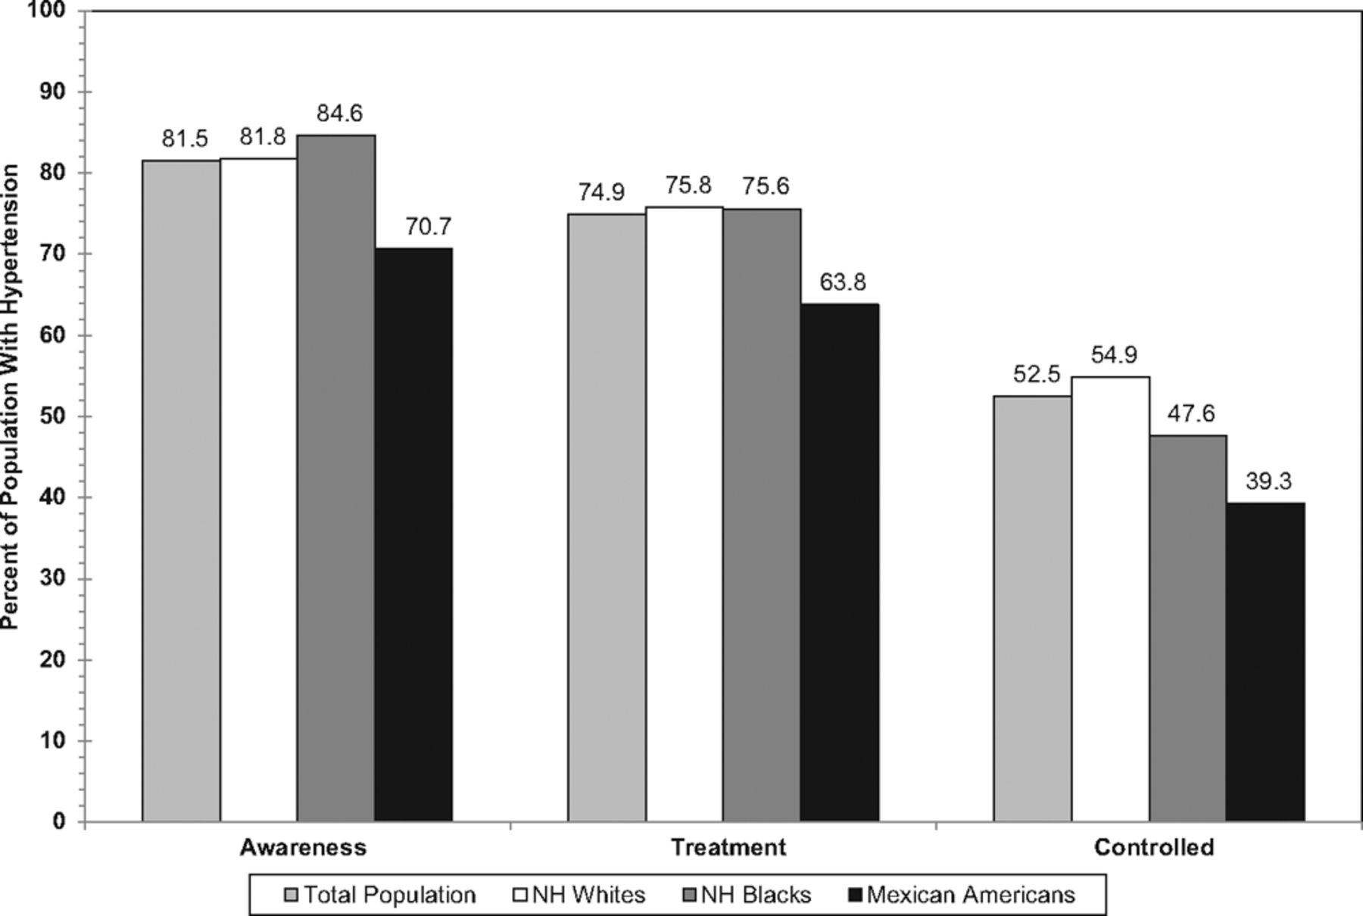
Extent of awareness, treatment, and control of high blood pressure by race/ethnicity (National Health and Nutrition Examination Survey: 2007–2010).
Go A S et al. Circulation 2013;127:e6-e245
Copyright © American Heart Association
Notes:
Extent of awareness, treatment, and control of high blood pressure by race/ethnicity (National Health and Nutrition Examination Survey: 2007–2010). NH indicates non-Hispanic. Source: National Center for Health Statistics and National Heart, Lung, and Blood Institute.

Slide 10
Racial/Ethnic Trends- Race
Hypertension is more common in African American adults than in Caucasian or Hispanic American adults:
Tend to get HBP earlier in life
Often have more severe HBP
Are more likely to be aware that they have HBP and to get treatment
Are less likely than Caucasians to achieve target control levels with HBP treatment
Have higher rates than Caucasians of early death from HBP-related problems, such as coronary heart disease, stroke, and kidney failure
HBP risks vary among different groups of Hispanic American adults. For instance, Puerto Rican American adults have higher rates of HBP-related death than all other Hispanic groups and Caucasians. However, Cuban Americans have lower rates of HBP-related death than Caucasians.
(National Institutes of Health)

Slide 11
Age adjusted prevalence 1999-2006

Slide 12
Geographic Distribution of Hypertension

Slide 13
Geographic Distribution of Hypertension
Interactive Atlast of Heart Disease and Stroke
http://apps.nccd.cdc.gov/DHDSPAtlas/viewer.aspx

Slide 14
Morbidity & Mortality
The strongest independent risk factor for stroke
Can lead to chronic kidney disease, a progressive loss of renal function and to end-stage renal disease
Cardiovascular diseases including coronary heart artery disease and congestive heart failure
69% of people who have a first heart attack, 77% of people who have a first stroke, and 74% of people with chronic heart failure have high blood pressure. (CDC)
High blood pressure was listed as a primary or contributing cause of death for about 348,000 Americans in 2008.

Slide 15
Screening
In adults, recommended that blood pressure should be measured at every routine clinic visit, then premeasured in 2 years in those with normal blood pressure, and in 1 year with those with prehypertension.
Screening should be aimed to identify high-risk patients- those with family history, African American ancestry, overweight/obese, sedentary lifestyle, or high alcohol/salt intake.

Slide 16
Genetics
About 40% of the variability in blood pressure levels can be explained by genetic factors
Risk of developing high blood pressure in persons younger than 50 years doubles for each first-degree relative with a history of high blood pressure.
Blood pressure is regulated by many different genetic mechanisms and are therefore hard to identify.
[CDC]

Slide 17
High-Risk Groups/Behaviors
SBP increases naturally with age in both men and women
Sex and age-specific SBP tend to be higher among African Americans than other racial/ethnic groups
DBP naturally increases with age until about 50 yo, then remains constant
Obesity- excessive accumulations of body fat lead to higher blood pressure

Slide 18
Modifiable Risk Factors
Individual Level Modifiable Risk Factors
Screening and early detection
Weight reduction
Healthy eating
Physical activity
Salt intake reduction
Dietary potassium increase
Moderation of alcohol intake
Smoking
Diabetes

Slide 19
Treatment for Hypertension
Lifestyle changes:
Weight reduction
Healthy eating- DASH (Dietary Approaches to Stop Hypertension)
Physical activity
Salt intake reduction
Dietary potassium increase
Moderation of alcohol intake
Smoking

Slide 20
Treatment for Hypertension
DASH (Dietary Approaches to Stop Hypertension)
The DASH eating plan focuses on fruits, vegetables, whole grains, and other foods that are heart healthy and low in fat, cholesterol, and sodium (salt).
DASH also focuses on fat-free or low-fat dairy products, fish, poultry, and nuts. The DASH eating plan is reduced in red meats (including lean red meats), sweets, added sugars, and sugar-containing beverages. It's rich in nutrients, protein, and fiber.
National Heart Lung and Blood Institute

Slide 21
Treatment for Hypertension
Blood pressure medicines work in different ways to lower blood pressure. Some remove extra fluid and salt from the body to lower blood pressure. Others slow down the heartbeat or relax and widen blood vessels. Often, two or more medicines work better than one.
Diuretics
Beta Blockers
ACE Inhibitors
Angiotensin II Receptor Blockers
Calcium Channel Blockers
Alpha Blockers
Alpha-Beta Blockers
Nervous System Inhibitors
Vasodilators
National Heart, Lung and Blood Institute
Notes:
Blood pressure medicines work in different ways to lower blood pressure. Some remove extra fluid and salt from the body to lower blood pressure. Others slow down the heartbeat or relax and widen blood vessels. Often, two or more medicines work better than one.
Diuretics
Diuretics sometimes are called water pills. They help your kidneys flush excess water and salt from your body. This reduces the amount of fluid in your blood, and your blood pressure goes down.
Diuretics often are used with other HBP medicines and sometimes combined into one pill.
Beta Blockers
Beta blockers help your heart beat slower and with less force. As a result, your heart pumps less blood through your blood vessels. This causes your blood pressure to go down.
ACE Inhibitors
ACE inhibitors keep your body from making a hormone called angiotensin II. This hormone normally causes blood vessels to narrow. ACE inhibitors prevent this, so your blood pressure goes down.
Angiotensin II Receptor Blockers
Angiotensin II receptor blockers are newer blood pressure medicines that protect your blood vessels from the angiotensin II hormone. As a result, blood vessels relax and widen, and your blood pressure goes down.
Calcium Channel Blockers
Calcium channel blockers keep calcium from entering the muscle cells of your heart and blood vessels. This allows blood vessels to relax, and your blood pressure goes down.
Alpha Blockers
Alpha blockers reduce nerve impulses that tighten blood vessels. This allows blood to flow more freely, causing blood pressure to go down.
Alpha-Beta Blockers
Alpha-beta blockers reduce nerve impulses the same way alpha blockers do. However, they also slow the heartbeat like beta blockers. As a result, blood pressure goes down.
Nervous System Inhibitors
Nervous system inhibitors increase nerve impulses from the brain to relax and widen blood vessels. This causes blood pressure to go down.
Vasodilators
Vasodilators relax the muscles in blood vessel walls. This causes blood pressure to go down.

Slide 22
Treatment for Hypertension
Current Guidelines and Controversy
Updated guidelines issued in 2011
Changes in drug recommendations for treating pts over 55 years old vs. under 55 years old
Recommendations for ambulatory and at home monitoring of blood pressure to confirm a clinical reading for HBP.
Critics say:
The new guidelines are overly complicated- 4 drug classes are more similar than different in their efficacy and safety, so drug choice based on drug price, tolerability, and individual patients’ characteristics
Evidence- there is not a lot of data from trials that justify the shift to ambulatory and home monitoring (the white coat effect)
Will cut those receiving antihypertensive drugs by 25% which is arguabley not evidence based or safe according to some.

Slide 23
Public Health Approaches to Hypertension
Emphasis on population-based strategies to reduce hypertension in the population including:
Monitoring and reducing population level sodium intake and other risk factors including BMI/weight
Improve surveillance and reporting of hypertension
Addressing socioeconomic barriers to accessing anti-hypertensive drugs
[CDC]

Slide 24
Research Efforts & Needs
A major goal of basic hypertension research is to identify the underlying biological pathways and mechanisms responsible for abnormalities in blood pressure control, related risk factors, co-morbidities, and susceptibility to target organ damage.
Genetic studies have demonstrated the enormous complexity involved in understanding the causes of high blood pressure.
Interdisciplinary research models from the gene to the intact organism, are needed to yield the important and much needed data on the causes of high blood pressure and organ damage.
National Heart, Lung and Blood Institute

Slide 25
Economic Impact - Hypertension
Costs directly attributable to high blood pressure for the nation total almost $131 billion annually in direct medical expenses and $25 billion in lost productivity (CDC 2008).
Reducing average population sodium intake from 3,300 mg to 2,300 mg per day may reduce cases of high blood pressure by 11 million and save 18 billion health care dollars annually (CDC 2008).

Slide 26
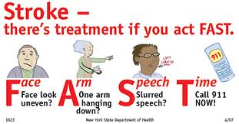
Stroke

Slide 27
Stroke
Occurs when a clot blocks the blood supply to the brain or when a blood vessel in the brain bursts.
Stroke can cause death or significant disability, such as paralysis, speech difficulties, and emotional problems.
Some new treatments can reduce stroke damage if patients get medical care soon after symptoms begin.

Slide 28
Types of Stroke
Ischemic Stroke. About 85% of all strokes are ischemic, in which blood flow to the brain is blocked by blood clots or fatty deposits called plaque in blood vessel linings.
Hemorrhagic Stroke. A hemorrhagic stroke occurs when a blood vessel bursts in the brain. Blood accumulates and compresses the surrounding brain tissue. There are two types of hemorrhagic stroke
Intracerebral hemorrhage is the most common type of hemorrhagic stroke. It occurs when an artery in the brain bursts, flooding the surrounding tissue with blood.
Subarachnoid hemorrhage is bleeding in the area between the brain and the thin tissues that cover it.
Transient ischemic attack (TIA) is a "warning stroke" or a "mini-stroke" that results in no lasting damage. Recognizing and treating TIAs immediately can reduce your risk of a major stroke.

Slide 29
Stroke Stats
National age-adjusted prevalence of stroke in 2010 was 2.6%
Strokes can and do occur at ANY age. Nearly one fourth of strokes occur in people under the age of 65.
Stroke death rates are higher for African-Americans than for whites, even at younger ages.
On average, someone in the United States has a stroke every 40 seconds.
The risk of ischemic stroke in current smokers is about double that of nonsmokers after adjustment for other risk factors.
Notes:
The following graphs will demonstrate these trends.

Slide 30
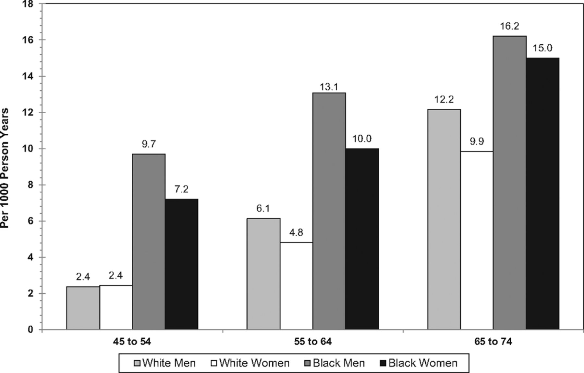
Age-adjusted incidence of stroke/transient ischemic attack* by race and sex, ages 45 to 74 years, Atherosclerosis Risk in Communities study cohort, 1987–2001.
Go A S et al. Circulation 2013;127:e6-e245
Copyright © American Heart Association
Notes:
Age-adjusted incidence of stroke/transient ischemic attack* by race and sex, ages 45 to 74 years, Atherosclerosis Risk in Communities study cohort, 1987–2001. Data derived from the National Heart, Lung, and Blood Institute, Incidence and Prevalence: 2006 Chart Book.¹⁷⁵

Slide 31
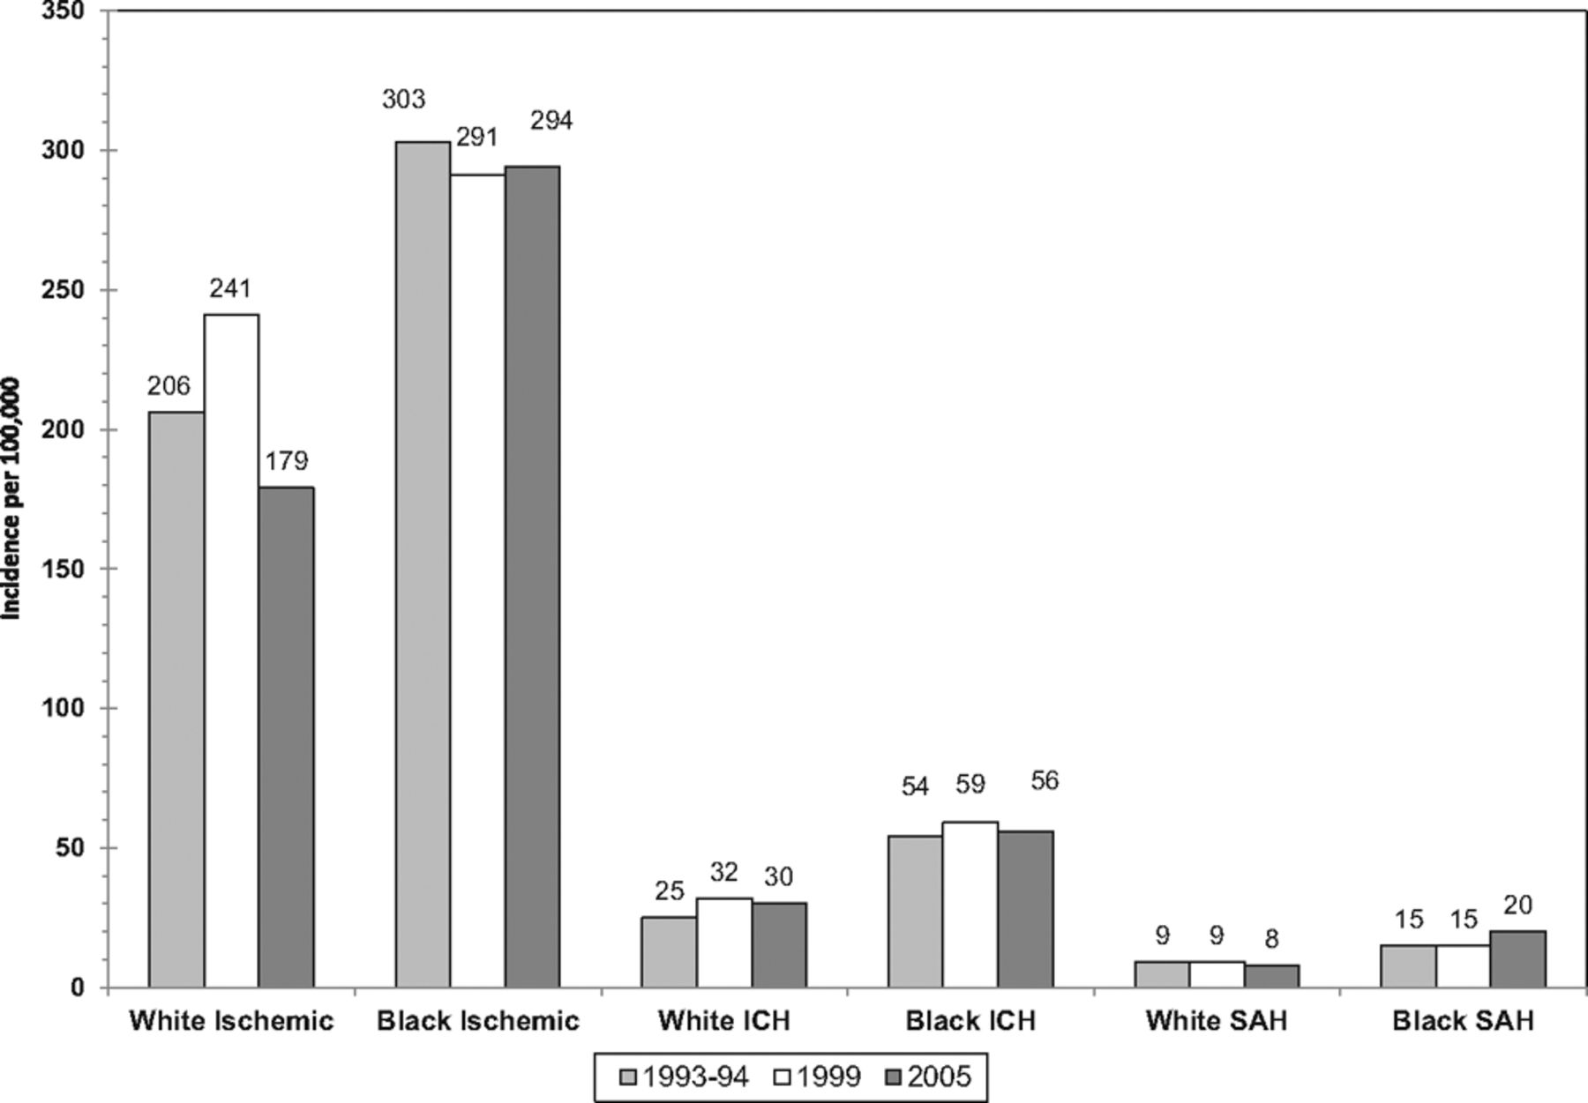
Annual age-adjusted incidence of first-ever stroke by race.
Go A S et al. Circulation 2013;127:e6-e245
Copyright © American Heart Association
Notes:
Annual age-adjusted incidence of first-ever stroke by race. Hospital plus out-of-hospital ascertainment, 1993 to 1994, 1999, and 2005. ICH indicates intracerebral hemorrhage; SAH, subarachnoid hemorrhage. Data derived from Kleindorfer et al.9

Slide 32
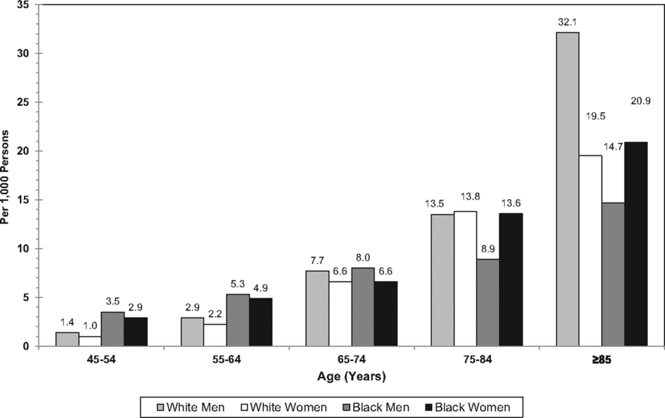
Annual rate of all first-ever strokes by age, sex, and race (Greater Cincinnati/Northern Kentucky Stroke Study: 1999).
Go A S et al. Circulation 2013;127:e6-e245
Copyright © American Heart Association
Notes:
Annual rate of all first-ever strokes by age, sex, and race (Greater Cincinnati/Northern Kentucky Stroke Study: 1999). Rates for black men and women 45 to 54 years of age and for black men ≥75 years of age are considered unreliable.

Slide 33
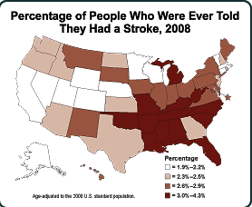
Stroke – Geographical Distribution
Interactive Atlas Stroke and Heart Disease
http://apps.nccd.cdc.gov/DHDSPAtlas/
http://apps.nccd.cdc.gov/DHDSPAtlas/viewer.aspx

Slide 34
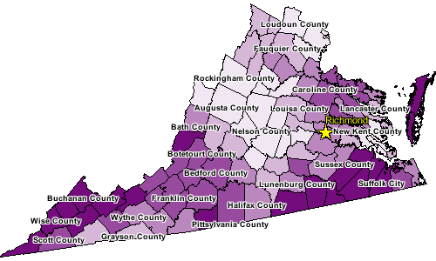
Virginia Stroke Hospitalization Rates
Total population, ages 65+, Medicare beneficiaries, 2000-2006
Notes:
Age adjusted rate per 1,000

Slide 35
Stroke Symptoms
Stroke can affect your senses, speech, behavior, thoughts, memory, and emotions.
The five most common signs and symptoms of stroke are:
Sudden numbness or weakness of the face, arm, or leg
Sudden confusion or trouble speaking or understanding others
Sudden trouble seeing in one or both eyes
Sudden dizziness, trouble walking, or loss of balance or coordination
Sudden severe headache with no known cause

Slide 36
Stroke Treatment – Call 911!
Emergency treatment. If you get to the hospital within three hours of the first symptoms of an ischemic stroke, a doctor may give you medications, called thrombolytics, to break up blood clots. Few medications can treat hemorrhagic stroke, but surgery may stop the bleeding.
Preventing another stroke. If you have had a stroke, you are at high risk for another one. At least one in every eight stroke survivors has another stroke within 5 years. Important to treat the underlying causes, including heart disease, high blood pressure, atrial fibrillation, high cholesterol, or diabetes.
Rehabilitation. Rehabilitation often involves physical therapy to help you relearn skills you may have lost because of the stroke.

Slide 37
Other treatments for Stroke
Other treatments given in the hospital depend on the cause of the stroke:
Blood thinners such as heparin, warfarin (Coumadin), aspirin, or clopidogrel (Plavix)
Medicine to control symptoms such as high blood pressure
Special procedures or surgery to relieve symptoms or prevent more strokes
Nutrients and fluids
A feeding tube in the stomach (gastrostomy tube)
Physical therapy, occupational therapy, speech therapy, and swallowing therapy
Notes:
The goal of treatment after a stroke is to help you recover as much function as possible and prevent future strokes.

Slide 38
Mortality & Morbidity
Stroke is the leading cause of serious, long-term disability in the U.S. (CDC).
Stroke is the third leading cause of death in the United States, killing nearly 130,000 Americans each year—that’s 1 of every 18 deaths. (CDC)
From 1995–2005, the stroke death rate fell ~30 percent and the actual number of stroke deaths declined ~14 percent. (National Stroke Association)

Slide 39
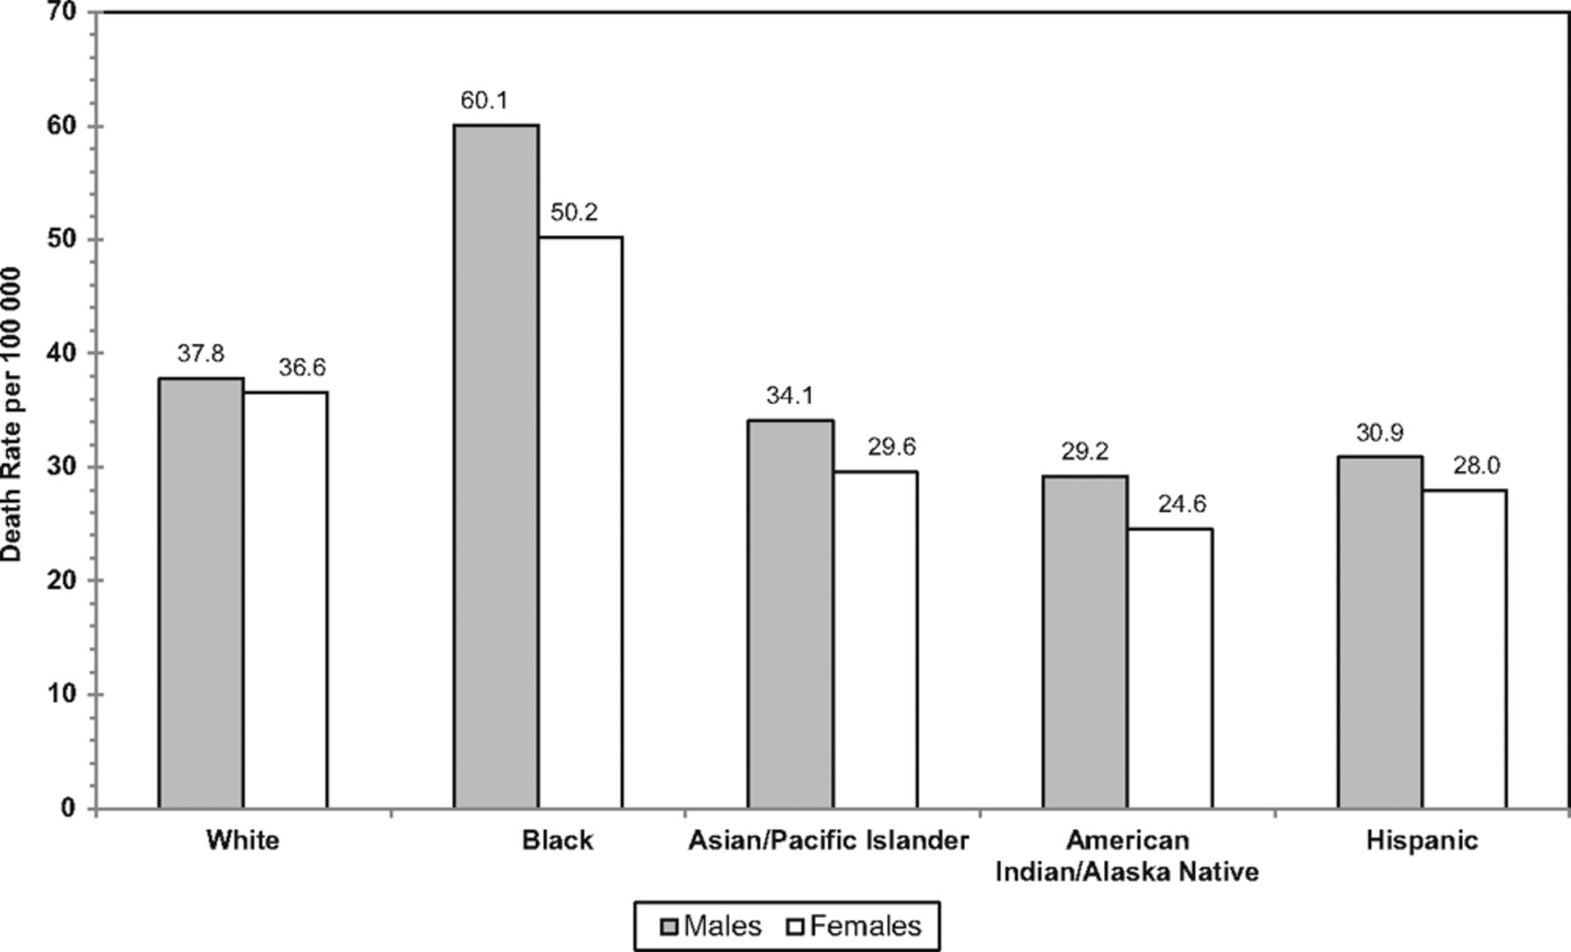
Age-adjusted death rates for stroke by sex and race/ethnicity, 2009.
Go A S et al. Circulation 2013;127:e6-e245
Copyright © American Heart Association
Notes:
Age-adjusted death rates for stroke by sex and race/ethnicity, 2009. Death rates for the American Indian/Alaska Native and Asian or Pacific Islander populations are known to be underestimated. Stroke includes International Classification of Diseases, 10th Revision codes I60 to I69 (cerebrovascular disease). Source: National Center for Health Statistics and National Heart, Lung, and Blood Institute.

Slide 40
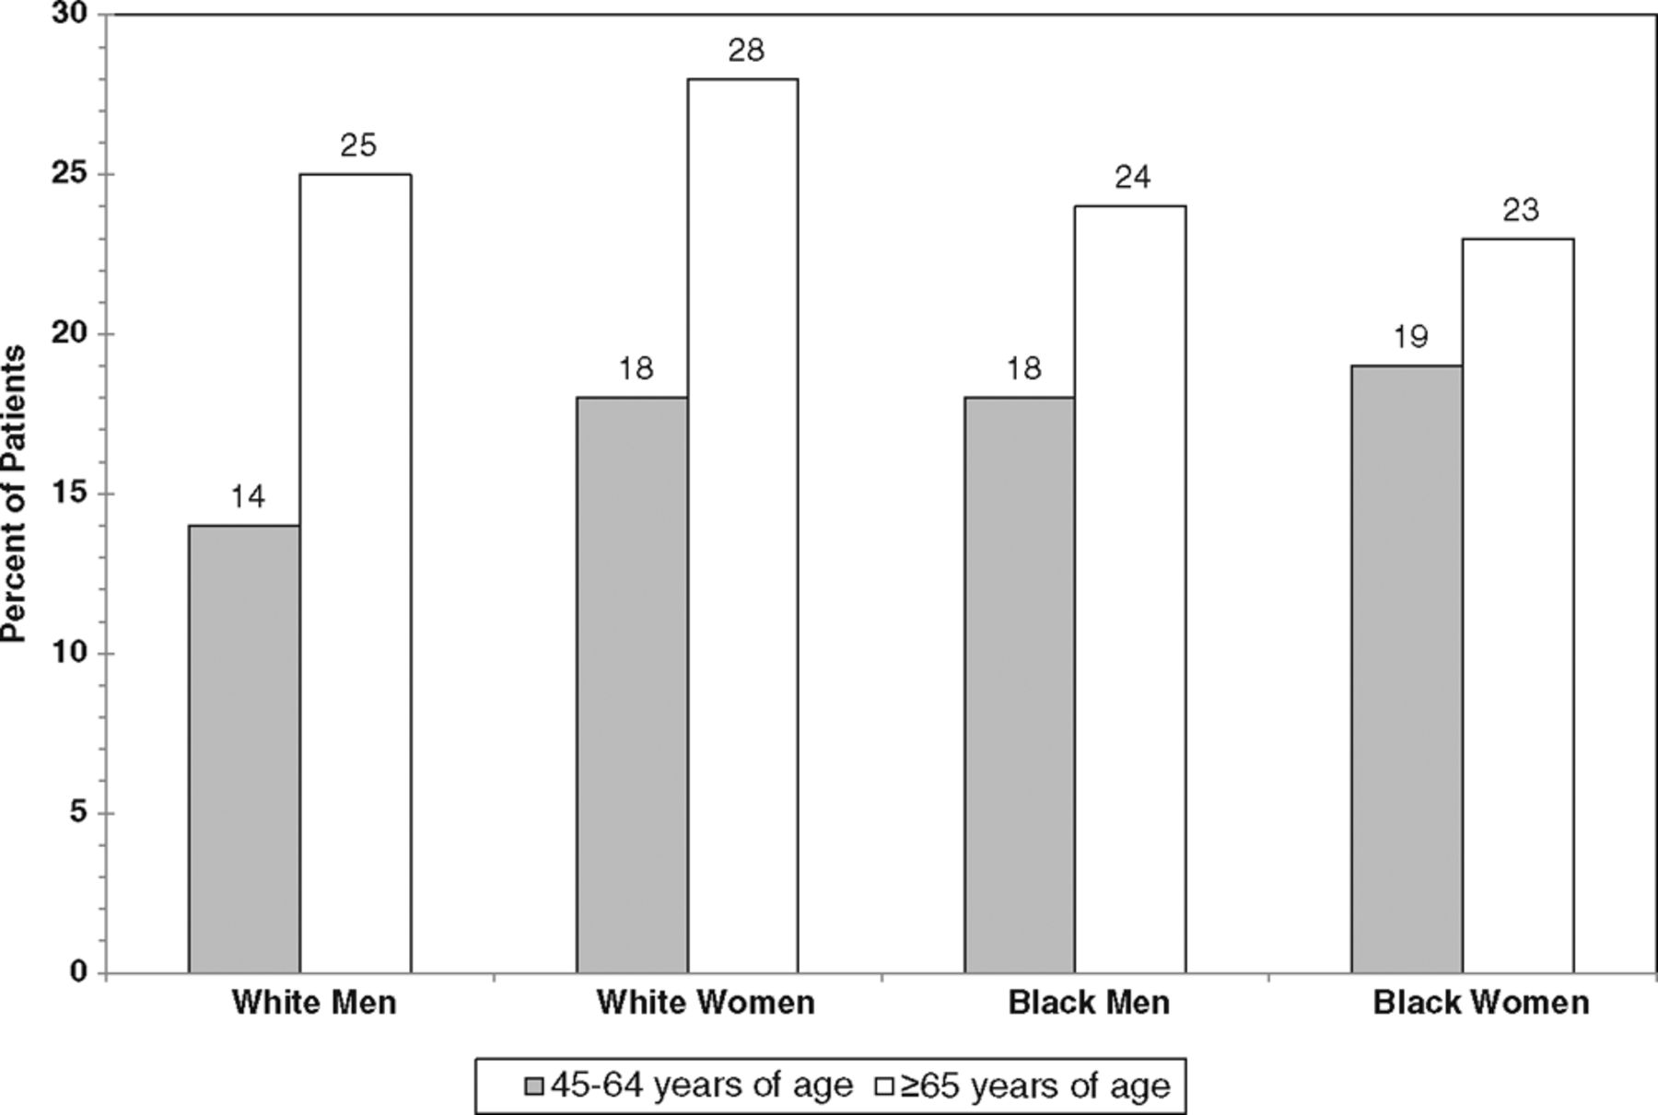
Proportion of patients dead 1 year after first stroke.
Go A S et al. Circulation 2013;127:e6-e245
Copyright © American Heart Association
Notes:
Proportion of patients dead 1 year after first stroke. Source: Pooled data from the Framingham Heart Study, Atherosclerosis Risk in Communities study, and Cardiovascular Health Study of the National Heart, Lung, and Blood Institute.

Slide 41
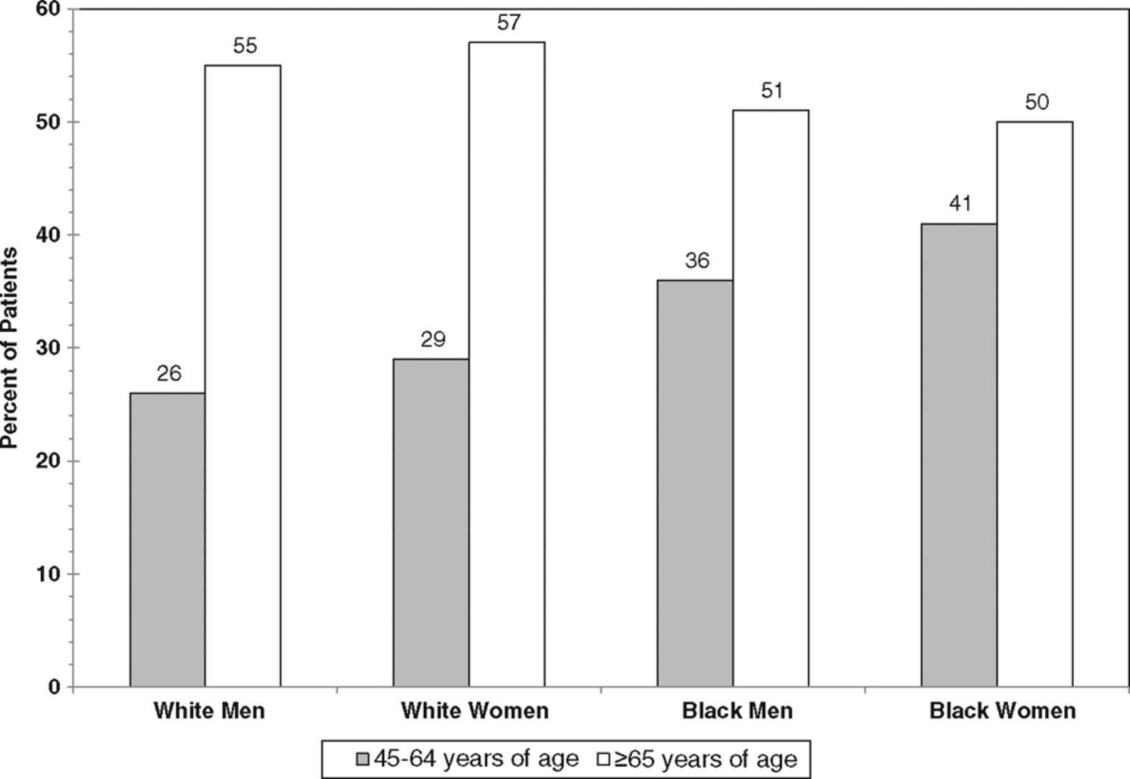
Proportion of patients dead within 5 years after first stroke.
Go A S et al. Circulation 2013;127:e6-e245
Copyright © American Heart Association
Notes:
Proportion of patients dead within 5 years after first stroke. Source: Pooled data from the Framingham Heart Study, Atherosclerosis Risk in Communities study, and Cardiovascular Health Study of the National Heart, Lung, and Blood Institute.

Slide 42
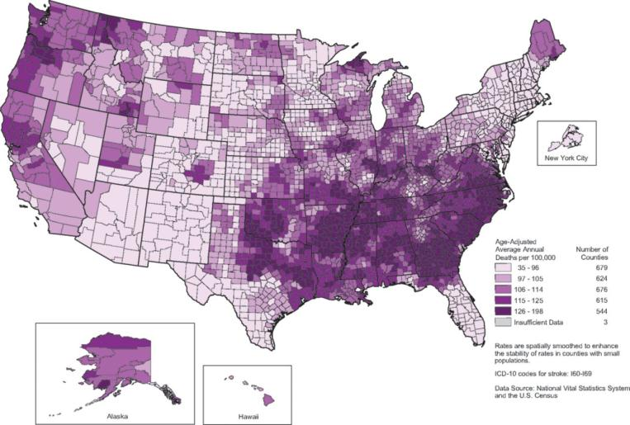
Stroke death rates, 2000 through 2006.
Go A S et al. Circulation 2013;127:e6-e245
Copyright © American Heart Association
Notes:
Stroke death rates, 2000 through 2006. Adults ≥35 years of age, by county. Rates are spatially smoothed to enhance the stability of rates in counties with small populations. International Classification of Diseases, 10th Revision codes for stroke: I60–I69. Data source: National Vital Statistics System and the US Census Bureau.

Slide 43
Distribution of Stroke Centers

Slide 44
Risk Factors
Certain Medical Conditions are associated with higher risks of stroke:
High blood pressure (#1 risk factor)
High blood cholesterol
Heart disease
Diabetes
Overweight and obesity
Previous stroke or transient ischemic attack (TIA)
Sickle cell disease

Slide 45
Other Risk Factors
Alcohol use
Tobacco use
Lack of physical activity
Poor diet leading to other medical conditions associated with higher risk of stroke
Age and gender (older and male)
Family history of stroke and other risk factors for
Race and ethnicity- Blacks, Hispanics, and American Indian/Alaska Natives have a greater chance of having a stroke than do non-Hispanic whites or Asians
Notes:
Risk Factors:
High BP is the number one risk factor; other major risk factors are atrial fibrillation, diabetes, family history of stroke, high cholesterol, increasing age, especially after age 55, and race.
Stroke risk varies by race and ethnicity- It is among the five leading causes of death for people of all races and ethnicities, but the risk varies. Compared to whites, AA are 2x the risk of having a first stroke (Hispanics risk falls between the two). AA and Hispanics are more likely to die following a stroke than are whites.

Slide 46
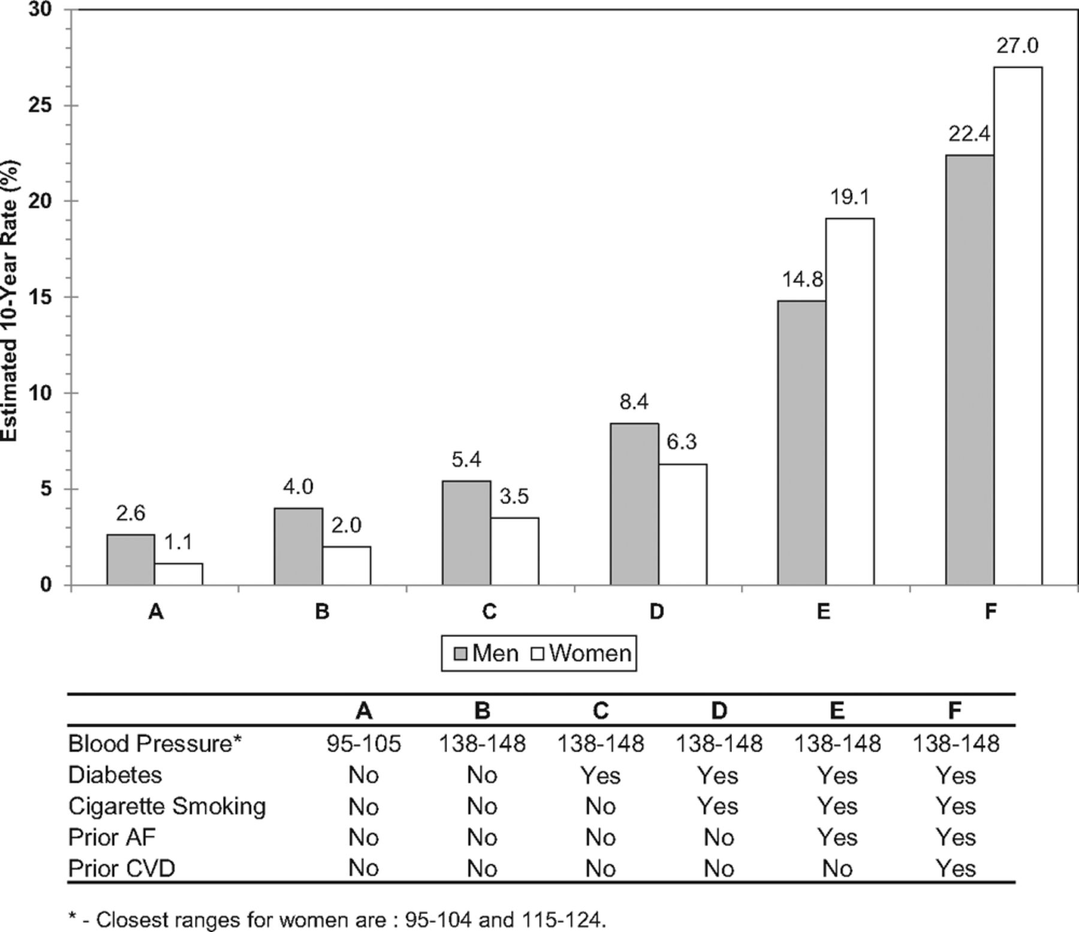
Estimated 10-year stroke risk in adults 55 to 84 years of age according to levels of various risk factors (Framingham Heart Study).
Go A S et al. Circulation 2013;127:e6-e245
Copyright © American Heart Association
Notes:
Estimated 10-year stroke risk in adults 55 to 84 years of age according to levels of various risk factors (Framingham Heart Study). AF indicates atrial fibrillation; CVD, cardiovascular disease. Data derived from Wolf et al176 with permission of the publisher. Copyright © 1991, American Heart Association.

Slide 47
Genetics
Genes play a role in the development of risk factors that can lead to a stroke, such as high blood pressure, heart disease, diabetes, and vascular conditions.
An increased risk for stroke within a family may also be due to common behavioral factors, such as a sedentary lifestyle or poor eating habits.
Stroke also occurs as a complication of several genetic disorders, the most common of these being sickle cell disease.
Notes:
Thus, family health history is an important tool for identifying people at increased risk for stroke because it reflects both an individual’s genes and shared environmental risk factors.

Slide 48
After a Stroke…
One may experience:
Paralysis on one side of the body
Weakness on one side of the body
Problems with thinking, awareness, attention, learning, judgment, and memory
Problems understanding or forming speech
Difficulty controlling or expressing emotions
Numbness or strange sensations
Pain in the hands and feet that worsens with movement and temperature changes
Depression

Slide 49
Organizations & Programs Devoted to Stroke Prevention and Treatment
American Stroke Association
http://www.strokeassociation.org/STROKEORG/
National Stroke Association
http://www.stroke.org/site/PageNavigator/HOME
Heart, Blood and Lung Institute
http://www.nhlbi.nih.gov/index.htm
American Heart Association
http://www.heart.org/HEARTORG/
The Stroke Center
http://www.strokecenter.org/

Slide 50
CDC Programs
Million Hearts™ Million Hearts™ is a national, public-private initiative of the Department of Health and Human Services to prevent 1 million heart attacks and strokes by 2017.
CDC's National Heart Disease and Stroke Prevention Program Since 1998, CDC has funded state health departments' efforts to reduce the number of people with heart disease or stroke. The program stresses policy and education to promote heart-healthy and stroke-free living and working conditions.
WISEWOMAN WISEWOMAN helps women with little or no health insurance reduce their risk for heart disease, stroke, and other chronic diseases. The program assists women age 40 to 64 in improving their diet, physical activity, and other behaviors. WISEWOMAN also provides blood pressure tests and other screening.
Notes:
Million Hearts- Co-led by CDC and the Centers for Medicare & Medicaid Services, the initiative brings together communities, health care professionals, health systems, nonprofit organizations, federal agencies, and private-sector partners to improve care and empower Americans to make heart-healthy choices.

Slide 51
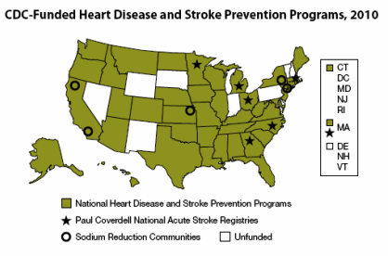
CDC Programs

Slide 52
Healthy People 2020
Healthy People 2020 Goal:
“Improve cardiovascular health and quality of life through prevention, detection, and treatment of risk factors for heart attack and stroke; early identification and treatment of heart attacks and stroke; and prevention of repeat cardiovascular events.”
www.healthypeople.gov/2020

Slide 53
Healthy People 2020
Hypertension and Stroke Related Objectives:
HDS-3: Reduce stroke deaths
HDS-4: Increase the proportion of adults who have had their blood pressure measured within the preceding 2 years and can state whether their blood pressure was normal or high,
HDS-5: Reduce proportion or persons with hypertension
HDS-9: Reduce the number of people with pre-hypertension who meet the recommended guidelines for BMI, saturated fat intake, sodium intake, physical activity and alcohol consumption.
HDS-11: Increase the proportion of adults with hypertension who are taking prescribed medications to lower their blood pressure
HDS-12: Increase the proportion of adults with hypertension whose blood pressure is under control
www.healthypeople.gov/2020

Slide 54
Current and Future Research - Stroke
National Institute of Neurological Disorders and Stroke- leading institute in U.S. researching stroke
Currently researchers are studying the mechanisms of stroke risk factors and the process of brain damage that results from stroke.
Researchers are also looking for ways to prevent secondary injury to the brain and cognitive damage post-stroke
Research is also focused on the genetics of stroke and stroke risk factors. One area of research involving genetics is gene therapy.
One promising area of stroke animal research involves hibernation. If scientists can discover how animals hibernate without experiencing brain damage, then maybe they can discover ways to stop the brain damage associated with decreased blood flow in stroke patients.

Slide 55
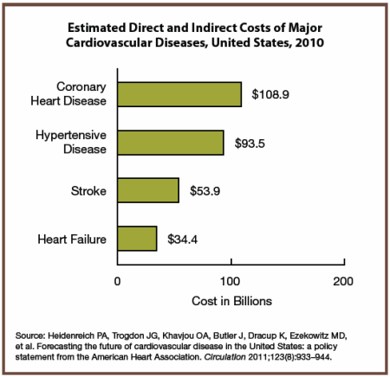
Financial/Economic Impact of Stroke
Estimated indirect and direct costs related to stroke are $53.9 billion in 2010 (AHA)
Notes:
The American Heart Association estimated that stroke cost the country about $53.9 billion in 2010. This total includes health care services, medications, and lost productivity due to illness or death.
Stroke results in substantial health care expenditures- the lifetime cost resulting from an ischemic stroke is estimated at $140,000 per patient (1)

Slide 56
Questions?
Notes:
The American Heart Association estimated that stroke cost the country about $53.9 billion in 2010. This total includes health care services, medications, and lost productivity due to illness or death.
Stroke results in substantial health care expenditures- the lifetime cost resulting from an ischemic stroke is estimated at $140,000 per patient (1)

