Slide 1
Diabetes
Chronic Disease Epidemiology
Notes:
https://www.youtube.com/watch?v=WvzIktiFY6k

Slide 2
Objectives
Diabetes overview
Type 1
Gestational diabetes
Type 2

Slide 3
Diabetes: Definition
Increased blood sugar as a result of insulin deficiency or resistance
Type 1- Autoimmune disorder
Type 2- Acquired insulin deficiency or resistance
Gestational- Diabetes which develops during pregnancy

Slide 4
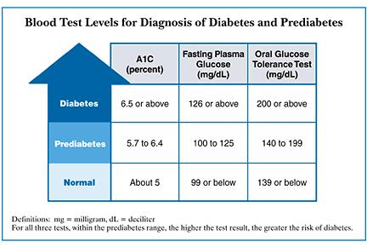
Diagnosis of Diabetes

Slide 5
Complications/Co-Morbid conditions
Heart disease and stroke: People with diabetes are twice as likely to have heart disease or a stroke as people without diabetes—and at an earlier age.
Blindness/eye problems: retinopathy (damage to blood vessels in
Kidney disease: High blood sugar levels can damage the kidneys long before a person has symptoms. Kidney damage can cause chronic kidney disease, and lead to kidney failure.
Amputations: Diabetes damages blood vessels and nerves, particularly in the feet, and can lead to serious, hard-to-treat infections. Amputation is sometimes necessary to stop the spread of infection.

Slide 6
Type 1 Diabetes

Slide 7
Type 1 Diabetes
Condition in which the body does not produce insulin
Autoimmune disorder caused by genetic susceptibility and environmental triggers
Usually begins in childhood
1% of population (5% of diabetes cases)
Increasing in prevalence

Slide 8
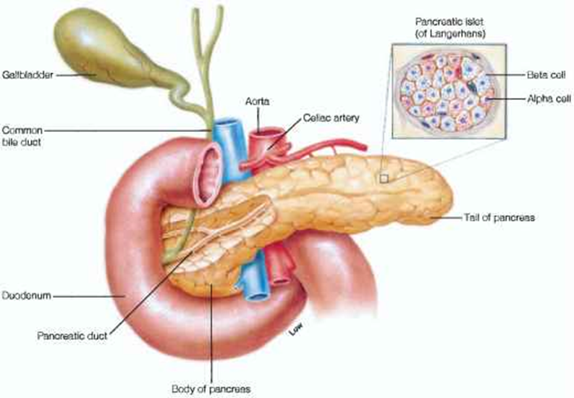
Type 1 Diabetes: Cause
Immune cells attack beta cells in the pancreas which produce insulin
Slow manifestation as beta cells are gradually lost

Slide 9
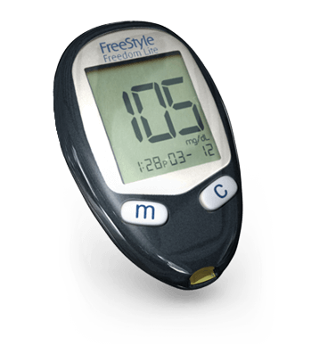
Treatment
Blood sugar monitoring
Insulin therapy
Diet
Exercise

Slide 10
Type 1 Diabetes: Risk Factors
Family history/genetic susceptibility
White race
Young age
Viral infection
Cow milk?
Cold weather?

Slide 11
Genetic Susceptibility
Mutations in Human Leukocyte Antigen (HLA) system
5-10% of people with mutation develop diabetes
Inheritance pattern is unknown
5% of family members also have T1 diabetes
Less than half of identical twins

Slide 12
Age
Diagnoses spike around 4-7 and 10-14 years old
Diagnosis in adulthood is uncommon
Often misdiagnosed as T2 diabetes

Slide 13
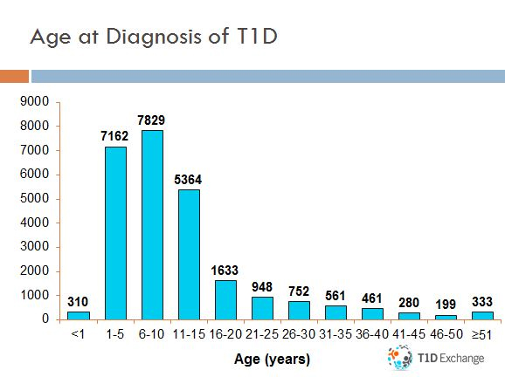

Slide 14
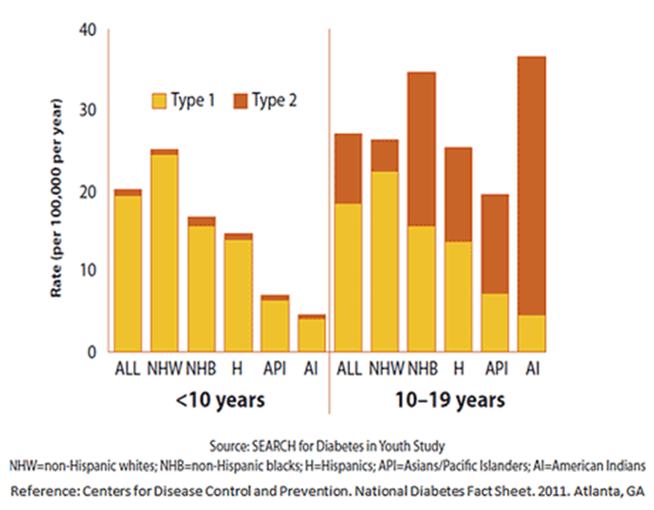

Slide 15
Viral trigger?
Enterovirus
Viral antigen resembles insulin/beta cell proteins?
Seasonal diagnosis/association with cold weather
Could also have a protective effect

Slide 17
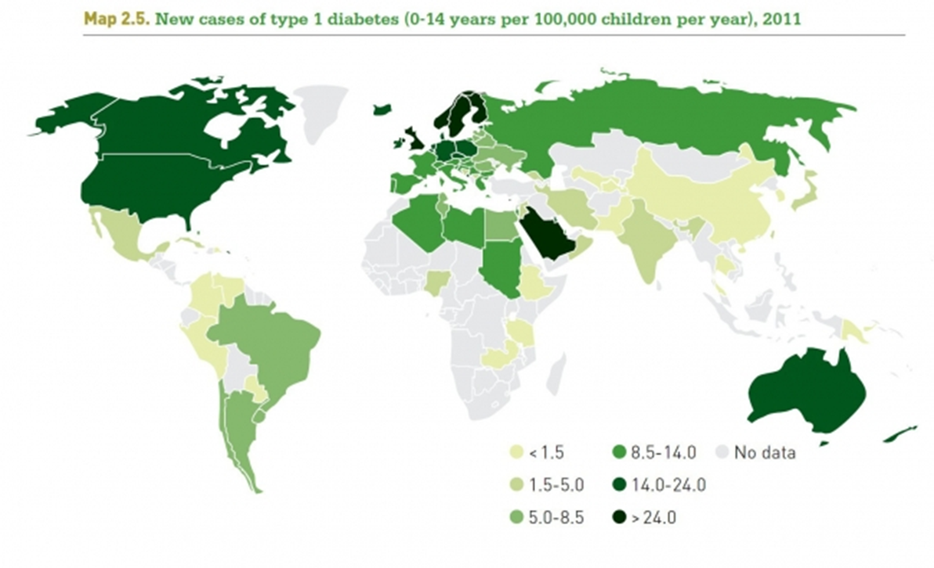

Slide 18
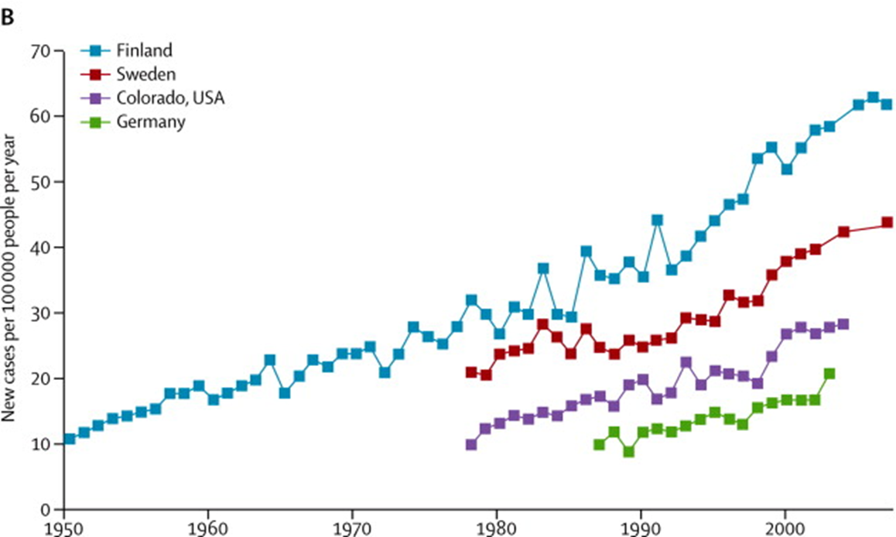

Slide 19
Research
Transplantation of beta cells
Stem cells
Inhibiting immune response
Vaccine?

Slide 20
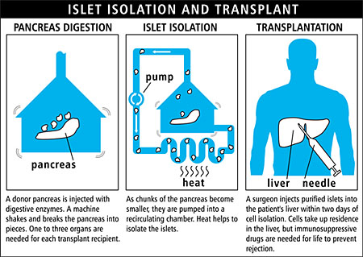

Slide 21
Gestational Diabetes

Slide 22
Gestational Diabetes
Hormonal changes during pregnancy block insulin uptake which leads to hyperglycemia
Usually develops in late pregnancy
9% of pregnancies

Slide 23
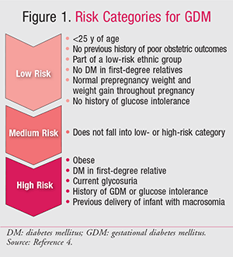
Risk factors
Age
Family history
Non-white race
Lifestyle factors

Slide 24
Complications
Babies:
Obesity
T2 diabetes
Preterm birth
Hypoglycemia
Respiratory distress
Mothers:
Hypertension/preeclampsia
T2 diabetes in future
Postnatal hypoglycemia
C section

Slide 25
Type 2 Diabetes

Slide 26
Type 2 Diabetes
Condition characterized by high blood glucose levels caused by either a lack of insulin or the body's inability to use insulin efficiently-insulin resistance. (ADA).
Type 2 is the most common type of diabetes- 95% of cases. (NIH, ADA)
Caused by several factors, including lifestyle factors and genes
Type 2 diabetes develops most often in middle-aged and older adults but can appear in young people.
Can be delayed or prevented.
Diabetes made simple - https://www.youtube.com/watch?v=MGL6km1NBWE
Notes:
Type 1 and type 2 animation- https://www.youtube.com/watch?v=XfyGv-xwjlI
Type 2 diabetes develops when the body becomes resistant to insulin or when the pancreas stops producing enough insulin

Slide 27
Type 2 Diabetes: Risk Factors
Overweight/Obese
Age: More likely to develop if you’re age 45 or older
Family history of diabetes
Fat distribution
Gestational Diabetes during pregnancy
Depression
Notes:
Being overweight is a primary risk factor for type 2 diabetes. The more fatty tissue you have, the more resistant your cells become to insulin. However, you don't have to be overweight to develop type 2 diabetes.
Age an important risk factor, but becoming more prevalent in children and young adults as obesity increases
If your body stores fat primarily in your abdomen, your risk of type 2 diabetes is greater than if your body stores fat elsewhere, such as your hips and thighs.
Gestational diabetes is a type of diabetes that develops during pregnancy. Most of the time, gestational diabetes goes away after your baby is born.
if your gestational diabetes goes away, you still have a greater chance of developing type 2 diabetes within 5 to 10 years

Slide 28
Type 2 Risk Factors: Prediabetes
Prediabetes- occurs blood glucose, levels are higher than normal, but not high enough to be called diabetes.
If left untreated, prediabetes often progresses to type 2 diabetes.
You won’t know if you have prediabetes unless you are tested.
Estimated that 1 in 3 Americans (86 million) have prediabetes (CDC 2014)
9 out of 10 people don’t know they have it.
Notes:
Prediabetes is serious because it raises your chance of developing type 2 diabetes.

Slide 29
Type 2 Diabetes: Family History/Genetics Risk
Occurs more often in: African American, Alaska Native, American Indian, Asian American, Hispanic/Latino, Native Hawaiian, or Pacific Islander ethnic/racial groups
With a family history of type 2 diabetes, it may be difficult to figure out whether diabetes status is due to lifestyle factors or genetic susceptibility. Most likely it is due to both. (ADA)
Many genes are thought to be involved in type 2 diabetes.
Uncertainty on how these genes variations interact and how environment affects those genes. (NIH)
https://www.ncbi.nlm.nih.gov/books/NBK1665/
Notes:
Genes also can increase the risk of type 2 diabetes by increasing a person’s tendency to become overweight or obese.
Even if you have a family history, Studies show that it is possible to delay or prevent type 2 diabetes by exercising and losing weight.
Type 2 diabetes has a stronger link to family history and lineage than type 1, although it too depends on environmental factors.
When one twin has type 2 diabetes, the other's risk is at most 3 in 4

Slide 30
Type 2 Risk Factors: Race/Ethnicity & Genetics
When food is always abundant, a “thrifty” genetic makeup turns into a survival disadvantage.
20th century diabetes epidemic on remote Pacific island of Nauru
Notes:
The classic example of an epidemic of diabetes is found on an remote island in the Pacific Ocean, the island of Nauru. Before the turn of the 20th century, the lifestyle of Nauruans was harsh. The soil was poor, agriculture was difficult, and frequent episodes of starvation were common. Despite these adverse conditions, the islanders were noted to be “heavy”. In 1922, it was discovered that Nauru contained phosphate rock, which was then mined for use in fertilizer, and for which the islanders received royalties. Over several decades, the Nauruans became extremely wealthy, and with their new-found riches came major lifestyle changes. Food was now abundant and could be bought from stores. Instead of fishing and farming, Nauruans now led sedentary lives. By the 1950s, type 2 diabetes exploded from being non-existent in this population to affecting 2 of 3 adults over the age of 55 and becoming a common cause of death
“Thrifty Gene theory”- genes that are metabolically thrifty give a survival advantage in times when there is a constant threat of famine and starvation. When food is abundant, these genes aid the efficient metabolism of the food, enabling rapid build up of fat stores

Slide 31
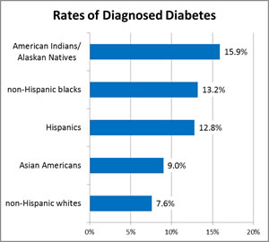
Diabetes by race/ethnicity
http://www.diabetes.org/diabetes-basics/statistics/?referrer=https://www.google.com/?referrer=http://www.diabetes.org/diabetes-basics/statistics/

Slide 32
Type 2 Diabetes National Outlook
Total: 29.1 million people or 9.3% of the population have diabetes. Diagnosed: 21.0 million people.
More than one-quarter of seniors (ages 65 and older) have diabetes (25.9 percent or 11 million seniors). Undiagnosed: 8.1 million people (27.8% of people with diabetes are undiagnosed or don’t know they have it).

Slide 33
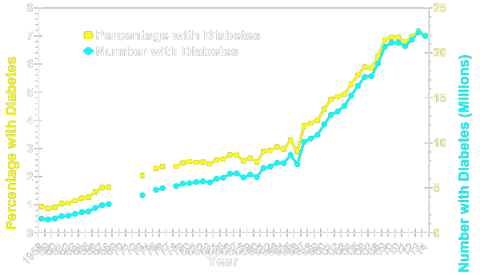
Number and Percentage of U.S. Population with Diagnosed Diabetes, 1958-2014
CDC’s Division of Diabetes Translation. United States Diabetes Surveillance System available at http://www.cdc.gov/diabetes/data
Notes:
Methodology
Number and percent of the U.S. population with diagnosed diabetes were obtained from the National Health Interview Survey (NHIS, available at http://www.cdc.gov/nchs/nhis.htm) of the National Center for Health Statistics (NCHS), Centers for Disease Control and Prevention (CDC) for years. Conducted continuously since 1957, the NHIS is a health survey of the civilian, noninstitutionalized population of the United States. The survey provides information on the health of the United States population, including information on the prevalence and incidence of disease, the extent of disability, and the utilization of health care services. The multistage probability design of the survey has been described elsewhere (1,2,3). Estimates for years 1958-1979 were obtained from published data (4) and estimates from 1980 forward were derived directly from the NHIS survey data.
References
1. Massey JT, Moore TF, Parsons VL, Tadros W. Design and estimation for the National Health Interview Survey, 1985-1994. Hyattsville, MD: National Center for Health Statistics. Vital and Health Statistics 1989;2(110).
2. Botman SL, Moore TF, Moriarity CL, Parsons VL. Design and estimation for the National Health Interview Survey, 1995–2004. National Center for Health Statistics. Vital and Health Statistics 2000;2(130).
3. Parsons VL, Moriarity C, Jonas K, et al. Design and estimation for the National Health Interview Survey, 2006–2015. National Center for Health Statistics. Vital Health Stat Vital and Health Statistics 2014, 2(165).
4. Harris MI: Prevalence of noninsulin-dependent diabetes and impaired glucose tolerance. Chapter VI in Diabetes in America, Harris MI, Hamman RF, eds. NIH publ. no. 85-1468, 1985.

Slide 34
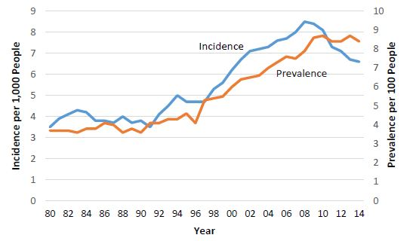
Trends in Incidence and Prevalence of Diagnosed Diabetes Among Adults Aged 20-79, United States, 1980-2014
Source: National Diabetes Surveillance System, CDC 2016.

Slide 35
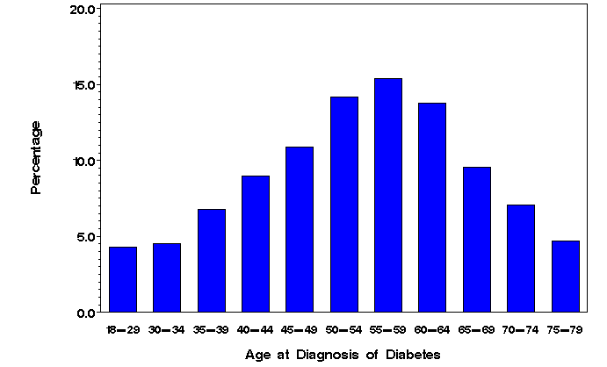
Distribution of Age at Diagnosis for Incident Cases
In 2011, 63% of the adult (aged 18–79 years) incident cases of diabetes were between the ages of 40 and 64 years.
About 16% were diagnosed at age 18–39 years, and about 21% were diagnosed at age 65–79 years

Slide 36
Diagnosed Diabetes, Age-Adjusted Percentage, Adults with Diabetes-Total, 2014
Source:
www.cdc.gov/diabetes
Disclaimer: This is a user-generated report. The findings and conclusions are those of the user and do not necessarily represent the views of the CDC.
National Center for Chronic Disease Prevention and Health Promotion
Division of Diabetes Translation

Slide 37
State Highlights
Mississippi has the highest rate of diabetes at 14.7 percent.
Ten of the 12 states with the highest type 2 diabetes rates are in the South.
Virginia ranked 22nd with rate of 10.3 percent
Utah, Colorado were 2 lowest at 7.0 and 6.8 percent respectively
Nationwide, diabetes rates have nearly doubled in the past 20 years — from 5.5 percent (1994) to 9.3 percent in 2012
http://stateofobesity.org/diabetes/

Slide 38
Diabetes Mortality
Diabetes was the 7th leading cause of death in the United States
Number of deaths: 76,488
Deaths per 100,000 population: 24.0
Diabetes may be underreported as a cause of death
Studies have found that only about 35% to 40% of people with diabetes who died had diabetes listed anywhere on the death certificate (ADA)
https://www.cdc.gov/nchs/fastats/diabetes.htm

Slide 39
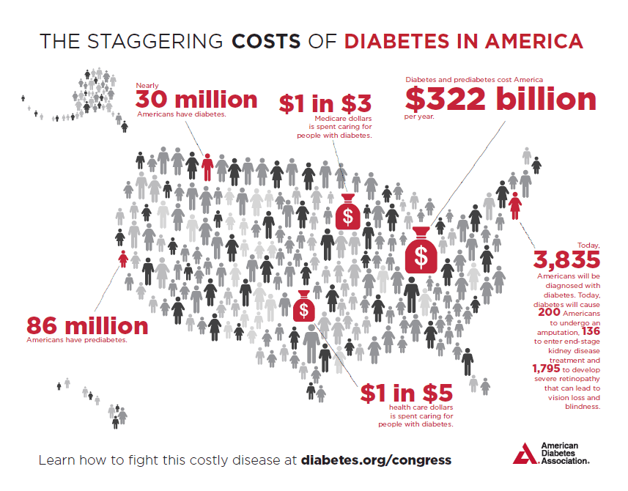

Slide 40
Estimated Economic Cost
$245 billion total costs of diagnosed diabetes in the United States in 2012 (CDC)
$176 billion for direct medical costs
$69 billion in indirect cost (reduced productivity)
Medical cost for individual with diabetes 2x higher than individual without

Slide 41
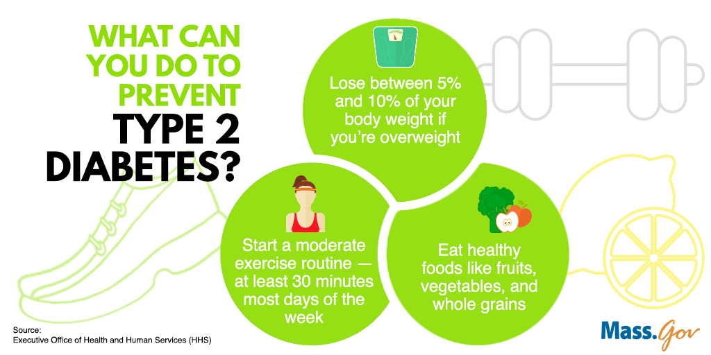
Type 2 Diabetes: Prevention
Weight loss (5-7% of your starting weight).
Regular physical activity (30 mins 5x/week)
Healthy diet/eating lifestyle
Notes:
Weight loss (5-7% of your starting weight. For instance, if you weigh 200 pounds, your goal would be to lose about 10 to 14 pounds.
Lose weight and keep it off. You may be able to prevent or delay diabetes by losing 5 to 7 percent of your starting weight.1 For instance, if you weigh 200 pounds, your goal would be to lose about 10 to 14 pounds.
Move more. Get at least 30 minutes of physical activity 5 days a week. If you have not been active, talk with your health care professional about which activities are best. Start slowly to build up to your goal.
Eat healthy foods most of the time. Eat smaller portions to reduce the amount of calories you eat each day and help you lose weight. Choosing foods with less fat is another way to reduce calories. Drink water instead of sweetened beverages.

Slide 42
Type 2 Diabetes Interventions
CDC- National Diabetes Prevention Program
https://www.youtube.com/watch?v=mRVZ9lkubag
Richmond YMCA one of many common community organizations that host the program nationwide
Year-long program focused on long-term changes and lasting results
Notes:
a structured program—in person or online—developed specifically to prevent type 2 diabetes. It is designed for people who have prediabetes or are at risk for type 2 diabetes, but who do not already have diabetes.
A trained lifestyle coach leads the program to help you change certain aspects of your lifestyle, like eating healthier, reducing stress, and getting more physical activity. The program also includes group support from others who share your goals and struggles.

Slide 43
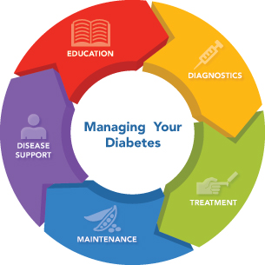
Type 2 Diabetes Management & Treatment
Healthy Eating
Physical Activity
Blood Sugar Monitoring
Diabetes Medication & Insulin Therapy
Metformin
Sulfonylureas
GLP-1 receptor agonists
SGLT2 inhibitors
Notes:
Healthy eating- fruits, vegetables, whole grains. Contrary to popular perception, there's no specific diabetes diet. However, it's important to center your diet on these high-fiber, low-fat foods:
metformin is the first medication prescribed for type 2 diabetes. It works by improving the sensitivity of your body tissues to insulin so that your body uses insulin more effectively
Sulfonylureas. These medications help your body secrete more insulin (side effect: weight gain)
GLP-1 receptor agonists. These medications slow digestion and help lower blood sugar levels, (helps with weight loss). Isnt usually used by itself.
Also bariatric surgery has been seen to lead to lower blood sugar levels
https://www.youtube.com/watch?v=qSpAF-JUKEA
https://www.youtube.com/watch?v=FPddG1w9luo

Slide 44
Type 2: Current Research Efforts
Connection between stress and type 2 diabetes.
E.g., Richmond Stress and Sugar Study, an ongoing longitudinal cohort study of the role of stress reactivity and glucose metabolism among individuals with pre-diabetes (Dr. Briana Mezuk)
Investigations on Diabetes and Psychosocial Care
Investigations on genetic defect in beta cells which may underlie both forms of diabetes.
Notes:
- When cortisol levels are consistently high but there’s no physical activity to buffer the effects of chronic stress, the consequences may contribute to type 2 diabetes. Higher cortisol results in higher insulin resistance, for example, forcing the pancreas to produce more insulin to get a response. With ongoing insulin resistance, the insulin-producing beta cells wear out, causing type 2 diabetes.
- By following them over time, she hopes to find out if their cortisol levels and other measures of stress are connected to higher rates of type 2 diabetes. “If there are ethnic differences in the stress pathways, that could help guide our intervention,

Slide 45
THANK YOU!

