Slide 1
Arthiritis
Rheumatoid, Osteo, and Traumatic Arthiritis
Bethel Kebede
Epidemiology of Chronic Diseases

Slide 2
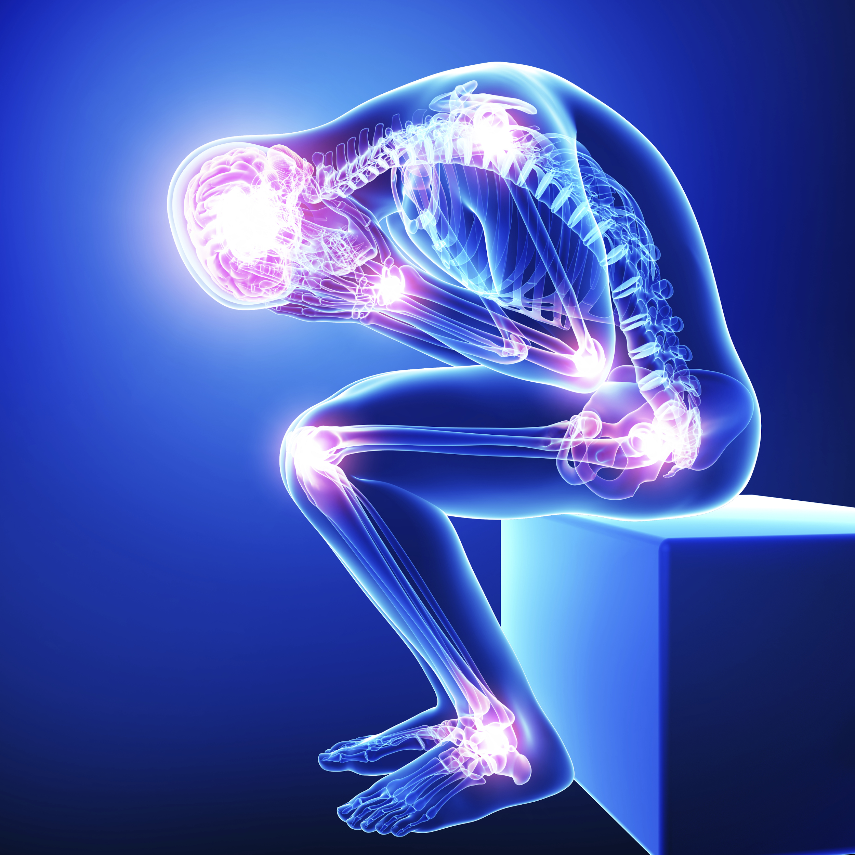
Objectives
What is arthritis?
Why should we focus on it?
What are the types of Arthritis?
Rheumatoid, Osteo and Traumatic

Slide 3
What is Arthritis?

Slide 4
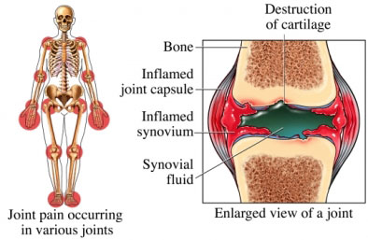
What is arthritis?
A condition that is not well undedrstood
Arthrithis is the inflamation or stiffness of a joint or joints
Arthritis is not a single disease rather a combination of over 100 different types of conditions that affect joints or tissue around joints.

Slide 5
Why Focus on Arthritis?

Slide 6
Because…

Slide 7
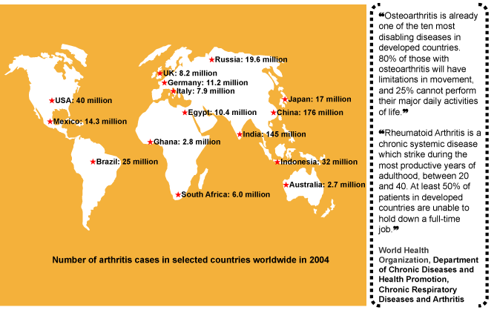
Notes:
http://www.terraclouds.com/images/Global-Arthritis-Statistics.gif

Slide 8
Current health and economic burden
Affects 1 in 5 adults
54.4 million adults in the US
Projected to increase to 78 million by 2040– 26% of the population
22.7% of adults- arthritis diagnosed by a doctor
Jumps to ~30% for age 45-64 and ~50% for adults > 65
Most common cause of disability among US adults
Many have activity limitations, work limitations, and report lower quality of life
From the current cases-23.7 million (43.5%) of adults with arthritis 18 years or older have arthritis-attributable activity limitation.
From the projected cases- with arthritis, an estimated 44% (35 million adults) will report arthritis-attributable activity limitations
Costs: 128 billion dollars (2003)
$80.8 billion were direct costs (i.e., medical expenditures).
$47.0 billion were indirect costs (i.e., lost earnings).

Slide 9
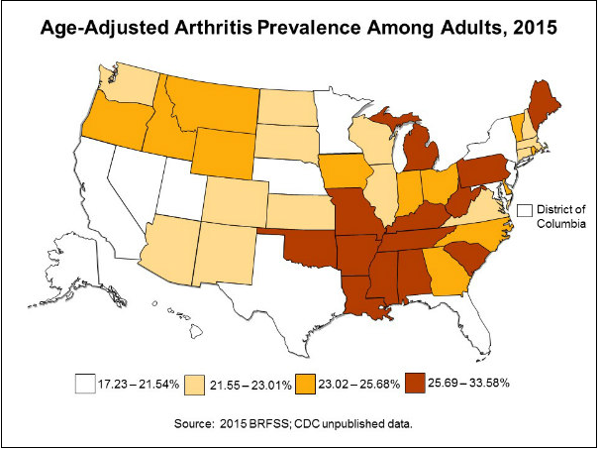
Notes:
https://www.cdc.gov/arthritis/data_statistics/state-data-current.htm

Slide 10
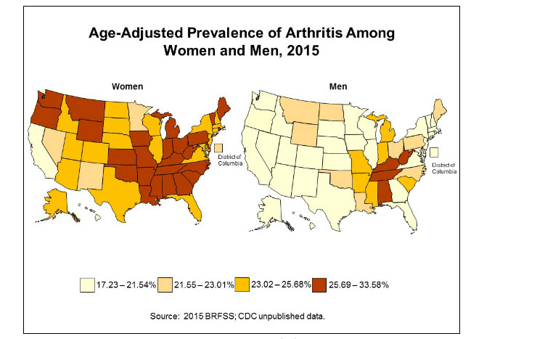
Notes:
https://www.cdc.gov/arthritis/data_statistics/state-data-current.htm

Slide 11
Notes:
https://www.cdc.gov/chronicdisease/resources/publications/aag/arthritis.htm

Slide 12
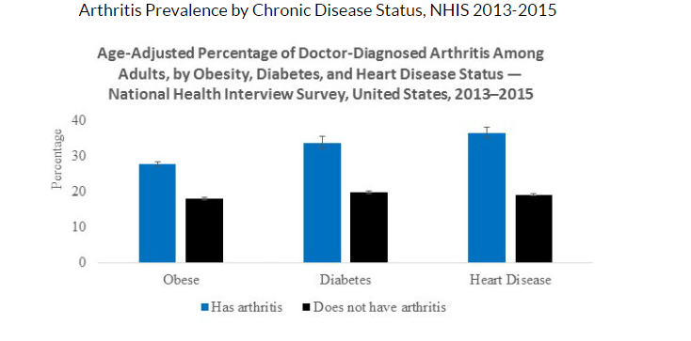
Age adjusted prevalence of (95% confidence interval) of dctor diagnoded arthritis among adults by obesity and heart disease.
Notes:
https://www.cdc.gov/chronicdisease/resources/publications/aag/arthritis.htm

Slide 13
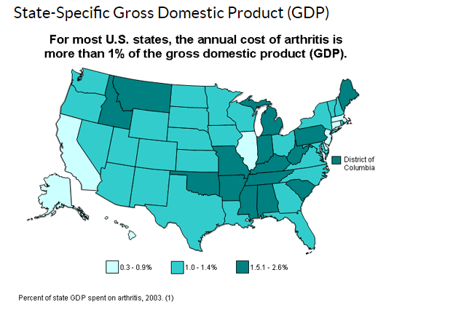
Notes:
https://www.cdc.gov/arthritis/data_statistics/cost.htm

Slide 14
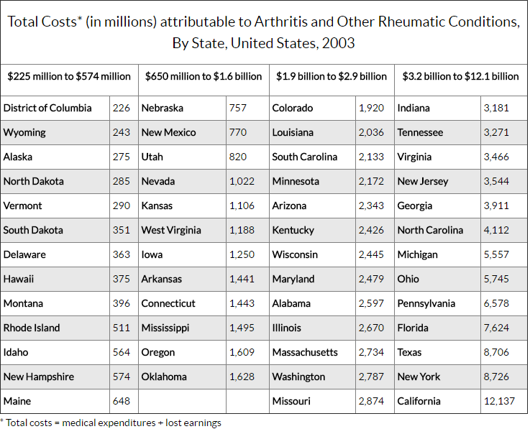
Notes:
https://www.cdc.gov/arthritis/data_statistics/cost.htm

Slide 15
Types of Arthritis

Slide 16
Aim
What are the main types
How do they develop
Cause
Risk factors
Symptoms
Treatment
Who is affected the most

Slide 17
Achilles tendinitis
Achondroplasia
Acromegalic arthropathy
Adhesive capsulitis
Adult onset Still's disease
Ankylosing spondylitis
Anserine bursitis
Avascular necrosis
Behcet's syndrome
Bicipital tendinitis
Blount's disease
Brucellar spondylitis
Bursitis
Calcaneal bursitis
Calcium pyrophosphate
dihydrate (CPPD)
Crystal deposition disease
Caplan's syndrome
Carpal tunnel syndrome
Chondrocalcinosis
Chondromalacia patellae
Chronic synovitis
Chronic recurrent multifocal osteomyelitis
Churg-Strauss syndrome
Cogan's syndrome
Corticosteroid-induced osteoporosis
Costosternal syndrome
CREST syndrome
Cryoglobulinemia
Degenerative joint disease

Slide 18
Foreign body synovitis
Freiberg's disease
Fungal arthritis
Gaucher's disease
Giant cell arteritis
Gonococcal arthritis
Goodpasture's syndrome
Gout Granulomatous arteritis
Hemarthrosis
Hemochromatosis
Henoch-Schonlein purpura
Hepatitis B surface antigen disease
Hip dysplasia
Hurler syndrome
Hypermobility syndrome
Hypersensitivity vasculitis
Hypertrophic osteoarthropathy
Immune complex disease
Impingement syndrome
Jaccoud's arthropathy
Juvenile ankylosing spondylitis
Juvenile dermatomyositis
Juvenile rheumatoid arthritis
Kawasaki disease
Kienbock's disease
Legg-Calve-Perthes disease
Lesch-Nyhan syndrome
Linear scleroderma
Lipoid dermatoarthritis
Lofgren's syndrome

Slide 19
Lyme disease
Malignant synovioma
Marfan's syndrome
Medial plica syndrome
Metastatic carcinomatous arthritis
Mixed connective tissue disease (MCTD)
Mixed cryoglobulinemia
Mucopolysaccharidosis
Multicentric reticulohistiocytosis
Multiple epiphyseal dysplasia
Mycoplasmal arthritis
Myofascial pain syndrome
Neonatal lupus
Neuropathic arthropathy
Nodular panniculitis
Ochronosis
Olecranon bursitis
Osgood-Schlatter's disease
Osteoarthritis
Osteochondromatosis
Osteogenesis imperfecta
Osteomalacia
Osteomyelitis
Osteonecrosis
Osteoporosis
Overlap syndrome
Pachydermoperiostosis Paget's disease of bone
Palindromic rheumatism
Patellofemoral pain syndrome
Pellegrini-Stieda syndrome

Slide 20
Pigmented villonodular synovitis
Piriformis syndrome
Plantar fasciitis
Polyarteritis nodos
Polymyalgia rheumatica
Polymyositis
Popliteal cysts
Posterior tibial tendinitis
Pott's disease
Prepatellar bursitis
Prosthetic joint infection
Pseudoxanthoma elasticum
Psoriatic arthritis
Raynaud's phenomenon
Reactive arthritis/Reiter's syndrome
Reflex sympathetic dystrophy syndrome
Relapsing polychondritis
Retrocalcaneal bursitis
Rheumatic fever
Rheumatoid arthritis
Rheumatoid vasculitis
Rotator cuff tendinitis
Sacroiliitis
Salmonella osteomyelitis
Sarcoidosis
Saturnine gout
Scheuermann's osteochondritis
Scleroderma
Septic arthritis
Seronegative arthritis

Slide 21
Shigella arthritis
Shoulder-hand syndrome
Sickle cell arthropathy
Sjogren's syndrome
Slipped capital femoral epiphysis
Spinal stenosis
Spondylolysis
Staphylococcus arthritis
Stickler syndrome
Subacute cutaneous lupus
Sweet's syndrome
Sydenham's chorea
Syphilitic arthritis
Systemic lupus erythematosus (SLE)
Takayasu's arteritis
Tarsal tunnel syndrome
Tennis elbow
Tietse's syndrome
Transient osteoporosis
Traumatic arthritis
Trochanteric bursitis
Tuberculosis arthritis
Arthritis of Ulcerative colitis
Undifferentiated connective tissue syndrome (UCTS)
Urticarial vasculitis
Viral arthritis
Wegener's granulomatosis
Whipple's disease
Wilson's disease
Yersinial arthritis

Slide 22
Types of Arthritis Cont…
For the purpose of this presentation
Osteoarthritis
Rheumatoid arthritis
Traumatic arthritis

Slide 23
1. Osteoarthritis
The most common non-inflammatory type of arthritis
Also called degenerative arthritis, non-infective arthritis, “wear and tear” arthritis
Osteoarthritis (OA) is a non-inflammatory degenerative joint disease characterized by progressive loss of articular cartilage with associated new bone formation (bony spurs and cysts) and capsular fibrosis.

Slide 24
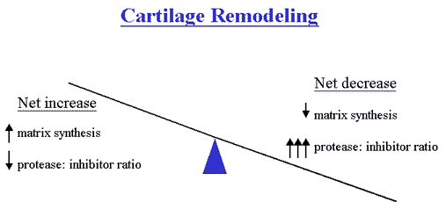
Osteoarthritis cont…
Normally there is low level of degenerative enzyme activity vs synthetic enzyme activity to maintain volume of cartilage.
In OA cartilage there is increased degenerative enzyme activity (over expressed), shifting the balance in favor of increased degradation.
Reparative attempts are made with increased production of proteoglycan and collagen (main constituents of cartilage) but progression of disease outmatches this attempt

Slide 25
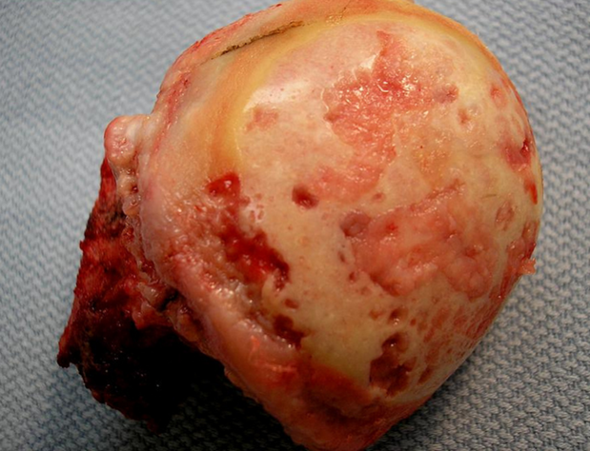
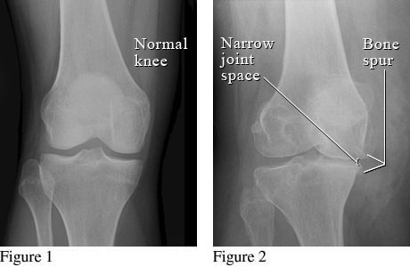
Osteoarthritis cont…
Normal knee joint vs knee joints affected by osteoarthritis
Cartilage that has sustained clinically observable erosion
Notes:
https://www.hopkinsarthritis.org/arthritis-info/osteoarthritis/oa-pathophysiology/#cart

Slide 26
Osteoarthritis cont…
Cause
Idiopathic (primary OA)- no known cause for joint breakdown, “just Happens”
Secondary OA- caused due to other condition
e.g. metabolic (Iron deposition, CPPD deposition), trauma (injury, instability, hypermobility), dysplasia (abnormal cells), etc…
Less likely than primary OA
Risk factors
Obesity- especially for knee, hip, hand
7X increased risk
Metabolic and mechanical reason
Heredity –increased risk with family history
Age- increased risk as age increases
Occupational- involving heavy loads and repetition of joint use
Sports

Slide 27
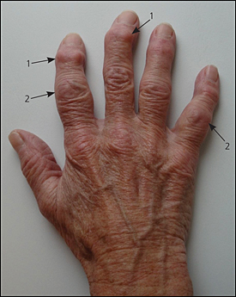
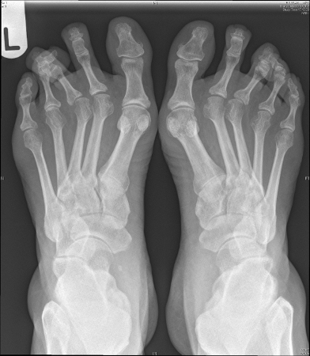
Osteoarthritis cont…
Symptoms
Pain
may start as sporadic moderate pain but worsens with time and becames constant chronic pain
May be misleading therefore not diagnosed early
Stiffness
Occurs after inactivity, becomes constant
Deformity
From joint instability
Disability
Difficulty performing daily tasks

Slide 28
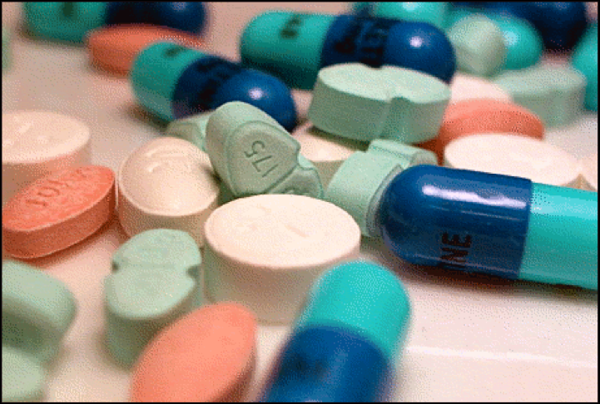
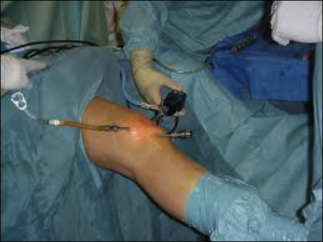
Osteoarthritis cont…
Treatment and management
Decreasing load to protect affected joints
Weight loss
Use of walking stick
Exercise of supporting muscles around joints to avoid wasting
Pain relief
Analgesics (NSAID)
Hyaluronic acid injections
Glucosamine and chondroitin
Surgical
Arthroscopy
Osteotomy
Arthrodesis
Excision arthroplasty
Replacement arthroplasty

Slide 29
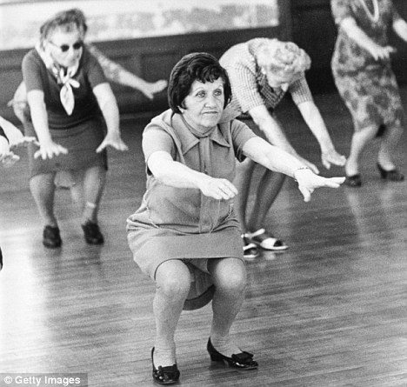
Osteoarthritis cont…
Prevalence and incidence
Affects 27 million people in the US
Although it affects people of all ages, it is more common in people over the ages of 65.
Increased risk with increased age
15% at 40 and 75% at 70
Men-hips
Women-knees and hands
One in 2 adults will develop symptoms of knee OA in their life time
One in 4 adults will develop hip symptom of hip OA by age 85
One in 12 adults ages 60 or above will develop hand OA

Slide 30
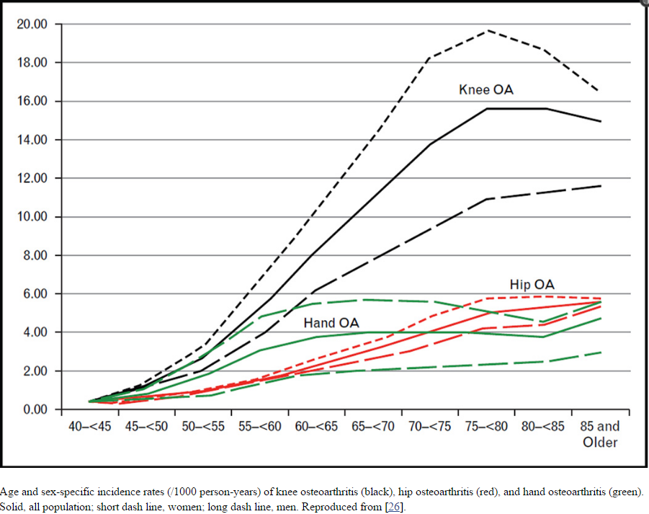
Age and sex-specific incidence rates (/1000 person-years) of knee osteoarthritis (black), hip osteoarthritis (red), and hand osteoarthritis (green). Solid, all population; short dash line, women; long dash line, men. Reproduced from.
Notes:
https://www.ncbi.nlm.nih.gov/pmc/articles/PMC4405030/

Slide 31
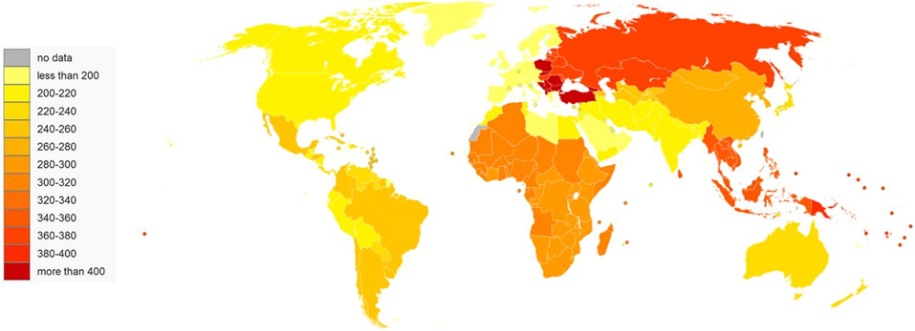
Represents international data collected from the WHO regarding the specific burden of OA worldwide.
The number is expected to increase both in developed and developing nations.
Notes:
http://sogacot.org/position-statement-the-epidemiology-pathogenesis-and-risk-factors-of-osteoarthritis-of-the-knee/

Slide 32
2. Rheumatoid Arthritis
The most common inflammatory arthritis
Rheumatoid Arthritis (RA) is an aoutoimmune disease where the immune system attacks the joints creating inflammation resulting in swelling and pain in and around the joints.
Damges cartilage, the elastic tissue covering the end of joint bones, as well as the bones themselves. The spacing between joints becomes smaller reducing mobility.
Can also cause inflammation in other tussues and organs (eg. Eyes, lungs and blood vessels).

Slide 33
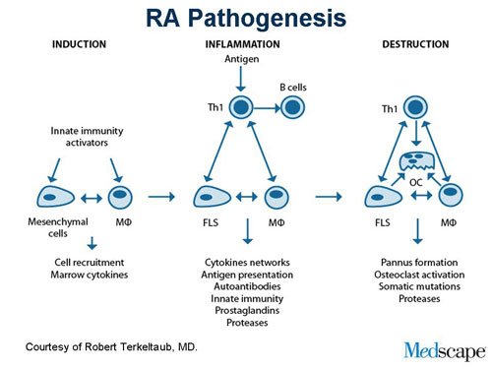
Rheumatoid Arthritis Cont...
Initial triggers are unclear- Hormones, genetic factors and environmental factors all play a role in onset of disease.
Once the initial immune response is triggered, production of autoantibodies and inflammatory cytokines begins creating inflammation.
Additional complex process of inflammatory mediators released in the affected joints
Results in formation of pannus which invades and destroys cartilage and bones

Slide 34
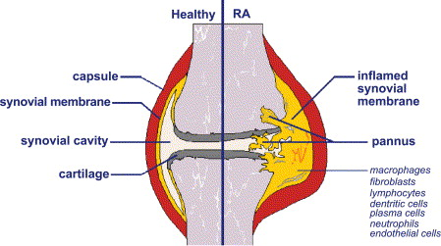
The difference between healthy joints and joints with inflammation due to Rheumatoid arthritis
Normal foot vs. foot affected by Rheumatoid arthritis
Notes:
https://www.rheumatoidarthritis.org/ra/

Slide 35
Rheumatoid Arthritis Cont...
Cause and risk factors
Genetic
Genetic markers that control the immune system (thereby playing a role in RA) have been identified.-eg. HLA gene- 5X more susceptible to RA.
Environmental factors
Bacteria and viruses
Smoking (including second hand smoking)
Air pollution
Insecticides
Occupational hazards- mineral oils and silica minerals (jobs in mining)
Gender- more common in women (70% are women)
Some say that the hormonal differences is why there is such huge difference
Contraceptive use has been identified promoting RA—jury is out on this
Family history

Slide 36
Rheumatoid Arthritis Cont...
Symptoms
Swelling
Thickness and swelling of the synovial tissue
Stiffness
Especially in the mornings and after long periods of rest.
Disability without pain
May not experience pain but be unable to function due to swelling
Pain
Wearing of joints causes pain
Redness
Joints can seem warm and appear to be pink.
Other symptoms resulting from inflammation
Fatigue
Minor fever
Muscle aches
Weight loss
Symptoms in other tissue damage
Scars in lungs may cause shortness of breath
Dry eyes, itching, burning, discharge, and impaired vision
Rheumathoid nodules-bumps under and on skin in areas where the bones are eroded.

Slide 37
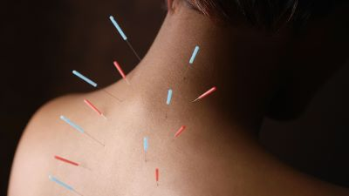
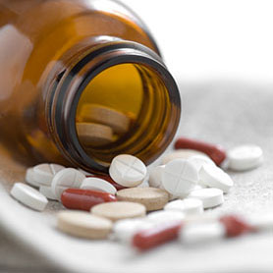
Rheumatoid Arthritis Cont...
Treatment and management
Non-pharmacological
Diet and exercise
Massage (some suggest acupuncture)
Stress reduction
Physical therapy
Medication
NAIDS
Corticosteroids
DMARDs ( Subset-biologics, JAK inhibitors)
Surgery
Synovectomy
Tenosynovectomy
Tendon realignment
Arthroplasty- also called joint replacement
Arthrodesis
* Some of the medication can have adverse effects on fetuses

Slide 38
Rheumatoid Arthritis Cont...
Prevalence and incidence
More common than psoriasis, chron’s disease, type 1 diabetes, lupus and multiple sclerosis
Affects about 1% of the world’s population
Prevalence of RA is diefferent from population to population with the lowest being in Asian countries and the highest among native American populations’
1.29 million people in the US
Incidence has decreased drastically since early 1960s

Slide 39
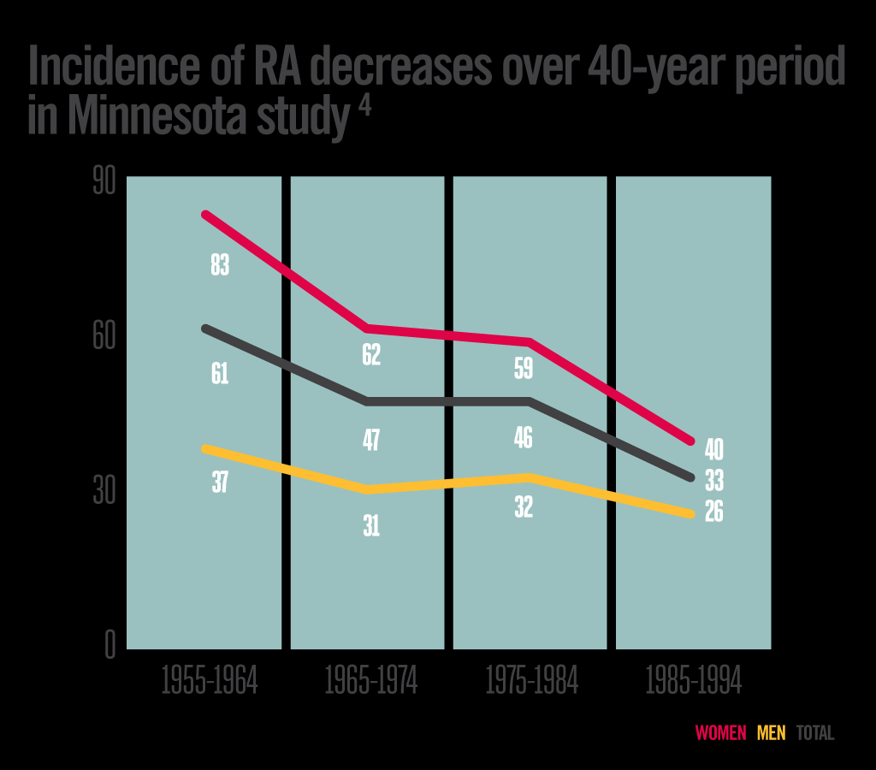
Incedence has decreased drastically since early 1960s
Twice the rate in women than in men
2X more likely to occur in women
1.6 % prevalence in women compared to 0.61% prevalence in men
Notes:
https://rheumatoidarthritis.net/what-is-ra/ra-statistics/

Slide 40
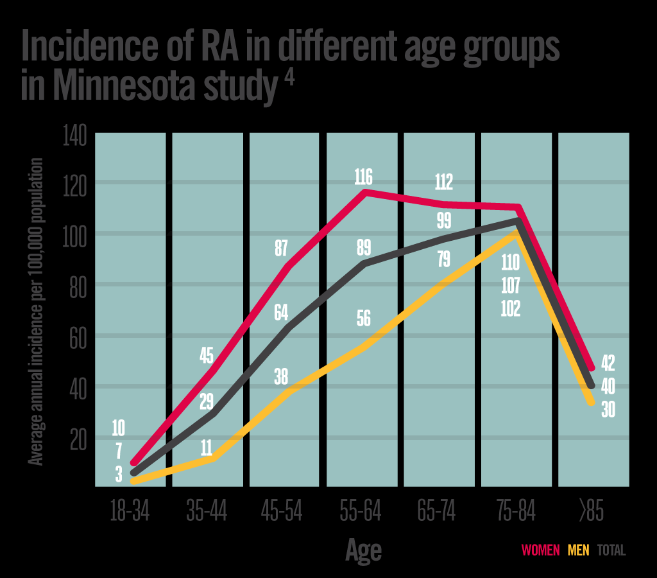
Increase of RA with increase of age
Yearly incidence increased until about ages 74-84 when it starts to decline
Incidence earlier for women between the ages of 55-64 compared to that of 74-84 for men
Notes:
https://rheumatoidarthritis.net/what-is-ra/ra-statistics/

Slide 41
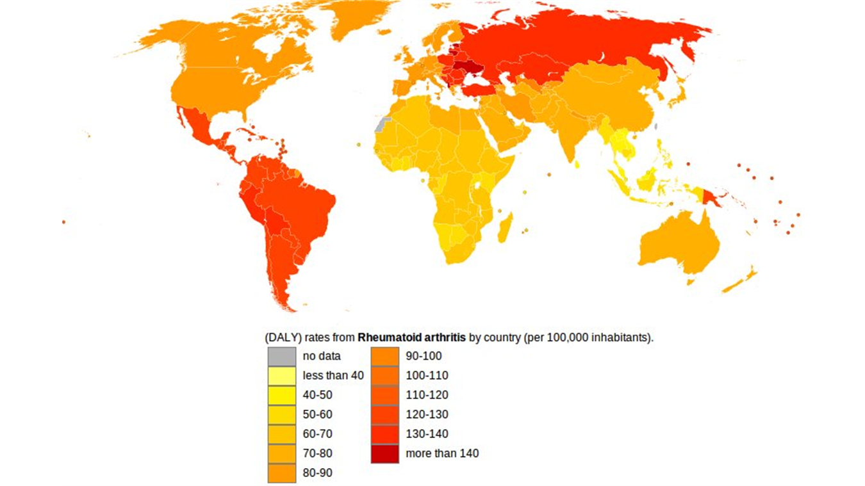
Notes:
http://sogacot.org/position-statement-the-epidemiology-pathogenesis-and-risk-factors-of-rheumatiod-of-the-knee

Slide 42
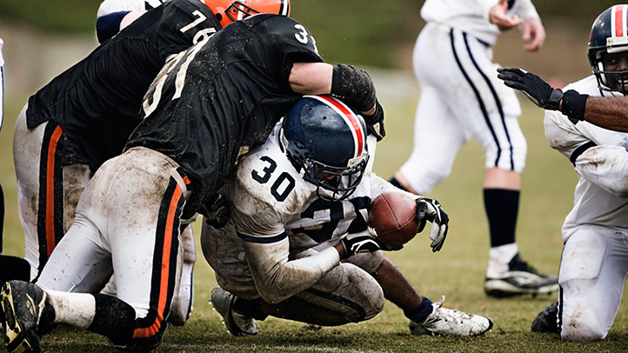
3. Traumatic Arthrithis
Occurs when there is damage to the articular cartilage with a joint leading to progressive deterioration of the joint.
Damaged articular cartilage takes a very long time to heal. In fact, torn cartilage never grows back.
Common cause of arthritis
E.g. Keen joint damage- often end in osteoarthritis

Slide 43
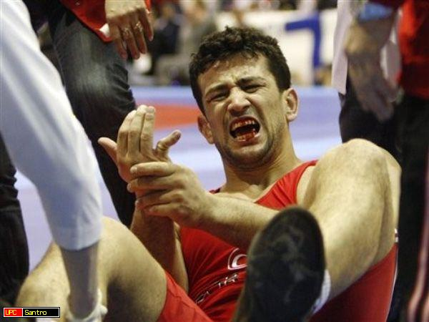
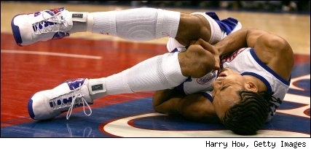
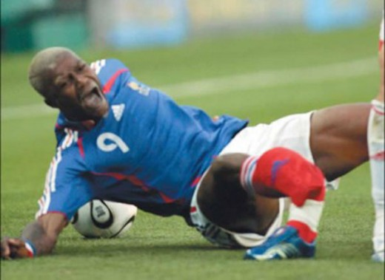
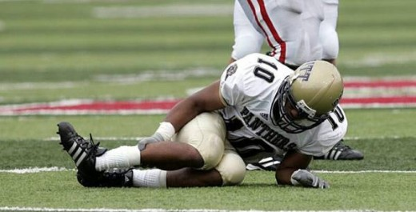
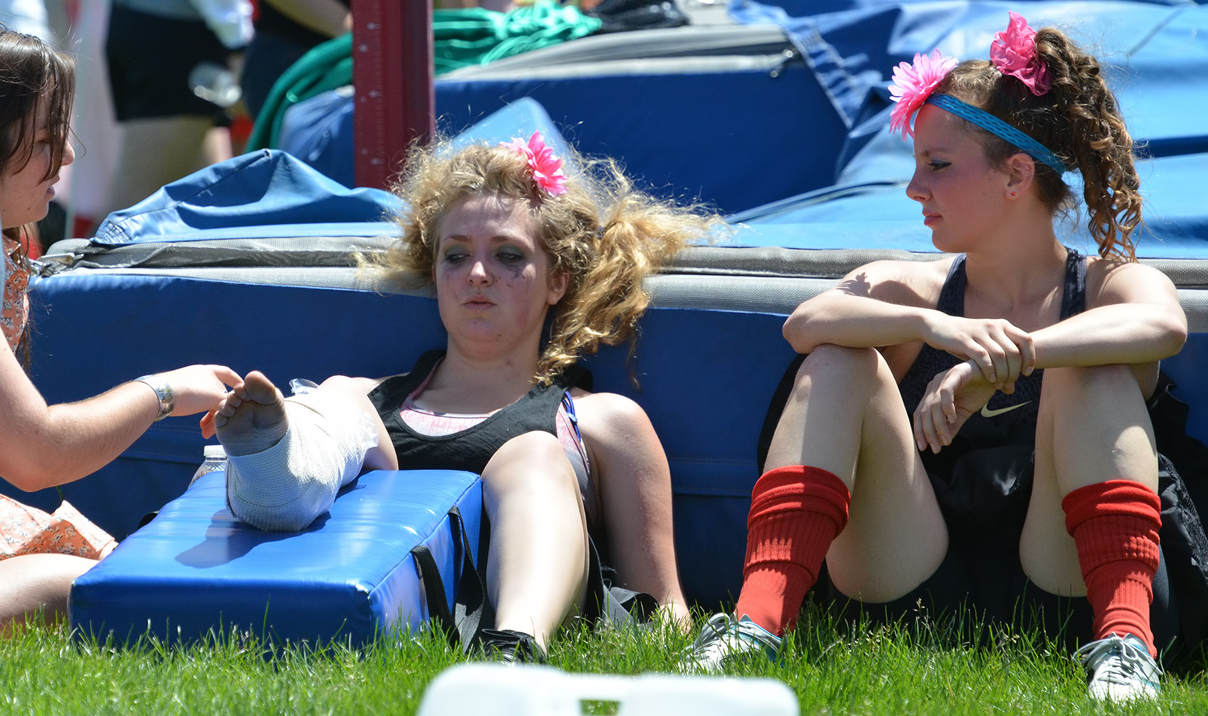
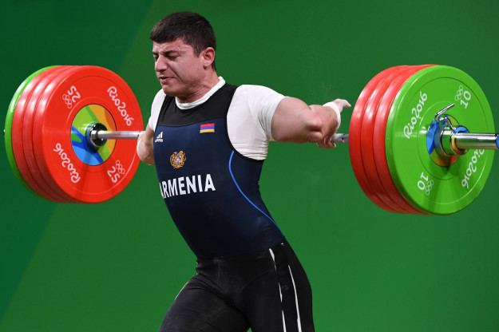
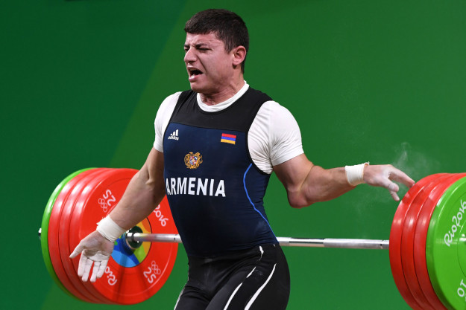
Traumatic Arthrithis cont…
Cause
sports injury
Car accident
Blunt force trauma
Fall
Over use of joints
Injury at work
Fracture

Slide 44
Traumatic Arthrithis cont…
Symptoms
Accumulation of fluid in the joints
Pain
Stiffness
Inflammation
Some bleeding inside the joints
Unable to bear any weight
Treatment
Similar to treatments of OA
Pharmacutical
Cortisone injections
Exercise
Surgery
Important to seek treatment early in order to avoid developing OA.

Slide 45
Awareness
Awareness month—”Moving in May”
Fun ones
https://www.youtube.com/watch?v=SrWykwEd_f0
Moving ones
https://www.youtube.com/watch?v=lQTVKuFPWR8
Yikes!!
https://www.youtube.com/watch?v=7RChEcy5yHo

Slide 46
Refferences
https://www.cdc.gov/chronicdisease/resources/publications/aag/arthritis.htm
http://www.healthline.com/health-slideshow/arthritis-types#1
https://www.cdc.gov/features/arthritisawareness/
www.who.org
http://www.arthritis.org/about-arthritis/understanding-arthritis/what-is-arthritis.php
http://www.arthritis.org/living-with-arthritis/pain-management/understanding/types-of-pain.php
http://youandarthritis.com/common-types-arthritis-treatment-options/
http://www.theepochtimes.com/n3/1913721-secrets-of-korean-medicine-part-7-end-the-pain-of-arthritis/
http://medical-dictionary.thefreedictionary.com/osteoarthritis
http://www.orthofracs.com/general/osteoarthritis/osteoarthritis.html

Slide 47
Refferences
https://www.ncbi.nlm.nih.gov/pmc/articles/PMC2920533/pdf/nihms193462.pdf
http://www.arthritis.org/about-arthritis/types/rheumatoid-arthritis/what-is-rheumatoid-arthritis.php
https://ghr.nlm.nih.gov/condition/rheumatoid-arthritis#genes
http://www.clinicaladvisor.com/features/osteoarthritis-and-rheumatoid-arthritis-2012-pathophysiology-diagnosis-and-treatment/article/265549/
http://www.medscape.org/viewarticle/573740_2
https://www.rheumatoidarthritis.org/ra/
http://emedicine.medscape.com/article/331715-treatment
http://www.arthritis.org/about-arthritis/types/rheumatoid-arthritis/treatment.php
https://rheumatoidarthritis.net/what-is-ra/ra-statistics/
http://www.medic8.com/healthguide/arthritis/traumatic-arthritis.html

