Slide 1
Arthritis
Rheumatoid
Osteo
Traumatic
Clara Bergeron

Slide 2
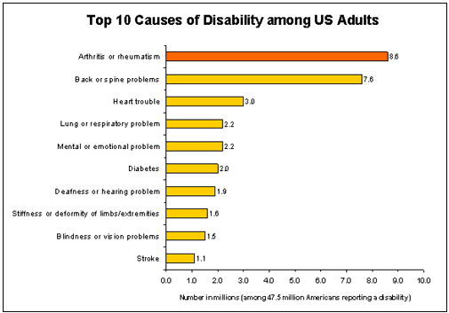
What is it?
Means “joint inflammation”
Describes more than 100 rheumatic diseases and conditions that affect joints, tissues surrounding the joints, and other connective tissue
Characterized by pain and stiffness in and around one or more joints
Can also involve immune system or various internal organs
#1 cause of disability among US adults
Notes:
http://www.cdc.gov/arthritis/basics.htm
-values from graph were self reported to the U.S. Census Bureau

Slide 3
Why is it a public health problem?
High prevalence
High lifetime risk
Common disability
Occurs with other chronic conditions
Discourages physical activity

Slide 4
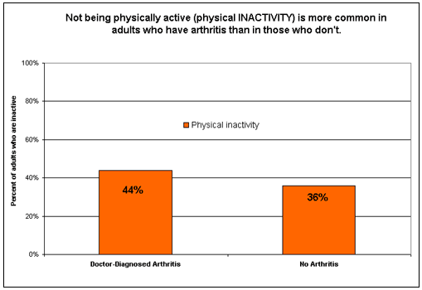
Arthritis Risk Factors
Physical Inactivity
Being a woman
Overweight/obesity
Notes:
-Inactive=no reported leisure-time physical activity
-http://www.cdc.gov/arthritis/data_statistics/national_nhis.htm#gender_specific

Slide 5
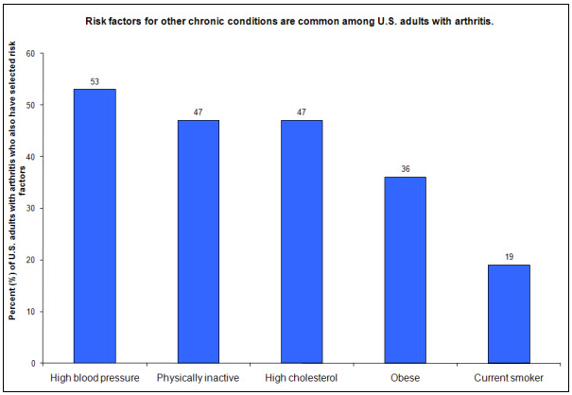
More Potential Risk Factors
Risk factors for OTHER chronic conditions are also common in U.S. adults with arthritis
High blood pressure
High cholesterol
Correlation, not causation at this point
Notes:
-http://www.cdc.gov/arthritis/data_statistics/comorbidities.htm

Slide 6
Prevalence
An estimated 50 million U.S. adults (22%) report having doctor-diagnosed arthritis
Number expected to increase to 67 million by 2030
By Age:
Ages 18-44: 7.6%
Ages 45-64: 29.8%
Ages 65+: 50.0% (1 in 2 people over 65)
2/3 of people with AORC are under 65 years old
300,000 children affected by AORC
Notes:
-http://www.cdc.gov/chronicdisease/resources/publications/aag/arthritis.htm
-http://www.cdc.gov/arthritis/data_statistics/state.htm
-data and projections based on National Health Interview Survey: annual survey conducted by the National Center for Health Statistics
-represents U.S. civilian, non-institutionalized population

Slide 7
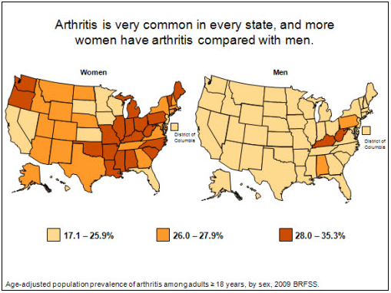
Prevalence
By sex:
Women: 24.3% affected
Men: 18.7% affected
Notes:
http://www.cdc.gov/arthritis/data_statistics/state.htm
-these percentages are of the total U.S. adult population of females and of males

Slide 8
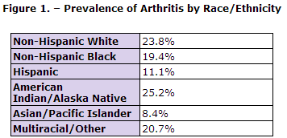
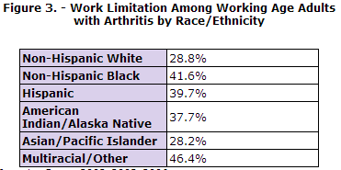
Prevalence
By race/ethnicity:
Highest prevalence among non-Hispanic whites
Low prevalence among Hispanics
High work limitation among Hispanics
Notes:
-http://www.cdc.gov/arthritis/data_statistics/race.htm

Slide 9
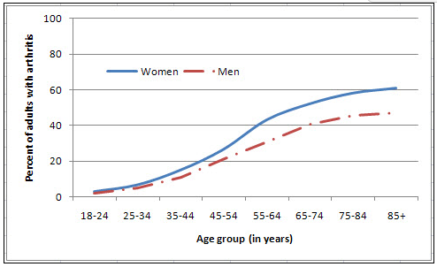
Arthritis Prevalence by Sex
Sex-specific prevalence of doctor-diagnosed arthritis
(includes all types of arthritis)
Notes:
-National Health Interview Survey, 2007-2009
-http://www.cdc.gov/arthritis/data_statistics/national_nhis.htm#gender_specific

Slide 10
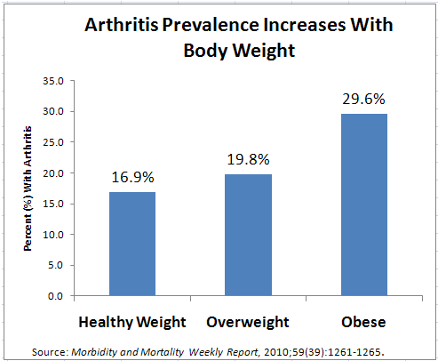
Arthritis Prevalence by Relative Weight
Higher prevalence in overweight people (by 3%)
Even higher prevalence in obese people (by 13%)
Especially relevant to arthritis in the knees
Notes:
-http://www.cdc.gov/arthritis/data_statistics/national_nhis.htm#gender_specific

Slide 11
Global Arthritis Prevalence
Not possible to estimate incidence, prevalence, or outcomes of arthritis in most countries
Notes:
-from WHO: http://www.who.int/healthinfo/statistics/bod_rheumatoidarthritis.pdf

Slide 12
What types are there?
Rheumatic Arthritis
Osteoarthritis
Traumatic Arthritis
Childhood Arthritis
Fibromyalgia
Gout
Systemic Lupus Erythematosus
Reactive arthritis

Slide 13
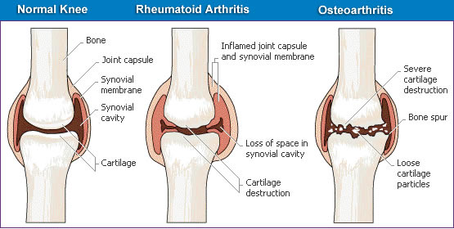
Rheumatic Arthritis (RA)-What is it?
An autoimmune condition, causing chronic inflammation of the synovial membrane
Inflamed synovium leads to erosions of cartilage and bone, and sometimes joint deformity
Polyarthritis: affects 5 or more joints in the body
Can begin at any age
No cure
Notes:
Info: http://www.cdc.gov/arthritis/basics/rheumatoid.htm
Image: http://web.sls.hw.ac.uk/teaching/level4/A34TS3/assignments%202006/Andy/Advance%20topics/arthritis.htm

Slide 14
RA: Risk Factors
Genetic
Strongest candidate so far is PTPN22 gene, which has been linked to several autoimmune conditions
Modifiable Environmental
Smoking: 1.3-2.4x higher risk
Reproductive and breastfeeding history
Oral contraceptives: decreased risk?
Live birth history: no live births=increased risk
Breastfeeding: decreased risk
Menstrual history: irregular menses or early menopause=increased risk
Low Socioeconomic Status
Excess disability and increases mortality
Notes:
Info: http://www.cdc.gov/arthritis/basics/rheumatoid.htm, Remington et. Al 2009
-OC: in early studies, decreased risk in women who had ever taken OCs, but this difference isn’t seen today, possibly because estrogen concentration in OCs today is 80-90% lower than in the 1960s
-Menstrual history: risk could be associated w/ aberrant menstrual history because women with Polycystic Ovarian Syndrome have increased RA risk

Slide 15
RA: Prevalence
0.5-1.0% of general population
1.5 million US adults (2007)
Decrease from 1990 estimate of 2.1 million
Rochester Epidemiology Project in Minnesota (age adjusted prevalence)
1995 2005
Women: 7.7 per 1000 9.8 per 1000
Men: 4.4 per 1000 4.1 per 1000
Notes:
Info: http://www.cdc.gov/arthritis/basics/rheumatoid.htm
-Rheumatoid arthritis is increasing in prevalence among women, but no change among men. Ideas?

Slide 16
RA: Incidence
41 per 100,000 people diagnosed with Rheumatoid Arthritis each year (1995-2007)
Increases with age
8.7 per 100,000 in ages 18-34
89 per 100,000 in ages 65-74
54 per 100,000 in ages >85
Notes:
Info: Rochester Epidemiology Project
-data age adjusted to 2000 U.S. population

Slide 17
RA: Morbidity
People with RA have worse functional status than those with osteoarthritis and those without arthritis
RA was the 19th most common cause for years lost to disability in the U.S. (1996)
Notable given that RA is a low prevalence condition

Slide 18
RA: Mortality and Co-morbidities
Associated with excess mortality
Most common causes: respiratory and infectious diseases, gastrointestinal disorders
Accounted for 22% of all deaths due to AORC (1997)
Standardized mortality ratio of 2.3 compared with general population (1990)
Co-morbidities
Cardiovascular disease: not sure if RA or CVD occurs first
Infections: especially tuberculosis
Mental health conditions: decreased physical function
Malignancies: especially leukemia and multiple myeloma. Cause unknown.
Notes:
-mortality ratio: people with RA are more than twice as likely to die than people of the same age in the general population
-the correlation of infections may be due to the use of nonsteroidal anti-inflammatory drugs, which are immunosuppressors
-didn’t include RA cost information because I couldn’t locate any data more recent than 1998

Slide 19
Osteoarthritis (OA)-What is it?
Degeneration of cartilage and its underlying bone within a joint, as well as bony overgrowth
Result of mechanical and molecular events in affected joint
Commonly affects: knees, hips hands, spine
Gradual onset after age 40
No cure
Notes:
Info: http://www.cdc.gov/arthritis/basics/osteoarthritis.htm
Image: http://web.sls.hw.ac.uk/teaching/level4/A34TS3/assignments%202006/Andy/Advance%20topics/arthritis.htm

Slide 20
OA: Risk Factors
Estrogen deficiency
Estrogen replacement therapy may reduce risk of knee/hip OA
Osteoporosis
Vitamins C, D, and E
C-reactive protein (increased risk with higher levels)
Smoking has been shown to be PROTECTIVE
Possibly due to physiological effects of smoking on bone, collagen, and cartilage tissue
Or some unmeasured surrogate factor
Notes:
-http://www.cdc.gov/arthritis/basics/osteoarthritis.htm#2

Slide 21
OA: Prevalence
Total U.S. adults with clinical osteoarthritis in at least one joint: 26.9 million
(up from 21 million in 1990)
Symptomatic hand osteoarthritis: 13.1 million U.S. adults
Symptomatic knee osteoarthritis: 9.3 million U.S. adults
By age:
25 and older: 13.9%
65+ years: 33.6% (12.4 million)
Notes:
-”total” data from 2005, taken from the American Academy of Orthopaedic Surgeons-http://www.aaos.org/news/aaosnow/mar09/research6.asp
-http://www.cdc.gov/arthritis/basics/osteoarthritis.htm#2

Slide 22
OA: Incidence
Increases with age, and levels off around 80 years
Age and sex standardized incidence of symptomatic OA:
Hand OA: 100 per 100,000 person years
Hip OA: 88 per 100,000 person years
Knee OA: 240 per 100,000 person years
By sex:
Women: 45% higher incidence risk of knee OA and 36% higher risk of hip OA than men
Notes:
http://www.cdc.gov/arthritis/basics/osteoarthritis.htm#2

Slide 23
OA: Morbidity
OA of the knee: one of the top five causes of disability among non-institutionalized adults
80% of patients with OA have some degree of movement limitation
25% cannot perform major activities of daily living
11% need help with personal care
14% require help with routine needs
Notes:
-NHANES III data: http://www.cdc.gov/arthritis/basics/osteoarthritis.htm#8

Slide 24
Traumatic Arthritis (TA)-What is it?
Arthritis caused by blunt, penetrating, or repeated trauma , or from forced inappropriate motion of a joint or ligament, generally leading to “bruised” cartilage
Defects in cartilage tissue are refilled with scar tissue, which doesn’t support weight well and isn’t as smooth as normal articular cartilage
Symptoms: swelling, pain, tenderness, joint instability, internal bleeding
Often lumped in as another form of osteoarthritis

Slide 25
Gout
Rheumatic disease caused by deposition of uric acid crystals in tissues and fluids in the body
Caused by overproduction or under excretion of uric acid
Acute Symptoms (typical): red, hot, swollen joints associated with excruciating pain
Chronic Gout: can lead to a degenerative form of chronic arthritis-“Gouty Arthritis”
Affects about 6 million people in the U.S.
Incidence increases with age
More prevalent in men than women
Treatment with medication and altered diet
Notes:
-data from 2005 U.S. Census

Slide 26
Reactive Arthritis
“Reiter’s Syndrome” autoimmune disorder that develops as a response to an infection elsewhere in the body
Commonly due to Chlamydia trachomatis bacteria (the STD)
Often misdiagnosed, incidence may rival or surpass that of rheumatoid arthritis (~125,000 new cases per year in U.S.)
Effectively treated by combination antibiotics
Notes:
-http://hscweb3.hsc.usf.edu/health/now/?p=12175 (2010)

Slide 27
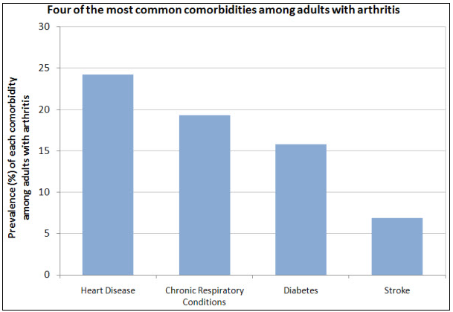
Comorbidities Associated with Arthritis
Medical expenses associated with these four conditions make up a significant portion of the estimated $353 billion in medical expenditures of U.S adults who have AORC
Notes:
-http://www.cdc.gov/arthritis/data_statistics/comorbidities.htm

Slide 28
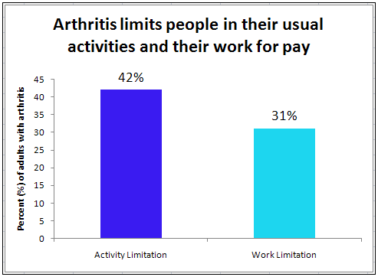
Arthritis-Attributable Limitations
~21 million U.S. adults with doctor-diagnosed arthritis reported limitations in their general activities due to the condition
Work limitation group only considered population between ages 18 and 64
Notes:
-http://www.cdc.gov/arthritis/data_statistics/national_nhis.htm#gender_specific
-based on the estimate of 50 million U.S. adults with doctor-diagnosed arthritis
-for working limitations: only took into account population ages 18-64

Slide 29
Screening and Treatment
Rheumatoid:
No screening or primary prevention per se
But can manage other risk factors: smoking cessation, influenza vaccination, moderate exercise
Medications: tumor necrosis factor blockers, interleukin 1 receptor antagonists
Early aggressive treatment with medication, followed by drug step-down
Osteo:
No screening or early detection
Multidisciplinary treatment: low-impact exercise, physical & occupational therapy, over the counter analgesics, non-steroidal anti-inflammatory drugs
Possible joint replacement if moderate/severe pain and limitation

Slide 30
Annual Cost of Arthritis in the U.S.
Total costs attributable to AORC in 2003: $128 billion
Equal to 1.2% of the 2003 U.S. gross domestic product
Direct costs: $80.8 billion
Indirect costs: $47 billion
24% growth between 1997 and 2003
Notes:
AORC: Arthritis and Other Rheumatic Conditions
-also includes gout, lupus, and approx. 100 other conditions
-http://www.cdc.gov/arthritis/data_statistics/cost.htm
-American Academy of Orthopaedic Doctors: http://www.aaos.org/news/aaosnow/mar09/research6.asp

Slide 31
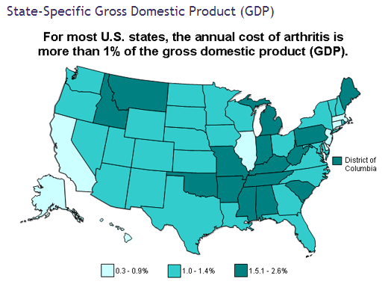
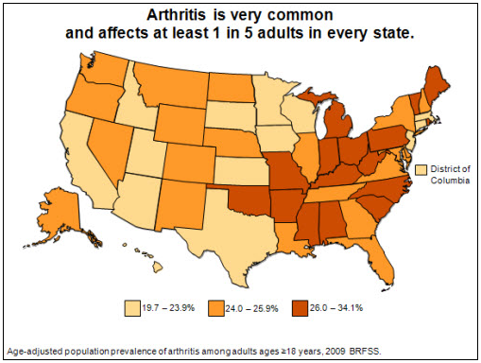
Cost: Percentage of GDP by State
Concentrated in the Eastern U.S.
Cost is well aligned with prevalence
Notes:
http://www.cdc.gov/arthritis/data_statistics/cost.htm
http://www.cdc.gov/arthritis/data_statistics/state.htm

Slide 32
Total Cost of U.S. Adults with Arthritis
Total medical expenditures of people with AORC in 1997: $252 billion
Total medical expenditures of people with AORC in 2005: $353 billion
Increased by 22% in 8 years
Due to 22% increase in the number of people diagnosed with arthritis
And a 15% increase in the medical expenditures for each person with arthritis
Prescription drugs accounted for the main portion of this increase
Ambulatory care costs also increased
Hospital care costs decreased
Notes:
-http://www.cdc.gov/arthritis/resources/spotlights/dollars.htm
-these numbers are not SOLELY the cost of arthritis, but rather the cumulative of healthcare for people who have arthritis (and often other comorbid conditions)
-AORC: Arthritis and Other Rheumatic Conditions (also includes

Slide 33
Efforts to Reduce Incidence and Prevalence
4 self-management education programs
Teach people with arthritis techniques to manage it on a day-to-day basis
2 of these programs are specifically designed for Spanish speakers
6 physical activity programs
Appropriate physical activity can decrease arthritis pain and disability
2 health communications campaigns promoting physical activity
1 designed for Caucasians and African Americans
1 designed for Spanish-speaking Hispanics
Notes:
-these are programs funded by the CDC
-http://www.cdc.gov/arthritis/interventions.htm

Slide 34
National Public Health Agenda for Osteoarthritis
Set in 2010, following a call to action by the Arthritis Foundation and the CDC
Three overall goals to be reached in 3-5 years (aka now…)
Availability of evidence-based intervention strategies to all Americans with OA
Establish supportive policies communication initiatives, and strategic alliances for OA prevention and maintenance
Initiate needed research to better understand the burden of OA, its risk factors and effective intervention strategies

Slide 35
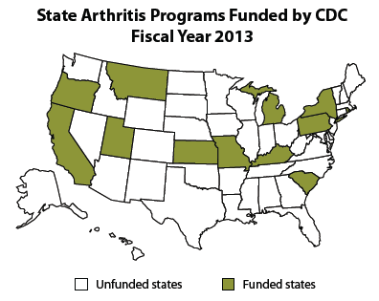
Are we meeting our goals?
Notes:
-granted, the National Agenda was in regards to Osteoarthritis in particular, whereas these maps depict general arthritis/program data, but still.
-http://www.cdc.gov/chronicdisease/resources/publications/AAG/arthritis.htm
-http://www.cdc.gov/arthritis/data_statistics/state.htm

Slide 36
Current CDC Projects
First Step to Active Health
4 part program including strategies for participating in aerobic, flexibility, strength and balance exercise
Evaluating effectiveness of program using outcomes of symptoms, physical activity level, functional performance, and strength
Choosing Arthritis-appropriate Physical Activity
Develop, implement, and evaluate the efficacy of brief psycho-educational intervention to select appropriate physical activity, and to modify it as necessary for their particular circumstances

Slide 37
Current CDC projects cont’d.
Johnston County Osteoarthritis Project: Arthritis & Disability
Community-based, longitudinal study of 3200 rural white and black residents aged 45 and older
Determine prevalence, incidence, and risk factors of hip and knee osteoarthritis
Has been conducted since 1991, with reports every 7 years
Lupus Registries
Developing population-based registries to better define the incidence and prevalence of lupus
Existing registries in GA and MI: white and black populations
Newer registries in CA and NYC: Hispanic and Asian populations

Slide 38
Other questions
More current cost estimates broken down by type of arthritis
Gauge whether cost is aligned with prevalence
Global data for incidence, prevalence, morbidity, mortality
Especially in areas where there is a lot of farming or factory work (repetitive motions)
Developing earlier detection strategies
Especially for Rheumatoid Arthritis, where early aggressive treatment is most beneficial

