Slide 1
Arthritides
Erik Haley
Epidemiology of Chronic Diseases
March 11, 2013

Slide 2
Definitions
Arthritis has many forms and conditions, all of which are characterized by inflammation of the joints
Osteoarthritis – joint symptoms due to defective cartilage and changes in the surrounding bone, most common form
Idiopathic – localized or generalized
Secondary - Traumatic, Congenital or Other Medical Cause
Rheumatoid – autoimmune disease attacking synovial membrane, leading to cartilage erosion

Slide 3
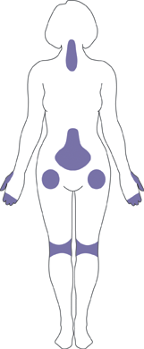
Sites of Arthritic Pain

Slide 4
Osteoarthritis Incidence
Incidence of osteoarthritis is higher in women than men and increases with age
Arthritis can be diagnosed either by symptoms (all) or by radiographic analysis (moderate to severe cases)
Osteoarthritis affects the various joints differently:
Hand= 100 in 100,000 per year
Hip = 88 in 100,000 per year
Knee= 240 in 100,000 per year

Slide 5
Osteoarthritis Prevalence
OA affects 13.9% of Americans 25 and older; 33.6% of people 65+ are diagnosed with a type of osteoarthritis
Symptomatic OA Prevalence (% of people):
8% Hand, 2% Feet, 12.1% Knee (16% of adults 45+), 4.4% Hip
Framingham Study showed Knee OA rates of 6.1% (9.5% for ages 63-93)
Radiographic OA Prevalence:
7.3% Hand, 2.3% Feet, .9% Knee, 1.5% Hip
Notes:
Knee and Hip Radiographic May Be Underestimated – more common to describe?
Feet higher Radio than Symp- cases more severe?

Slide 6
OA Prevalence
Women have a higher incidence and prevalence of OA
Men have 45% lower knee OA incidence and 36% lower hip OA incidence
Hand OA Prevalence - Sym(8.9% Female, 6.7% male) and Rad (9.5% Female, 4.8% male)
Knee OA is significantly more severe in females than males
Blacks have a higher rate of knee OA than whites, but no racial differences in hand/foot/hip OA have been detected
Asian populations have been shown to have reduced risk of OA

Slide 7
OA Risk Factors
Risk Factors for OA include both modifiable and non-modifiable factors
Non-modifiable risk factors include age, gender, race and genetic predisposition
Modifiable risk factors include joint trauma, body mass, and repetitive usage
Jobs related to OA include construction, cleaning, agriculture, professional sports

Slide 8
Rheumatoid Arthritis Incidence
The Rochester Epidemiology Project (RE Project) is responsible for most data on RA incidence and prevalence
From 1995-2007, 41 in 100,000 people were diagnosed with RA per year
A longitudinal study from the 50’s to the 80’s showed that incidence rate decreased from the beginning of the project to the end

Slide 9
RA Prevalence
The prevalence of RA was estimated to be .6% (1.5 million adults) in 2005, a drop from 2.1 million in 1990
The prevalence of RA increases to about 2% for people above age 60
In 1995, RA prevalence was 7.7 per 1000 in women and 4.4 per 1000 in men; 2005 showed an RA prevalence of 9.8 for women and 4.1 for men

Slide 10
RA Risk Factors
RA is shown to be higher in women and elderly populations; no risk factor is seen for race
Reproductive hormone levels may affect risk
Evidence suggests that several genes, including DR4 and DRB1 of the MHC genes and PTPN22, can lead to a pre-disposition for RA
Smoking is associated with a moderate (~2) increased risk of RA onset
Notes:
Live Births and Breast-feeding show lower levels of RA onset. Oral contraceptives and early menopause show an increased risk.
MHC- Major Histocompatability Complex, PTPN22 related to auto-immune disorders

Slide 11
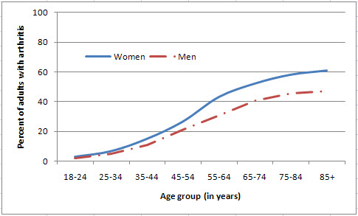
Arthritis Prevalence

Slide 12
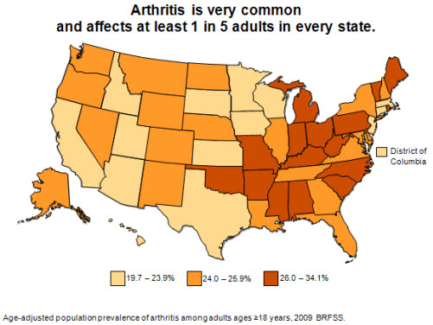
Arthritis Prevalence

Slide 13
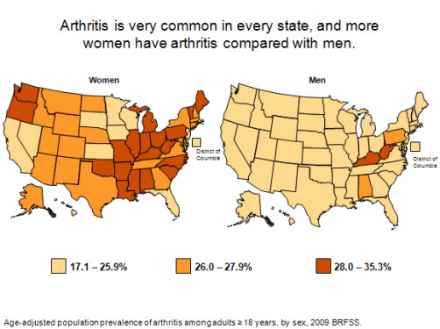
Arthritis Prevalence

Slide 14
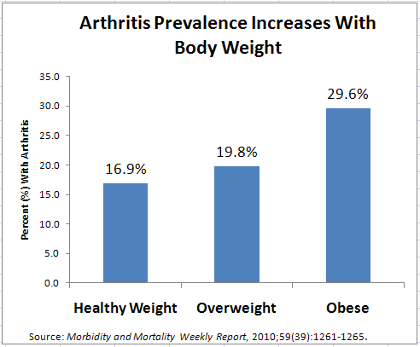
Arthritis Prevalence

Slide 15
Virginia Prevalence
Virginia (state data) | 2003 | 2005 | 2007 | 2009
Adults with arthritis | 1,495,000 | 1,539,000 | 1,540,000 | 1,488,000
Adults limited by arthritis | 554,000 | 577,000 | 522,000 | 627,000
% of adults with arthritis | 27 | 28 | 27 | 26
% women/men with arthritis | 30/24 | 32/23 | 32/22 | 29/23
% whites with arthritis | 29 | 28 | 29 | 28
% blacks with arthritis | 26 | 25 | 26 | 23
% Hispanics with arthritis | 13 | 27 | 12 | 12
% 18–44 year olds with arthritis | 14 | 12 | 10 | 12
% 45–64 year olds with arthritis | 37 | 37 | 37 | 34
% 65+ year olds with arthritis | 52 | 59 | 58 | 54
% with arthritis who are overweight or obese | 66 | 69 | 69 | 68
% with arthritis who are physically inactive | 19 | 15 | 16 | 18

Slide 16
Osteoarthritis Cost
OA costs an individual about $2600 in out-of-pocket expenses- total cost is $5700 per year
Knee and hip replacement surgeries for OA cost $7.9 billion
Job-related costs are 3.4-12.1 billion a year

Slide 17
Osteoarthritis Impact
Arthritis is the leading cause of disability in the USA with OA of the knee being most prominent
80% of people with OA have some degree of limited motion- 1 in 4 cannot perform daily living activities
In 1999, adults with OA reported more than 13 days of work lost due to health problems

Slide 18
RA Cost
The RE Project reported that RA would cost an individual $5,763 in medical expenses annually in 1987
Non-medical costs in 1992 were reported to be $2785 for RA, compared to $1011 for OA
The mean estimated lifetime cost of RA was given to be $61,000 – $122,000 in 1995, depending on age of diagnosis

Slide 19
RA Impact
Patients with RA have worse motor function than patients with OA or non-affected people
Patients with RA were more likely to change jobs or hours worked, lose their jobs, be unable to find another job or retire.
Most common in service jobs compared to management or jobs with limited physical activities
People with RA were twice as likely as unaffected individuals to report some form of motor limitation

Slide 20
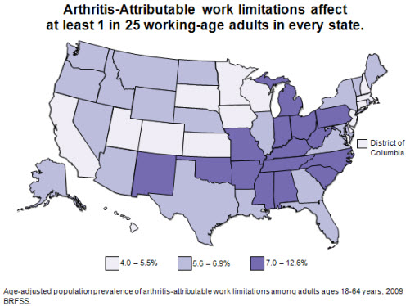
Arthritis Impact

Slide 21
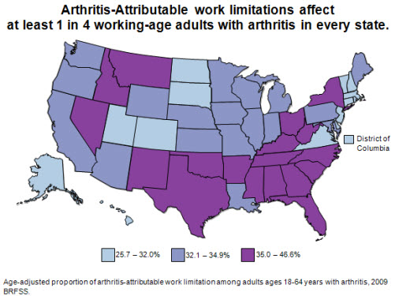
Arthritis Impact

Slide 22
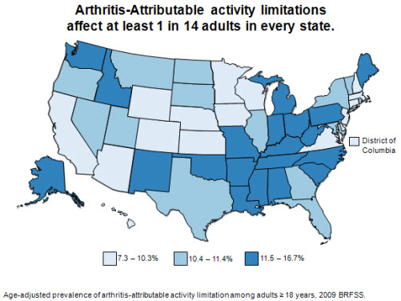
Arthritis Impact

Slide 23
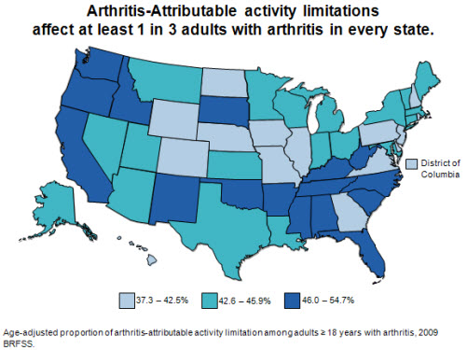
Arthritis Impact

Slide 24
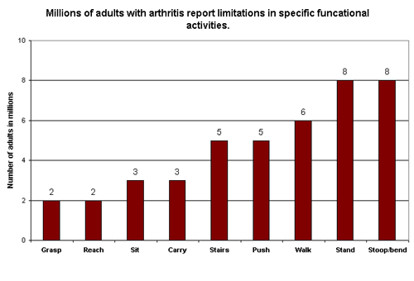
Arthritis Impact

Slide 25
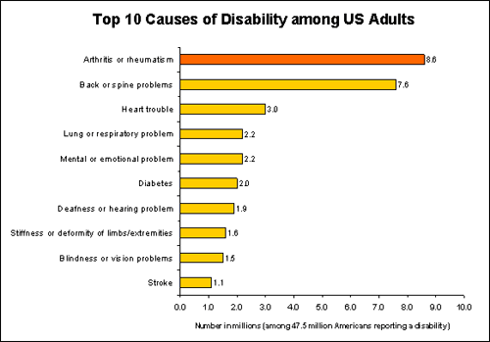
Arthritis Impact

Slide 26
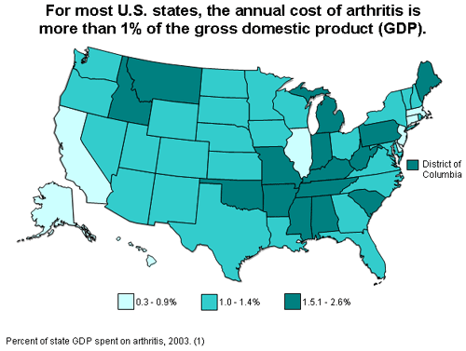
Arthritis Cost

Slide 27
Hospitalizations
A 2004 study showed that 992,000 people a year were hospitalized with an arthritic condition as the primary diagnosis
3.6 million had an AORC as a secondary condition
44.2 million individuals were shown to receive medical care for an arthritic condition as the primary diagnosis, mostly for primary care physicians and orthopedic surgeons
22.2 million had an AORC as a secondary condition
Children 0-17 were estimated to have 827,000 visits for arthritis or rheumatic conditions (AORC)
Notes:
Primary- generally older patients, fewer co-morbidities, short stay and likely to undergo procedure
Secondary- older, more co-morbidities, longer hospializations

Slide 28
Mortality
OA mortality is reported as .2-.3 per 100,000 yearly (6% of arthritis deaths)- numbers increased over past 10 years
Underreported as deaths due to treatments not counted
RA accounted as cause of death in 22% of arthritic conditions – patients 2.3 times as likely to die as non-affected patients
Presence of rheumatoid factor (RF) may be signal of premature morbidity

Slide 29
Co-morbidities of RA
CVD is more common in patients with RA with ischemic heart disease as most prevalent
Infections, particularly tuberculosis
Mental Health Diseases, especially anxiety and depression
Malignancies such as leukemia
Notes:
All co-morbidities could be due to treatments for RA (ie. Immunosuppression leading to increased infections) or risk factors associated with RA (ie. Smoking for CVD)

Slide 30
Treatments
OA treatment generally focuses on pain relief and self-management to increase physical activity or decrease weight
Joint replacement surgeries can be done for patients with reduced quality of life
RA treatment begins with corticosteroids and NSAIDS at first, followed by non-biologic and then biologic DMARDS if patient does not respond
Includes OA Treatment and Physical Therapy
Notes:
NSAID- Non-steroid anti-inflammatory drug, carries risk of intestinal bleeding and GI disorders
DMARD- Disease modifying antirheumatic drug

Slide 31
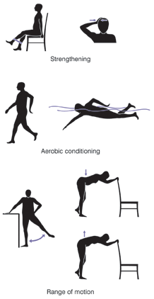
OA Treatments

Slide 32
Interventions
Arthritis interventions focus on improving the quality of life in patients with arthritis
These include self-management (Arthritis Self-Management Program and Chronic Disease Self-management Program) and physical activity plans ( Arthritis Fundation Exercise/Aquatic Foundation)
Media campaigns are underway to focus on physical activity as a form of treatment

Slide 33
Research
National Institute of Arthritis and Muscloskeletal Diseases funds most research for arthritis
Current topics of interest include biomarkers for OA, tools to monitor cartilage levels, pharmacologic treatments and methods to heal cartilage damage
Doxycycline has been shown to stop enzymes that damage cartilage but more study is required
3-D scaffold patch in development can be combined with cartilage stem cells to allow replacement

Slide 34
Gout
Gout is a rheumatic disease caused by uric acid crystal accumulation
Gout incidence is higher for men (3x) than women and higher for blacks (3.1 per 1000/year) than whites (1.8)
Risk factors include obesity, hypertension, alcohol, diet
Gout prevalence increased from 2.9 per 1000 in 1990 to 5.2 in 1999; Men under 65 had 4x the rate of women
Gout is commonly episodic instead of chronic – low mortality and impact on quality of life

Slide 35
Osteoporosis
Osteoporosis is a skeletal disorder characterized by low bone mass and weak bone structural integrity
In 1988-94, 56% of women had reduced bone density, 16% of which was characterized as osteoporosis; only 18% of men had reduced bone density with only 2% as osteoporosis
Whites had the highest prevalence of osteoporosis (17%), followed by Hispanics (12%) and blacks (8%)
http://www.cdc.gov/nchs/data/nhanes/databriefs/osteoporosis.pdf

Slide 36
Risk Factors/Impact
Risk factors for osteoporosis include gender, age, obesity, smoking, drinking and hormone level
Major impact of osteoporosis is increased amounts of fractures, mostly due to falls-1.6 million patients with osteoporosis 65+ were treated for fractures in 2002
$16 billion a year was spent on osteoporosis, $14B on fractures
Treatment involves exercise , diet and hormone regulation to build up bone density (high Ca and Vitamin D intake)

Slide 37
Resources
NIH Site on OA: http://www.niams.nih.gov/Health_Info/Osteoarthritis/default.asp
CDC Site on Arthritis: http://www.cdc.gov/arthritis/basics/general.htm
CDC State Data: http://www.cdc.gov/arthritis/data_statistics/state_data_list.htm#virginia
CDC Gout Data: http://www.cdc.gov/arthritis/basics/gout.htm

Slide 38
Resources:
NHAMES III Data: http://www.cdc.gov/nchs/data/nhanes/databriefs/osteoporosis.pdf
NIH Osteoporosis Data: http://www.niams.nih.gov/Health_Info/Bone/Osteoporosis/osteoporosis_ff.asp, http://www.ncbi.nlm.nih.gov/pubmed/21165602

