Slide 1
Obesity
Jamie Chen & Julie Park
EPID 624
9 January 2015

Slide 2
The Basic Facts on Obesity
Definition: Overweight VS Obese
What form of measurement do we use to tell the difference? Body Mass Index aka “BMI” and Waist Circumference
Notes:
Overweight and Obese: synonyms for a weight greater than what is considered to be healthy for a given height; both terms identify a point at which likelihood of increase in disease will occur.
The World Health Organization defines obesity as abnormal or excessive fat accumulation that may impair health, whereas overweight is defined as having excessive body weight for a certain height.

Slide 3
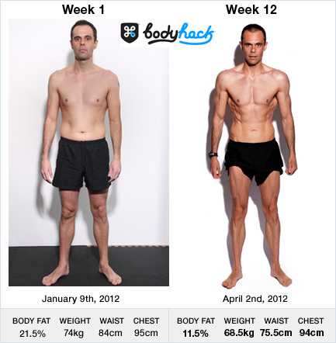
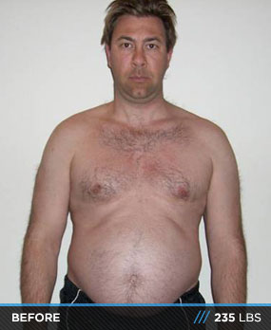
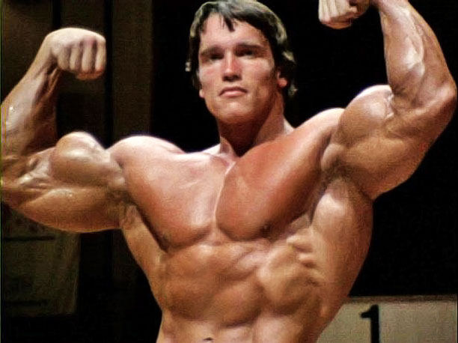
Body Mass Index (BMI)
BMI Calculator
Limitations of the BMI scale
Notes:
Graph from the CDC website.
Overweight: a BMI of 25.0 – 29.9
Obese: a BMI of 30.0+
Limitations of the BMI scale: it can be a good gauge of an individual’s risk for disease, however, it is only an estimate of an individual’s body fat. It can overestimate the body fat of an athlete or someone with higher muscle mass, and it can underestimate older people or those who have lost muscle mass (“skinny fat”).
There are other measures used to measure body fat like skinfold thickness (uses calipers), underwater weighing, bioelectrical impedence, dual-energy x-ray absorptiometry, and isotope dilution. However, the CDC doesn’t use these methods because they’re not always readily available and they also require highly trained personnel.
Arnold Schwarzenegger at his competition weight was 235 lbs, same as the man in the first picture.

Slide 4
Waist Circumference
At risk for higher likelihood of disease and diabetes type 2:
Females: ≥ 35 inches
Males: ≥ 40 inches
Notes:
The measurement is taken at the middle of your torso, right about the hipbones as you exhale.
The more fat that sits around your waist rather than your hips, increases your likelihood for certain diseases and diabetes type 2.

Slide 5
Risk Factors
Other factors that will increase the likelihood of disease:
Physical inactivity
Cigarette smoking
Family history of CVD
High blood pressure
High LDL cholesterol (“bad” cholesterol)
Notes:
If you are considered overweight or obese (according to the BMI index/waist circumference) and have two or more of these risk factors→ will be told to lose weight.
Even a small weight loss of 5-10% of your body weight is enough to lower the risk of disease.

Slide 6
Why do we care?
~33% of adults are obese
~17% of children are obese
Costs ~ $147 billion in healthcare costs annually or ~17% of US medical expenditure
Obesity can lead to a network of diseases like: cardiovascular disease, diabetes, certain cancers, sleep apnea, asthma, myocardial infarction, stroke…
Metabolic Syndrome: abdominal obesity + high BP + raised cholesterol and fats in blood
Notes:
http://www.commed.vcu.edu/Chronic_Disease/Obesity/percentHealthbudget.pdf
http://www.cdc.gov/obesity/data/adult.html
Average medical spending for obese people is found to be about 42% higher than their healthier counterparts.
The network of diseases connected to obesity is very high: it’s harder to find a disease not exacerbated by obesity than to find one that is. A question that now needs to be considered is: should we consider obesity as a disease? A condition? A disorder? And if we did categorize it as a disease, would actually help improve the health outcomes that are labeled as obese?

Slide 7
Quality of Life
An increase in obesity shows an inverse correlation to quality of life.
Outside of correlated disease, obesity can cause:
Depression
Sexual problems
Discrimination/social isolation
Lower productivity

Slide 8
Childhood Obesity
Childhood obesity has more than doubled in children and quadrupled in adolescents in the past 30 years.
In a population based sample, ~70% of obese youth had at least one risk factor for CVD
Childhood obesity increases the risk of joint issues, sleeping issues, social and psychological issues as well.
Notes:
Childhood obesity: 7% in 1980 to 18% in 2012
Adolescent obesity: 5% in 1980 to 21% in 2012
With the increasing rates of childhood obesity, we need to remember that childhood health predicts adult morbidity and mortality; we also need to keep in mind how it affects the quality of life for children.
With the increase in childhood obesity comes the rise of diabetes type 2 in children. Studies have shown that most youth with diabetes type 2 will be required to take oral medications or insulin therapy after just a few years after diagnosis, which will carry on for the rest of their lives as diabetes is a disease that is treatable but not curable.

Slide 9
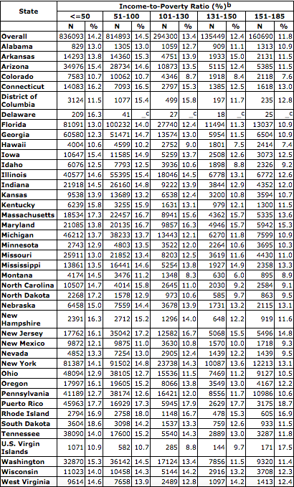
Notes:
The Prevalence of Obesity among Low-Income Children aged 2-4 years by state and income, 2011
http://www.cdc.gov/obesity/data/childhood.html
They found that obesity prevalence was highest in familes with incomes below the poverty line. Why?

Slide 10
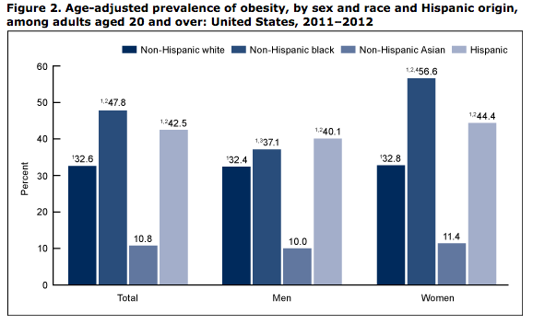
Prevalence
Obesity is lower among Caucasians then among African-Americans and Mexican-Americans.
In females, obesity is highest among African-Americans. In males ≤ 20 years old, obesity is the highest in Mexican-Americans.
Notes:
There was little disparity among male and female obesity rates. However, among African-American adults, 56.6% of women were obese compared to 37.1% of men.

Slide 11
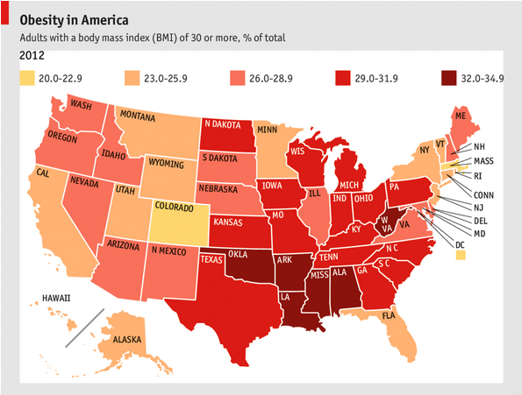
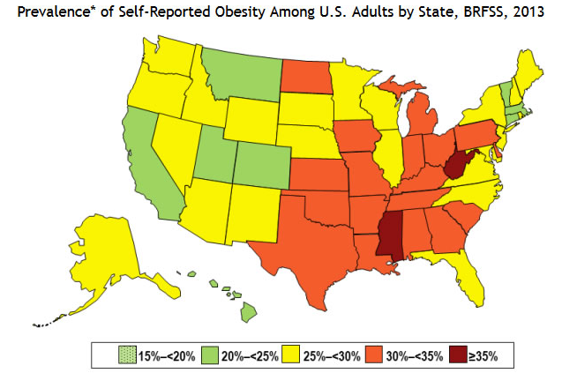
Distribution in the US
Notes:
http://www.cdc.gov/obesity/data/prevalence-maps.html

Slide 12
Global Prevalence (IHME)
Notes:
Institute for Health Metrics and Evaluation at University of Washington
For both sexes adults
Larger percentages due to adding overweight figures as well, but good representation of geographical data

Slide 13
http://www.theatlantic.com/health/archive/2013/04/look-how-quickly-the-us-got-fat-1985-2010-animated-map/274878/
Notes:
Percentage of populations medically defined as obese

Slide 14
What Got Us Here?

Slide 15
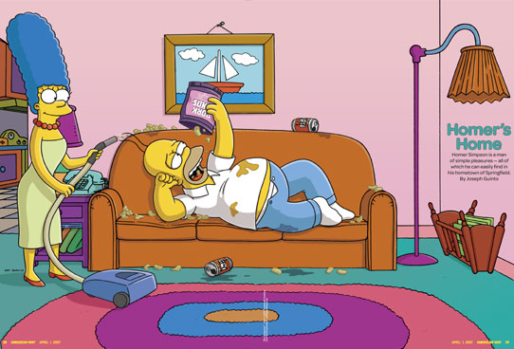
Etiology of Obesity: Multifaceted
There are various factors that tie into obesity:
Environmental
Genetic
Physiologic
Psychological
Socio-economic
Political
Sources
Practical Diabetes International 2001: Causes of Obesity
Abdominal Imaging 2012: Causes of Obesity
Most common attributing factor: we eat too much, move too little!

Slide 16
S.M. Wright, L. J. Aronne: Causes of Obesity
Notes:
Sleep Debt: ever tried an all-nighter and found yourself munching away?
Endocrine disruptors: polychlorinated biphenols, dichlorodiphenyltrichloroethane
Increasing Gravida Age: prezygotic hypothesis-development is subject to environmental influences on the oocyte prior to conception. Such influences may occur in the maternal grandmother's uterus where oogenesis is completed or in the mother before fertilization

Slide 17
Research

Slide 18
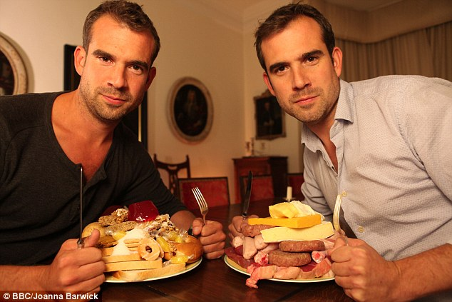
http://www.dailymail.co.uk/health/article-2546975/One-twin-gave-sugar-gave-fat-Their-experiment-change-YOUR-life.html
Notes:
Twins Alexander and Chris Van Tulleken- Sugar vs. Fat
“So, what were our conclusions? If you want to lose weight it will be much easier if you avoid processed foods made with sugar and fat. These foods affect your brain in a completely different way from natural foods and it's hard for anyone to resist eating too much.
And any diet that eliminates fat or sugar will be unpalatable, hard to sustain and probably be bad for your health, too.”

Slide 19
Professional/Multidisciplinary Impact
“Impact of a nurse-directed, coordinated school health program to enhance physical activity behaviors and reduce body mass index among minority children: a parallel-group, randomized control trial” – International Journal of Nursing Studies
Intervention phase and post-intervention assessment
“The effect of a combined intervention on body mass index and fitness in obese children and adolescents- a clinical experience”- European Journal of Pediatrics
Notes:
Parallel group, randomized control trial : 251 children (of 305 students to attended at least half of KNF) in urban, low-income neighborhoods in LA
Randomized to Kids N Fitness or General Education
Kids N Fitness: 6 week, met weekly – 45 min physical activity, 45 min nutrition ed class
Intervention sites also participated in school-wide wellness activities
In contrast to clinical programs, school programs delivered at little to no cost to families – reach low income and urban
Result: girls- BMI reduction -3.65 (base:22.65), boys- BMI reduction -2.56 (base:21.89) 12 months from baseline
Due to baseline diff of physical activity of genders
2. longitudinal, nonrandomized clinical – 177 obese children (age 6-16) participate in 3month program, 65 of those completed a 6 month intervention
- controls: 25 age and maturity matched obese children – at obesity clinic not able to commit to program
- body weight, BMI, fitness measured at baseline, after 3 & 6 months
- combined diet and exercise program
- 1/month visit to dietician, 2/week training program by professional youth coaches, 1/week self-guided exercise
- results: BMI correlated significantly w/ hrs of TV and computer playing
-3 months: 65% of subjects lost weight, 74% reduction in BMI (26.1+-1.4 kg/m2 – 25.4); significant increase in BW and BMI in control
-6 months: significantly greater BMI reduction (-0.95 vs -0.53 in 3months)

Slide 20
Community Involvement
“Lifestyle modifications in an adolescent dormitory: a clinical trial” – Korean Journal of Pediatrics
“A controlled, class-based multicomponent intervention to promote healthy lifestyle and to reduce the burden of childhood obesity” – Pediatric Obesity
Notes:
Study based on 36 obese adolescents from low socioeconomic background – 21 completed (low compliance from participants, school staff and parents)
controls: healthy, normal age-appropriate BMI children
6months: 1/week clinical dietician, 2/week exercise regimen (60min)
Conclusion: BMI significantly decreased from 32.46 – 30.32
Complex task, emphasis on integrating parents and school environment necessary
5 month intervention 209 primary school – divided to 103 intervention, 106 control
Groups matched on basis of deprivation index, score to ID underprivileged areas
Mostly physical activity intervention, children had time to explore healthy eating options
- 8 month followup- mean SDS (standard deviation score) BMI decrease by 0.06 units in intervention group, increase by 0.12 in controls

Slide 21
Complications in Research
Co-morbidities
Multifaceted nature of causes and outcome
Study subject compliance
Funding?
Notes:
What can we do to impact the subject compliance complication - long term commitment, acceptance of problem

Slide 22
Children and adolescents are prime targets for research!
Less co-morbidities that can complicate research
Easier to study in institutional/community settings
Intervention at earlier ages make both prevention and treatment much more feasible

Slide 23
So What Are We Doing About It?

Slide 24
Translational Research Institutes and Programs
Translational Research Institute For Metabolism and Diabetes – Florida
Institute for Diabetes, Obesity and Metabolism – UPenn SOM
Translational Obesity Research Program – VTech College of Agriculture and Life Sciences

Slide 25
The First Lady’s Initiative
In 2010, the First Lady Obama took on the challenge of combating childhood obesity in our nation
Passed the Child Nutrition Bill – Healthy, Hunger-Free Kids Act
USDA given the authority to set nutritional standards for all foods sold in schools
Additional funding to schools that meet updated nutritional standards
Help establish local farm to school networks, create school gardens
Improves nutritional quality of commodity foods that schools receive from USDA for breakfast and lunch programs
Expands access to drinking water in schools
Set basic standards for school wellness policies: nutrition, physical activity
Expand support for breastfeeding
Accountability
School districts required to be audited every three years
Requires schools to make nutrition information more readily available
Include food safety provisions
Provide training and technical assistance for school food service providers

Slide 26
Public Initiatives/Implementation
Childhood Initiatives
Michelle Obama’s Childhood Initiative
Childhood Obesity Prevention Strategies for Rural Communities

Slide 27
Public Initiatives/Implementation
2014 State Indicator Report on Physical Activity
Presents info on physical activity behaviors, environmental and policy supports for physical activity
Examples:
Michigan – Complete Streets Initiatives: plan, design, maintain streets for safety of all users (pedestrians, bicyclists, motorists, transit riders, wheelchair users)
Boston – Bike-to-Market Program: increase local access to bicycles, educate on safety, provide free bike services at various farmer’s markets in neighborhoods without bicycle repair shops
2013 State Indicator Report on Fruits and Vegetables

