Slide 1
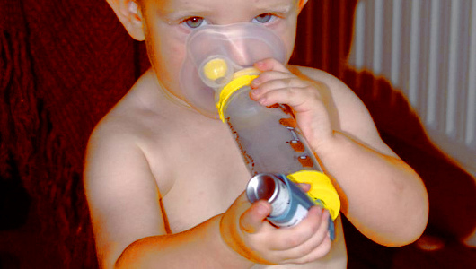
Asthma
By: Brittany Cox
Epidemiology of Chronic Diseases

Slide 2
Asthma Definition
Asthma is a disease in which inflammation of the airways causes airflow into and out of the lungs to be restricted
People with asthma have oversensitive airways that react strongly to allergens and when exposed to triggers, the immune system kicks into overdrive and closes off the airways, making it difficult to breathe
The most common long-term diseases of children
Can occur in adults also
Causes are unknown

Slide 3
How Can You Tell if You Have Asthma?
Doctor administer a breathing test called spirometry
Measure how well your lungs are working
Computer with a mouthpiece to test how much air you can breathe out after taking a very deep breath
The spirometer can measure airflow before and after the use asthma medication
During a checkup the doctor will ask:
Cough a lot, especially at night
Breathing problems are worse after physical activity or at certain times of year
Family history

Slide 4
Notes:
Spirometry is a painless study of air volume and flow rate within the lungs. Spirometry is frequently used to evaluate lung function in people with obstructive or restrictive lung diseases such as asthma or cystic fibrosis.

Slide 5
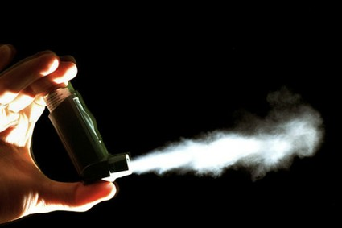
Risk Factors
Gender
Obesity
Smoking
Socio-economic status
Living in urban environments
Geographical location
Notes:
As of 2002, an estimated 20 million adults had asthma. Risk factors for Asthma include gender, obesity, smoking, socio-economic status, living in urban environments, and geographical location.
There are, by contrast, relatively few conclusive findings about what risk factors contribute to the development of the condition itself, and the factors that cause asthma remain largely unidentified

Slide 6
Asthma Triggers
Common asthma triggers include:
Animals (pet hair or dander)
Dust mites
Certain medicines (aspirin and other NSAIDS)
Changes in weather (most often cold weather)
Chemicals in the air or in food
Exercise
Mold
Pollen
Respiratory infections, such as the common cold
Stress
Tobacco smoke
Many people with asthma have a personal or family history of allergies or eczema

Slide 7
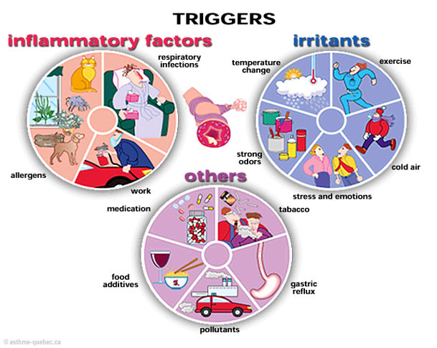

Slide 8
Asthma Symptoms
Symptoms of asthma include:
Wheezing
Coughing, especially early in the morning or at night
Chest tightness
Shortness of breath
Other symptoms that may occur:
Abnormal breathing pattern
--breathing out takes more than twice as long as breathing in
Breathing temporarily stops
Chest pain

Slide 9
Emergency Asthma Symptoms
Emergency symptoms that need prompt medical assistance:
Bluish color to the lips and face
Decreased level of alertness, such as severe drowsiness or confusion, during an asthma attack
Extreme difficulty breathing
Rapid pulse
Severe anxiety due to shortness of breath
Sweating

Slide 10
What Is an Asthma Attack?
The attack happens in the body’s airways
During an asthma attack:
The sides of the airways in the lungs swell and the airways shrink
Less air gets in and out of the lungs,
Mucus production is increased and clogs up the airways
Muscles of the bronchial tree become tight and the lining of the air passages swells
Reducing airflow and producing the characteristic wheezing sound

Slide 11
Notes:
Asthma is a disease in which inflammation of the airways causes airflow into and out of the lungs to be restricted. When an asthma attack occurs, mucus production is increased, muscles of the bronchial tree become tight, and the lining of the air passages swells, reducing airflow and producing the characteristic wheezing sound.

Slide 12
Complications
The complications of asthma can be severe, and may include:
Death
Decreased ability to exercise and take part in other activities
Lack of sleep due to nighttime symptoms
Permanent changes in the function of the lungs
Persistent cough
Trouble breathing that requires breathing assistance (ventilator)

Slide 13
Treatment
Follow doctor's instructions on taking medicines, eliminating asthma triggers, and monitoring symptoms.
There are two kinds of medicines for treating asthma:
Control medicines to help prevent attacks
Quick-relief (rescue) medicines for use during attacks

Slide 14
Control Medicines
Long-term Medicines or controller medicines are used to prevent symptoms in people with moderate to severe asthma
Must take them every day for them to work
Some are breathed in (inhaled), such as steroids and long-acting beta-agonists
Others are taken by mouth (oral)

Slide 15
Quick-relief Medicines
Also called rescue medicines
They are taken for:
Coughing, wheezing, trouble breathing, or an asthma attack
Just before exercising to help prevent asthma symptoms caused by exercise.
Quick-relief medicines include:
Short-acting inhaled bronchodilators
Oral corticosteroids for when an asthma attack does not go away

Slide 17
Peak Flow Meter
A simple device to measure how quickly you can move air out of your lungs
It can help regulate if an attack is coming, sometimes even before symptoms appear
Peak flow measurements help let you know when medicine or other action needs to be taken
Peak flow values of 50% - 80% of your best results are a sign of a moderate asthma attack
Numbers below 50% are a sign of a severe attack

Slide 18
Notes:
A peak flow meter is commonly used by a person with asthma to measure the amount of air that can be expelled from the lungs. If the airways become narrow or blocked due to asthma, peak flow values will drop because the person cannot blow air out of the lungs as well. A peak flow meter can be a useful aid in monitoring a person's asthma over time and can also be used to help determine how well a patient's medications are working.

Slide 20
Prevalence
Every day in America:
44,000 people have an asthma attack
36,000 kids miss school due to asthma
27,000 adults miss work due to asthma
4,700 people visit the emergency room due to asthma
1,200 people are admitted to the hospital due to asthma
9 people die from asthma
Notes:
Asthma and Allergy Foundation of America
Asthma prevalence increased from 7.3% in 2001 to 8.4% in 2010, when 25.7 million persons had asthma. (CDC)

Slide 21
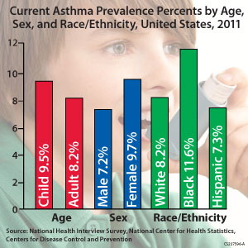

Slide 22
Geographic Distribution
Asthma prevalence:
Northeast (8.1%)
Midwest (7.5%)
West (6.8%)
South (6.7%)
Emergency department visit rate estimates:
Northeast (10.4 per 100 persons with current asthma)
South (9.6 per 100 persons with current asthma)
Midwest (8.7 per 100 persons with current asthma)
West (6.7 per 100 persons with current asthma)
Notes:
Based on standard U.S. census regions, asthma prevalence is highest in the Northeast (8.1%), followed by the Midwest (7.5%), West (6.8%), and South (6.7%). (Moorman et al. 2007)
Emergency department visit rate estimates from the National Hospital Ambulatory Medical Care Survey for the same period are highest in the Northeast (10.4 per 100 persons with current asthma), followed by the South (9.6), Midwest (8.7) and West (6.7). (Moorman et al. 2007)

Slide 24
Asthma is increasing every year in the US
The number of people with asthma continues to grow
One in 12 people (about 25 million, or 8% of the population) had asthma in 2009
Compared with 1 in 14 (about 20 million, or 7%) in 2001
More than half (53%) of people with asthma had an asthma attack in 2008
More children (57%) than adults (51%) had an attack
185 children and 3,262 adults died from asthma in 2007
About 1 in 10 children (10%) had asthma and 1 in 12 adults (8%) had asthma in 2009. Women were more likely than men and boys more likely than girls to have asthma.
About 1 in 9 (11%) non-Hispanic blacks of all ages and about 1 in 6 (17%) of non-Hispanic black children had asthma in 2009
The highest rate among racial/ethnic groups.
The greatest rise in asthma rates was among black children (almost a 50% increase) from 2001 through 2009

Slide 29
Cost
Asthma has a high cost for individuals and the nation
Asthma cost the US about $3,300 per person with asthma each year from 2002 to 2007 in medical expenses
Medical expenses associated with asthma increased from $48.6 billion in 2002 to $50.1 billion in 2007
About 2 in 5 (40%) uninsured people with asthma could not afford their prescription medicines
About 1 in 9 (11%) insured people with asthma could not afford their prescription medicines
More than half (59%) of children and one-third (33%) of adults who had an asthma attack missed school or work because of asthma in 2008
On average, in 2008 children missed 4 days of school and adults missed 5 days of work because of asthma
Notes:
CDC

Slide 30
Who isn’t getting the care they need because of the cost?
Effective asthma care can be expensive
Difficult for people to get the care
In many cases, private and public healthcare programs ensure that children receive care
Therefore, adults are less likely to receive the care they need when cost is an issue
Many ethnic and racial minorities struggle to pay for the medicines they need:
More than 1 in 4 black adults can’t afford their asthma medicines
1 in 5 Hispanic adults can’t afford their asthma medicines
Although doctors are an important part of effective asthma management, many ethnic and racial minorities don’t see a doctor regularly as part of their asthma care:
More than 1 in 4 black adults can’t afford routine doctor visits
Nearly 1 in 7 Hispanic adults can’t afford routine doctor visits.
Notes:
Data from the CDC National Asthma Control Program

Slide 31
Prevention
Reduce asthma symptoms by avoiding triggers and substances that irritate the airways
Cover bedding with allergy-proof casings to reduce exposure to dust mites
Remove carpets from bedrooms and vacuum regularly
Use only unscented detergents and cleaning materials in the home
Keep humidity levels low and fix leaks to reduce the growth of organisms such as mold
Notes:
Eliminate tobacco smoke from the home. This is the single most important thing a family can do to help someone with asthma. Smoking outside the house is not enough. Family members and visitors who smoke outside carry smoke residue inside on their clothes and hair. This can trigger asthma symptoms.

Slide 32
Prevention cont.
Keep the house clean and keep food in containers and out of bedrooms
This helps reduce the possibility of cockroaches
Body parts and droppings from cockroaches can trigger asthma attacks in some people
If a person is allergic to an animal that cannot be removed from the home, the animal should be kept out of the bedroom
Place filtering material over the heating outlets to trap animal dander
Change the filter in furnaces and air conditioners often
Eliminate tobacco smoke from the home
Avoid air pollution, industrial dust, and irritating fumes

Slide 33
Types of Asthma
Occupational Asthma
Childhood Asthma
Exercise-Induced Asthma
Cough-Variant Asthma
Notes:
American Academy of Allergy Asthma & Immunology

Slide 34
Allergic Asthma
People with a family history of allergies or asthma are more prone to developing asthma
Many people with asthma also have allergies
Most common form of asthma
Triggered by inhaling allergens
Notes:
Allergic asthma is the most common type of asthma. About 90% of kids with childhood asthma have allergies, compared with about 50% of adults with asthma. Inhaling specific substances called allergens (allergy triggers such as pollen, mites, or molds) brings on the asthma symptoms associated with allergic asthma. Nearly everyone with asthma (allergic or nonallergic) gets worse after exercising in cold air or after inhaling any type of smoke, dust, fumes, and sometimes strong smells.

Slide 35
Occupational Asthma
Caused by inhaling fumes, gases, dust or other potentially harmful substances while on the job
Irritants in high doses that induce occupational asthma include:
Hydrochloric acid
Sulfur dioxide
Ammonia
Which is found in the petroleum or chemical industries
If exposed to any of these substances at high concentrations, may begin experiencing asthma symptoms immediately after exposure
Notes:
American Academy of Allergy Asthma and Immunology

Slide 36
Childhood Asthma
Impacts millions of children and their families
The majority of children who develop asthma do so before the age of five
The most common serious chronic disease in infants and children; yet is often difficult to diagnose
Notes:
Diagnosing the precise cause of asthma is sometimes difficult because two or more causes may be present in one child. Unfortunately, there is not a single test that provides all the answers.
American Academy of Allergy Asthma and Immunology

Slide 37
Exercise-Induced Asthma
Type of asthma triggered by exercise or physical exertion
Many people with asthma experience some degree of symptoms with exercise
Some without asthma can develop symptoms only during exercise
Airway narrowing peaks five to 20 minutes after exercise begins, making it difficult to catch your breath
Symptoms of an asthma attack such as wheezing and coughing make occur
An asthma inhaler can be used before exercise to prevent asthma symptoms

Slide 38
Cough-Variant Asthma
Type of asthma where severe coughing is the predominant symptom
There can be other causes of cough such as postnasal drip, chronic rhinitis, sinusitis, or heartburn
Coughing because of sinusitis with asthma is common
Vastly underdiagnosed and undertreated
Asthma triggers for cough-variant asthma are usually respiratory infections and exercise
The doctor may order specific asthma tests, such as lung function tests, to show how well the lungs work
Visit a lung specialist for further tests before an asthma diagnosis can be made

Slide 39
International Prevalence
The prevalence of asthma in different countries varies widely
But the disparity is narrowing due to rising prevalence in low and middle income countries and plateauing in high income countries
An estimated 300 million people worldwide suffer from asthma
With approximately 250,000 annual deaths attributed to the disease
Almost all of these deaths are avoidable
It is estimated that the number of people with asthma will grow by more than 100 million by 2025
Workplace conditions, such as exposure to fumes, gases or dust, are responsible for 11% of asthma cases worldwide

Slide 40
What can be done
Federal, state, and local health officials can:
Track asthma rates and the effectiveness of control measures so continuous improvements can be made in prevention efforts
Promote influenza and pneumonia vaccination for people with asthma
Promote improvements in indoor air quality for people with asthma through measures such as smoke-free air laws and policies, healthy schools and workplaces, and improvements in outdoor air quality
Notes:
CDC

Slide 41
What can be done cont.
Health care providers can:
Determine the severity of asthma and monitor how much control the patient has over it
Make an asthma action plan for patients
Use this to teach them how to use inhaled and other prescribed medicines correctly and how to avoid asthma triggers such as tobacco smoke, mold, pet dander, and outdoor air pollution
Prescribe inhaled corticosteroids for all patients with persistent asthma

Slide 42
What can be done cont.
Schools and school nurses can:
Use student asthma action plans to guide use of inhaled corticosteroids and other prescribed asthma medicines correctly and to avoid asthma triggers
Make students' quick-relief inhalers readily available for them to use at school as needed
Take steps to fix indoor air quality problems like mold

Slide 43
What can be done cont.
Employers and insurers can:
Promote healthy workplaces by reducing or eliminating known asthma triggers
Promote measures that prevent asthma attacks such as eliminating co-payments for inhaled corticosteroids and other prescribed medicines
Provide reimbursement for educational sessions conducted by clinicians, health educators, and other health professionals both within and outside of the clinical setting
Provide reimbursement for long-term control medicines, education, and services to reduce asthma triggers that are often not covered by health insurers

Slide 44
Future Research
Further work to develop appropriate animal models for asthma research is needed
More data on long-term side effects of asthma medication
Cost effectiveness of avoidance of asthma triggers
Development of better treatment options
Notes:
Risk factors for the development of childhood asthma have not been fully assessed, and further work to develop appropriate animal models for asthma research is needed.
A broader description of the generic determinants of asthma will help enable the identification of high risk individuals for whom particular interventions to prevent asthma might be recommended.
Although effective medications for asthma control exist, there remain concerns about long-term side effects such as growth restrictions in children for which more data are required.
Although interventions to refuse exposure to asthma triggers in the home can be effective, the evidence to demonstrate their cost-effectiveness to the managed care community remains tenuous.
Further data on the cost savings that may be associate with carious approaches to home trigger reduction would beof great benefit.

Slide 45
National Institute of Allergy and Infectious Diseases (NIAID)
Current basic, preclinical, and clinical research aims to:
Investigate the role of the immune system in the development, treatment, and prevention of asthma
Understand the role that environmental allergens and pollution may play in the development and worsening of asthma
Improve current treatments and develop new ones that reduce or eliminate the response of the immune system to environmental allergens that trigger asthma
Notes:
NIAID-supported investigators are working to prevent asthma from occurring in people and to develop new, better treatments for those who are currently affected.

Slide 46
National Asthma Control Program
CDC’s National Asthma Control Program helps Americans with asthma achieve better health and improved quality of life and to reduce the overall hardship that asthma puts on the workforce, healthcare system, and communities
A resource for people with asthma
Collect information and follow trends related to asthma
Share our knowledge with the programs we support and the asthma community
Fund programs to create localized efforts to assist people with asthma
Study the impact of asthma programs and treatment measures
Use what we learn to re-invest in strategies that will help Americans with asthma

Slide 47
COPD Definition
Chronic Obstructive Pulmonary Disease, or COPD, refers to a group of diseases that cause airflow blockage and breathing-related problems
It includes emphysema, chronic bronchitis, and in some cases asthma

Slide 48
Types of COPD
There are two main forms of COPD:
Chronic bronchitis
Which involves a long-term cough with mucus
Emphysema
Which involves destruction of the lungs over time
Most people with COPD have a combination of both conditions

Slide 49
Diagnosis of COPD
The list of diagnostic tests used in the diagnosis of COPDincludes:
Spirometer (lung function test)
Forced vital capacity (FVC) lung test
Residual volume (RV) lung test
Total lung capacity (TLC) lung test
Diffusing capacity lung test

Slide 50
Risk Factors
In the United States, tobacco smoke is a key risk factor in the development and progression of COPD
Although exposure to air pollutants in the home and workplace, genetic factors, and respiratory infections also play a role
In the developing world, indoor air quality is thought to play a larger role in the development and progression of COPD than it does in the United States

Slide 51
Symptoms
Chronic cough (also known as smoker’s cough)
Chronic phlegm production
Shortness of breath while doing things you used to be able to do
Not being able to take a deep breath
Wheezing

Slide 52
Prevalence
The third leading cause of death in the United States in 2011
15 million Americans report that they have been diagnosed with COPD
More than 50% of adults with low pulmonary function were not aware that they had COPD
Therefore the actual number may be higher
The following groups were more likely to report COPD:
People aged 65–74 years
Non-Hispanic whites
Women
Individuals who were unemployed, retired, or unable to work
Individuals with less than a high school education
People with lower incomes
Individuals who were divorced, widowed, or separated
Current or former smokers
Those with a history of asthma
Notes:
CDC

Slide 53
Notes:
The figure shows age-adjusted prevalence of chronic obstructive pulmonary disease (COPD) among adults in the United States during 2011. The prevalence of COPD varies considerably by state, from <4% in Washington and Minnesota to >9% in Alabama and Kentucky. The states with the highest COPD prevalence are clustered along the Ohio and lower Mississippi Rivers.

Slide 54
Prevention
Avoid inhaling tobacco smoke, home and workplace air pollutants, and respiratory infections to prevent developing COPD
Early detection of COPD might change its course and progress
A spirometry can be used to measure pulmonary or lung function and detect COPD in anyone with breathing problems

Slide 55
Treatment
There is no cure for COPD
Treatment is available to manage the symptoms and improve quality of life
Treatment of COPD requires a careful and thorough evaluation by a physician
COPD treatment can:
Alleviate symptoms
Decrease the frequency and severity of exacerbations
Increase exercise tolerance
For those who smoke, the most important aspect of treatment is smoking treatment options include:
Medication (such as inhalers)
Pulmonary rehabilitation
Physical activity training
Oxygen treatment
Pulmonary rehabilitation is an individualized treatment program that teaches COPD management strategies to increase quality of life
Plans may include:
Breathing strategies, energy-conserving techniques, and nutritional counseling

Slide 56
Medications used to treat COPD
Inhalers (bronchodilators) to open the airways
ipratropium (Atrovent), tiotropium (Spiriva), salmeterol (Serevent),formoterol (Foradil), or albuterol
Inhaled steroids to reduce lung inflammation
Anti-inflammatory medications
montelukast (Singulair) and roflimulast are sometimes used
In severe cases or during flare-ups, may need to receive:
Steroids by mouth or through a vein (intravenously)
Bronchodilators through a nebulizer
Oxygen therapy
Assistance during breathing from a machine (through a mask, BiPAP, or endotracheal tube)
Antibiotics are prescribed during symptom flare-ups, because infections can make COPD worse

Slide 57
Complication of COPD
Heart failure
Pulmonary hypertension
Polycythemia
Death

Slide 58
Notes:
Although death rates for COPD have declined among US men between 1999 (57.0 per 100,000) and 2010 (47.6 per 100,000) in the United States, there has been no significant change among death rates in women (35.3 per 100,000 in 1999 and 36.4 per 100,000 in 2010).

