Slide 1

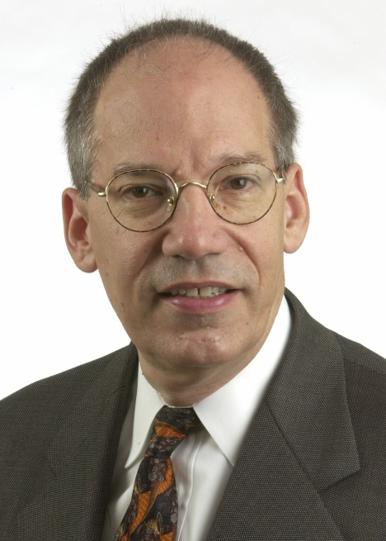
Ten Things You Should Know about Health Care Cost Trends
Providing Insights that Contribute to Better Health Policy
Paul B. Ginsburg, Ph.D.
President
Center for Studying Health Change
Washington, DC
Notes:
“Paul intro”

Slide 2
1. Spending is Rising Very Rapidly
Per capita spending up 10% in 2001
  First double-digit increase since 1990
  Much larger than 1.4% increase in per capita Gross Domestic Product
Someone will be paying for this
Notes:
“spending”

Slide 3
2. Hospital Care is the Largest Component of Cost Trends in 2001
Outpatient spending increased 16.3%
  Inpatient spending increased 7.3%
  Enormous reversal from 5.3% decrease in 1997
Combined hospital trend accounts for 51% of total spending increase in 2001
  Accounted for only 18% in 1997
Prescription drug spending in 2001
  13.8% increase
  Accounts for 21% of total spending increase
Notes:
“hospitals”

Slide 4
3. Rising Hospital Spending Reflects Steeper Increases in Prices Paid to Providers and Use of Services
Prices rising for hospitals but not physicians
  Steeply rising hourly wages
  More leverage with health plans
    Consolidation
    Broad networks
Rising use of services even more important
  Service use up 8% in 2001
    Reversal of trend on admission rate
    Rising use of outpatient services
Notes:
“hospitals 2”

Slide 5
Trends in Hospital Price and Quantity
*
*Compares data for Jan-June 2002 to corresponding months in 2001.
Note: the PPI (Producer Price Index) for Hospital Services is for non-public payors and for general medical and surgical hospitals only. The quantity index is calculated as the residual of the Milliman USA hospital spending trend and the trend in the PPI for Hospital Services.
Notes:
“hospitals 3”

Slide 6
4. Key Cost Driver: Retreat From Tightly Managed Care
Decline in prior authorization requirements
Easier access to specialists
Broad networks lead to higher prices for services
Rich managed care benefit structure remains — for now
Notes:
“managed care”

Slide 7
5. Demographic Trends Contribute Only Slightly to Rising Costs
Contribution of aging to cost trend
  2001: 0.7%
  1990: 0.1%
Explains little of increase in underlying cost trend
  2001: 10.0%
  1996: 2.2%
Implication: More of trend potentially controllable
Notes:
“demographics”

Slide 8
6. General Economy Influences Health Care Costs
Recent research: five-year lag
Mechanism uncertain
  Employer strategies important
During recessions, high cost trends driven by previous booms
Notes:
“economy”

Slide 9
7. New Technology is the Dominant Long-term Driver of Costs
Prominent studies: 1/2 to 2/3 of trend
Ready acceptance is a key factor
  Public expects new cures
  Extensive third-party payment precludes costs from restraining technology
Notes:
“long term”

Slide 10
8. Premium Trend is Higher Now Than Trend in Underlying Costs
Premium increase in 2002: 12.7%
  Underlying cost trend: 10% or less
  Insurer profits up sharply
Insurance underwriting cycle will turn — but not yet
Notes:
“profits”

Slide 11
9. Shift to More Patient Cost Sharing Already Underway
Deductibles, coinsurance, copayments
  “Buydown” of 2-3% in 2002
Tiered networks
Consumer-driven plans
Consumer information on quality and price
Notes:
“cost sharing”

Slide 12
10. Potential for Some Slowing of Trend
Trend declined to 8.8% for early 2002
Potential factors
  Increased cost sharing
  Completion of transition to looser managed care
Projection critical to planning hospital capacity and physician supply
Notes:
“slow?”

Slide 13
Further Information
Health Affairs, Web Exclusive, September 25, 2002
www.hschange.org
Notes:
“more info”

